Slide 1
Optimizing Targeted Marketing: A Framework for Customer Segmentation and Automated Cluster-Based Notification
Dickshith Raj Nagaraj
MSc Advanced Computer Science — University of Leeds — Session 2025/2026
ASSESSOR: Dr Dibyayan Chakraborty
Notes:
Open with the one-line story: raw transactions go in at the top; a costed, per-customer marketing action comes out at the bottom — automatically, reproducibly, and with the money quantified BEFORE any campaign is sent.

Slide 2
The Problem: Blanket Marketing
2 min
• Retailers hold rich transactional data …
• … yet most outbound marketing is still “blanket”: every customer gets the same message.
• Doubly wasteful:
• spends contact budget on customers who will never respond
• fatigues high-value customers with irrelevant contact — eroding the very lifetime value it should protect
Research question: how do you convert a raw retail transaction log — automatically, reproducibly, and with quantified financial justification — into a per-customer, prioritised marketing-notification plan?
Notes:
Keep this to 90 seconds. The framed box is the thesis of the whole talk.

Slide 3
Aim & Six Objectives
2 min
• O1 — Background research: systematic survey justifying every method choice
• O2 — Data foundation: auditable cleaning + RFM+ feature engineering
• O3 — Validated segmentation: 6 algorithms benchmarked, pre-declared selection rule
• O4 — Predictive layer: probabilistic CLV + leakage-guarded churn models
• O5 — Decision layer: rule-based notification engine + dashboard
• O6 — Commercial quantification: Monte Carlo ROI vs untargeted baseline
UCI Online Retail II
~160 s
Stages 1 → 10
Exploratory software
public dataset, 2009–2011
full pipeline, commodity CPU
one auditable pipeline
MSc project type
Notes:
One breath per objective. Emphasise: each objective is measurable and each is discharged in an identified chapter of the report.

Slide 4
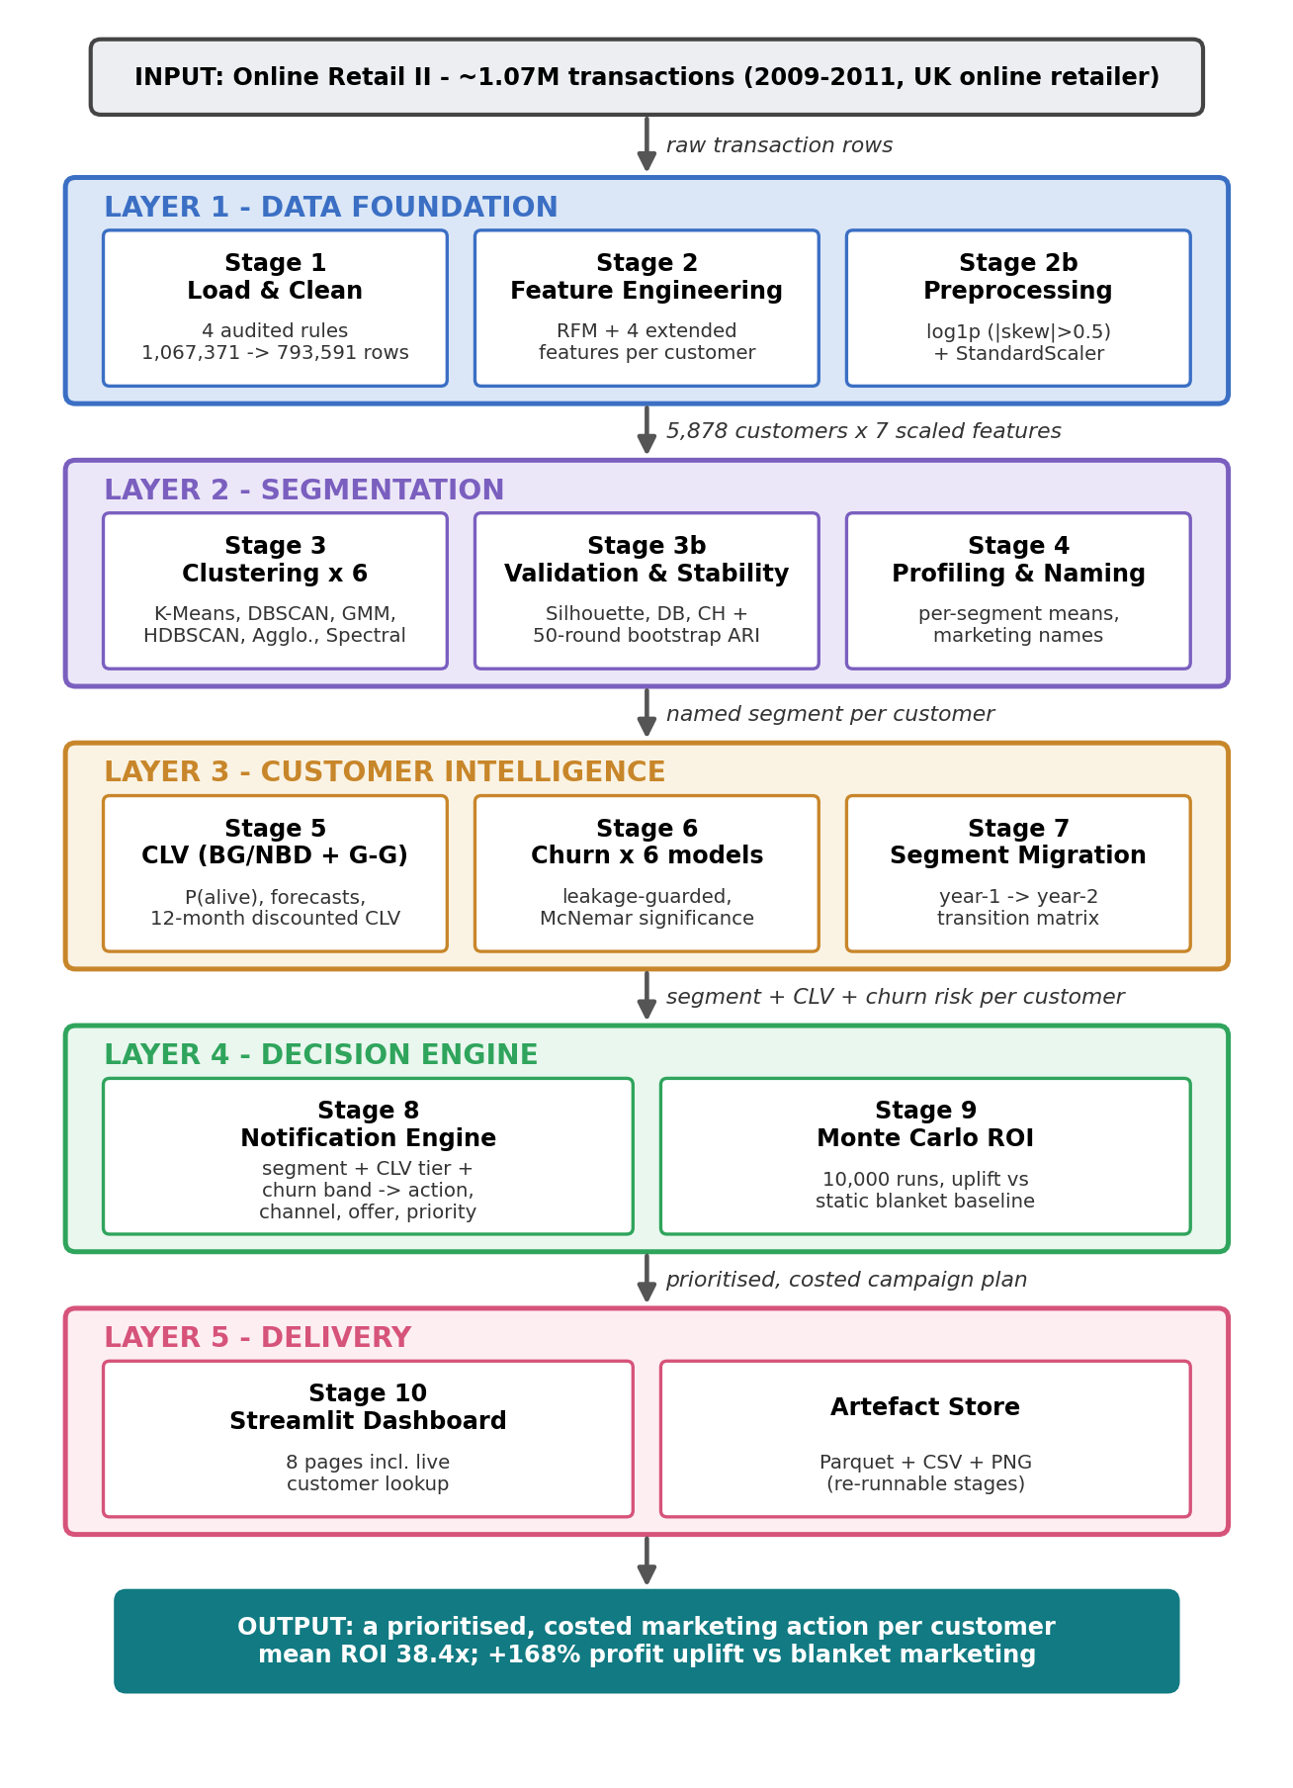
System Architecture — Five Layers, Stages 1–10
2 min
• Layer 1 — Data foundation: Stage 1 load & clean, 2 features, 2b preprocessing
• Layer 2 — Segmentation: Stage 3 clustering ×6, 3b validation, 4 profiling
• Layer 3 — Customer intelligence: Stage 5 CLV, 6 churn, 7 migration
• Layer 4 — Decision engine: Stage 8 notifications, 9 Monte Carlo ROI
• Layer 5 — Delivery: Stage 10 dashboard + artefact store
• Data flows strictly one way; every stage persists its artefacts → independently re-runnable, trivially auditable
Notes:
Point down the figure as you name the layers. Close with the one-way data flow point — it is what makes the system auditable.

Slide 5
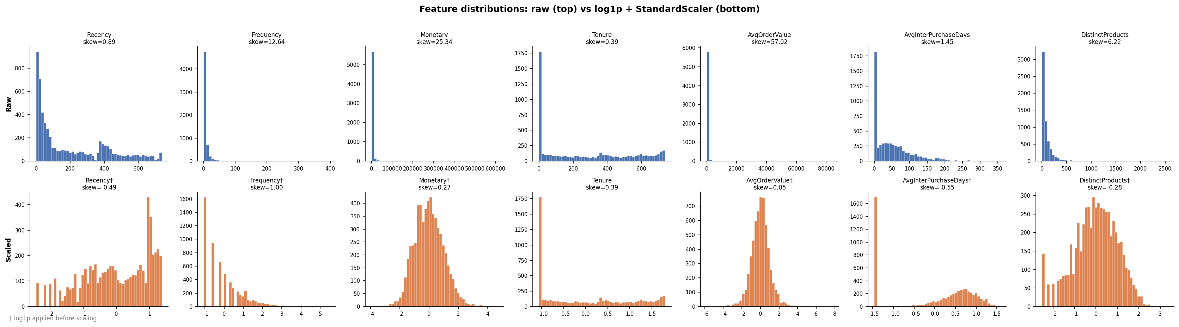
Stages 1–2b — Data, Cleaning, Features
3 min
• Four sequential, logged cleaning rules (every exclusion measured):
• missing Customer ID −243,007 rows (22.77%)
• cancellations (“C” invoices) −18,744 (2.27%)
• invalid quantity/price −89 (0.01%)
• exact duplicates −11,940 (1.48%)
• 7 behavioural features per customer: RFM + Tenure, AvgOrderValue, AvgInterPurchaseDays, DistinctProducts
• Skew-gated preprocessing: log1p only where |skew| > 0.5, then z-scaling — correct geometry for distance-based clustering
1.07M → 794K
5,878
7
Audit table
raw → audited rows (−25.65%)
unique customers
behavioural features
persisted for every rule
Notes:
Stress the audit table: nothing is silently dropped — this is the evidence an examiner or auditor would ask for.

Slide 6
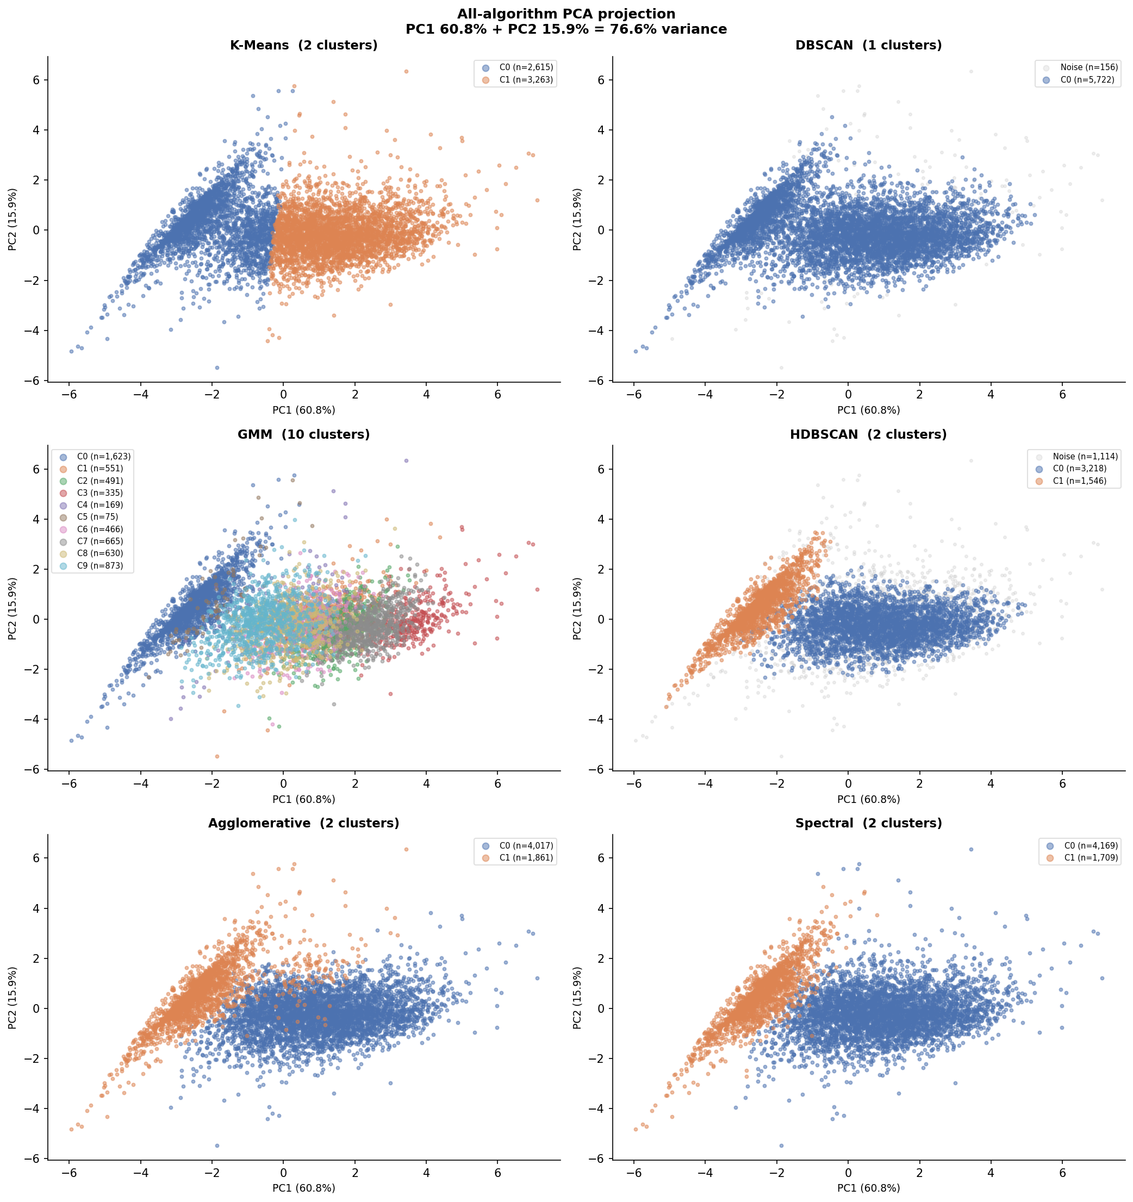
Stage 3 — Six Clustering Algorithms, Five Families
4 min
• Literature: no single algorithm dominates → choose empirically per dataset
• K-Means · GMM · DBSCAN · HDBSCAN · Agglomerative (Ward) · Spectral
• Automatic hyper-parameter selection:
• K-Means: elbow (k=4) vs silhouette (k=2) — heuristics disagree; reported, not hidden
• GMM: BIC picks 10 components — a warning sign
• DBSCAN: ε from k-distance knee · HDBSCAN: min cluster size 50 (~1% of base)
• All six projected on identical PCA axes (76.6% variance) for like-for-like comparison
Notes:
This and the next slide are your strongest methodology minutes. The point is not any single algorithm — it is that the choice is made by evidence.

Slide 7
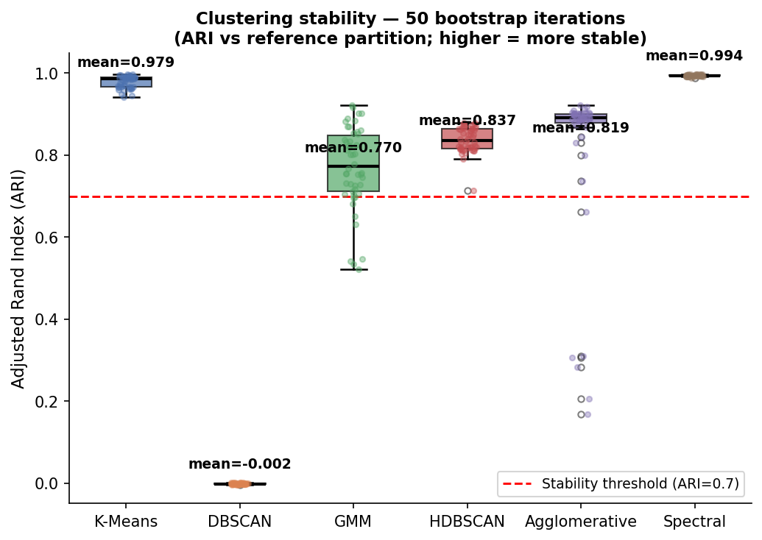
Stage 3b — Validation, Stability, Pre-Declared Selection
• Three internal indices: silhouette, Davies–Bouldin, Calinski–Harabasz
• Stability: 50 bootstrap resamples, Adjusted Rand Index vs full-data partition
• Selection rule (pre-declared, applied mechanically):
• 1. disqualify noise fraction > 30%
• 2. require mean bootstrap ARI ≥ 0.70
• 3. among survivors: highest silhouette
• Winner: HDBSCAN — silhouette 0.416, best overall rank 1.75
• Honest negatives: DBSCAN collapsed (ARI ≈ 0, eliminated mechanically); GMM over-fragmented (silhouette 0.081); K-Means default rejected by evidence
Notes:
Say the rule verbatim — being pre-declared is what makes the selection reproducible and criticisable. Rigour changed the answer: K-Means was rejected.

Slide 8
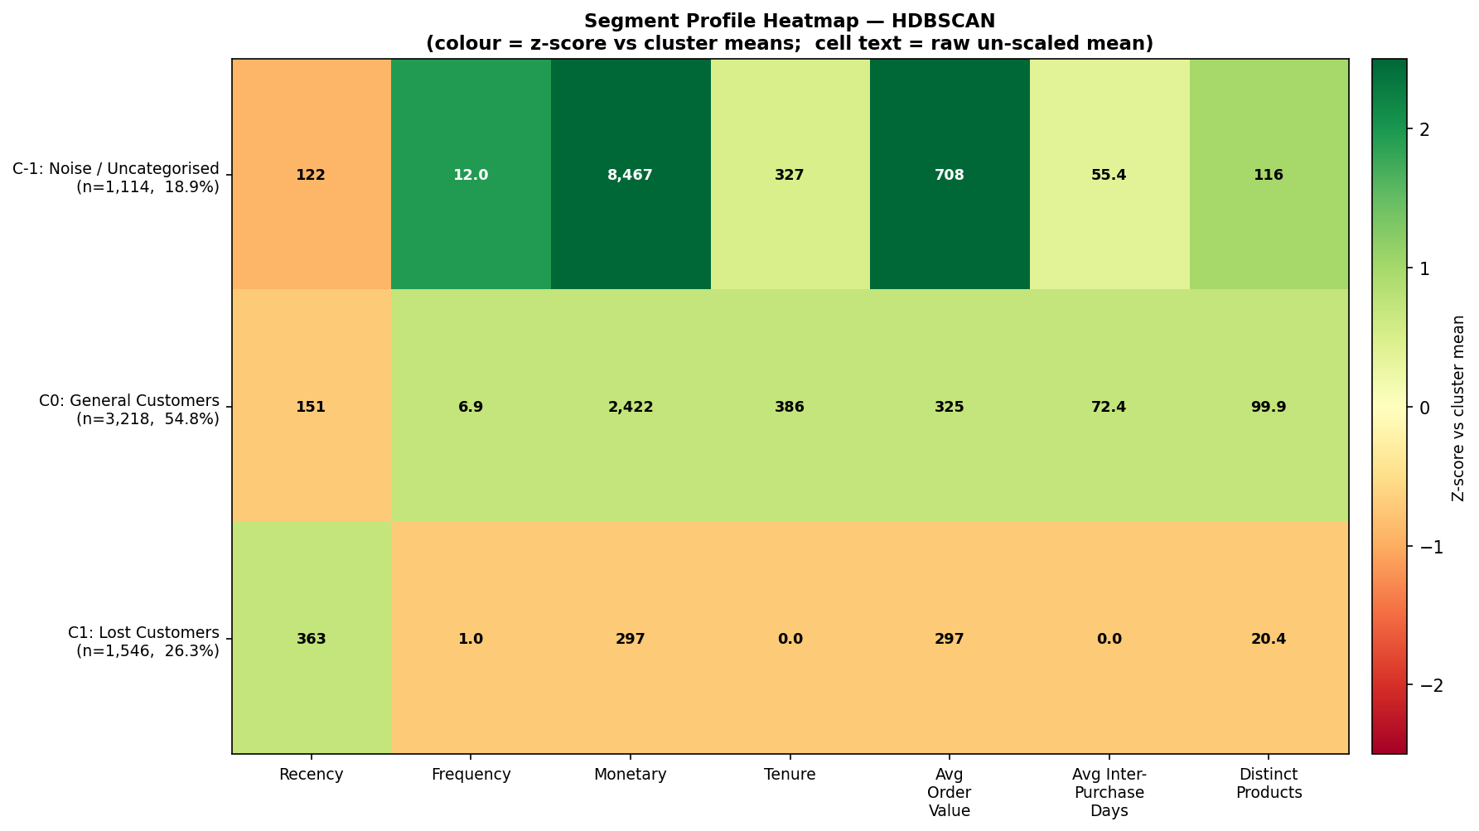
Stage 4 — Three Operational Segments
• General Customers — 3,218 (54.8%): the mainstream; moderate recency, frequency ≈7, spend ≈£2,422
• Lost Customers — 1,546 (26.3%): exactly one purchase, tenure 0, recency 363 days — a sharply defined lapsed group
• Noise / Uncategorised — 1,114 (19.0%): a finding, not a failure — the most valuable, most heterogeneous customers (mean spend £8,467)
• Deterministic naming rules → same profile always gets the same marketing name
• Noise customers are excluded from generic campaigns and flagged for individual treatment — marketing-meaningful, ethically safer
Notes:
The counter-intuitive highlight: the customers HDBSCAN refuses to classify are the highest-value accounts. Forcing them into a segment would mis-target them.

Slide 9
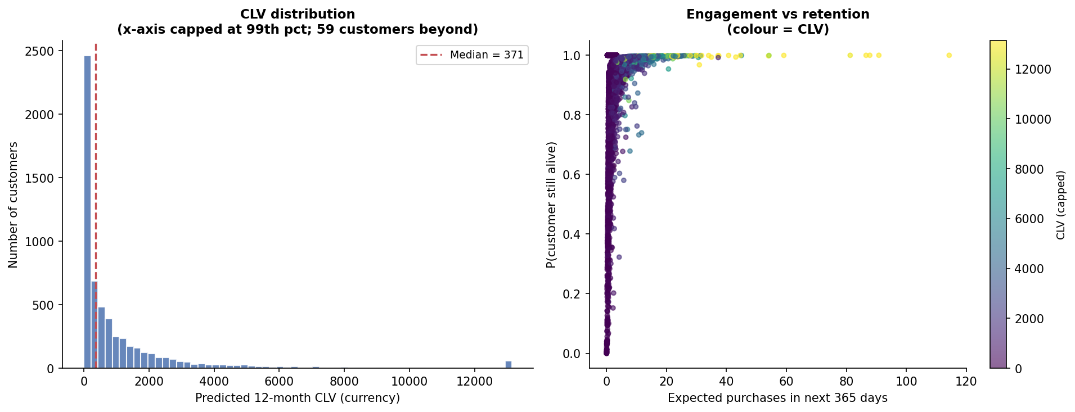
Stage 5 — Customer Lifetime Value (BG/NBD + Gamma–Gamma)
4 min
• Probabilistic models built for non-contractual retail — customers lapse silently, never “cancel”
• Independence assumption (frequency vs value) checked before fitting: ≈ 0 ✓
• Outputs per customer: P(alive), expected purchases at 90/180/365 days, 12-month discounted CLV
• Classic long tail: top decile holds a disproportionate share of value
• Role in the system: relative value ranking that feeds the CLV tiers of the decision engine
£8.33M
£371 / £1,418
0.909
90/180/365 d
12-month portfolio CLV
median / mean CLV
mean P(alive)
purchase forecasts
Notes:
Honest caveat if asked: no temporal hold-out (data ends 2011), so CLV is used as a ranking, not a validated forecast — listed in threats to validity.

Slide 10
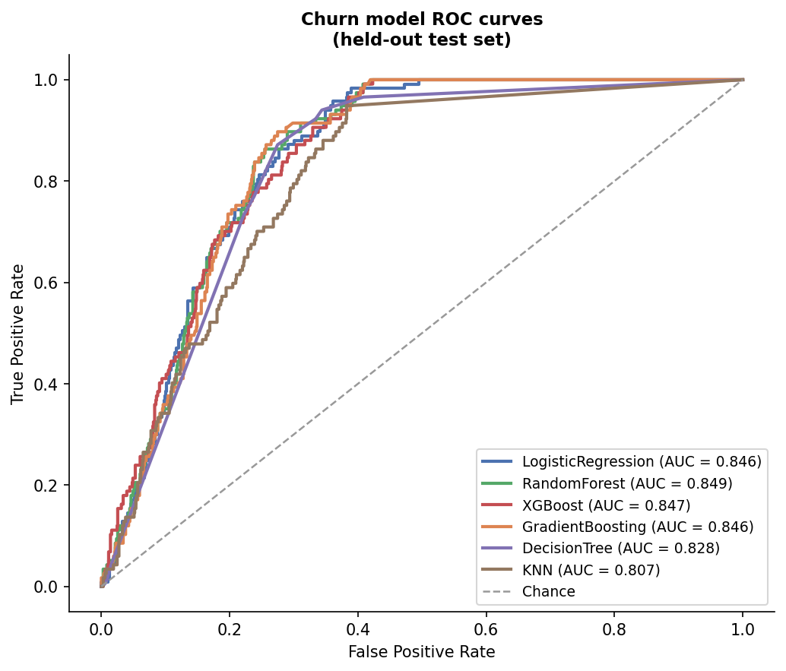
Stage 6 — Churn: Six Classifiers Under a Leakage Guard
• Label: Recency > 90th percentile (535 days) → 10% churners
• Leakage guard: label is derived from Recency → Recency EXCLUDED from features (verified by unit test)
• Best: Random Forest — ROC-AUC 0.849, recall 0.752 …
• … but McNemar exact test: RF vs XGBoost p = 0.878 → statistically tied; no over-claimed “winner”
• Deliberate contrast: GB & KNN left unweighted → ROC-AUC ≈0.85 but recall collapses to 0.03–0.07 — ROC-AUC alone misleads under imbalance
• Error asymmetry: a missed churner costs £371+ CLV; a wasted retention email costs pence → recall-heavy operating points are economically rational
Notes:
“An AUC near 1.0 would have been a red flag for leakage; 0.849 with the guard is a credible ceiling.” Drivers: Tenure 0.37, cadence 0.22.

Slide 11
Stage 7 — Rule-Based Notification Engine
3 min
• Where analysis becomes action — the gap most published studies leave open
• Inputs per customer: segment name + CLV tier (80th/40th pct) + churn band (0.50/0.25)
• Step 1 — segment playbook: action, channel, offer, base priority (1–5)
• Step 2 — value & risk modulation: high-risk + valuable → “Priority retention intervention” on premium channels; low-value high-risk → cheap automated reactivation
• Step 3 — contact timing: 0.6 × the customer’s own inter-purchase interval — no fixed drumbeat, over-contact suppressed by construction
• Why rules, not a learned policy? Auditability (NFR5): every recommendation traceable, inspectable, overridable by a human
5,878
64 (1.1%)
3,023
recommend(id)
campaigns planned (all customers)
priority retention interventions
engagement promotions
on-demand API → dashboard
Notes:
Read one plan row aloud from the dashboard in the demo: segment, CLV, risk, action, priority, contact day. Expensive attention is rare by construction.

Slide 12
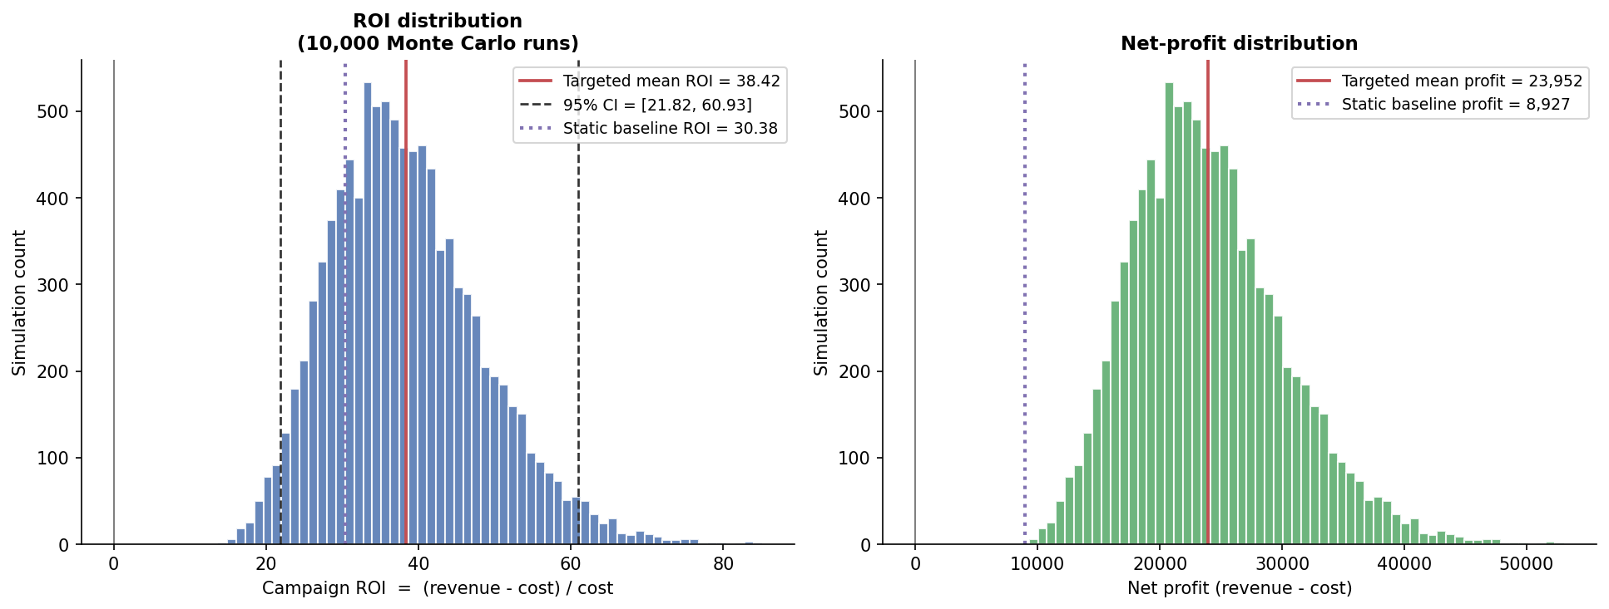
Stage 8 — Monte Carlo ROI vs Blanket Baseline
2 min
• 10,000 simulated worlds: Beta response priors → Binomial conversions → noisy revenue − real channel costs
• Targeted plan: mean ROI 38.4×, 95% CI [21.8×, 60.9×], P(ROI>0) = 100%
• Static blanket baseline (same machinery): 30.4×
• Headline: +168% profit uplift (+£15,025)
• Why the uplift is the defensible number: both plans share the same priors, margin and cost model → assumption errors cancel in the difference
£623.50
£293.90
38.4× vs 30.4×
+168%
targeted contact cost
blanket contact cost
targeted vs blanket ROI
profit uplift
Notes:
Pre-empt the objection yourself: response rates are documented planning assumptions, not fitted — which is exactly why the uplift, not the absolute ROI, is the headline. A/B calibration is future work item #1.

Slide 13
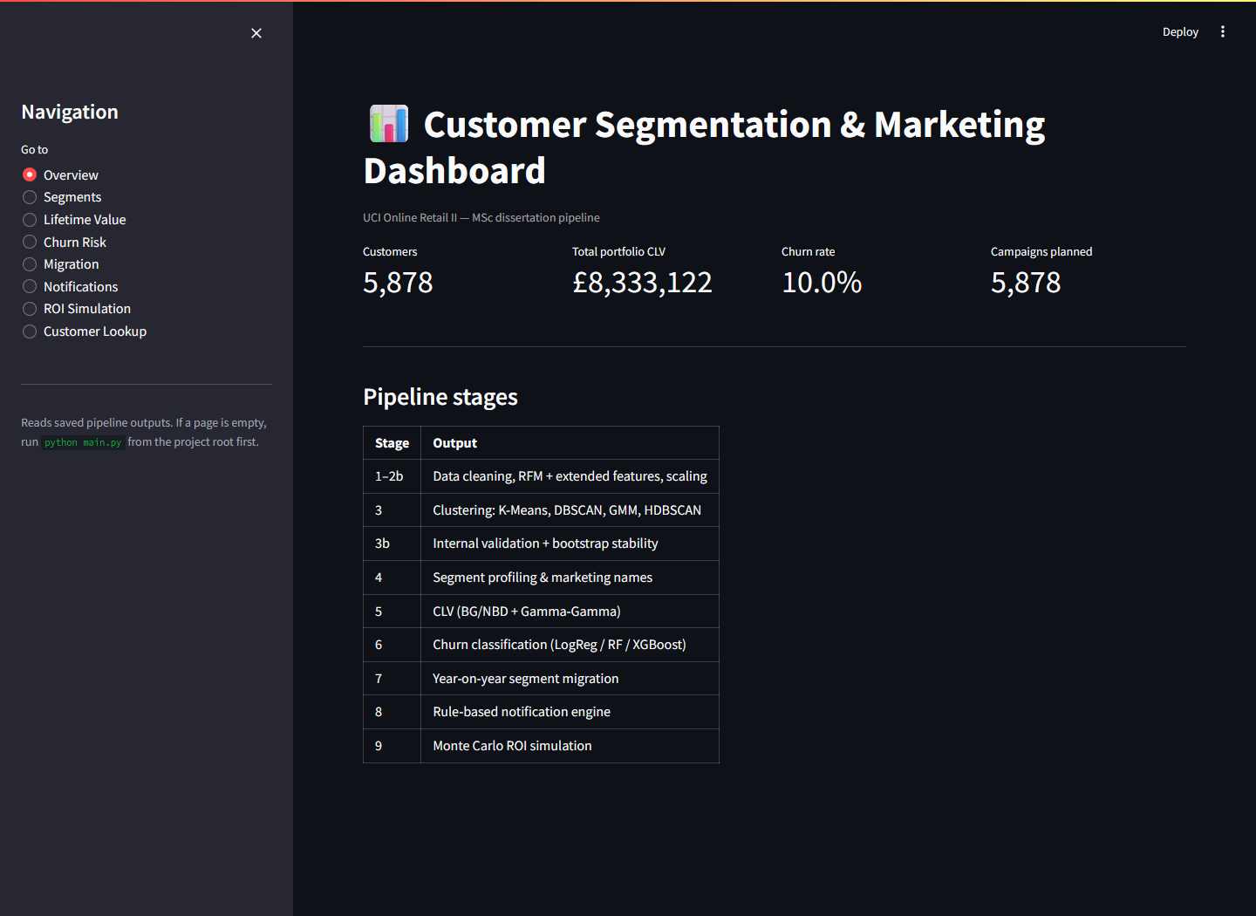
Stage 9 — Interactive Dashboard (live demo)
3 min
• Eight Streamlit pages reading only persisted artefacts
• Overview · Segments · Lifetime Value · Churn Risk · Migration · Notifications · ROI · Customer Lookup
• Demo route: Overview → Segments → ROI → finish on Customer Lookup
• Lookup answers, for any Customer ID: “what should we send this person, and why?” — with the why traceable to explicit rules
• Turns the batch pipeline into a tool a non-technical marketer can operate
Notes:
Have Streamlit already running before the meeting. If the demo fails, this screenshot and the PDF figures are the fallback.

Slide 14
Engineering Rigour & Reproducibility
2 min
• Fixed seed (42) + pinned snapshot date → byte-identical outputs on every run
• 20 pytest unit tests on synthetic data — cleaning rules, leakage guard, priority cap, ROI arithmetic all asserted
• Single configuration module — no magic numbers; the config file IS the experiment registry
• Artefact-mediated coupling: stages communicate only through files → any stage re-runnable and inspectable in isolation
• ≈160 s end-to-end on commodity CPU — no GPU, no cluster
• Ethics by design: pseudonymised public data, GDPR principles, noise customers get the LEAST aggressive action, cadence-based timing discourages over-contact
Notes:
One breath for the whole slide if time is short — but do not skip the tests and reproducibility lines; they anchor the professional-practice marks.

Slide 15
Honest Limitations & Future Work
• Limitations (volunteered, not hidden):
• single dataset (one UK retailer, 2009–2011) — no generalisation claim
• coarse structure (2 clusters + noise) — what the evidence supports; forcing more degrades quality
• CLV: no temporal hold-out → used as ranking, not validated forecast
• ROI priors are planning assumptions → hence the uplift framing
• Future work (in order of value):
• A/B-calibrated uplift modelling — target by incremental response
• temporal validation of CLV & churn on a longer window
• real-time deployment: recommend() behind a service API on streaming features
• learned embeddings + GPU implementations at larger scale — the validation framework transfers unchanged
Notes:
Volunteering limitations earns marks. Each limitation pairs with a future-work item that would resolve it.

Slide 16
Conclusions
1. Rigour changes answers — the evidence rejected the K-Means default, blocked an unjustified “best model” claim, and exposed two silently failing churn models.
2. The closed loop is the contribution — validated clusters, value forecasts and risk scores only become worth computing when a traceable decision layer turns them into costed actions.
3. The whole loop fits in one auditable, three-minute, commodity-hardware pipeline — raw transactions in, a costed action per customer out.
Thank you — questions welcome
Notes:
Close on the loop: most published studies stop at the clusters; this project goes all the way to the campaign plan and the money.

