Slide 1
Arduino Uno
A microcontroller brain for your electronics projects: pins, functions and the voltage divider
Notes:
Introduction to the Arduino Uno: what it is, how its pins work, and how a voltage divider is built and calculated (SCRUM-25).

Slide 2


What is the Arduino Uno?
A digital microcontroller that can be used as the brain of an electronics project. It has both analog and digital pins.
ATmega328P
8-bit CMOS chip that forms the CPU
Analog + Digital
Two kinds of pins on one board
Notes:
The Uno is built around an ATmega328P, an 8-bit CMOS chip that acts as the CPU. It exposes analog and digital pins.

Slide 3
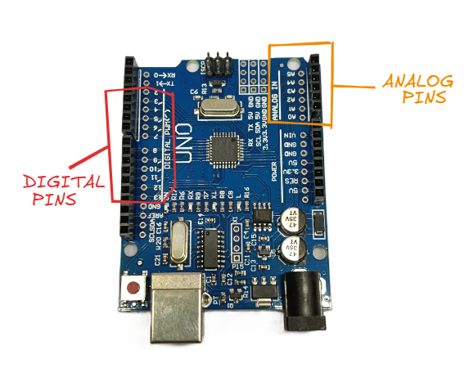


Digital and analog pins
Digital pins
Marked DIGITAL on the board
Analog pins
Marked ANALOG IN (A0 to A5)
Figure 1: Arduino Uno pins
Notes:
Digital and analog pins read and execute differently. Figure 1 shows where each group sits on the board.

Slide 4


Declare a pin before using it
To read any pin value, the pin must first be declared in void setup() as either INPUT or OUTPUT.
INPUT
Read a value from the pin
void setup() {
pinMode(pin, INPUT);
pinMode(pin, OUTPUT);
}
OUTPUT
Send a command out of the pin
Notes:
pinMode is called inside void setup() for every pin you plan to use.

Slide 5
Reading and writing pins
DIGITAL PINS
ANALOG PINS
Read with
Read with
digitalRead(pin)
analogRead(pin)
Write / execute with
Write with
digitalWrite(pin, value)
analogWrite(pin, value)
Notes:
Digital pins use digitalRead and digitalWrite; analog pins use analogRead and analogWrite.

Slide 6
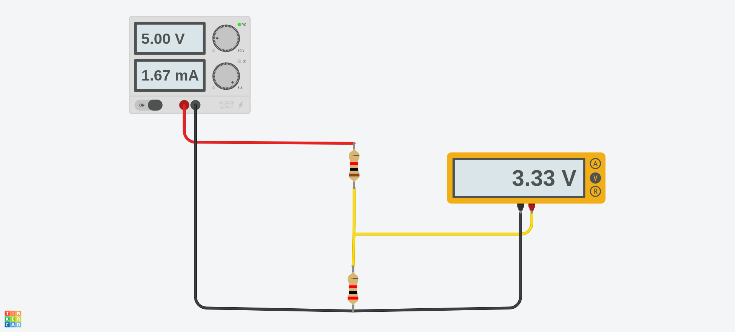
The voltage divider circuit
5.00 V
Voltage in
3.33 V
Voltage out
1.67 mA
Figure 2: Voltage divider circuit
Current
Notes:
Two resistors in series across a 5 V supply. The multimeter between them reads 3.33 V.

Slide 7
The voltage divider formula
Vout = R2 / (R1 + R2) × Vin
Worked example (Figures 2 and 3)
3.333 V = 2 / (2 + 1) × 5 V
R2 is the resistor the output is measured across; R1 sits between the supply and the output.
Notes:
Vout = R2 / (R1 + R2) x Vin. With R1 = 1 and R2 = 2 and 5 V in, the output is 3.333 V.

