Slide 1
Supervisor update: Month 27
David Simons

Slide 2
Thesis outline: 1
Abstract:
Understanding rodent host ecology can inform predictions of zoonotic infectious disease spillover events
To do this we need to understand current biases in data that contributes to these studies
Robust rodent trapping survey design can describe the composition of rodent species assemblages across a land use gradient which can quantify hazard of spillover
Understanding contact between individuals of different species in different land use types can elucidate viral transmission patterns among rodents
Incorporating host occurrence and co-occurrence can generate hazard maps that can inform public health interventions and vaccine development trials
Chapter 1: General introduction
Introduction to zoonoses
Zoonoses in a changing world and the use of prediction
Zoonotic host ecology
Zoonotic pathogens, specifically viruses and Lassa
Lassa fever ecology and epidemiology
Lassa fever pathology in humans and rodents

Slide 3
Thesis outline: 2
Chapter 2: Rodent trapping studies as an overlooked information source for understanding endemic and novel zoonotic spillover.
Synthesis of rodent trapping studies conducted across West Africa from a search of literature between 1964-2019.
Investigate geographic biases in the rodent trapping dataset in relation to human population density and land use classification.
Compare trapping locations to global host datasets (IUCN and GBIF) to understand differences in reported host geographic distributions.
Compare identified host-pathogen associations with global datasets (CLOVER) to understand discrepencies in rodent host-pathogen associations and report the proportion positive for pathogens of interest.
Investigate the spatial extent of current host-pathogen sampling to identify areas of undersampling of pathogens within their host ranges.
Chapter 3: Small mammal species community structures vary importantly by land-use type in a Lassa fever endemic region of Sierra Leone.
Rodent trapping survey conducted in the Lassa fever endemic region of Eastern Sierra Leone along a land use gradient to understand the association land use on the occurrence of Mastomys natalensis and other rodent species.
Assess co-occurrence of different species within these land use types.
Chapter 4: Understanding small mammal contact networks in a Lassa fever endemic region and the implications for viral transmission.
What are the mixing patterns of rodents in different land use types?
Which rodent species are more likely to contact others and do the number of contacts vary importantly by species?
Which rodent species in a Lassa fever endemic region display evidence of prior infection with Lassa mammarenavirus?

Slide 4
Thesis outline: 5
Chapter 5: Purpose of discussion today.
TBC
Chapter 6: General discussion

Slide 6
Thesis writing:
I have begun formulating the Introductory chapter to weave a narrative thread through the planned chapters.
I will share a draft of the introduction prior to our next meeting in January.

Slide 7
Chapter 2
Final revisions have been submitted. Accepted for publication.

Slide 8
Rodent trapping
584 individuals trapped as of December 2022 – awaiting data for some of them (26. 4.5%) from field team (upload from phones).
Expect final sample of 600 February 2023
End of PANDORA funding perhaps good time to end collection
Will give 9 trapping session at Lalehun and Seilama and 7 at Baiama and Lambayama
Was hoping for 10 and 8 as that gives a minimum of 2 years at each village but funding and time are perhaps putting pressure on that
127 DNA extracts sent to Eurofins in Germany, confirmation of species from 119 (94%). Concordance with field identification in 108 (91%). Likely that some of the samples have been mislabelled. I can fix this for most of them but need to think about how to identify those I can’t and how to handle them.
Awaiting confirmation of how many individuals have had DNA extracted to calculate remaining number needed for processing and how much additional reagents need to be sent.
420 individuals have been tested with ELISA (72%), 397 negative (94.5%), 20 positive (4.7%), 3 equivocal needing retesting. 164 needing testing, 4 plates will need to be purchased.

Slide 9
Finances
£5626.06 remains
February trip to SL – Flights and Accommodation £2,500? – requested RVC travel fund support
ELISA strips – EUR1600
ELISA shipment to UK?
PCR reagents:
Currently have in the UK; Taq Polymerase x2 , dNTP mix x3, DNA ladder x1, PCR grade water x2
Require (known); Midori green agarose tablets x2 (GBP240), MgCl x2 (GBP70)
UK material can go with UCL to SL
Cannot afford additional traps so Rashid will support the team to spend more nights in the field

Slide 10
Chapter 3
I have updated the occurrence models to incorporate a spatial-autocorrelation component.
Will discuss with Rory tomorrow to get input into the occupancy and co-occurrence modelling.
Following that will finalise the draft including the introduction. Completed draft will be circulated around mid/end-January.
Next steps:
Further discussions with Rory about the co-occurrence component
Finalised draft January
Feed in final rodent data and finalise manuscript around March/April

Slide 11
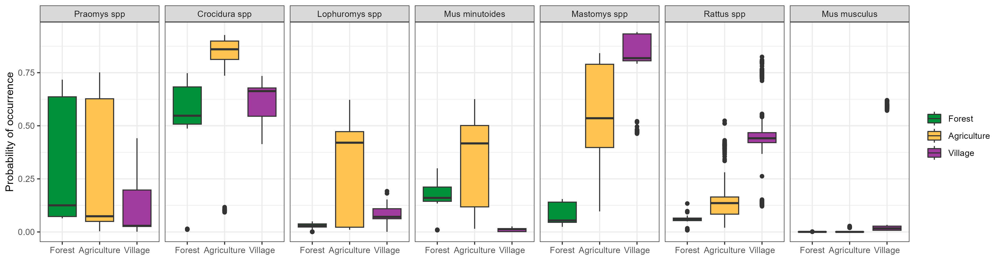
Chapter 3

Slide 12
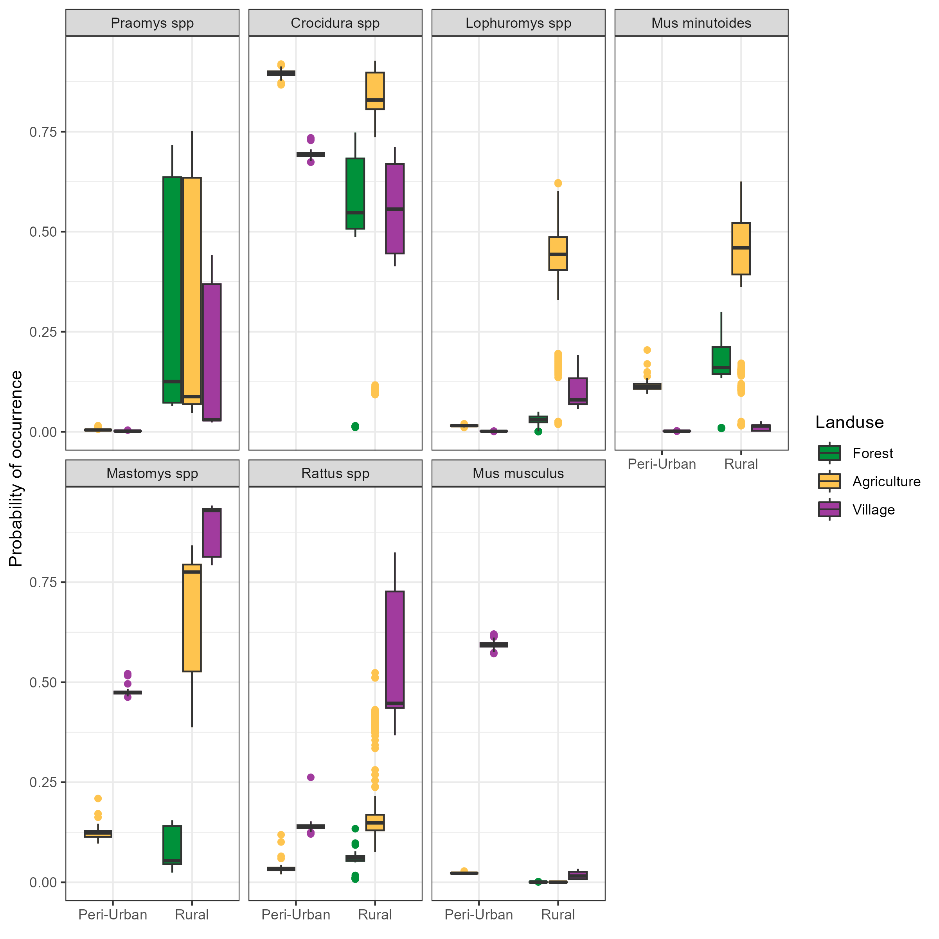
Chapter 3

Slide 13
Chapter 4
Finalising network structure, decision to aggregate on land use and village study site, so will remain separate by time.
Will derive the number of potential individuals in a network using the Royle-Nichols model of abundance (this will be an approximation but could be helpful).
Will produce estimates of the probability of contact between individuals of different species in different land use types.
Won’t be enough data on antibody status so this will be described only, not included in the network models.
Continuing to write chapter

Slide 14
Chapter 5
Need to decide on what this will be based on the data I have available.
Currently undecided between three options:
1: A mathematical model of rodent population dynamics in different land use types in Eastern Sierra Leone and how this may impact the hazard of Lassa Fever spillover into local populations.
2: A species distribution model based approach to map the occurrence of Mastomys natalensis, accounting for species interactions to estimate hazard of spillover.

Slide 15
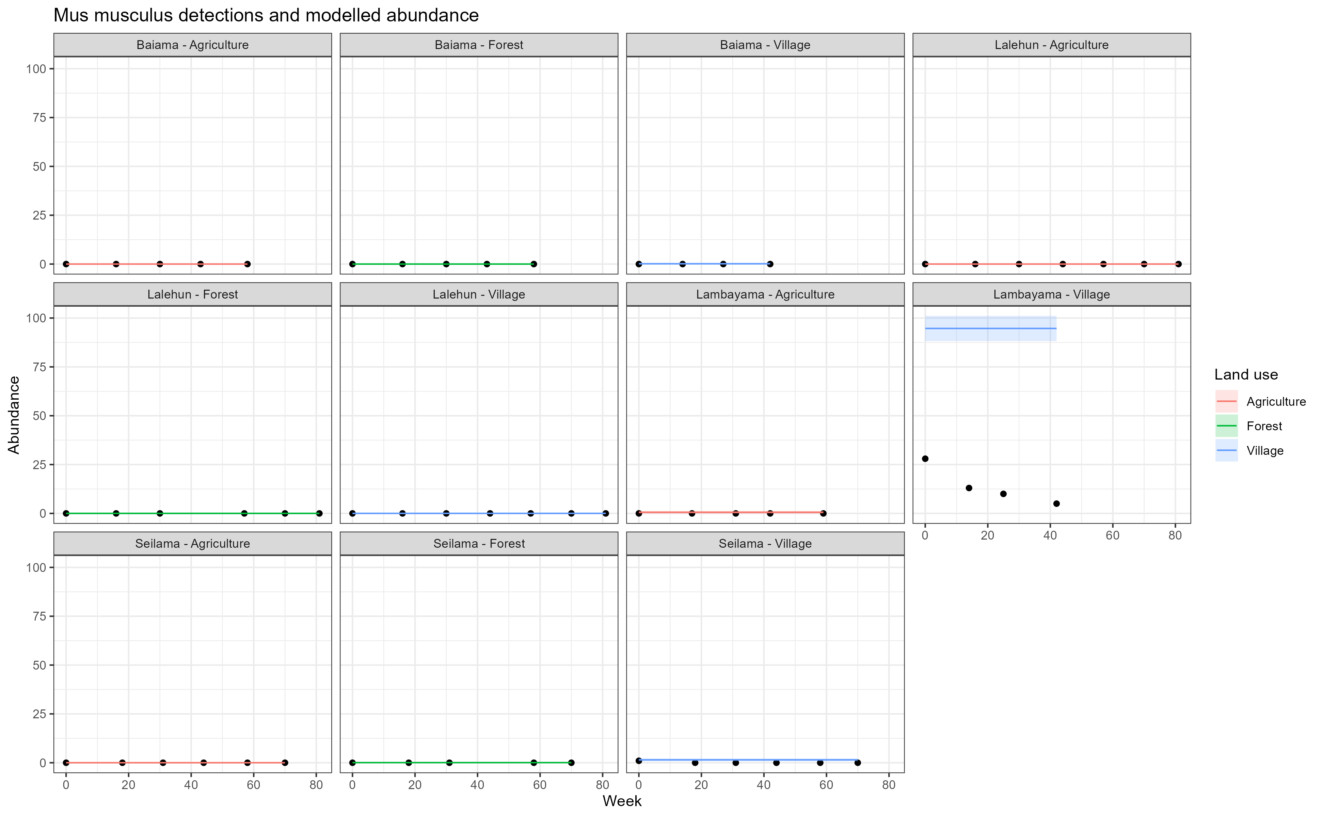
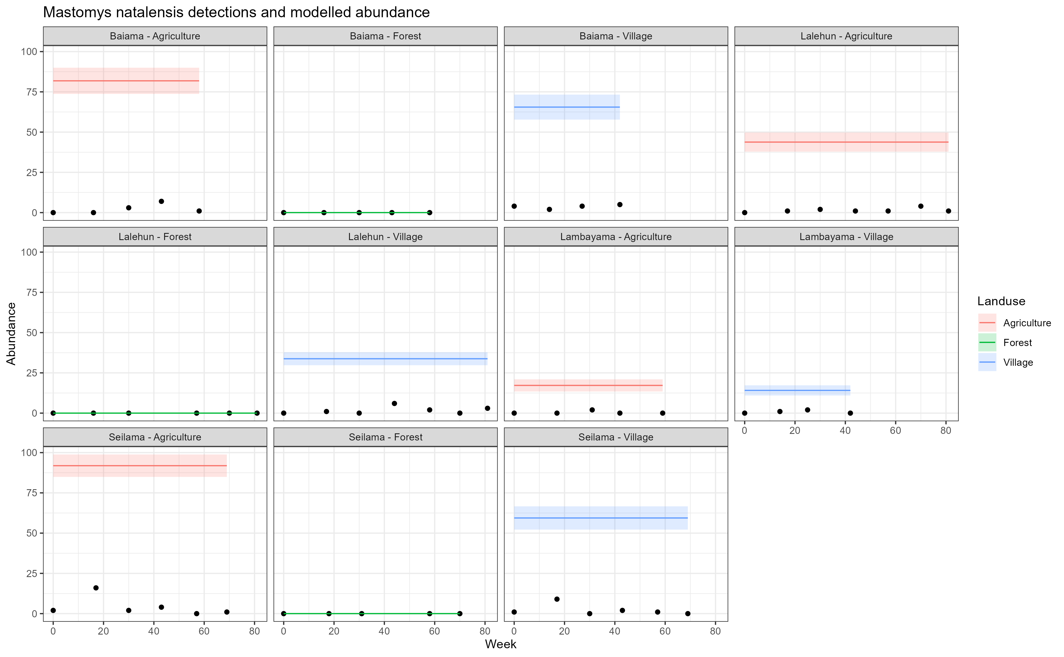
Option 1 – Population model
First step would be estimate abundance of different species in different landuse types.
Will produce a compartmental model to estimate number alive assuming steady state and equilibrium. I am not sure this is appropriate.
Use parameters from the literature including life expectancy, litter size, birth rate etc. To fit a mathematical model to each species.
Expected time frame 2-3 months, once other chapters are completed.
The first step would be to estimate the abundance (number of individuals

Slide 16
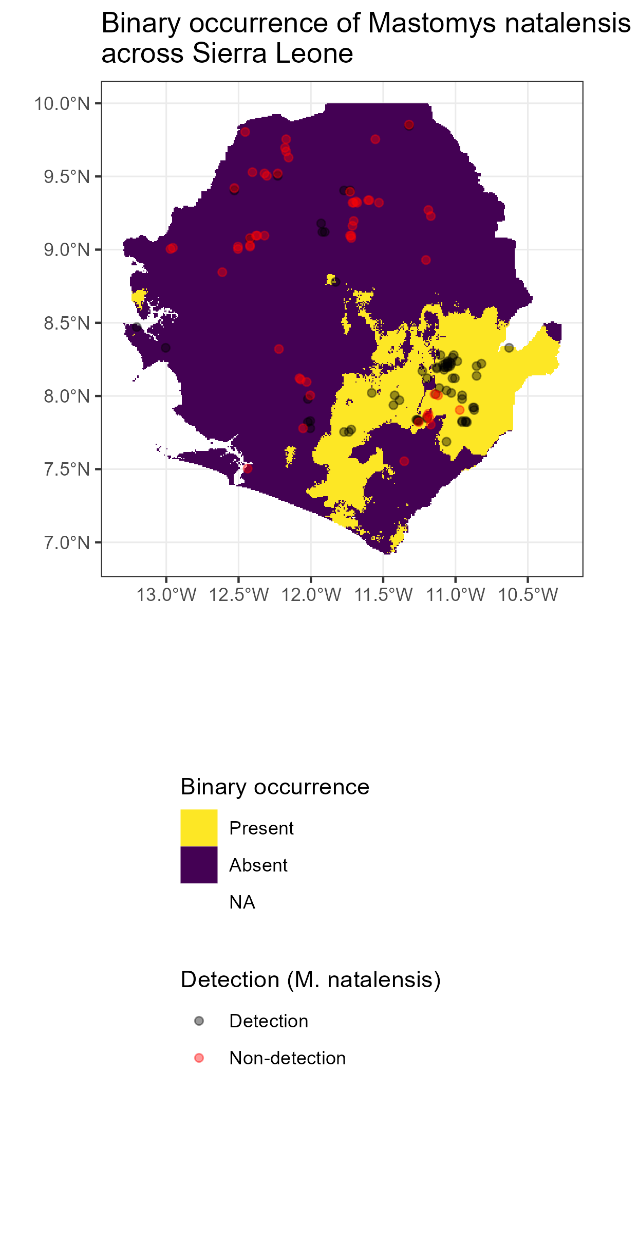
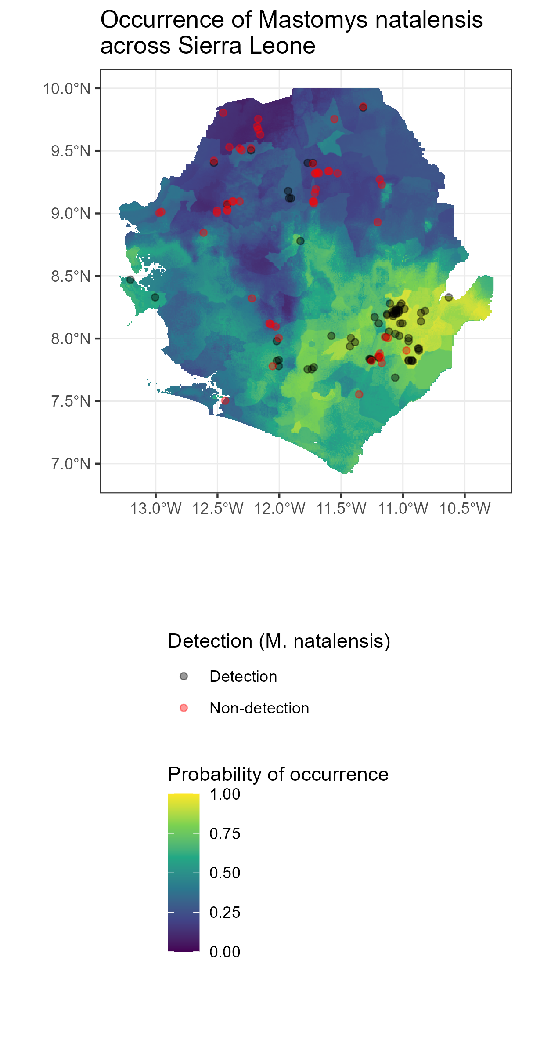
Option 2 – Species distribution
Won’t use this model but this is to demonstrate the approach.
Dave Redding has written on using clustered occurrence data for SDMs and will trial the approach he suggests if it can be adapted for multi-species models.
Have contacted Brian Bird to see if potential for adding their data which I think covers currently under-sampled regions.

Slide 17
Immediate next steps
Chapter 3:
Finalise for sharing in January
Prepare for incorporation of species data when finalised
Chapter 4:
Run models on current network aggregation
Share updated version
Further ELISA kits/reagents to SL
Chapter 5:
Decide on topic for this chapter

Slide 18
Potential issues and mitigations
Chapter 2:
Nil
Chapter 3:
Issue 1: Sequencing of processed DNA
Seems feasible as long as chase up Rashid, hopeful that after Umaru has arrived things will be a bit smoother.
Chapter 4:
Issue 1: Low seroprevalence may limit between species or between habitat inferential statistics (i.e. low statistical power)
Mitigation: May have to limit to description of risk of Lassa mammarenavirus infection
Chapter 5:
Issue 1: Concern about timeline
Mitigation: Perhaps limit to simpler model

Slide 19
Other news

