Slide 1
Supervisor update: Month 19
David Simons

Slide 2
Thesis outline: 1
Chapter 1: General introduction
Summarising current knowledge around risk of Lassa fever emergence and impact on human populations in endemic regions.
Discussion of ecology of the rodent host and ecology of small mammal assemblages in West Africa.
Review of current approaches to understand future hazard/risk of Lassa spillover.
Chapter 2: Rodent trapping studies can improve our understanding of the hazards of zoonotic pathogen spillover and novel zoonotic pathogen emergence.
Synthesis of rodent trapping studies conducted across West Africa from a search of literature between 1964-2019.
Investigate geographic biases in the rodent trapping dataset in relation to human population density and land use classification.
Compare trapping locations to global host datasets (IUCN and GBIF) to understand differences in reported host geographic distributions.
Compare identified host-pathogen associations with global datasets (CLOVER) to understand discrepencies in rodent host-pathogen associations and report the proportion positive for pathogens of interest.
Investigate the spatial extent of current host-pathogen sampling to identify areas of undersampling of pathogens within their host ranges.
Chapter 3: Rodent trapping to explore rodent assemblage structure in Eastern Sierra Leone.
Rodent trapping survey conducted in the Lassa fever endemic region of Eastern Sierra Leone along a land use gradient to provide novel evidence on the impact of land use on the occurrence of Mastomys natalensis and rodent species assemblage structure.
Assess the association of land use with the probability of species occupancy at trapping sites and species richness.
Produce species distribution maps for Mastomys natalensis and the species with which it competes to investigate the potential alterations to these species assemblages based on projected climate and land use change to understand how future land use change may modify the hazard of Lassa fever outbreaks.

Slide 3
Thesis outline: 2
Chapter 4: Serological investigation of Lassa mammarenavirus among rodent species in Eastern Sierra Leone.
Which rodent species in a Lassa fever endemic region display evidence of prior infection with Lassa mammarenavirus?
Is there evidence of temporal variation in the prevalence of antibodies to Lassa mammarenavirus among rodents in Eastern Sierra Leone?
What is the role of diverse or depauparate rodent assemblages on the risk of seropositivity of rodent species?
Chapter 5: Serological studies investigating Lassa mammarenavirus seropositivity in peridomestic species.
Chapter 6: Development of a LIPS serological assay for Lassa mammarenavirus.
Chapter 7: Parameterisation of a mathematical model of viral transmission in rodent populations to investigate viral spillover risk.
Can the incorporation of land use type and the structure of rodent species assemblages contribute to our understanding of Lassa mammarenavirus transmission dynamics in a Lassa fever endemic region of Sierra Leone?
Chapter 8: General discussion

Slide 4
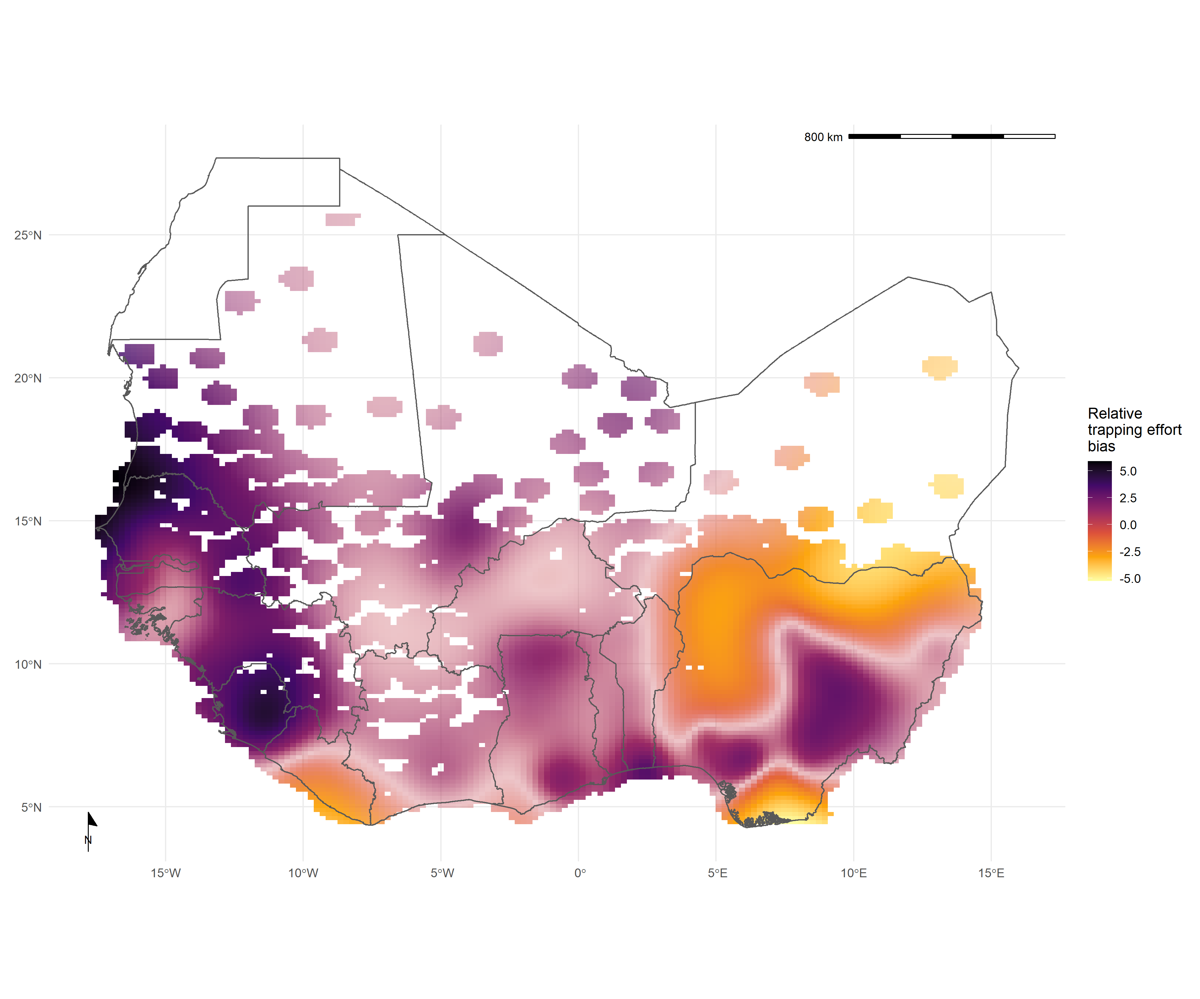
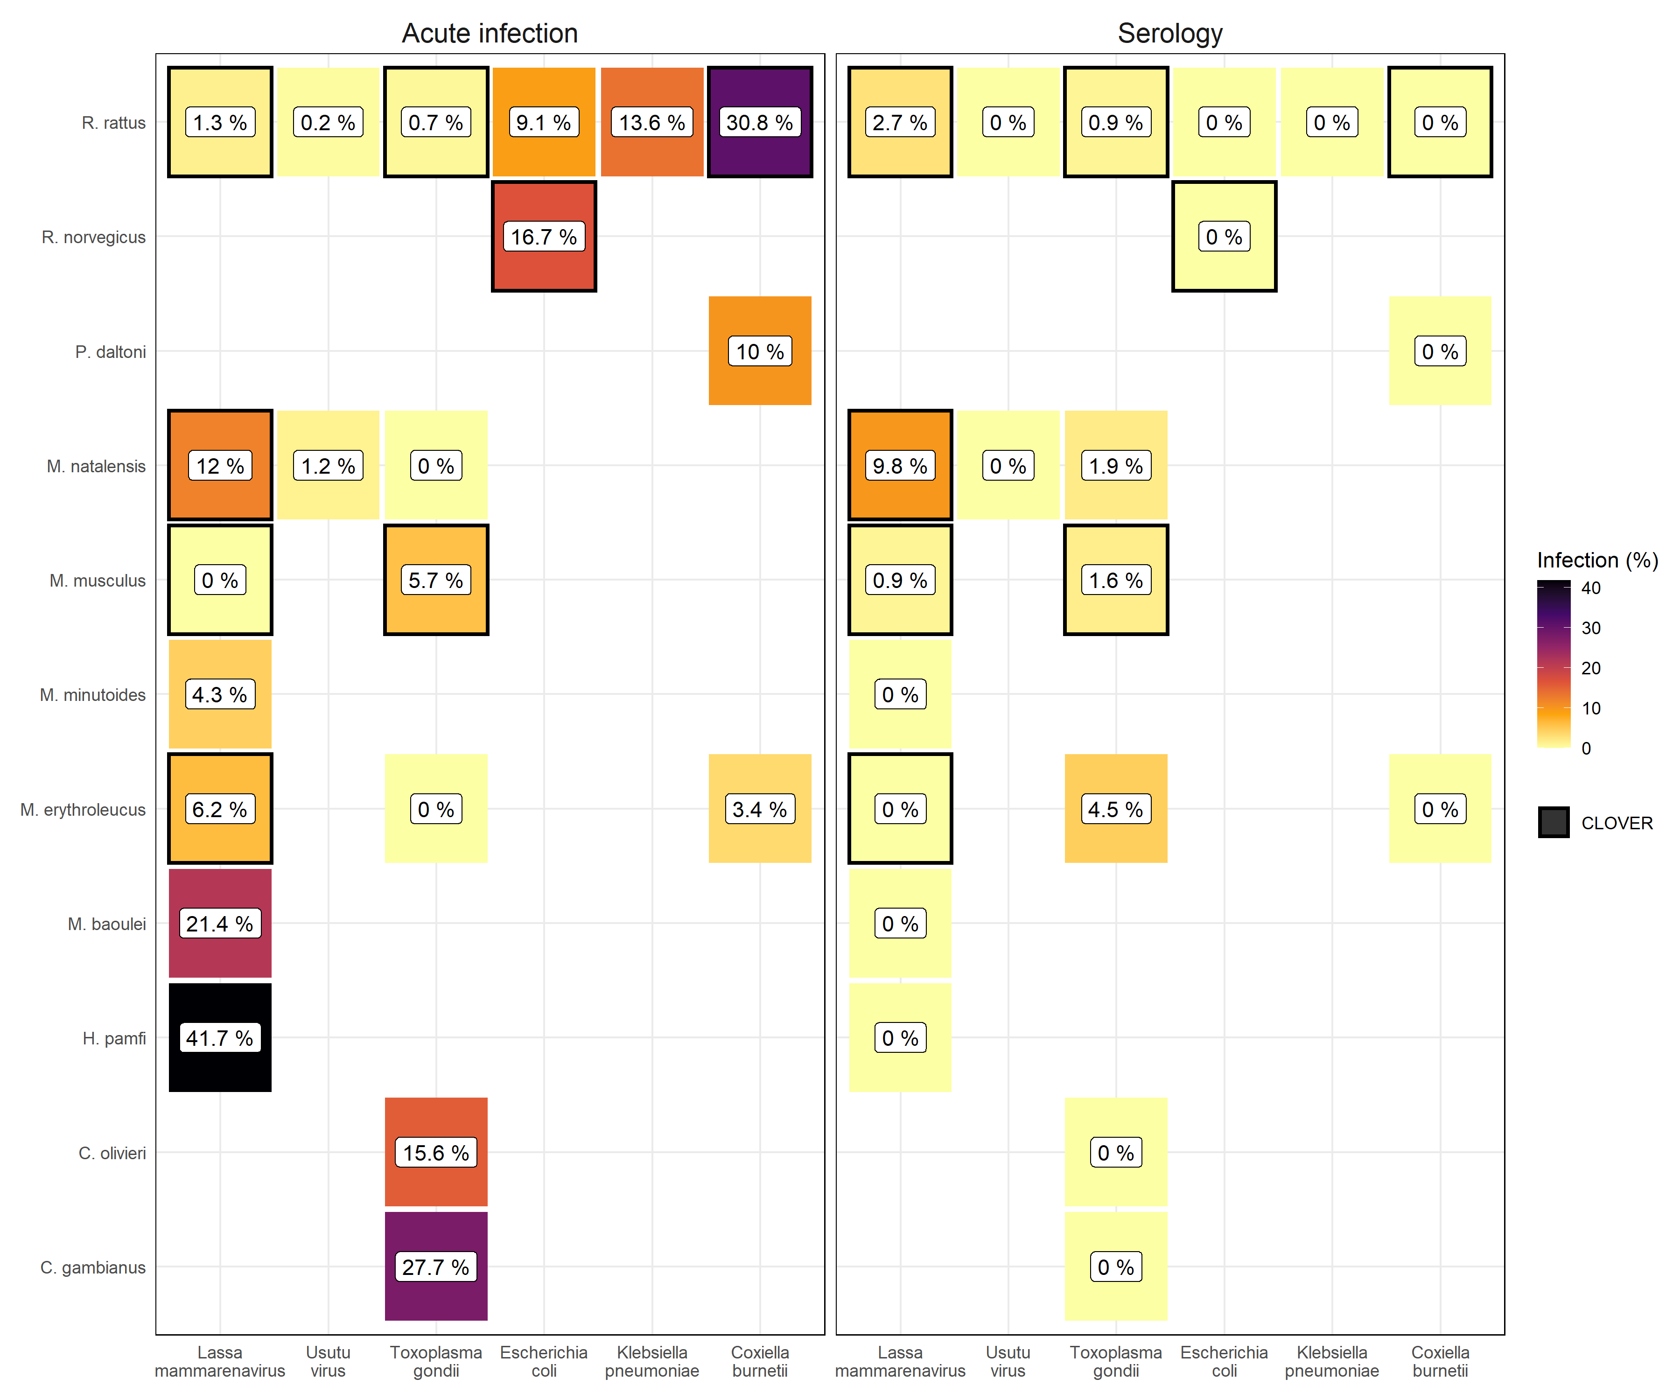
Progress: Chapter 2
Chapter 2:
An updated analysis has been shared with supervisors, I have received comments from Richard and am awaiting comments from others and Lauren.

Slide 5
Progress: Chapter 3 and 4
Chapter 3:
The chapter outline has been shared, I have received comments from Richard and am awaiting comments from others.
I will train on the PCR methods over the next 2 weeks for implementation in SL.
Once I have identified required consumables/equipment I will order to the RVC and take with me to SL.
Elisabeth suggested that it may be worth consolidating our data using her studies around Bo, this may be worth further discussion.
Chapter 4:
I will prepare the chapter outline for dissemination following this meeting.
I have trained on the ELISA technique and believe I will be able to replicate this in SL on stored and future samples.
I have requested ELISA kits from the DDL at BNITM they anticipate no problems in getting them into SL for the end of April.
Next visit to SL. Currently planned for end of April for 2 weeks for ELISA and rodent PCR.

Slide 6
Progress: Chapter 5 and 6
Chapter 5:
Peridomestic samples have been collected and are in storage for analysis
Chapter 6:
Epitope identification has been completed.
Work at UCL appears to be on hold. I am unsure of progress at IAEA

Slide 7
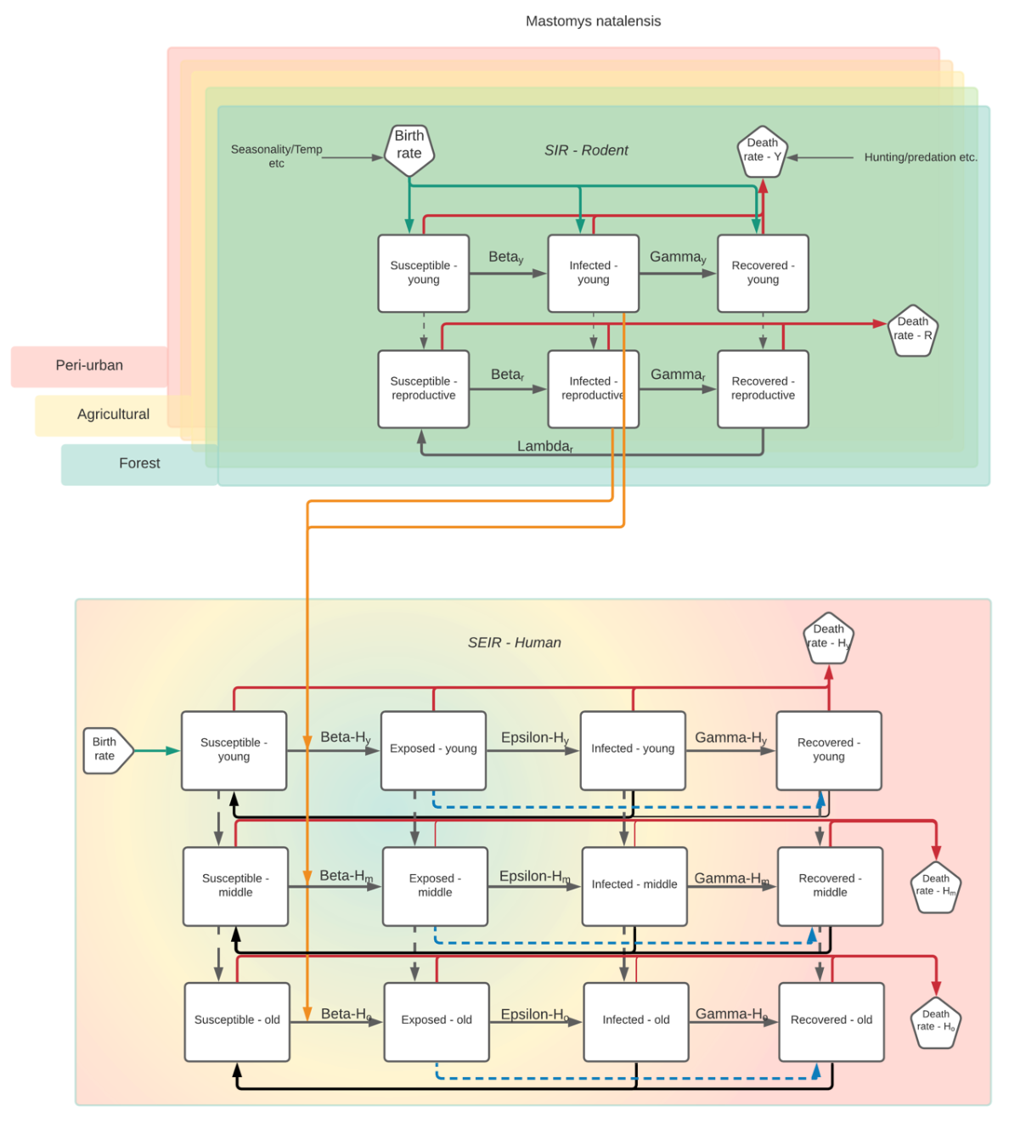
Progress: Chapter 7
Chapter 7:
Potential model has been drafted, further work is required to identify potential suitability with obtained data.

Slide 8
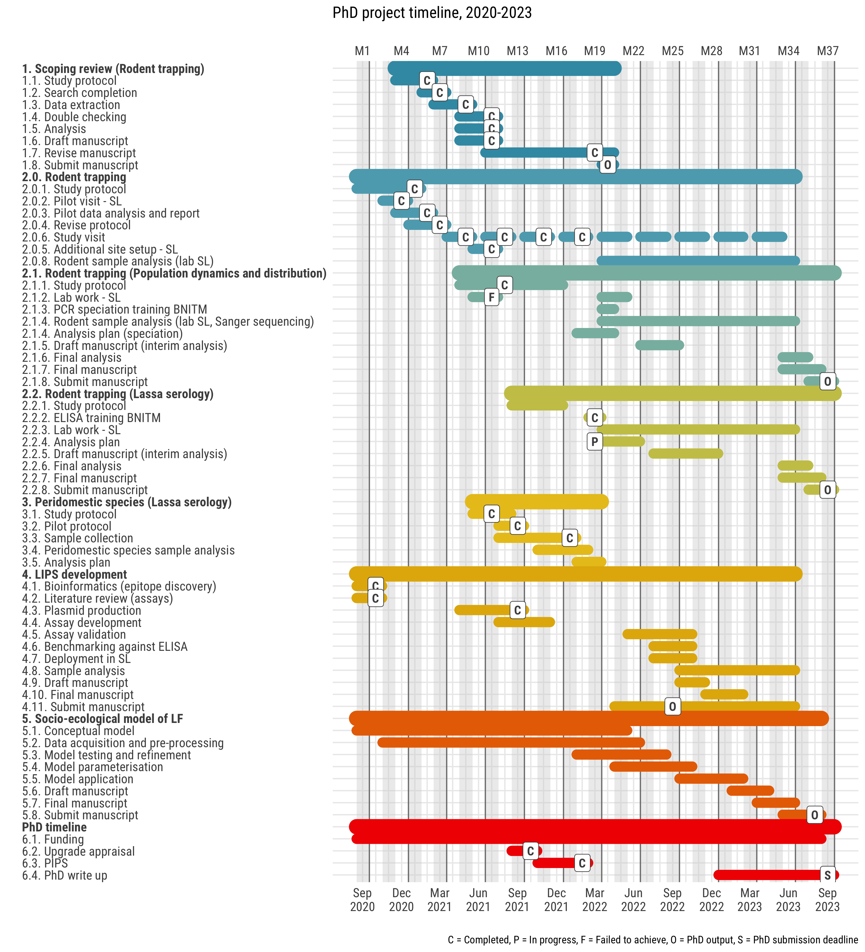
Timeline

Slide 9
Immediate next steps
Chapter 2:
Respond to feedback from supervisors
Prepare for submission ?aim PLOS NTD – May 2022
Chapter 3:
Respond to feedback from supervisors
Develop naïve Bayes classifier for preliminary species identification
Continue with PCR training and analysis of currently available samples
Identify location to perform Sanger sequencing on prepared samples from Sierra Leone, alternatively identify company to send prepared samples to for sequencing
Produce analysis plan based on currently available data
Preliminary results for conference
Chapter 4:
Produce study outline
Disseminate to supervisors for feedback
Train SL staff on ELISA – perform for >398 current samples
Produce analysis plan based on currently available data

Slide 10
Next steps
Chapter 5 and 6:
Remain dependent on progress by UCL/IAEA on the development of LIPS. May need to reconsider suitability for inclusion in thesis due to ongoing delays.
Chapter 7:
Once data streams from chapter 3 and 4 are in place further consideration of the potential modelling structures will be needed.
Potential replacement(s) for Chapter 5 and 6:
Using data obtained from Chapter 2 to produce updated estimates of the distribution of Mastomys, Rattus and Mus across the Lassa fever endemic region and how this may impact currently available estimates of risk.

Slide 11
Potential issues and mitigations
Chapter 3:
Issue 1: Finding suitable location for sequencing of processed DNA
Mitigation: Explore feasibility at RVC or UCL if neither possible may need to be sent off for sequencing which may be expensive
Issue 2: Data sparsity will limit predictive ability of SDM approaches
Mitigation: Improving coverage through enrichment with additional data sources i.e. Lina’s trapping data, Elisabeth’s trapping data, GBIF data, literature date
Chapter 4:
Issue 1: Low seroprevalence may limit between species or between habitat inferential statistics (i.e. low statistical power)
Mitigation: May have to limit to description of risk of Lassa mammarenavirus infection
Chapter 5 and 6:
Issue 1: Unlikely that LIPS will be suitable for inclusion in thesis based on timelines
Mitigation: Removing these chapters from the thesis

