Slide 1
Supervisor update: Month 25
David Simons

Slide 2
Thesis outline: 1
Chapter 1: General introduction
Summarising current knowledge around risk of Lassa fever emergence and impact on human populations in endemic regions.
Discussion of ecology of the rodent host and ecology of small mammal assemblages in West Africa.
Review of current approaches to understand future hazard/risk of Lassa spillover.
Chapter 2: Rodent trapping studies as an overlooked information source for understanding endemic and novel zoonotic spillover.
Synthesis of rodent trapping studies conducted across West Africa from a search of literature between 1964-2019.
Investigate geographic biases in the rodent trapping dataset in relation to human population density and land use classification.
Compare trapping locations to global host datasets (IUCN and GBIF) to understand differences in reported host geographic distributions.
Compare identified host-pathogen associations with global datasets (CLOVER) to understand discrepencies in rodent host-pathogen associations and report the proportion positive for pathogens of interest.
Investigate the spatial extent of current host-pathogen sampling to identify areas of undersampling of pathogens within their host ranges.

Slide 3
Thesis outline: 2
Chapter 3: Small mammal species community structures vary importantly by land-use type in a Lassa fever endemic region of Sierra Leone.
Rodent trapping survey conducted in the Lassa fever endemic region of Eastern Sierra Leone along a land use gradient to understand the association land use on the occurrence of Mastomys natalensis and other rodent species.
Assess co-occurrence of different species within these land use types.
Chapter 4: Understanding small mammal contact networks in a Lassa fever endemic region and the implications for viral transmission.
What are the mixing patterns of rodents in different land use types?
Which rodent species are more likely to contact others and do the number of contacts vary importantly by species?
Which rodent species in a Lassa fever endemic region display evidence of prior infection with Lassa mammarenavirus?
Chapter 5: Parameterisation of a mathematical model of viral transmission in rodent populations to investigate viral spillover risk.
Can the incorporation of land use type and the structure of rodent species assemblages contribute to our understanding of Lassa mammarenavirus transmission dynamics in a Lassa fever endemic region of Sierra Leone?
Chapter 6: General discussion

Slide 4
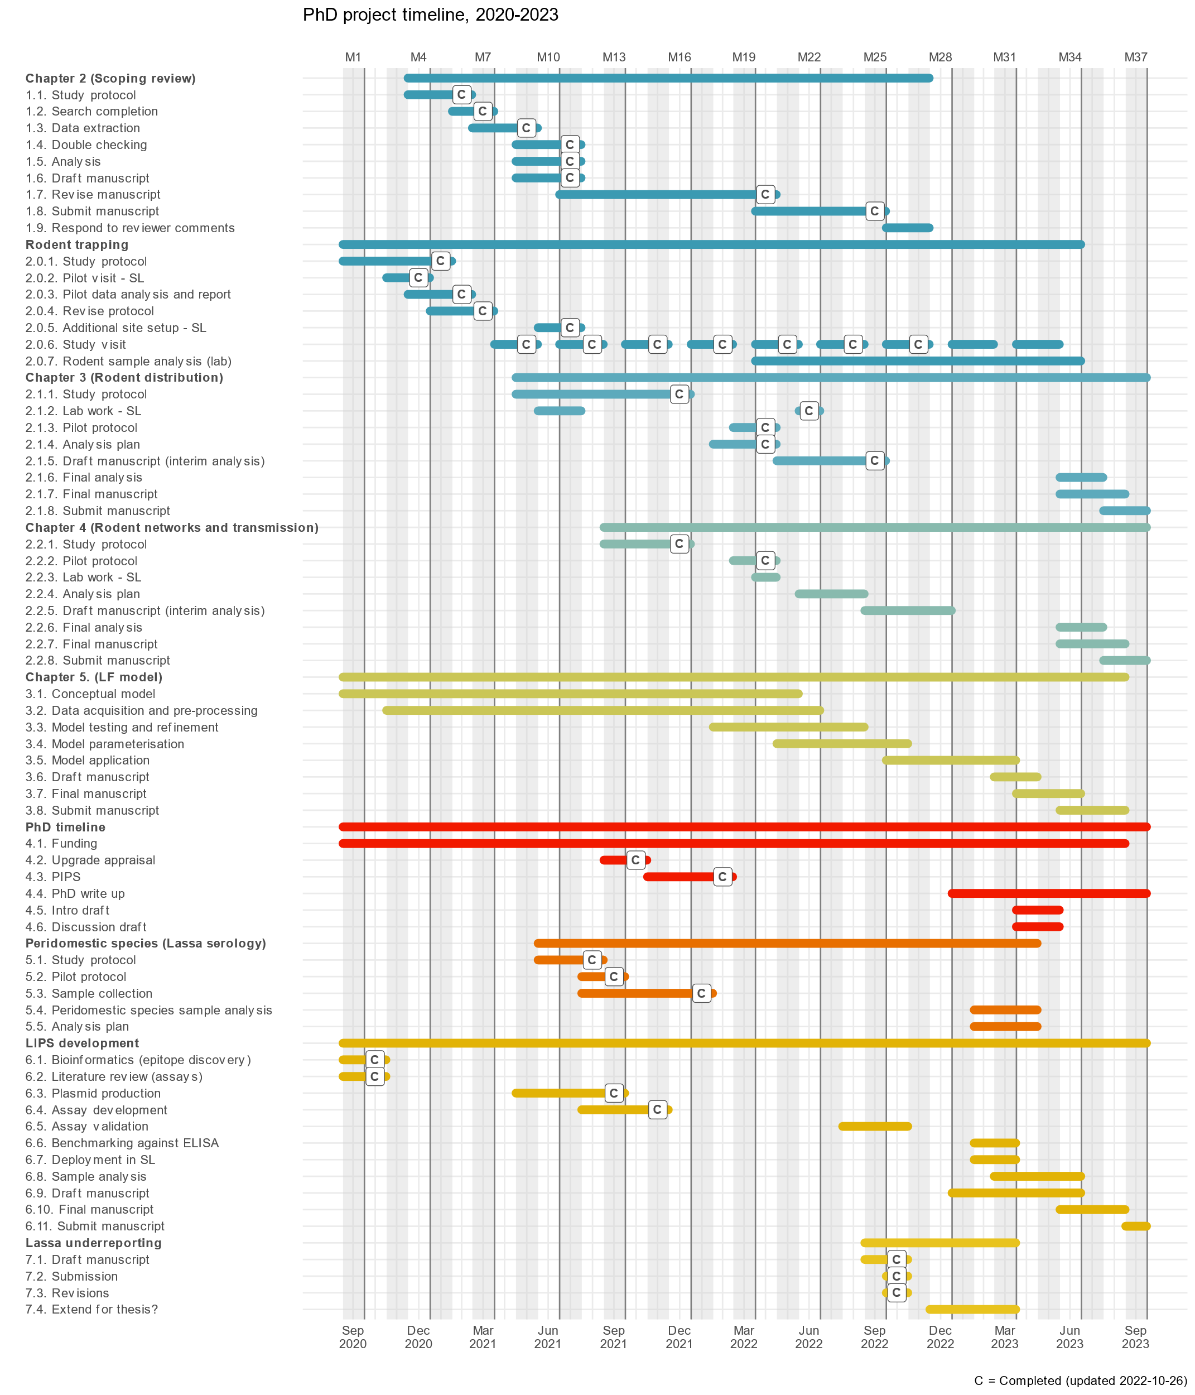

Slide 5
Chapter 2
Reviewer comments, key points.
Methods:
Why go back to the 1960s? Explain that this is to highlight that certain systems have been investigated to importantly different extents. Zoonotic pathogens have been circulating in rodents in West Africa throughout this time (for example Lassa identified in the late 60’s) so this data is important to consider.
Highlight the number of studies investigating species that are known hosts of zoonoses, consider limiting to just these. Could be useful to add something describing the number more clearly. Although, I don’t think we should limit to this. Studies trapping rodents that are not currently hosts or not tested for pathogens are important sources of information for assessing the risk of potential pathogen sharing or pathogen range expansion.
Separate out the descriptives and data sources, clarify description of micro-organisms and pathogens.

Slide 6
Chapter 2
Results:
What is happening in Benin?
Suggested table changes.
Conclusions:
Add raster cell size selection as limitation
What is the advantage of the model compared to reporting figure 1. Highlight that this allows both trapping location and trapping effort to be combined and adjusted for factors that may modify trapping success and rodent abundance i.e. landuse and human population density. This information can benefit researchers and public health professionals to identify regions of suspected pathogen presence where the rodent populations are undersampled relative to other areas.
Additional information on the breakdown by species. Include a summary number in the text and direct to the webapp/supplementary data/perhaps a supplementary table.
Editorial:
Country and city names. Will add a supplementary figure, will make it too difficult to interpret them with labels

Slide 7
Chapter 2
General:
Issue of overlap between Lassa mammarenavirus and all Arenaviridae. The inclusion of Arenaviridae is only from studies that have not identified the micro-organism down to species level. They have not been discarded as they could be Lassa mammarenavirus but there is no way of knowing and I do not feel it is appropriate to combine these. What would you suggest for this?
Include something on how GBIF and CLOVER obtain data and why these studies may or may not be included in these databases. I can ask Rory about CLOVER which I expect to contain a not-insignificant proportion of these studies but with no spatial information. GBIF to my knowledge can also include some of these studies but is more typically museum specimens but I can get this information.
Explain why Tweedie is beneficial here
Revise through a “One Health lens”. Thought I was but I’ll have a look at what I can add in to more clearly take this approach.

Slide 8
Chapter 3
The chapter outline has been shared. I am awaiting comments from Kate but following discussions the network component will be removed and incorporated in Chapter 4.
This chapter will be limited to the description of the rodent species assemblages, estimating the effect of land use on occurrence and species richness and the assessment of co-occurrence of species.
Following further discussion with Elisabeth it seems she does not want to share the data just yet.
Awaiting data on rodent molecular ID, samples should be en-route to Germany.
Further reagents will be needed for ongoing sample collection/testing
Next steps:
Further discussions with Rory about the co-occurrence component
Incorporate spatial effects in the detection-occurrence model if possible
Further work on interpreting the model outputs and presenting them

Slide 9
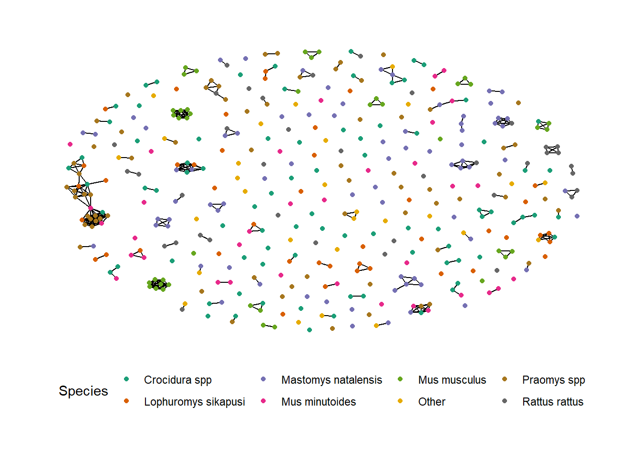
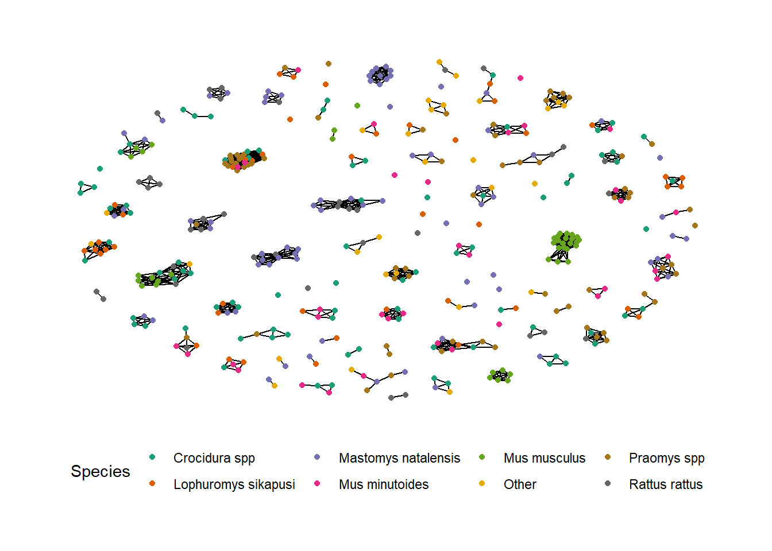
Chapter 4
Will focus on reporting potential contact networks among rodent species in different land use types and the implications this may have for viral transmission (identified through seroconversion) through these networks.

Slide 10
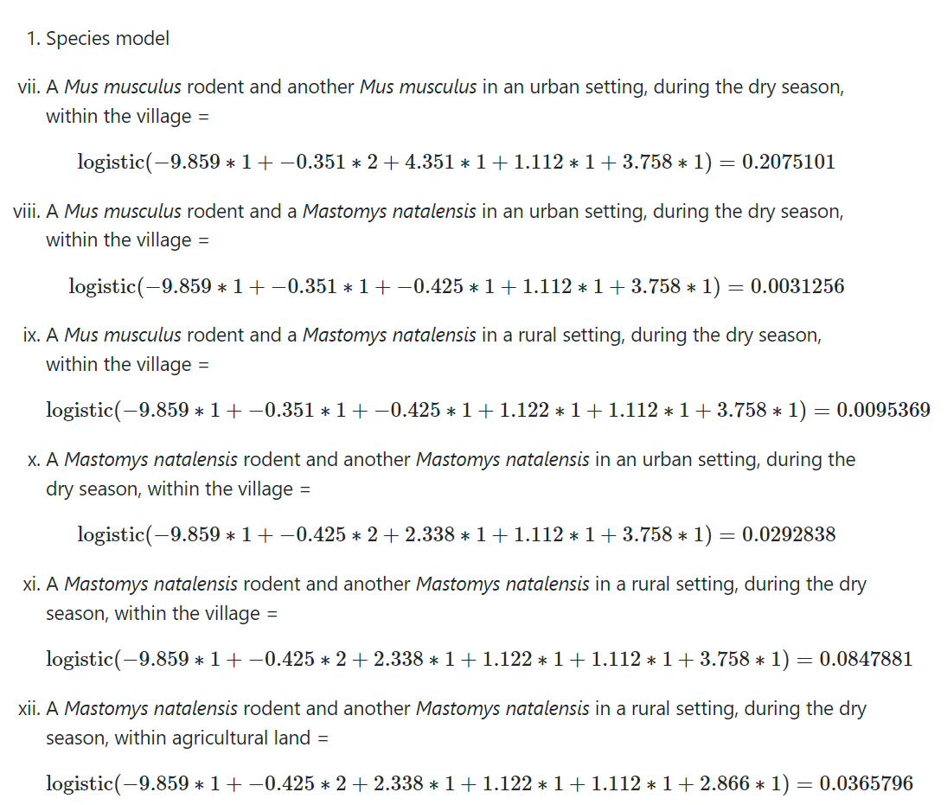
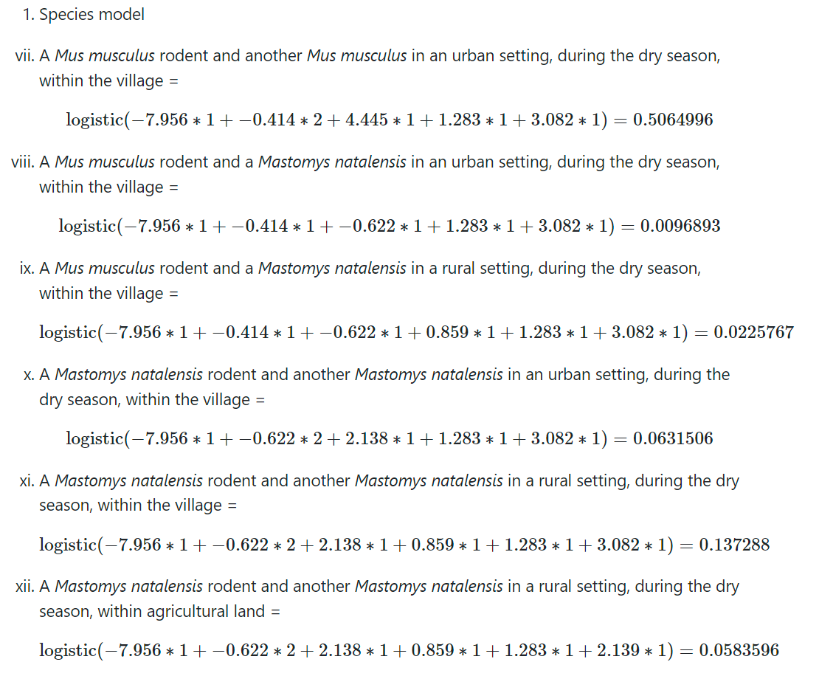
15m vs. 50m

Slide 11
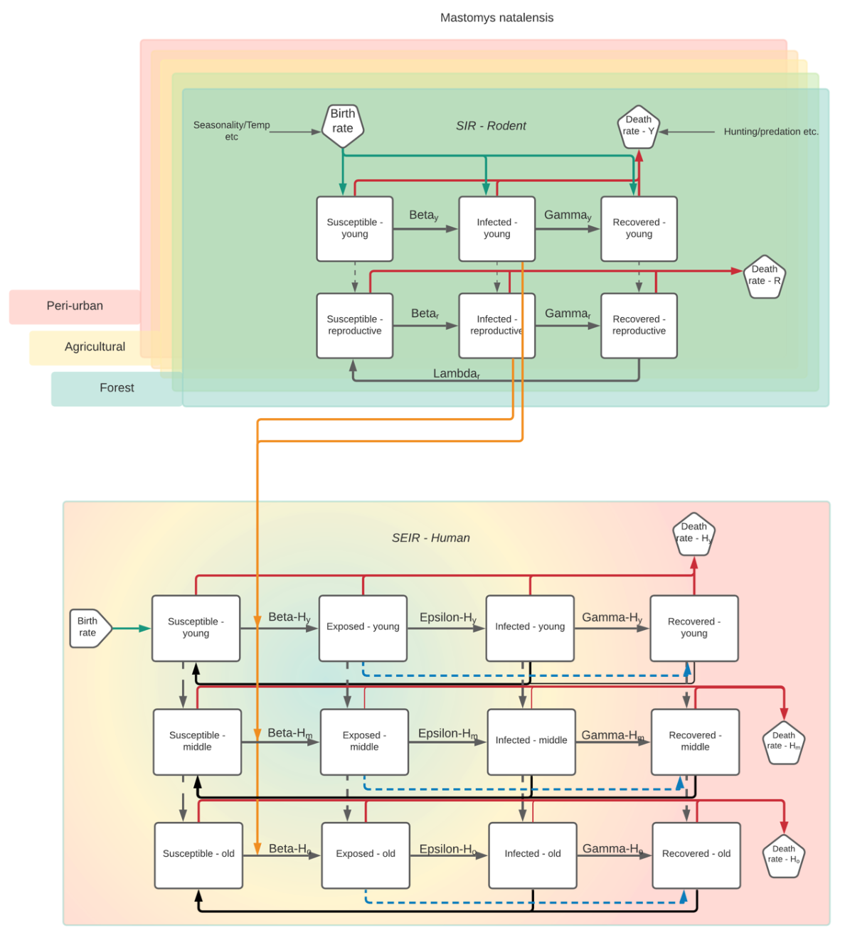
Chapter 5
Potential model has been drafted, further work is required to identify potential suitability with obtained data.

Slide 12
Chapter 5
Chapter 5:
Peridomestic samples have been collected and are in storage for analysis

Slide 13
Immediate next steps
Chapter 2:
Will share response to reviewer comments and updated manuscript
Chapter 3:
Respond to feedback from supervisors and update draft
Continue to refine methods/interpretation
Await data from molecular classification
Chapter 4:
Decide on network approach
Share analysis plan with supervisors for feedback
Further ELISA kits/reagents to SL

Slide 14
Next steps
Chapter 5:
Considering attending a course, the Clinic on Dynamical Approaches to Infectious Disease Data, in December to ensure that I am using a suitable mathematical modelling approach.

Slide 15
Potential issues and mitigations
Chapter 2:
Nil, will be ready
Chapter 3:
Issue 1: Sequencing of processed DNA
Assess after first results back from Germany, otherwise will need trip to SL to sort
Chapter 4:
Issue 1: Low seroprevalence may limit between species or between habitat inferential statistics (i.e. low statistical power)
Mitigation: May have to limit to description of risk of Lassa mammarenavirus infection
Chapter 5:
Issue 1: Concern about timeline
Mitigation: Perhaps limit to simpler model alternatively this chapter can be swapped for an expansion of my under-reporting work

