Slide 1


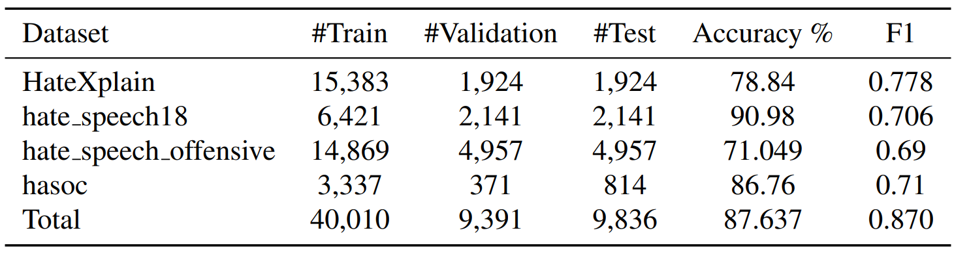
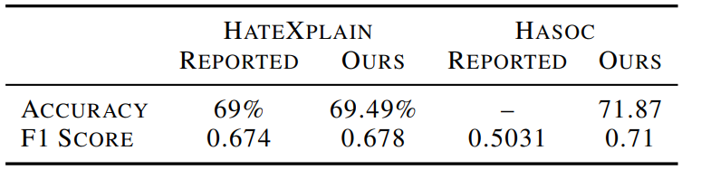
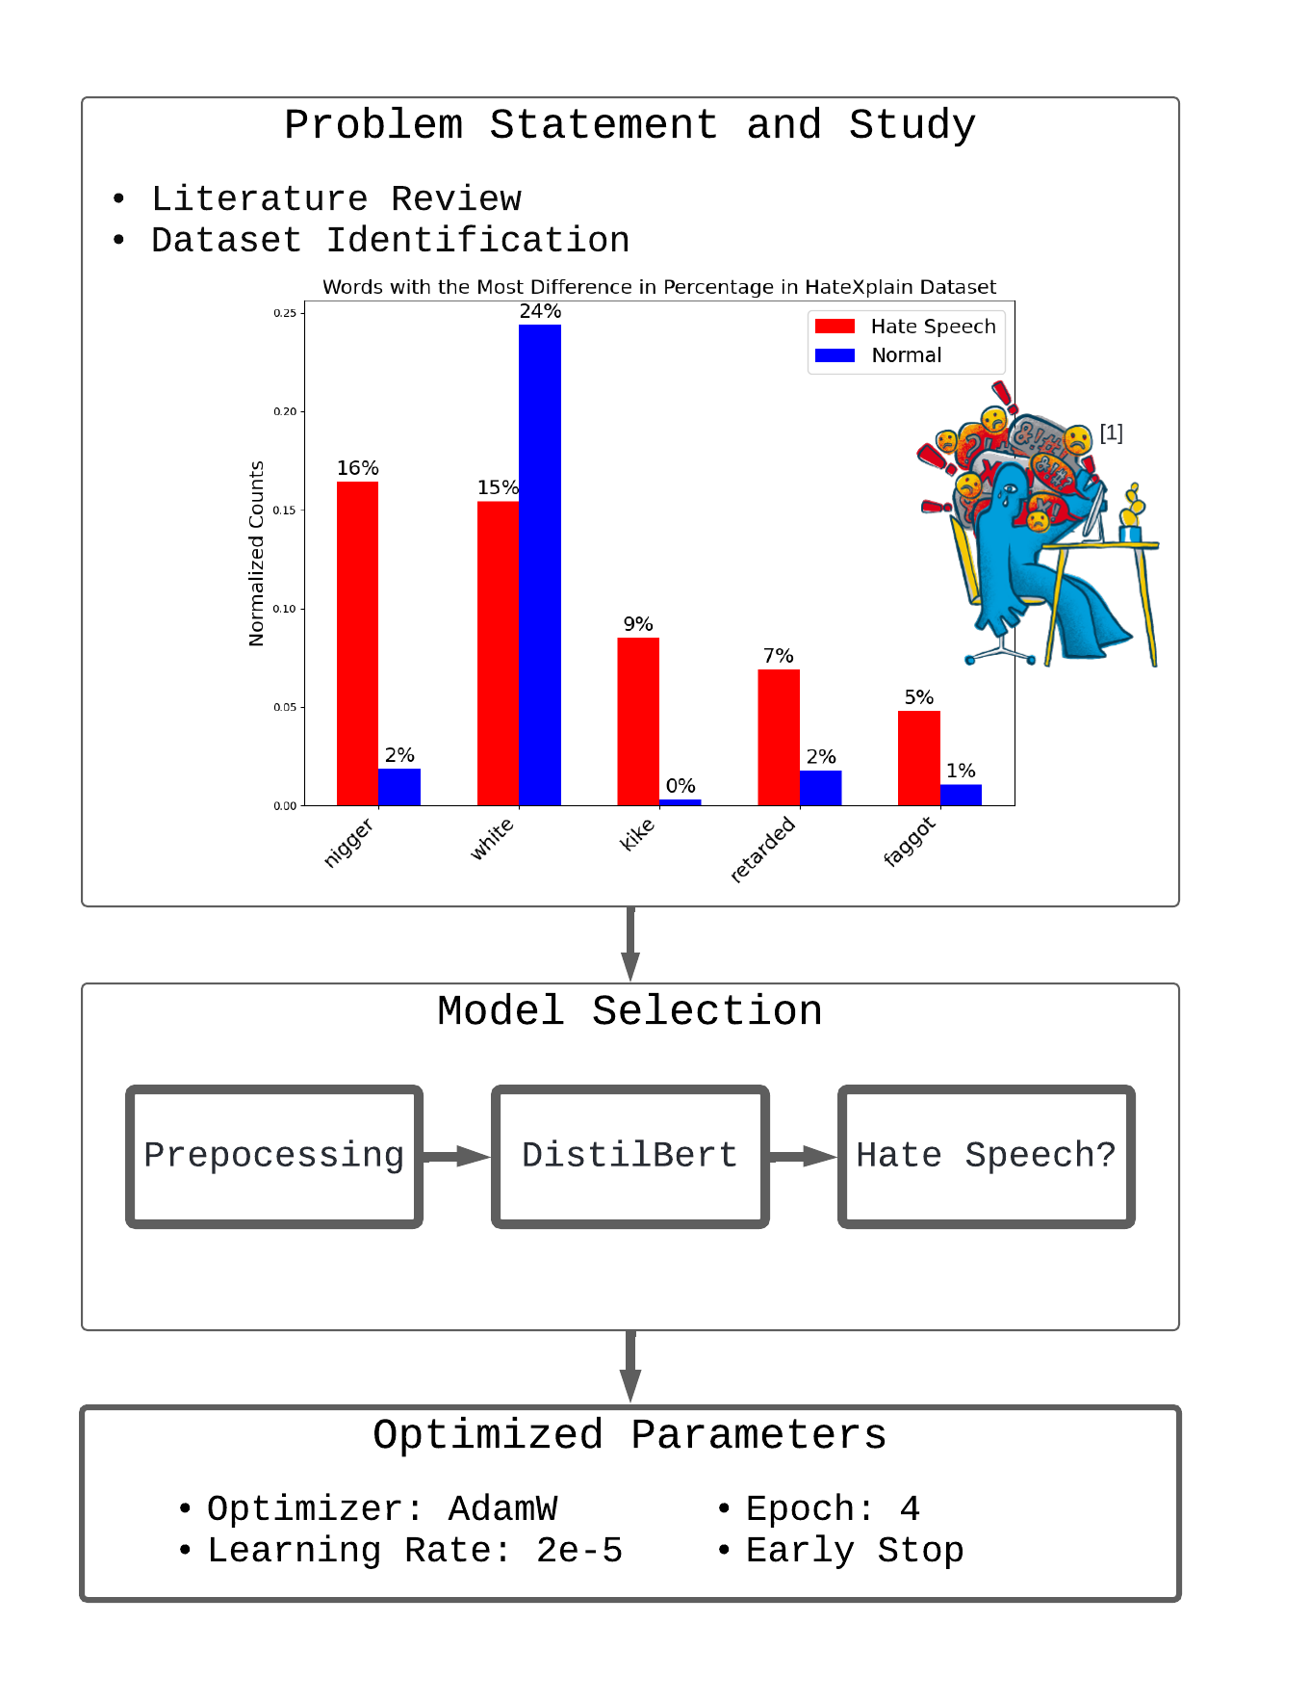
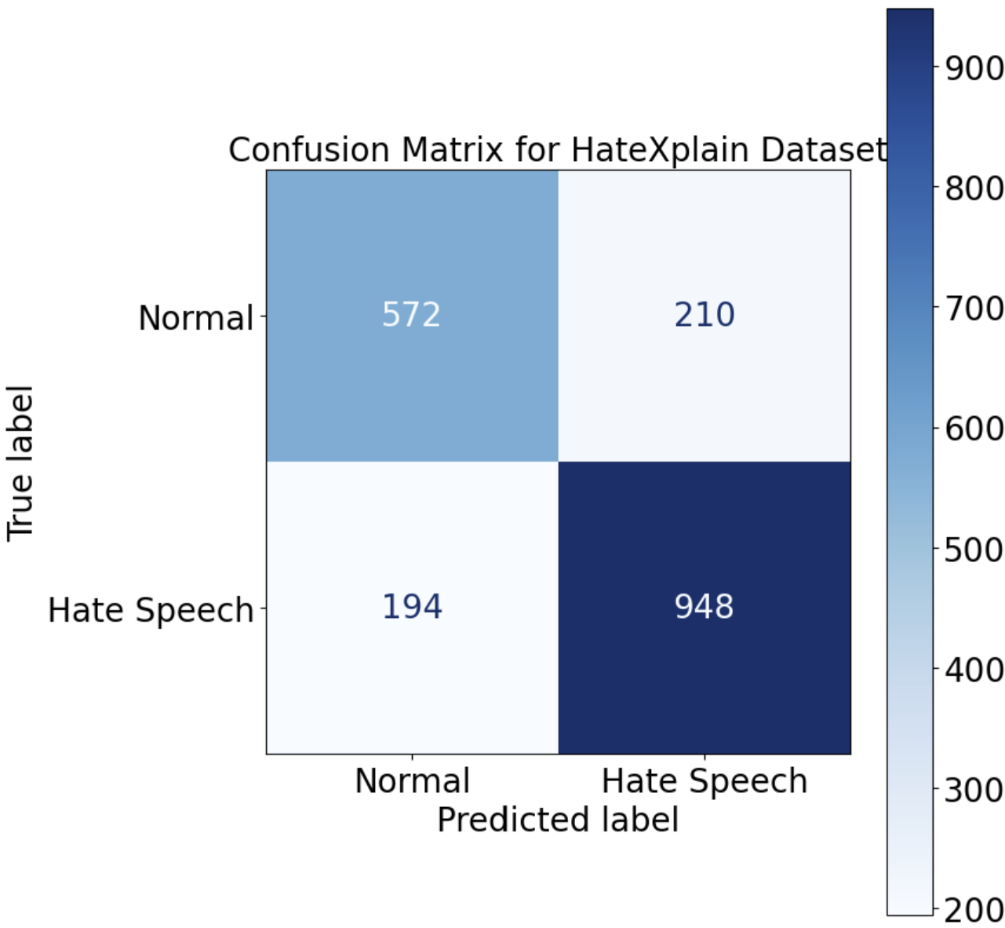
Hate Speech Detection on Social Media
Noamen Syrine, Neuenschwander Didier
Group 27
Problem definition
Validation
The pseudo-anonymity and ease of social media to post against minorities based on their inherent characteristics is detrimental to peace. This project aims to automate the detection of hate speech on social networks. This challenge requires great care to avoid violating freedom of expression[1]. To capture the complexity of the semantic nuances of human language, this project uses the pre-trained DistillBert model[2] and commonly used datasets.
We validated our BERT-based hate speech detection model on multiple datasets, demonstrating good performance.
Summary of the Curated Dataset:
Key Related Works
Hate speech detection
Transfer learning
Language modelling
DistillBert
Fine-tuning, social media
Comparison of our Approach to Other Works[3]:
Method
Confusion Matrix (Binary HateXplain):
Limitations
Binary classification: Hate speech vs. normal.
Detection is limited to the English language.
Audiovisual not covered.
Conclusion
The fine-tuned BERT-based model shows promising performance in detecting hate speech, comparable to more complex state-of-the-art methods. However, challenges remain, such as biases and omissions in the training data. To address these, we would plan to curate larger, more diverse datasets from multiple sources and annotators. Future works would focus on improving data collection and annotation to increase model robustness and fairness.
Datasets
HateXplain
Hate_speech18
Hate_speech_offensive
Hasoc
References
[1] U. Nations, ‘What is hate speech?’, United Nations. Accessed: May 26, 2024. [Online]. Available: https://www.un.org/en/hate-speech/understanding-hate-speech/what-is-hate-speech
[2] V. Sanh, L. Debut, J. Chaumond, and T. Wolf, ‘DistilBERT, a distilled version of BERT: smaller, faster, cheaper and lighter’. arXiv, Feb. 29, 2020. doi: 10.48550/arXiv.1910.01108.
[3] B. Mathew, P. Saha, S. M. Yimam, C. Biemann, P. Goyal, and A. Mukherjee, ‘HateXplain: A Benchmark Dataset for Explainable Hate Speech Detection’. arXiv, Apr. 12, 2022. doi: 10.48550/arXiv.2012.10289.
EE-559: Deep Learning, 2024

