Slide 1
Named Entity Recognition (NER)
Summer School “Computational Language Technologies for Medievalists”
Graz, 8-12 July 2024
Ismail Prada-Ziegler, Sandy Aoun, Selina Galka

Slide 2
What is a Named Entity?
Notes:
about 20min?

Slide 3
What is a Named Entity (NE)?
A Named Entity (NE) (very generally speaking) is a word or phrase that clearly identifies an individual item or concept in a text, such as names of people, organizations, locations, dates, and numerical expressions.
"Barack Obama was born in Hawaii."
"Apple Inc. announced the iPhone 13 on September 14, 2021."

Slide 4
What is a Named Entity (NE)?
A Named Entity (NE) (very generally speaking) is a word or phrase that clearly identifies an individual item or concept in a text, such as names of people, organizations, locations, dates, and numerical expressions.
"Barack Obama was born in Hawaii."
(Barack Obama - Person, Hawaii - Location)
"Apple Inc. announced the iPhone 13 on September 14, 2021."
(Apple Inc. - Organization, iPhone 13 - Miscellaneous, September 14, 2021 - Date)

Slide 5
That was the simple introduction…
Over the years, there have been several attempts to define what a NE is.
The term “named entity” first appeared at the Sixth Message Understanding Conference (MUC-6) held in November 1995
[...] the named entity task basically involves identifying the names of
all the people, organizations, and geographic locations in a text.
named entities are referring to unique identifiers of entities
Ralph Grishman and Beth M. Sundheim. 1996. Message understanding conference-6: A brief history. In Proceedings of the 16th International Conference on Computational Linguistics. 466–471.

Slide 6
Definitions of NE
following years: extension of categories/types (miscellaneous, currency, time, percentage expressions)
2002: Petasis et al.: a named entity is a proper noun, serving as a name for something or someone
2007: Nadeau & Sekine - word “named” serves as a constraint and only includes entities for which there are one or more rigid designators.
They relied on Saul Kripke's characterization of rigid designators from 1980
Petasis, G., Cucchiarelli, A., Velardi, P., Paliouras, G., Karkaletsis, V. & Spyropoulos, C. D. (2000). Automatic adaptation of Proper Noun Dictionaries through cooperation of machine learning and probabilistic methods. In Proceedings of the 23rd annual inter- national ACM SIGIR conference on Research and development in information retrieval (S. 128–135). Association for Computing Machinery. doi: 10.1145/345508.345563
Nadeau, D. & Sekine, S. (2007). A survey of named entity recognition and classification. Lingvisticae Investigationes, 30 (1), 3–26. doi: 10.1075/li.30.1.03nad
Notes:
Petasis, G., Cucchiarelli, A., Velardi, P., Paliouras, G., Karkaletsis, V. & Spyropoulos, C. D. (2000). Automatic adaptation of Proper Noun Dictionaries through cooperation of machine learning and probabilistic methods. In Proceedings of the 23rd annual international ACM SIGIR conference on Research and development in information retrieval (S. 128–135). Association for Computing Machinery. doi: 10.1145/345508.345563

Slide 7
Definitions of NE
a rigid designator refers to the same identifier in all possible worlds and contexts e.g. "Donald Trump"
non-rigid designator e.g. “the president of the USA”
Kripke, S. (1980). Naming and Necessity. Harvard University Press.

Slide 8
Definitions of NE
There is still no general and unambiguous definition of NE.
Marrero et al. (2013) presented four categories that can be used based on a survey of the definitions to determine whether something can be defined as an NE or not:
Grammatical category “proper noun”
Rigid designator
Unique identifier
Purpose and scope
Marrero, Mónica, Julián Urbano, Sonia Sánchez-Cuadrado, Jorge Morato, und Juan Miguel Gómez-Berbís. „Named Entity Recognition: Fallacies, Challenges and Opportunities“. Computer Standards & Interfaces 35, Nr. 5 (September 2013): 482–89. https://doi.org/10.1016/j.csi.2012.09.004.
Notes:
Marrero, Mónica, Julián Urbano, Sonia Sánchez-Cuadrado, Jorge Morato, und Juan Miguel Gómez-Berbís. „Named Entity Recognition: Fallacies, Challenges and Opportunities“. Computer Standards & Interfaces 35, Nr. 5 (September 2013): 482–89. https://doi.org/10.1016/j.csi.2012.09.004.

Slide 9
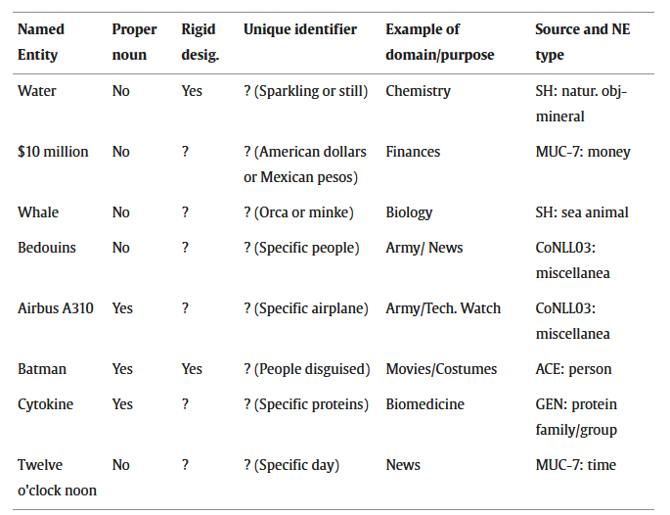

Slide 10
Types of entities
Used by most NER-Systems:
Persons, Places, Organisations (PER, LOC, ORG)
Miscellaneous (MISC)
includes everything that does not fit into the categories of personal names, places and organisations, such as events, works of art and nationalities
Sometimes dates and numbers:
Date, Time
Money, Percentage
Sometimes the categories are simply adapted to specific needs; in biomedicine, for example, cells, genes, diseases, drugs…

Slide 11
Types of entities
ENAMEX (Entity Name Expression) | Person, Place, Organisation
TIMEX (Time Expression) | Date, Time
NUMEX (Numeric Expression) | Currency, Percentage, Quantity
NER-categories after MUC-7 (Seventh Message Understanding Conference 1998)
Notes:
N. Chinchor and P. Robinson. 1998. Appendix E: MUC-7 Named Entity Task Definition (version 3.5). In Seventh Message Understanding Conference (MUC-7): Proceedings of a Conference Held in Fairfax, Virginia, April 29 - May 1, 1998.

Slide 12
Nested Entities
A nested entity is an entity that is subsumed into another entity. Many works on NER ignored Nested Entities, but especially in the case of historical texts they can play an important role.
University of Graz
Bank of China
Herzog Otten von Luneburg
Yu Wang, Hanghang Tong, Ziye Zhu, and Yun Li. 2022. Nested Named Entity Recognition: A Survey. ACM Trans. Knowl. Discov. Data 16, 6, Article 108 (December 2022), 29 pages. https://doi.org/10.1145/3522593
Notes:
More S. 68f

Slide 13
Nested Entities
A nested entity is an entity that is subsumed into another entity. Many works on NER ignored Nested Entities, but especially in the case of historical texts they can play a important role.
University of Graz
ORG with nested LOC
Bank of China
ORG with nested LOC
Herzog Otten von Luneburg
PER with nested LOC and a title (“Herzog”)
Notes:
More S. 68f

Slide 14
Types of Nested Entities
entities containing one or more shorter embedded entities
University of Graz
entities with more than one entity category
“Ford” - the automotive company created by Henry Ford in 1903
coordinated entities (more broadly known as discontinuous entities)
“the human T and B cell”
"John and Mary Smith attended the conference."
Notes:
Yu Wang, Hanghang Tong, Ziye Zhu, and Yun Li. 2022. Nested Named Entity Recognition: A Survey. ACM Trans. Knowl. Discov. Data 16, 6, Article 108 (December 2022), 29 pages. https://doi.org/10.1145/3522593

Slide 15
Boundaries of NE
Boundaries in NER refer to the determination of where an entity starts and ends in the text.
including the title/role/honorific etc. of a person?
Dr. Richard Smith
consider Nested Entities?
Herzog Otten von Luneburg
how to deal with discontinuous Entities?
“New York-based company”?
Depends on what you want, but the annotation should be consistent.

Slide 16
Subtypes of NE (Summary)
flat named entities
nested named entities
multi-category named entities
overlapping named entities
discontinuous named entities
Yu Wang, Hanghang Tong, Ziye Zhu, and Yun Li. 2022. Nested Named Entity Recognition: A Survey. ACM Trans. Knowl. Discov. Data 16, 6, Article 108 (December 2022), 29 pages. https://doi.org/10.1145/3522593, S.2.
Notes:
Yu Wang, Hanghang Tong, Ziye Zhu, and Yun Li. 2022. Nested Named Entity Recognition: A Survey. ACM Trans. Knowl. Discov. Data 16, 6, Article 108 (December 2022), 29 pages. https://doi.org/10.1145/3522593, S.2.

Slide 17
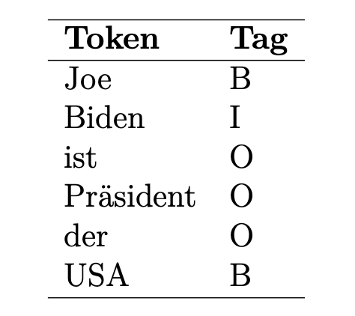
Tagging formats
There are different tagging formats for Named Entities in terms of NER.
A famous standard is the
IOB (Inside-Outside-Beginning)-Format
presented 1995 by Ramshaw and Marcus
I = Token is inside a NE
B = Token is at the beginning of a NE
O = Token is outside of a NE
More, S. 60

Slide 18
Tagging formats
Another format: BILOU
I Token is located inside an entity
O Token is located outside an entity
B Token is at the beginning (begin) of an entity
L Token is the last token of a multi-part entity
U Entity consists of only a single token (single-token unit)

Slide 19
Group Discussion
Notes:
about 30min

Slide 20
Group Discussion
Task: Have a look at different historical datasets
How is a NE defined?
What classes (types) do they use?
Are the NE nested? Where are the boundaries?
Is the goal of the NE-Annotation formulated?
Please form groups!
2 groups of 6 people
2 groups of 5 people
the groups will be reshuffled

Slide 21
Group Discussion
Historical Datasets:
French/Latin/Spanisch
https://gitlab.com/magistermilitum/ner_medieval_multilingual/
https://gitlab.com/magistermilitum/ner_medieval_multilingual/-/blob/main/datasets/french_ner_annotated_08_03_2022.json?ref_type=heads
Latin
https://github.com/Herodotos-Project/Herodotos-Project-Latin-NER-Tagger-Annotation
German
https://zenodo.org/records/11500543
Arabic
https://github.com/RamziSalah/Classical-Arabic-Named-Entity-Recognition-Corpus?tab=readme-ov-file
https://www.researchgate.net/publication/330075080_BUILDING_THE_CLASSICAL_ARABIC_NAMED_ENTITY_RECOGNITION_CORPUS_CANERCORPUS

