Slide 1
Dataset Annotation for NER
Sandy Aoun

Slide 2
Annotation Guidelines for NER

Slide 3
Annotation Guidelines for NER
Annotation Guidelines for NER:
Agreed upon instructions and criteria which specify how to label named entities
Annotation Guidelines Motivation:
Ensuring consistent and precise data annotation
Guiding annotators in dealing with ambiguous cases
Allow for:
Scalability (large team of annotators)
Reproducibility (complementing existing annotated data)

Slide 4
Drafting Annotation Criteria for NER
Provide plenty of examples to clarify the guidelines
Criteria to Establish:
What entity types will be annotated?
Clear definition of each entity type to be annotated
Clear definition of entity boundary (e.g., Dr. Richard Smith)
How to deal with nested entities?
How to handle special cases? (e.g., abbreviations)
How to handle ambiguous cases:
Agents (acting as issuer or recipient of a legal act) like monasteries, churches, chapels, etc. to be annotated as ORG

Slide 5
Annotation Toolkits for NER

Slide 6


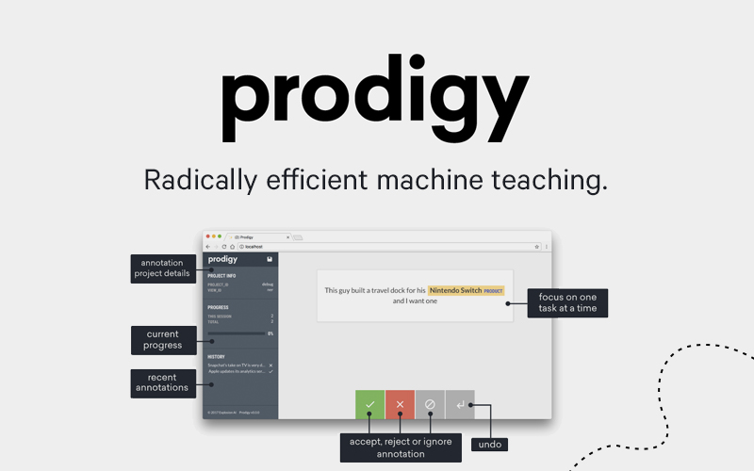


Slide 7
NER Dataset Annotation Hands-On

Slide 8
NER Annotation Hands-On
Data:
Data in Inception instance
Sample of 100 Latin charters text:
https://github.com/kreeedit/didip_ss/blob/main/D03/data/mom_latin_sample_100.tsv
Your own data
Toolkit:
Inception: https://inception-project.github.io/
Inception invitation link:
http://157.230.123.17:8080/p/summerschool/join-project/pDzNJc7l-V7qx7eP4jEk4w

Slide 9
NER Annotation Hands-On
To Do:
Discuss and agree on annotation guidelines
Explore the toolkit and try annotating

