Slide 1
Topic Modeling
Gabriel Viehhauser

Slide 2
Topic Modeling
Method to extract topics (thematic clusters?) from a large number of documents
Based on distributional semantics (John Rupert Firth: You shall know a word by the company it keeps)
An (old, but still great) example: http://signsat40.signsjournal.org/

Slide 3
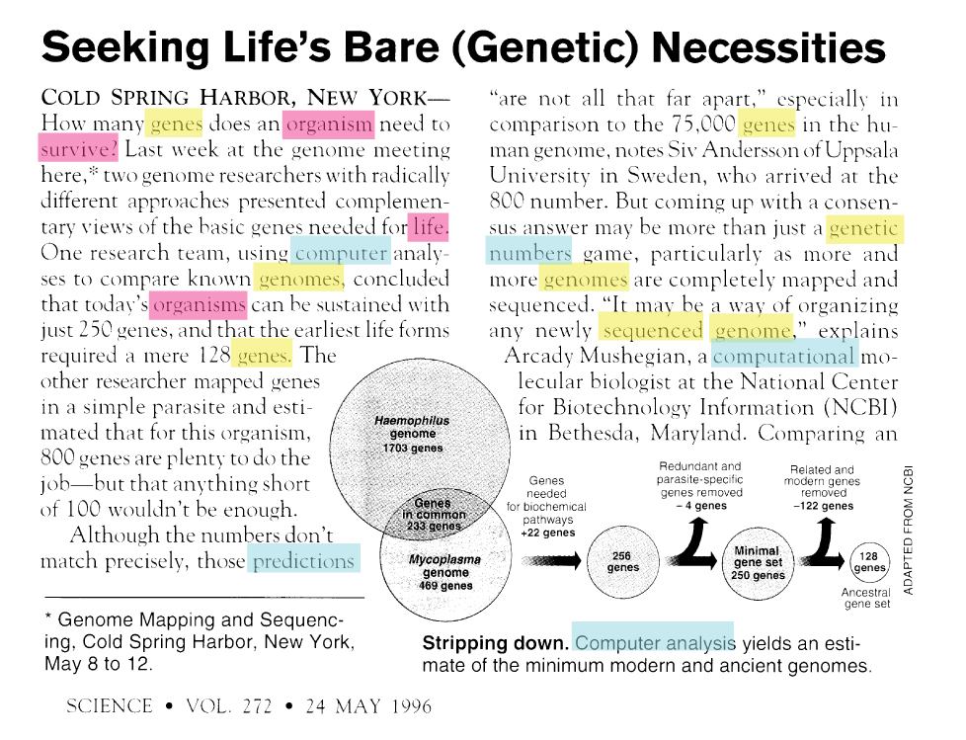
aus: David Blei: Probalistic Topic Models. August 22, 2011

Slide 4
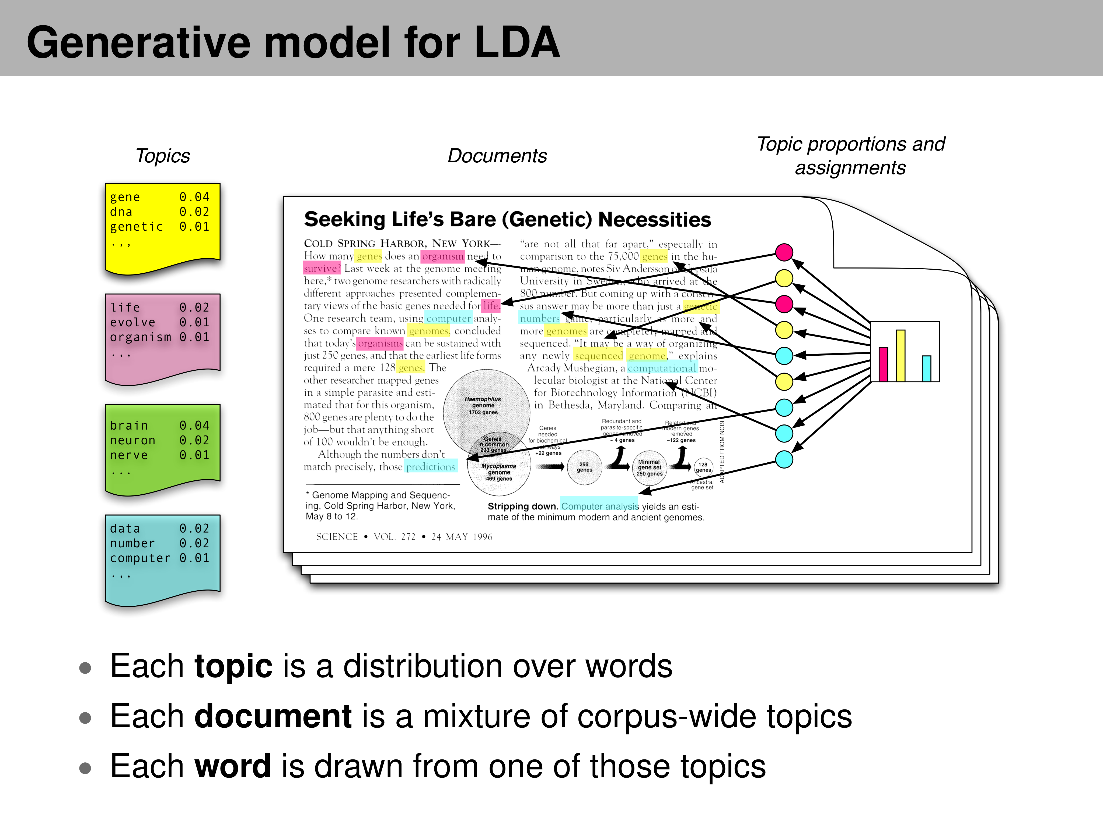
- -> Latent Dirichlet Allocation (LDA)
aus: David Blei: Probalistic Topic Models. August 22, 2011

Slide 5
LDA – Gibbs Sampling
Start with random assignment of words to topics.
For each document, go through each word w and consider:
the proportion of words in the document d that are assigned to topic t. If a lot of words from d are in t, it is more likely, that w is in t.
How often does word w appear in topic t elsewhere? If w appears in t very often, this instance of w is most likely part of t.
Update the probability
p(word w with topic t) = p(topic t | document d) * p(word w | topic t)
Example of one step: Topic 1 = nature, Topic 2 = city. We assigned „tree“ to t1, „building“ and „car“ to t2 We see a document „The tree is in front of the building and behind a car“ -> probability for „tree“ in t1 will decrease, because „tree“ normally is in t1, but in this document, there are only t2-words. On the other hand, probability for „tree“ in t2 will increase.
https://towardsdatascience.com/latent-dirichlet-allocation-lda-9d1cd064ffa2

Slide 6
Topic Modeling - Workflow
Tokenize Texts
Preprocessing: Exclude Stopwords, proper names or certain POS
Create Document-Term-Matrix
Determine number of topics
Let computer calculate the topics in several iterations
Inspect model and adapt parameters
Interpret and name topics.

Slide 7
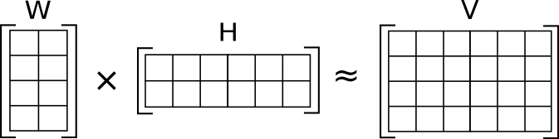
Nonnegative matrix factorization (NMF)
automatically extracts sparse and meaningful features from a set of nonnegative data vectors.
Quwertyus, https://commons.wikimedia.org/wiki/File:NMF.png

Slide 8
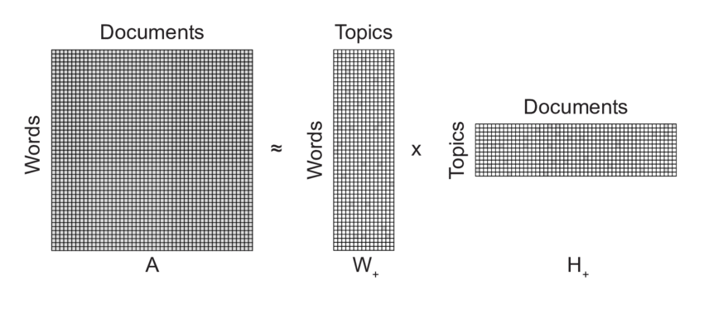
Nonnegative matrix factorization (NMF)
„NMF is designed for discovering interpretable latent components in high-dimensional unlabeled data such as the set of documents described by the counts of unique words. NMF uncovers major hidden themes by recasting the term-document matrix A into the product of two other matrices, one matrix representing the relationships between words and topics and another representing the relationship between topics and documents in the latent topic space“
Kuang, Da & Brantingham, P. & Bertozzi, Andrea. (2017). Crime Topic Modeling. Crime Science. 6. 10.1186/s40163-017-0074-0.

Slide 9
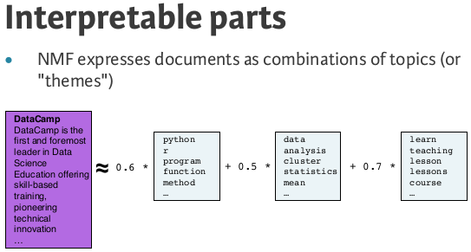
Nonnegative matrix factorization (NMF)
https://goldinlocks.github.io/Non-negative-matrix-factorization/

