Slide 1
Process Quality KPI Report
Case-study focus: specific KPI data and insights
Performance metrics case study
2026-06-29–2026-07-05 vs 2026-07-06–2026-07-12
56 Tasks completed
+27.3% WoW
68.8% SLA compliance
+18.8pp WoW
5 SLA breaches
down from 7
This deck translates the Excel KPI report into a clear case-study story: what changed, where performance improved, and what the automation made visible.
1

Slide 2
Executive performance snapshot
The recent week shows higher throughput, better SLA control, and a more mature task mix.
56 Total tasks completed
44 → 56 (+12)
68.8% SLA compliance
50.0% → 68.8%
5 SLA breaches
7 → 5 (−28.6%)
28.6% Priority share
31.8% → 28.6%
Overall KPI movement
Key insight: volume increased by 27.3% while SLA breaches fell by 28.6%, which suggests throughput improved without sacrificing service performance.
The recent week handled 16 priority escalation reviews, but only 5 missed SLA, compared with 7 misses from 14 priority reviews in the prior week.
Business value: a management-ready view of task volume, risk, and team-level performance in one workbook.
Process Quality KPI Reporting Automation · Portfolio case study
2

Slide 3
Task volume increased across every work type
The recent week grew from 44 to 56 completed tasks, with no task category declining.
Task Type
Older
Recent
Change
Quality Review
11
15
+4
Complex Case Review
10
13
+3
Process Exception Investigation
9
12
+3
Priority Escalation Review
14
16
+2
Largest absolute lift: Quality Review increased by +4 tasks. The other categories also increased, supporting a broad productivity gain rather than a single-category spike.
Priority Escalations rose only +2 while overall throughput rose +12, lowering the priority share from 31.8% to 28.6%.
Process Quality KPI Reporting Automation · Portfolio case study
3

Slide 4
SLA performance improved while priority volume rose
The process handled more priority work and reduced the number of SLA misses.
11 SLA met
+4 WoW
5 SLA breaches
−2 WoW
Interpretation: SLA compliance improved from 50.0% to 68.8%, an +18.8 percentage-point movement, even with priority escalation volume increasing from 14 to 16 tasks.
Process Quality KPI Reporting Automation · Portfolio case study
4

Slide 5
Team performance: volume gains were broad, SLA gains were uneven
Each team completed more tasks in the recent week, but SLA performance shifted differently by team.
Team
Tasks Δ
SLA Δ
Managerial focus: Team Delta improved volume but reduced SLA compliance; Team Epsilon and Gamma show the strongest SLA recovery and are candidates for process practice review.
Alpha
+5
+16.7pp
Beta
+3
+8.3pp
Gamma
+1
+33.3pp
Delta
+1
−16.7pp
Epsilon
+2
+41.7pp
Process Quality KPI Reporting Automation · Portfolio case study
5

Slide 6
Task mix: priority escalation share decreased despite higher volume
The recent week was not driven only by urgent work; the task mix remained distributed across all four work types.
Task Type
Recent Share
28.6% Priority share
down from 31.8%
Quality Review
26.8%
Complex Case Review
23.2%
Process Exception Investigation
21.4%
Priority Escalation Review
28.6%
56 Recent tasks
+12 WoW
Insight: Priority Escalation Review remained the largest single category, but its share fell by 3.2 percentage points because non-priority categories grew faster.
Process Quality KPI Reporting Automation · Portfolio case study
6

Slide 7
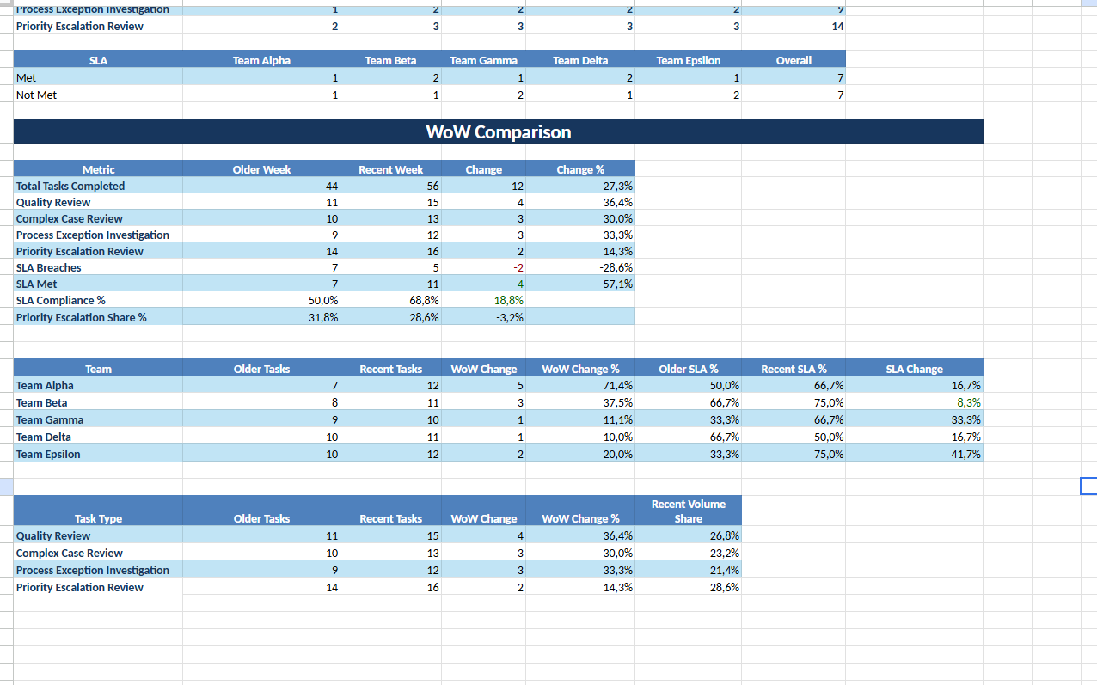
Automated report output used for management review
The final workbook consolidates task-level rows and formula-driven KPI summaries.
Inputs: SQL extracts closed tasks from the two most recent completed Monday–Sunday weeks.
Processing: Python maps task tags to task types and filters records by team tag + agent name.
Output: Excel tables calculate weekly totals, SLA results, task-type mix, and team-level movement.
Impact: leadership can compare performance without manual consolidation of multiple team tabs.
Process Quality KPI Reporting Automation · Portfolio case study
7

Slide 8
Case-study conclusion: what the KPI report proves
The project demonstrates both technical automation and operational performance analysis.
100 rows Automation scope
two-week sample dataset
+27.3% Efficiency signal
task throughput growth
+18.8pp Control signal
SLA compliance improvement
−28.6% Risk signal
SLA breach reduction
Skills demonstrated
SQL extraction • Python/Pandas preparation • tag-based task classification • team mapping • Excel KPI modelling • stakeholder-ready reporting
Portfolio narrative
This is a production-inspired reporting workflow: raw operational task data is transformed into a structured performance pack that highlights workload, SLA risk, and team-level trends.
Core message: the report does not just show counts — it identifies where operational performance improved and where management attention is still needed.
Process Quality KPI Reporting Automation · Portfolio case study
8

