Slide 1
ECG recorder
Do I have cardiac arrhythmia?

Slide 2
Take a look at the friend next to you
About 50% of you guys have cardiac arrhythmias
That means that either you or your friend has arrhythmias at least occasionally
Usually this is not a problem but…

Slide 3
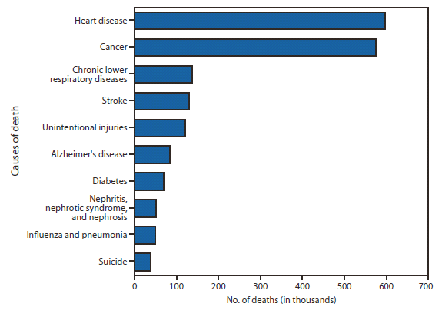
Facts
Heart attacks are the number 1 cause of death in the world
Many heart attacks are caused by cardiac arrhythmia

Slide 4
Do I have cardiac arrhythmia?
In case of cardiac arrhythmia, the following symptoms might occur:

Slide 5
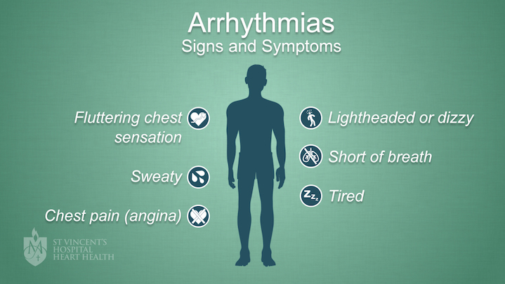

Slide 6
But I don’t have these symptoms so I’m OK, right?
In many cases the symptoms of cardiac arrhythmia are unnoticeable

Slide 7
The problem to be solved
While measuring ECG at doctor, nothing might show up

Slide 8
The solution
Record your ECG anywhere or anytime you want
Save your ECGs to your own personal account
Present your ECGs to your doctor

Slide 9
The team to solve this problem
Veli-Pekka Porrassalmi, Hardware engineer
Steven Dijcks, Software engineer
Chingiz Mizambekov, Software engineer

Slide 10
Our plan
Wearable and easy to use device that records your ECG
Website to present your ECGs
User profiles for personal info
Possibility to handle your data

Slide 11
Why a web application?
Responsive: adaptive to all screen sizes
Cross platform
Easy to use on any device
No need to install any software
Easy to deploy and to introduce updates

Slide 12
Competition with existing applications
Reliable and portable device
Relatively inexpensive costs
User friendly UI

Slide 13
Target Market
Everyone who has heart complaints should definitely use it
Everyone who is concerned about their health might be interested to use it

Slide 14
Progress so far
Measurement circuit
Amplifier
Filters
Actual ECG data

Slide 15
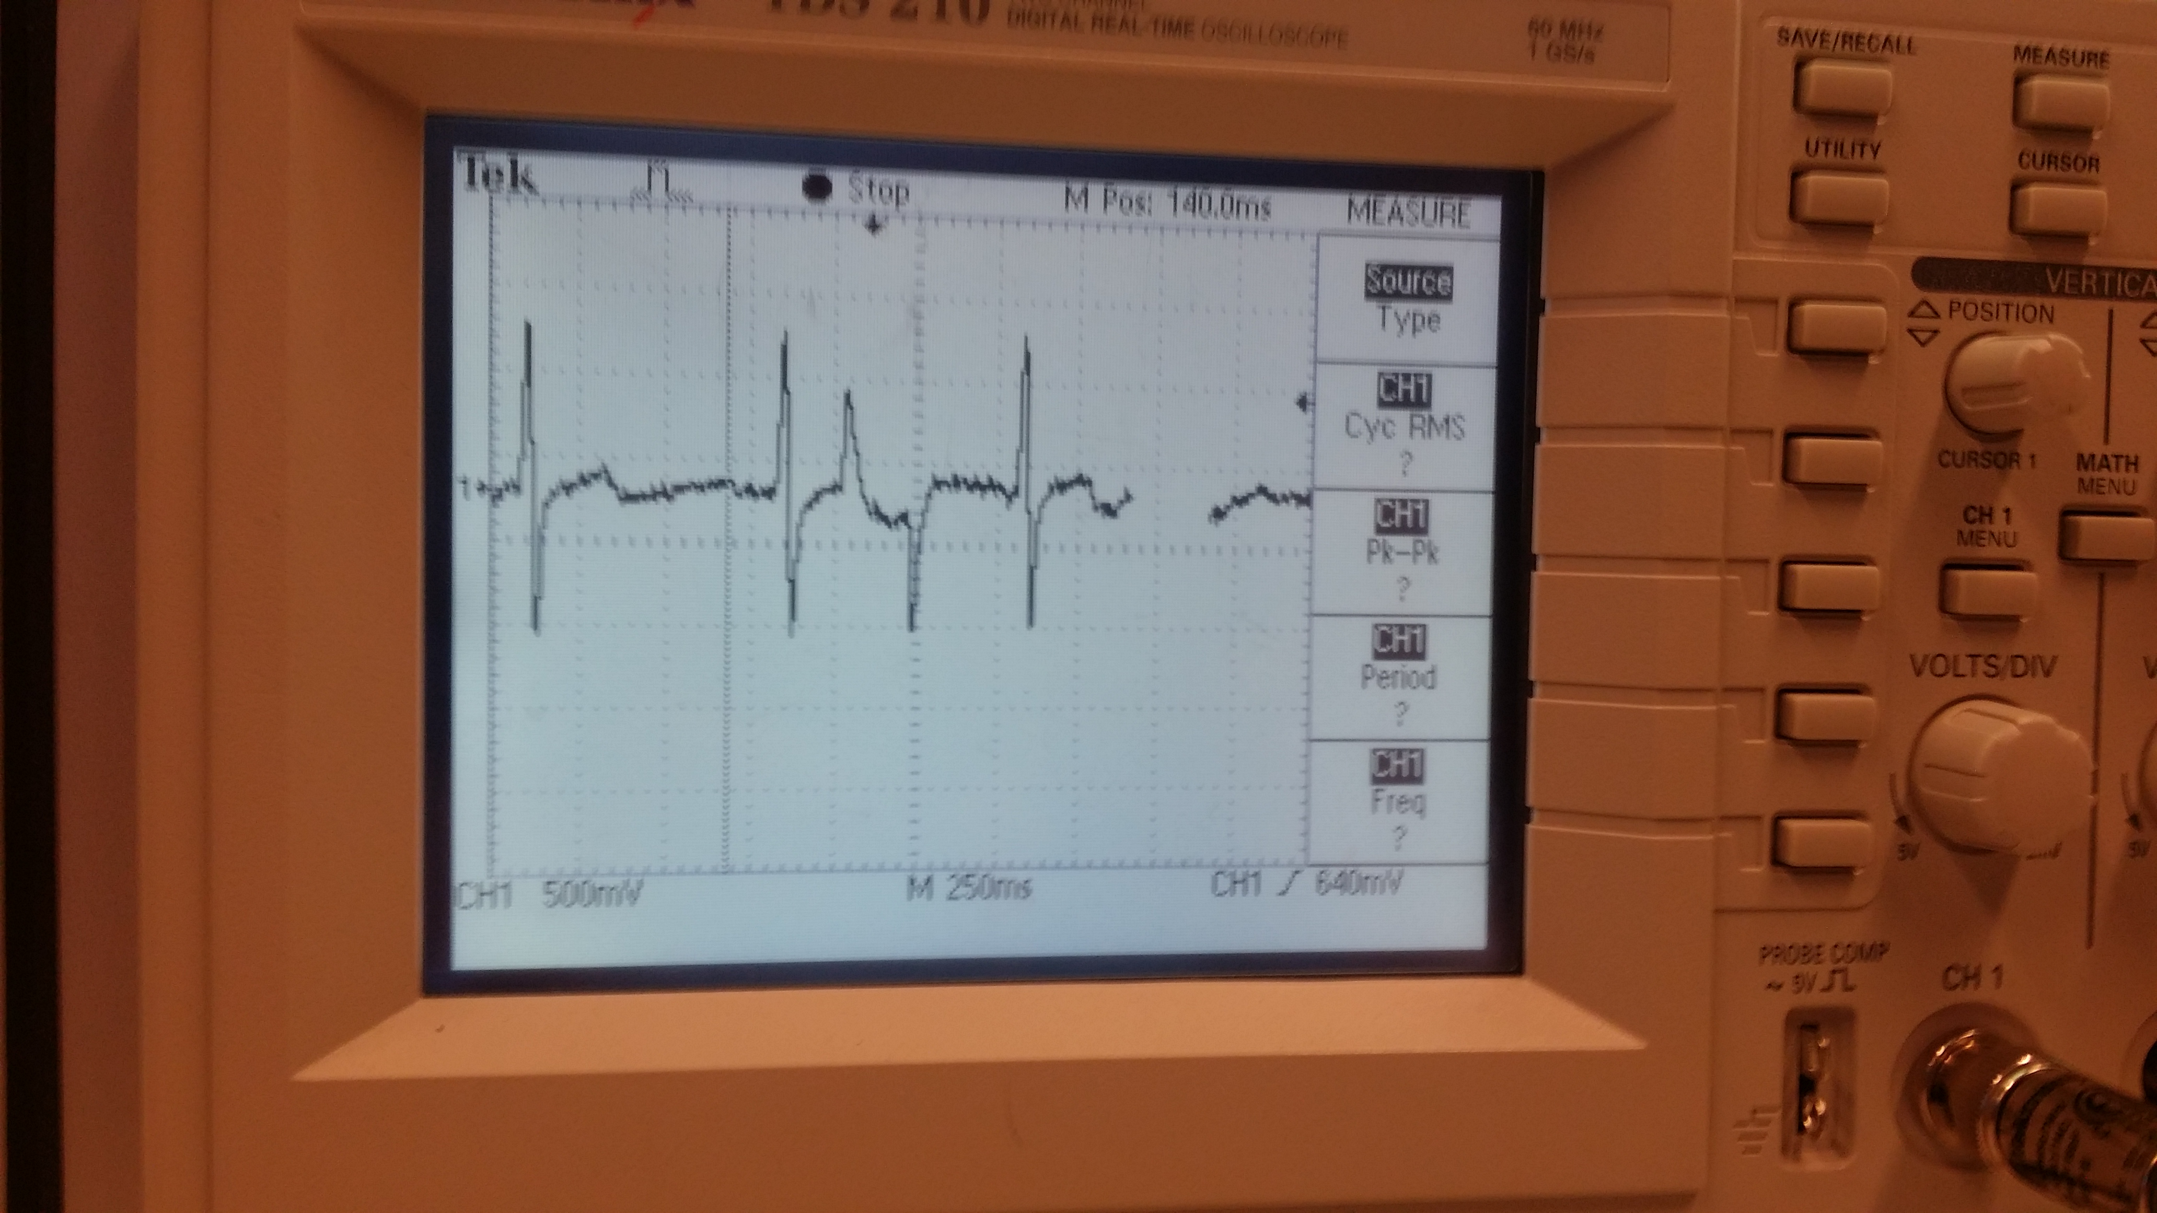

Slide 16
Thank you for your attention

