Slide 1
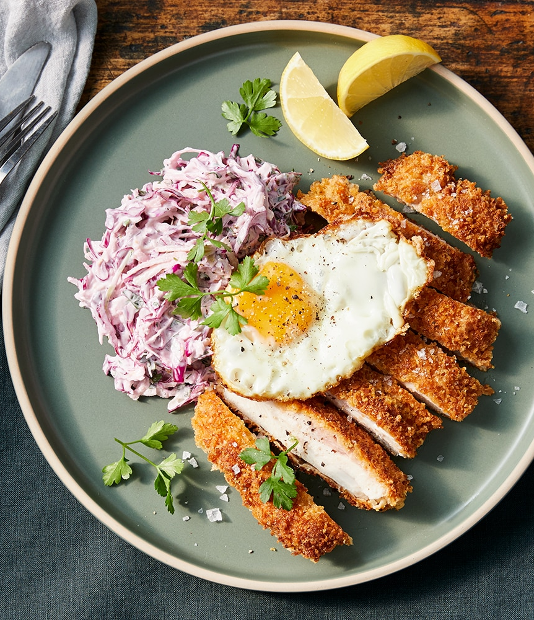
Meal Calorie Estimator
FABRIKAM RESIDENCES

Slide 2

Project Overview
Objective
Estimate meal calories from images automatically
Enable easy and automated dietary tracking
Main Components
Object Detection (YOLOv8)
Image Classification (ResNet18)
Segmentation (Segment Anything Model - SAM)
Calorie estimation via food type + portion size

Slide 3

Two-model solution
Portion Estimation:
Uses depth + segmentation to estimate grams
Food Classification:
Identifies food type → links to calories per gram

Slide 4

Model Methodology
Object Detection: YOLOv8 for plate & reference detection
Image Scaling: Real-world scaling via plate size & depth estimation
Segmentation: SAM for food region
Portion Calculation: Area × height × density

Slide 5

Experimenting with different datasets and models

Slide 6
Training ResNet18 model on NutritionVerse-Real datset

Slide 7
Segment Anything + Yolo approach on Food-101 dataset.

Slide 8
Training YOLO on Food Recognition 2022 dataset

Slide 9
Calorie estimation steps
Object Detection: Plate + reference items (forks, etc.)
Scaling: Convert pixels → cm using plate size
Food Portion Detection: SAM + thresholding + contours
Portion Size Calculation: grams=Area (cm2)×5cm×0.85g/cm3\text{grams} = \text{Area (cm}^2) \times 5 \text{cm} \times 0.85 \text{g/cm}^3grams=Area (cm2)×5cm×0.85g/cm3

Slide 10

Future improvements
Depth Mapping: Use MiDaS for real height
Ingredient Detection: Fine-grained YOLO training
Variable Densities: Per-food-type densities for better gram → calorie conversion

Slide 11

Key Challenges
Rotated Objects: Solved via Oriented Bounding Boxes (OBBs)
Portion Segmentation: Lighting & visual variety make detection hard
Density Variance: Current system uses fixed density

Slide 12
Thank you
FABRIKAM RESIDENCES
Kaloyan Petkov
Milen Valev
Petar Kirilov
Asen Krasimirov

