Slide 1




How We Move, What We Reach
AAG Annual Meeting 2026
Capabilities, Constraints, and Daily Activity Space in California
Presenter: Die Hu
Advisor: Konstadinos G. Goulias
Geography Department
Notes:
Hi Everyone. My name is Die Hu from UC Santa Barbara. It’s a great honor to be here to present our tentative research work.
Today I'll talk about how daily travel patterns shape the spatial extent of people's activity spaces in California — and
why accessibility's role is more nuanced than we might expect.

Slide 2
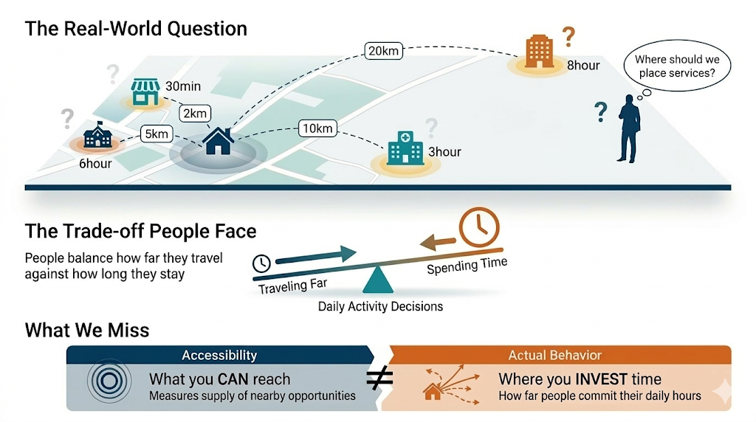
Traveling Far vs. Spending Time
Service Provision & Destination Choice Where should we place services relative to residents?
How far do people actually invest their daily time to participate in activities?
The Daily Trade-off People balance traveling far against spending time at places.
A 1-hour errand far away ≠ an 8-hour workday far away.
The Measurement Gap How far you actually commit your time (behavior).
→ Whether infrastructure is serving people where they actually live their lives.
Die Hu | UC Santa Barbara | AAG 2026
Notes:
Let me start with a simple observation. Two people can travel the same distance, but if one rushes through a quick errand while the other spends eight hours at a workplace far from home, their effective spatial footprint is very different.
From a planning perspective, this matters: where should we place services if we want to serve people where they actually live their daily lives?
Existing measures — trip counts, distances — miss this trade-off between traveling far and spending time. We need a measure that captures how far people actually commit their time across space.

Slide 3
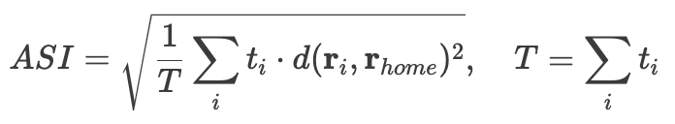
Key Concept: Activity Space Indicator (ASI)
Formula
Key Properties
Standard Distance
(Xu et al., 2015; Pappalardo et al., 2015)
✓ Home-centered
Distance from home anchor
✓ Dwell-time weighted
ASI: Realized spatial reach (home-centered).
r_{i}: Geographic coordinates of activity location i.
r_{home}: Geographic coordinates of the home anchor.
t_{i}: Dwell time (weight) spent at location i.
T: Total dwell time across all locations.
d(rᵢ, rₕ) = distance to home (km).
Captures HOW FAR activities spread in geographic space: Spatial Extent
Die Hu | UC Santa Barbara | AAG 2026
Notes:
So we adopt the Activity Space Indicator, or ASI. It is a home-centered, dwell-time-weighted standard distance — essentially a standard distance anchored at home.
The formula is shown here: for each activity location, we take the distance to home, square it, weight by dwell time at that location, sum across all locations, divide by total time, and take the square root.
The key property: a workplace where you spend eight hours dominates a ten-minute coffee stop.
It captures how far your daily activities spread from home, weighted by how much time you actually invest at each place.

Slide 4
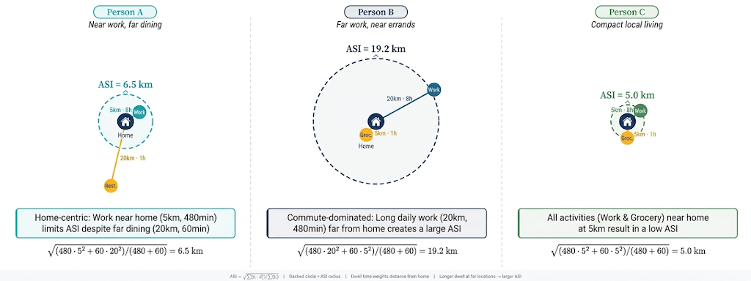
Demo: Activity Space Indicator (ASI)
Notes:
Here are three people with similar trip chains but very different ASI.
Person A works 5 kilometers from home but dines 20 kilometers away — ASI is only 6.5 kilometers because the 8-hour workday close to home dominates the brief restaurant visit.
Person B flips this — works 20 kilometers out, shops nearby — ASI jumps to 19.2 because the long dwell at a distant workplace pulls everything outward.
Person C keeps everything within 5 kilometers — ASI is just 5.
Same number of stops, but duration weighting completely changes the picture.
This is what ASI captures that trip counts cannot.
But ASI alone tells us how far — it does not tell us how people organize their trips across the day. That is where motif comes in.

Slide 5
Key Concept: Motif
STRUCTURE
DEMO
Trip Chain Motif
H→O→H Two stops
(Schneider et al., 2013; Su et al., 2020)
Daily trips abstracted as a directed graph
Nodes = {Home, Work, Other}
Edges = trips between locations
Graph isomorphism
H→W→O→H Commute + errand
H→W→O→W→H Multi-stop commute
Captures HOW people organize travel, not WHERE they go: Topological Structure.
Notes:
We classify daily trip chains using Schneider and colleagues' motif framework.
Each person's travel day is abstracted as a directed graph: nodes are home, work, or other locations; edges are trips between them.
Graph isomorphism groups structurally identical chains together regardless of specific destinations.
For example, a simple home-work-home commute is one motif; home-work-other-home is another. This captures how people organize travel — the topological structure — not where they go.

Slide 6
Research Questions
RQ1
Spatial Patterns
What are the spatial patterns of daily activity space among California residents?
RQ2
Determinants
Controlling for trip chain structure, what individual, household, and built-environment factors shape activity space extent?
RQ3
Spatial Heterogeneity
How does the effect of home-based accessibility on activity space vary across California?
Pattern → Mechanism → Spatial Variation
3
Notes:
Three research questions.
First, what are the spatial patterns of ASI across California?
Second, controlling for trip chain structure, what individual, household, and built-environment factors shape ASI?
Third, does accessibility's effect on ASI vary across space?
The logic: pattern, then mechanism, then spatial variation.

Slide 7
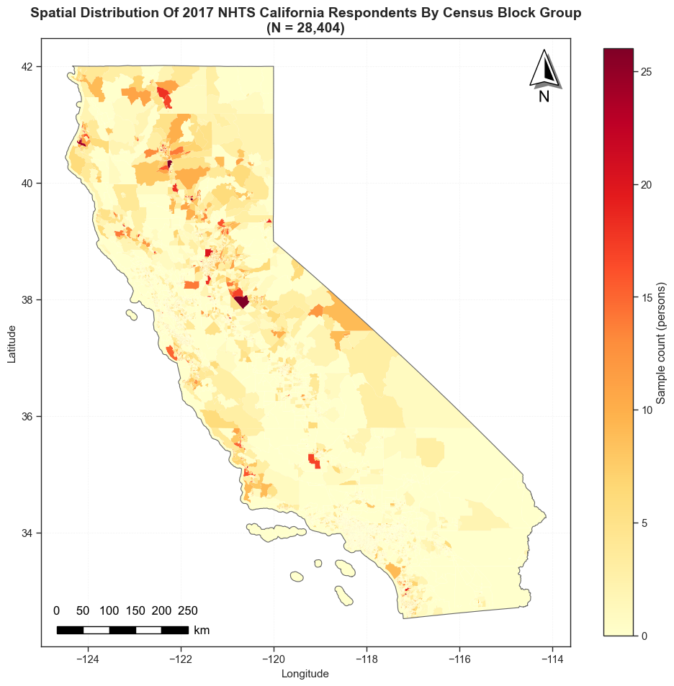

Data & Preprocessing
The California component of the National Household Travel Survey (NHTS) in 2017
A single day travel diary
Personal/household characteristics
Location (Lat/Lon)
Sample Processing Pipeline
N = 55,819 NHTS CA Add-On (total persons)
▼
Non-holiday weekdays.
Leave home at least once on the reported day.
With neighbors within a four-kilometer driving distance (Open Street Map data): Spatial Weights.
Non-missing ASI & ASI < 100 km (outliers removed).
▼
N = 28,404
Work-trip days
N = 10,495 (≥1 work trip)
Non-work-trip days
N = 17,909 (0 work trips)
Die Hu | UC Santa Barbara | AAG 2026
Notes:
We use the 2017 NHTS California add-on — a single-day travel diary with person and household characteristics plus geographic coordinates.
Starting from about 56,000 persons, we filter to 28,404 person-days: non-holiday weekdays, people who left home at least once, with valid spatial weights and ASI under 100 kilometers.
An important split: about 10,500 made at least one work trip that day, while 17,900 did not.
This is a daily behavior distinction — whether you commuted that day — not employment status.

Slide 8
Analytical Framework
WHO
WHERE
HOW
Individual
Attributes
Built
Environment
Trip Chain
Topology (Motif)
Age, income, race,
worker status, vehicles
Density, land use mix,
transit, accessibility
Types of daily trip organization
▼
Activity Space Index (ASI)
OLS
Ordinary Least Squares
→
Spatial Error Model (SEM)
→
GWR
Baseline:
N = 28,404
Motif explanatory power
Spatial Error Model:
λ absorbs autocorrelation
Local regression: Spatial heterogeneity
Adaptive bisquare kernel
Bandwidth: 708 NN
→
→
Spatial Diagnostics
Moran's I = 0.203***
Autocorrelation eliminated
Moran‘s I: −0.001 (n.s.)
Notes:
Progressive deepening: OLS baseline, then Spatial Error Model (SEM) to account for spatial autocorrelation in residuals. When SEM reveals accessibility is globally insignificant, we turn to GWR to test whether this null masks spatial heterogeneity. [
Here is our modeling pipeline. Three groups of info: individual attribute; built environment; and trip chain topology as motif dummies.
We start with OLS as a baseline. Spatial Error Model. When SEM shows accessibility is marginally non-significant, we turn to GWR to test whether this masks local heterogeneity
Moran's I on OLS residuals is 0.203, highly significant — clear spatial autocorrelation.
Following Anselin's LM diagnostic decision rule, robust LM-Error is significant while robust LM-Lag is not, pointing to the Spatial Error Model.
SEM with lambda of 0.204 eliminates the autocorrelation — residual Moran's I drops to negative 0.001, non-significant.

Slide 9
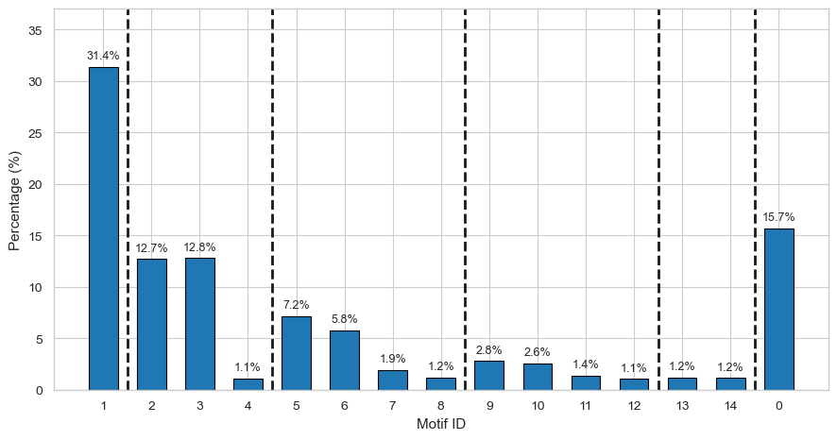
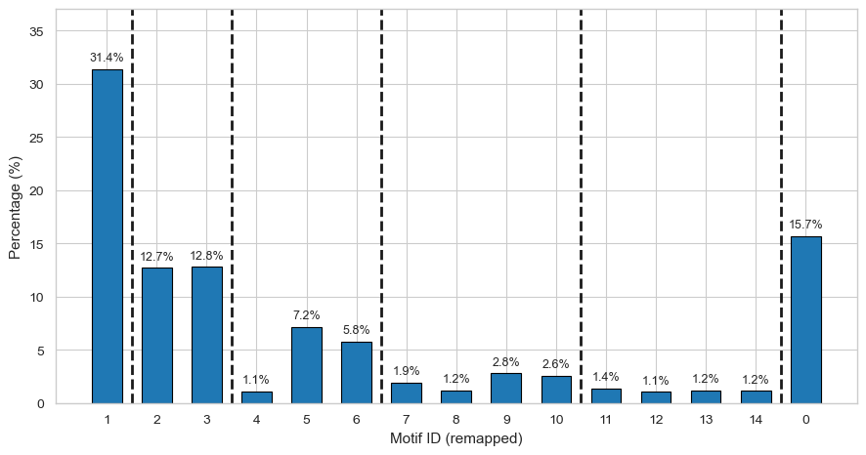
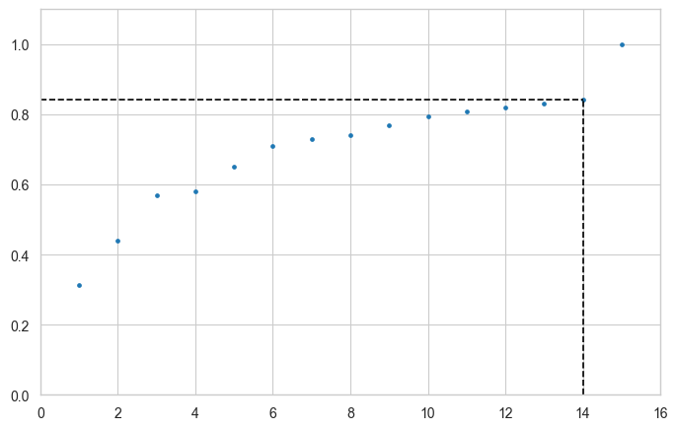





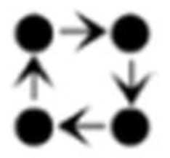






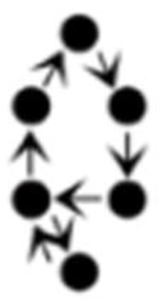

Results: Motif Construction
14 canonical types account for ~84% of of all person-days.
Fig. 2. Cumulative distribution function for count of mobility motif types. (Top 14 + other 28 types)
The merged rare category (28 types) is a low-representativeness group rather than a core mobility pattern.
Fig.1. Percentage of human mobility motif patterns. (Top 14 + merged rare category)
Notes:
We identified over 40 unique motif topologies in California, but the top 14 canonical types account for about 84 percent of all person-days.
The CDF on the right confirms that a small number of canonical types capture the vast majority of travel behavior.
The remaining types are rare and merged into a residual category.
The bar chart shows the distribution — the simplest home-work-home motif dominates, but substantial shares have more complex multi-stop chains.

Slide 10
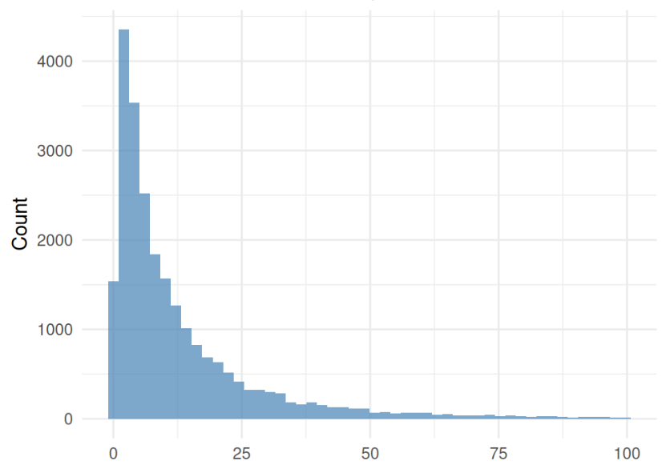
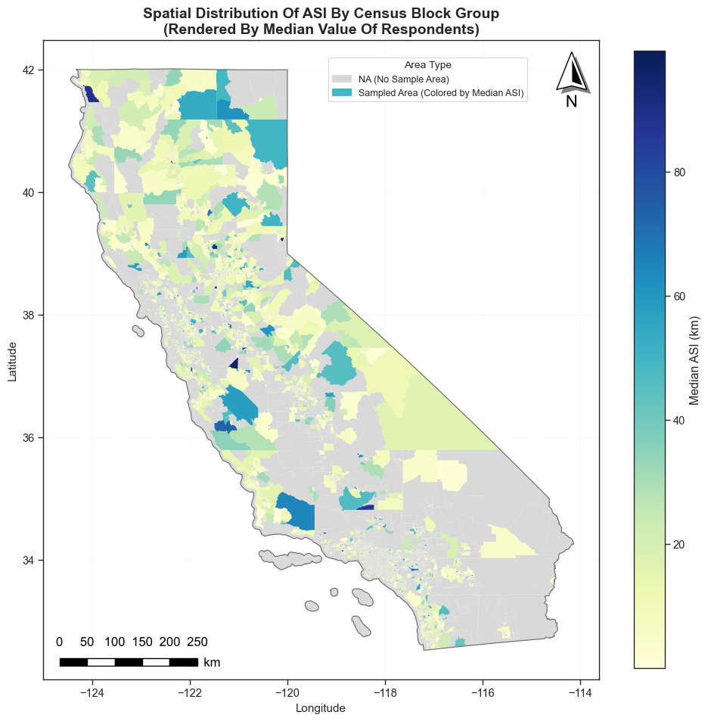
R1: Spatial Distribution of Activity Space Indicator (ASI)
Statewide: Median ASI = 6.38 km, with strong right skew (mean = 12.03 km) — most residents' daily activities concentrate within ~6 km of home, but a subset travels extensively.
ASI (km)
Higher ASI (inland/suburban): San Bernardino (8.25 km), San Mateo (9.44 km), and Sierra foothill counties — lower density and job-housing separation push daily activity farther from home.
Lower ASI (dense urban cores): San Francisco (3.91 km), Santa Barbara (4.72 km) — compact land use and nearby services keep daily activities close to home.
6
Notes:
Mapping ASI at the block-group level reveals clear spatial patterns.
Statewide median is 6.38 kilometers, but with strong right skew — the mean is 12 kilometers, meaning a subset of residents travels extensively.
The geographic pattern: inland and suburban counties show higher ASI — San Bernardino at 8.25 kilometers, San Mateo at 9.44 — where lower density and job-housing separation push daily activity farther from home.
Dense urban cores show lower ASI.
This immediately raises the question: is this just about accessibility? Or are individual and structural factors at play?

Slide 11
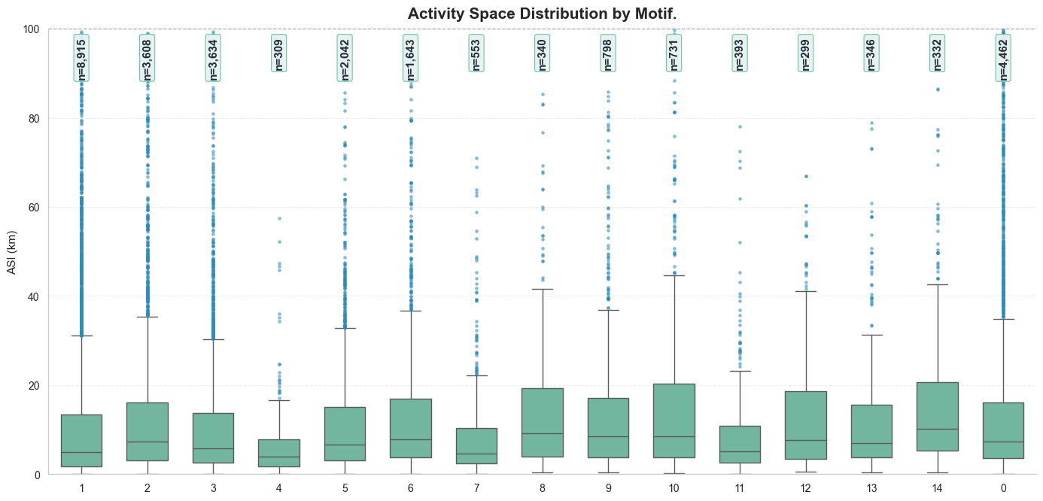
Results: ASI Distribution by Motif
Overall pattern: Medians range from 3.89 km (Motif 4) to 10.29 km (Motif 14), but IQRs heavily overlap across all motifs (IQR = 6–16 km) — motif type alone does not sharply separate ASI distributions.
No monotonic increase with complexity: Motif 4 (median 3.89 km) and Motif 7 (median 4.61 km) have lower ASI than the simpler Motif 1 (median 4.96 km). More complex chains do not automatically produce larger activity spaces.
Substantial within-motif variance: Every motif shows wide dispersion (e.g., Motif 10: median 8.46 km but IQR = 3.83–20.31 km), indicating that individual and spatial factors drive most of the ASI variation beyond trip chain structure.
Notes:
Now, ASI by motif type.
Here is the key finding that motivates our modeling approach.
First, medians range from 3.9 to 10.3 kilometers across motifs, but the IQRs overlap heavily — motif alone does not sharply separate ASI.
Second, and critically, there is no monotonic increase with complexity: Motif 4 with three locations has lower median ASI than the simpler Motif 1. More stops do not automatically mean larger activity space — topology matters, not just destination count.
Third, within every single motif, the variance is enormous. Someone with a simple home-work-home chain can have ASI of 2 kilometers or 30 kilometers. This tells us individual and spatial factors drive most of the variation beyond trip chain structure — which is exactly what we explore with Spatial error model.

Slide 12
RQ 2: SEM Results - What Shapes Activity Space?
log(ASI) | N = 28,404 | λ = 0.204*** | Only significant coefficients shown
Worker (vs non-worker)
0
-0.337***
+0.445***
Works from Home
-0.265***
Homemaker
Key Findings
Has Driver License
+0.233***
Non-Urban (vs Suburban)
+0.168***
Worker status
+0.445 ***
-0.172***
Student
Workers travel farther
-0.165***
Retired
Male
+0.112***
Mobility resources
Near Rail Station
+0.108***
Built environment
Black NH (vs White)
+0.108**
Vehicles per Driver
+0.101***
Race and ethnicity
Hispanic (vs White)
+0.097***
Black (NH)
-0.070***
+0.108 **
# Children
-0.045***
Log(Pop Density)
~11% larger ASI
HH Income
+0.030***
Accessibility
−0.011 (p=.067)
-0.011n.s.
Log(Accessibility)
Marginal →GWR
Notes:
The strongest predictor: having made a work trip that day, at plus 0.45 — that is a 45 percent increase in ASI. The commute anchor pulls the entire activity space outward.
On the flip side, working from home compresses ASI by 29 percent, and being a homemaker by 23 percent.
Mobility resources matter: having a driver's license increases, more vehicles per driver adds more ASI.
Built environment. The near rail station is positive. Rail does not reduce spatial extent; it enables longer-distance travel along corridors. This is consistent with the TOD literature
Race and ethnicity: Black residents show 11 percent larger ASI, Hispanic 10 percent, after controlling for income and car access.
This is consistent with spatial mismatch — longer commutes forced by residential segregation.
And at the very bottom: accessibility. Better home-location accessibility does not significantly shrink activity space globally. But is this the whole story? That is where GWR comes in.

Slide 13
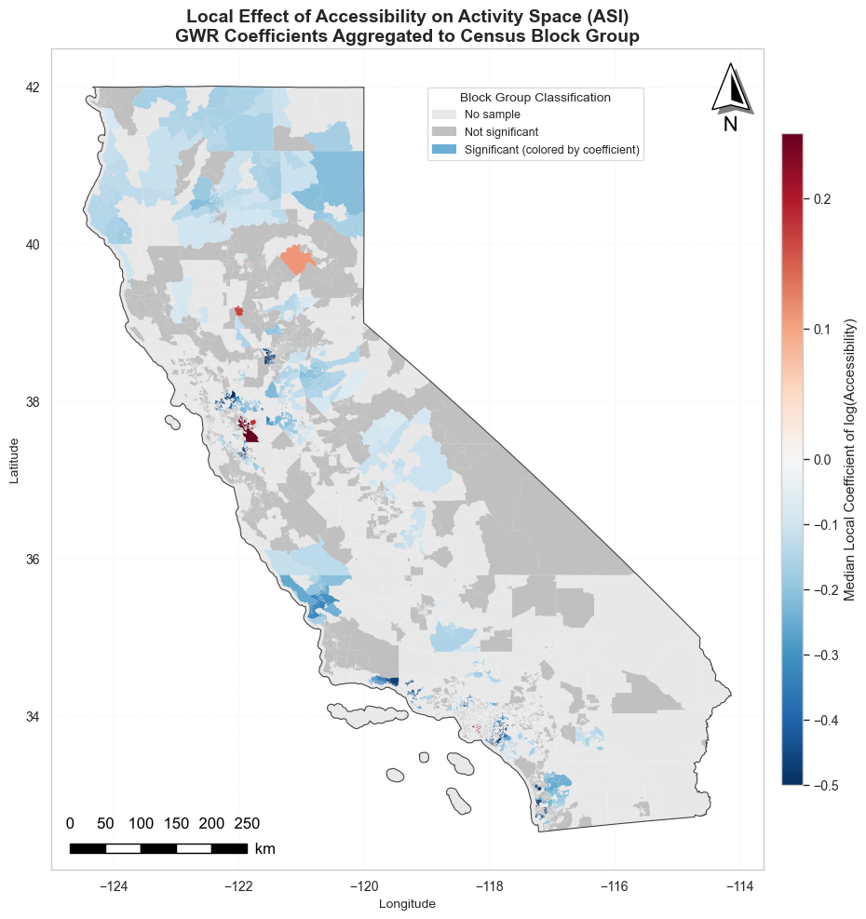
RQ 3: GWR - The Accessibility Paradox Resolved
GWR reveals what SEM hides: the effect is real but spatially varying
83% of locations: negative effect (more access = smaller ASI); 17% of locations: positive or null effect
Strong negative effect (blue): LA Basin, Inland Empire, Central Valley — higher accessibility is associated with smaller ASI, suggesting compact urban form constrains travel
Weak/positive effect (red): Rural Northern CA, Sierra Nevada foothills — accessibility has little constraining power where land use is sparse and destinations are distant
Bay Area pattern: Negative in urban core (SF, Oakland) but weaker in suburban East Bay and South Bay — accessibility compresses ASI only where dense, mixed-use environments exist
Policy implication: Accessibility improvements reduce travel burden most in dense urban areas; rural areas need complementary strategies beyond proximity-based accessibility
Notes:
GWR reveals what SEM hides. This map shows local accessibility coefficients at the block-group level. The global SEM said non-significant — but look at the spatial pattern.
83 percent of local coefficients are negative — accessibility does reduce ASI in most places. But 17 percent are positive or null. The effect is real but spatially varying.
Where is the effect strongest? The dark blue clusters: LA Basin, the Inland Empire, and the Central Valley. These are sprawling, car-dependent areas where better accessibility
— more jobs reachable within a short drive — genuinely compresses daily spatial extent.
Where is it weak or reversed? Rural Northern California, the Sierra foothills — areas where land use is so sparse that accessibility has little constraining power. People travel far regardless.
The Bay Area shows an interesting gradient.
Accessibility compresses ASI only where dense, mixed-use environments provide viable nearby alternatives.
The policy takeaway: one-size-fits-all accessibility interventions will not work. Improvements reduce travel burden most in dense urban areas; rural communities need complementary strategies beyond proximity-based accessibility alone.

Slide 14
Conclusions & Looking Forward
1
2
3
ASI Varies Spatially
Capability Dominates
Spatial Heterogeneity
ASI varies substantially across California — inland and suburban residents travel twice as far as urban core residents
Commuting, driver license, and vehicle access are the strongest predictors -- individual capability matters more than built environment
Accessibility effect is spatially variable (83% neg / 17% pos), masked by global averaging in the SEM
Limitations
Future Directions
Single-day travel diary -- day-to-day variability not captured
Some motif types have small sample sizes
GPS trajectory data for longitudinal validation
Split-sample analysis: workers vs non-workers
Refined motif classification (purpose-aware)
Multi-scale accessibility measures
Notes:
Three takeaways.
First, ASI varies substantially across California — inland and suburban residents travel twice as far as urban core residents. this is shaped by individual capability, not trip complexity alone
Second, individual capability dominates. Commuting, having a driver's license, and vehicle access are the strongest predictors — more than built environment. And trip chain topology, while significant as a structural control, does not determine spatial extent: same motif, very differenASI.
Third, accessibility appears globally non-significant, but GWR shows the effect is real but spatially variable. This means uniform
accessibility policy won't work everywhere.
Limitations: single-day diary means day-to-day variability is not captured, and motif and ASI are derived from the same trip record, so motif is a structural control, not a causal mechanism。
Future work: multi-day GPS data for longitudinal validation, purpose-aware motif classification

Slide 15
Thank You
Questions & Discussion
Die Hu
diehu@ucsb.edu
Advisor: Konstadinos G. Goulias
Department of Geography, UC Santa Barbara
｜ AAG Annual Meeting 2026
Notes:
Thank you. I'm happy to take questions.

Slide 16
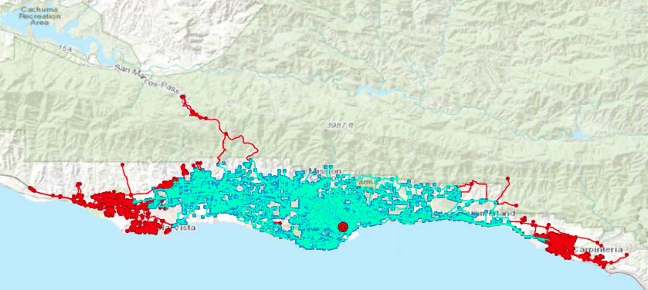
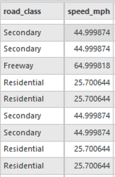

A1: Accessibility Measure Construction
Network Data
Cumulative Opportunity Measure
OpenStreetMap California road network
1.16M nodes, 2.89M edges
Edge weights = travel time (minutes)
Pandana library for network analysis
Contraction hierarchies for speed
Home location based
Count of jobs reachable within threshold
Drive-time based (not Euclidean)
Person 1: Downtown Santa Barbar
Notes:
This appendix details our accessibility measure. We use the California OSM road network — 1.16 million nodes, 2.89 million edges — with travel-time weights. Accessibility is a
cumulative opportunity measure: the count of jobs reachable within a 15-minute drive from each person's home location, computed using the Pandana library with contraction
hierarchies for speed.

Slide 17
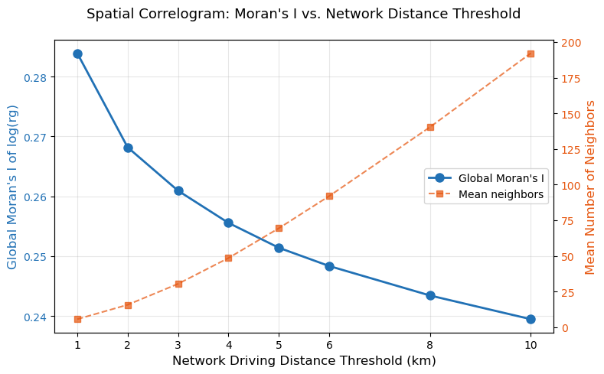
A2: Spatial Diagnostics & Model Selection
Lagrange Multiplier Tests (Anselin Decision Rule)
Test | Statistic | p-value | Sig.
LM-Error | 1,033.2 | < 2.2e-16 | ***
Robust LM-Error | 144.3 | < 2.2e-16 | ***
LM-Lag | 889.7 | < 2.2e-16 | ***
Robust LM-Lag | 0.82 | 0.365 | n.s.
Robust LM-Error significant + Robust LM-Lag not → Select SEM
Fig.1. Spatial Autocorrelation for OLS Resedual
A3
Notes:
This shows the Lagrange Multiplier specification tests following Anselin's decision rule. Both standard LM tests are significant, but the robust tests diverge: robust LM-Error
remains highly significant while robust LM-Lag becomes non-significant at p equals 0.365. This clearly points to the Spatial Error Model. The scatter plot shows OLS residual
spatial autocorrelation that SEM eliminates.

Slide 18
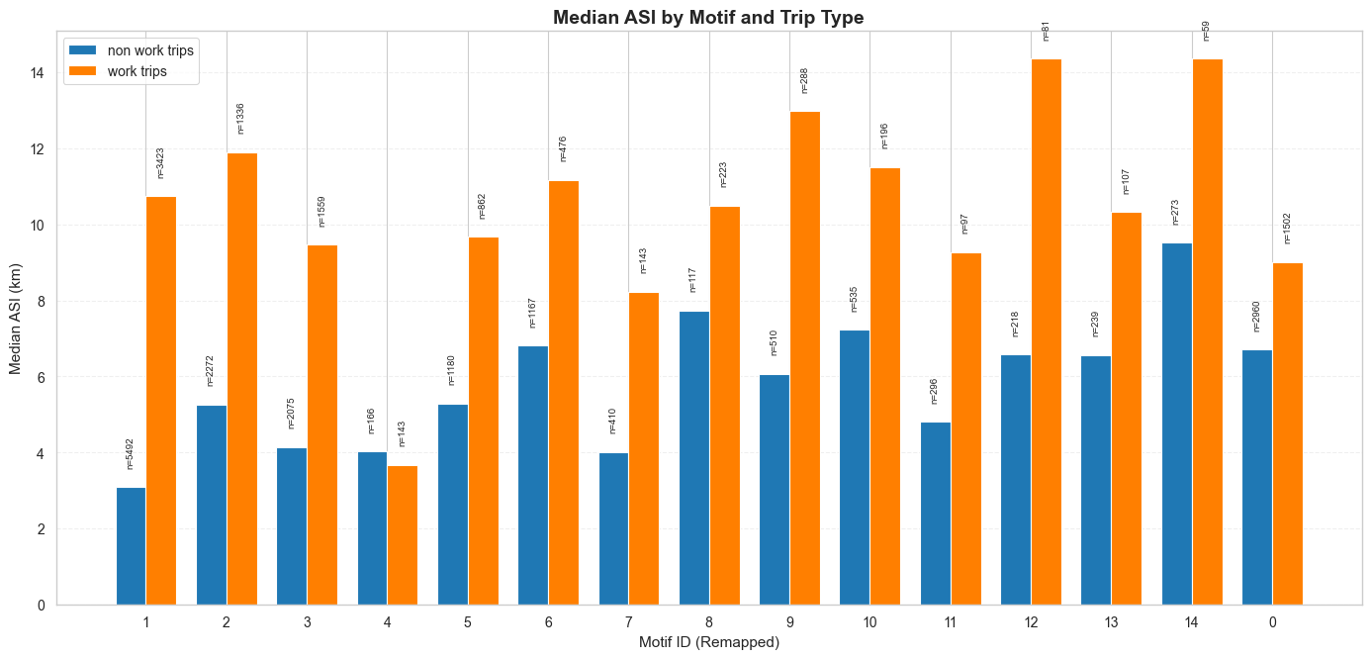
A3: Commute Anchoring Effect
Commute expands activity space consistently: median gap = 4.39 km, range 2.31–7.77 km. The commute anchor point pulls daily activity space outward.
Gap varies by motif structure: The largest work/non-work gaps appear in Motif 1 (7.65 km, simple round-trip) and Motif 12 (7.77 km), where commuting roughly doubles or triples ASI.
Motif 4 is the exception: The only motif where work-trip ASI (3.68 km) is lower than non-work ASI (4.02 km) — likely reflecting short-distance commuters whose work location is closer to home than their non-work destinations.
Motif 1
Motif 12
Motif 4
Notes:
Work-trip days show substantially higher ASI across nearly all motifs. Median gap 4.39 km.
The commute acts as a spatial anchor. Exception: Motif 4 where gap disappears. Daily work-trip behavior matters more than employment status.

