Slide 1
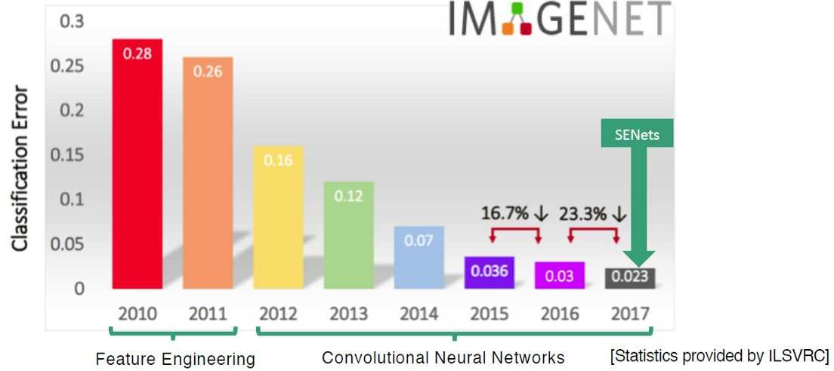
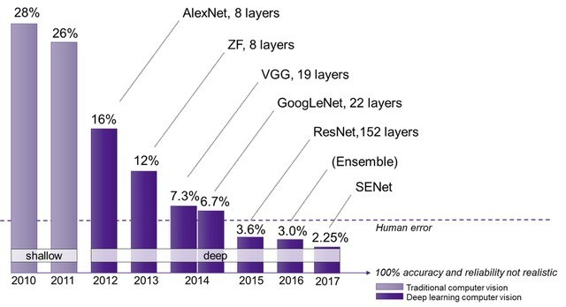
Convolutional neural networks
These dense neural networks are not what made the huge strides in deep learning over the last few years.
■

Slide 2
Convolutional neural networks
These dense neural networks are not what made the huge strides in deep learning over the last few years.
Instead, those are deep convolutional neural networks
■
■

Slide 3
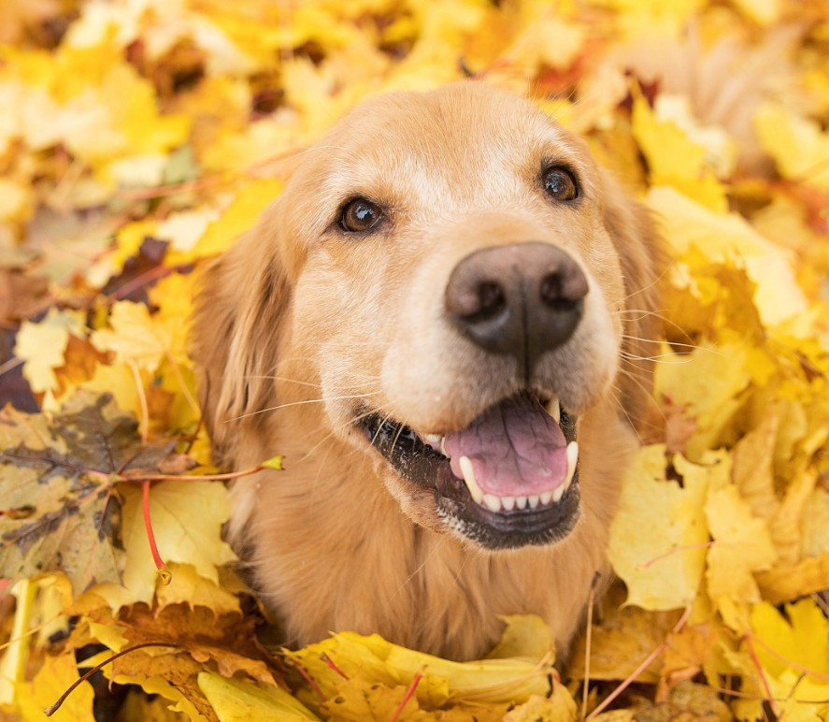
Convo-what now?
Let’s look at an image
■

Slide 4
Convo-what now?
Let’s look at an image
In a dense architecture, every pixel value is connected to
every neuron.
■
■

Slide 5
Convo-what now?
Let’s look at an image
In a dense architecture, every pixel value is connected to
every neuron.
■
■
Etc.

Slide 6
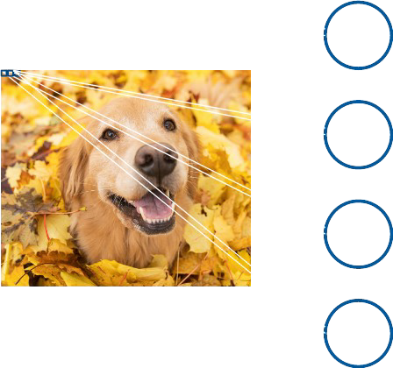
Convo-what now?
Let’s look at an image
In a dense architecture, every pixel value is connected to every
neuron.
This gives problems:
■
■
■
–
You get an insane amount of parameters to optimise. 250*250 pixels * 20 HL 1 neurons = 1,250,020 weights and biases. You can forget about any sort of findable or achievable (global) optimum.
There is no locality: if you want your network to know whether or not there is a dog in an image, all these parameters must be
optimised so that you can recognise the dog anywhere.
–

Slide 7
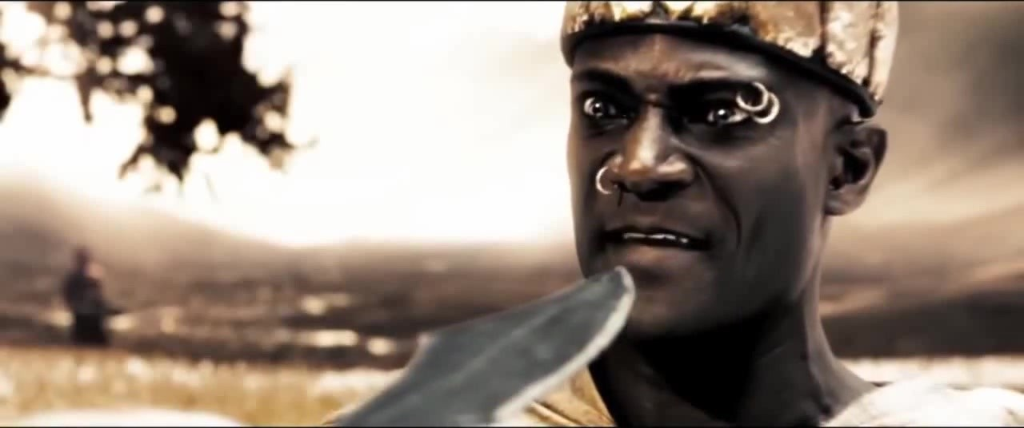
Convo-what now?
This is madness!

Slide 8

Convo-what now?
The answer: convolution. Let’s look at a 1D example!
■
When is the heart beating?
■
These slides were gladly stolen borrowed (with permission) from Marc Pages Gallego

Slide 9
Convo-what now?
The answer: convolution. Let’s look at a 1D example!
■
When is the heart beating?
■

Slide 10
Convo-what now?
The answer: convolution. Let’s look at a 1D example!
■
signal= x=[ 0 0 0 1 −1 0.5 0 0 0 0 0 ]
label= y=[ 0 0 0 1 1 1 0 0 0 0 0 ]

Slide 11

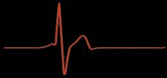
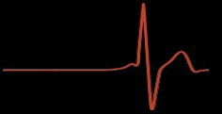
Convo-what now?
Signal can be at different positions in the sequence:
■

Slide 12
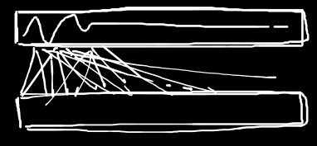
Convo-what now?
Signal can be at different positions in the sequence:
■
Dense network needs to optimise such that different weights somehow cause the network to output 1 for different positions of the signal:
■
label= y=[ 1
1
1
0
0
0
0
0
0
0
0 ]

Slide 13
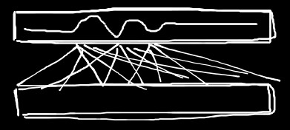
Convo-what now?
Signal can be at different positions in the sequence:
■
Dense network needs to optimise such that different weights somehow cause the network to output 1 for different positions of the signal:
■
label= y=[ 1
1
1
0
0
0
0
0
0
0
0 ]

Slide 14
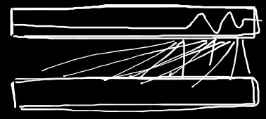
Convo-what now?
Signal can be at different positions in the sequence:
■
Dense network needs to optimise such that different weights somehow cause the network to output 1 for different positions of the signal:
■
label= y=[ 0
0
0
0
0
0
0
0
1
1
1]

Slide 15
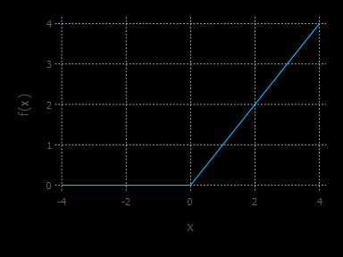
Convo-what now?
Convolution:
■
Input
0 | 0 | 0 | 1 | -1 | 0.5 | 0 | 0 | 0 | 0
Kernel
2
Kernel output
0
ReLu output
0 | 0 | 0 | 1 | -1 | 0.5 | 0 | 0 | 0 | 0

Slide 16
Convo-what now?
Convolution:
■
Input
0 | 0 | 0 | 1 | -1 | 0.5 | 0 | 0 | 0 | 0
*
2
Convolve (move) the kernel over the sequence
Kernel
Kernel output
0
ReLu output
0

Slide 17
Convo-what now?
Convolution:
■
Input
0 | 0 | 0 | 1 | -1 | 0.5 | 0 | 0 | 0 | 0
*
Kernel
2
Kernel output
0 | 0
ReLu output
0 | 0

Slide 18
Convo-what now?
Convolution:
■
Input
0 | 0 | 0 | 1 | -1 | 0.5 | 0 | 0 | 0 | 0
*
Kernel
2
Kernel output
0 | 0 | 0
ReLu output
0 | 0 | 0

Slide 19
Convo-what now?
Convolution:
■
Input
0 | 0 | 0 | 1 | -1 | 0.5 | 0 | 0 | 0 | 0
*
Kernel
2
Kernel output
0 | 0 | 0 | 2
ReLu output
0 | 0 | 0 | 1

Slide 20
Convo-what now?
Convolution:
■
Input
0 | 0 | 0 | 1 | -1 | 0.5 | 0 | 0 | 0 | 0
*
Kernel
2
Kernel output
0 | 0 | 0 | 2 | -2 | 1 | 0 | 0 | 0 | 0
ReLu output
0 | 0 | 0 | 2 | 0 | 1 | 0 | 0 | 0 | 0

Slide 21
Convo-what now?
Convolution:
■
Input
0 | 0 | 0 | 1 | -1 | 0.5 | 0 | 0 | 0 | 0
*
Kernel
2
Kernel output
0 | 0 | 0 | 2 | -2 | 1 | 0 | 0 | 0 | 0
ReLu output
0 | 0 | 0 | 2 | 0 | 1 | 0 | 0 | 0 | 0
This is a kernel that detects positive numbers

Slide 22
Convo-what now?
Convolution:
■
Input
0 | 0 | 0 | 1 | -1 | 0.5 | 0 | 0 | 0 | 0
*
Kernel
2
Just like a neuron has weights, this kernel has a trainable weight (2)
Kernel output
0 | 0 | 0 | 2 | -2 | 1 | 0 | 0 | 0 | 0
ReLu output
0 | 0 | 0 | 2 | 0 | 1 | 0 | 0 | 0 | 0
This is a kernel that detects positive numbers

Slide 23
Convo-what now?
Convolution:
■
Input
* * *
0 | 0 | 0 | 1 | -1 | 0.5 | 0 | 0 | 0 | 0
Kernel
0 2 1
A kernel can have a size >1
+
Kernel output
- 0
-
ReLu output
- | 0 |  |  |  |  |  |  |  | -

Slide 24
Convo-what now?
Convolution:
■
Input
0 | 0 | 0 | 1 | -1 | 0.5 | 0 | 0 | 0 | 0
* * *
Kernel
0 | 2 | 1
+
Kernel output
- | 0 | 1 |  |  |  |  |  |  | -
ReLu output
- | 0 | 1 |  |  |  |  |  |  | -

Slide 25
Convo-what now?
Convolution:
■
Input
0 | 0 | 0 | 1 | -1 | 0.5 | 0 | 0 | 0 | 0
* * *
Kernel
0 2 1
+
Kernel output
- | 0 | 1 | 1 |  |  |  |  |  | -
ReLu output
- | 0 | 1 | 1 |  |  |  |  |  | -

Slide 26
Convo-what now?
Convolution:
■
Input
0 | 0 | 0 | 1 | -1 | 0.5 | 0 | 0 | 0 | 0
* * *
Kernel
0 2 1
+
Kernel output
- | 0 | 1 | 1 | -1.5 |  |  |  |  | -
ReLu output
- | 0 | 1 | 1 |  |  |  |  |  | -

Slide 27
Convo-what now?
Convolution:
■
Input
0 | 0 | 0 | 1 | -1 | 0.5 | 0 | 0 | 0 | 0
*
* *
Kernel
0 2 1
+
Note shrinkage due
Kernel output
- | 0 | 1 | 1 | -1.5 | 1 | 0 | 0 | 0 | -
to edge effects
ReLu output
- | 0 | 1 | 1 | 0 | 1 | 0 | 0 | 0 | -

Slide 28
Convo-what now?
Convolution:
■
Input
0
0 | 0 | 0 | 1 | -1 | 0.5 | 0 | 0 | 0 | 0
0
* * *
Kernel
0 2 1
+
Could fix by
padding the input
Kernel output
0 | 0 | 1 | 1 | -1.5 | 1 | 0 | 0 | 0 | 0
ReLu output
0 | 0 | 1 | 1 | 0 | 1 | 0 | 0 | 0 | 0

Slide 29
Convo-what now?
Convolution:
■
Input
0 | 0 | 0 | 1 | -1 | 0.5 | 0 | 0 | 0 | 0
* * *
Or could compress output size further by changing stride (step size). Stride = 3 now.
Kernel
0 2 1
+
Kernel output
- 0
-
ReLu output
- | 0 |  |  |  |  |  |  |  | -

Slide 30
Convo-what now?
Convolution:
■
Input
0 | 0 | 0 | 1 | -1 | 0.5 | 0 | 0 | 0 | 0
* * *
Kernel
0 2 1
+
Kernel output
- | 0 | - | - | -1.5 |  |  |  |  | -
ReLu output
- | 0 | - | - | 0 |  |  |  |  | -

Slide 31

Convo-what now?
Convolution:
■
Size = 3
Stride = 3
Input
0 | 0 | 0 | 1 | -1 | 0.5 | 0 | 0 | 0 | 0
*
* *
Kernel
0 2 1
+
Kernel output
- | 0 | - | - | -1.5 | - | - | 0 | - | -
ReLu output
- | 0 | - | - | 0 | - | - | 0 | - | -

Slide 32

Convo-what now?
Convolution:
■
Size = 3
Stride = 3
Input
0 | 0 | 0 | 1 | -1 | 0.5 | 0 | 0 | 0 | 0
Kernel
Kernel output
0 | 2 | 1
0 | -1.5 | 0
ReLu output
0 | 0 | 0
This example is not useful because I randomly picked some weights for the kernel. But normally you can train these weights by backpropagation such that the network works well!
32

Slide 33
Convo-what now?
Convolution:
■
Size = 3
Stride = 1
Input
0 | 0 | 0 | 1 | -1 | 0.5 | 0 | 0 | 0 | 0
*
* *
Kernel
0 2 1
+
Note shrinkage due
Kernel output
- | 0 | 1 | 1 | - 1.5 | 1 | 0 | 0 | 0 | -
to edge effects
ReLu output
- | 0 | 1 | 1 | 0 | 1 | 0 | 0 | 0 | -

Slide 34
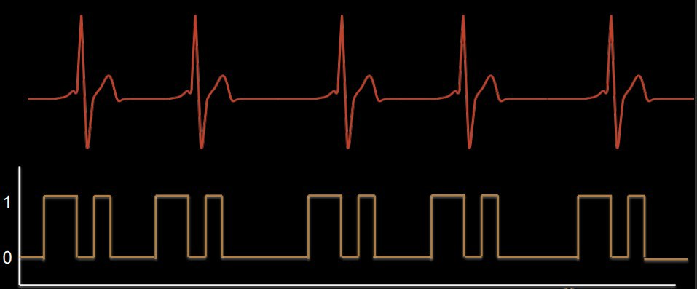
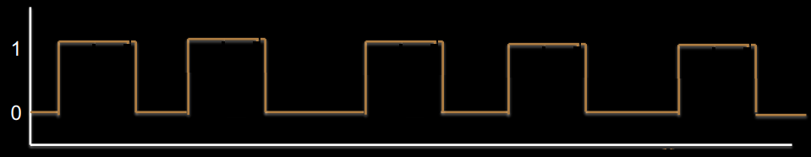
Convo-what now?
Input
0 | 0 | 0 | 1 | -1 | 0.5 | 0 | 0 | 0 | 0
* * *
Size = 3
Stride = 1
Kernel
0 2 1
+
Kernel output
ReLu output
Not optimal, but by adding another convolution layer, you might get to something like:
- | 0 | 1 | 1 | -1.5 | 1 | 0 | 0 | 0 | -
- | 0 | 1 | 1 | 0 | 1 | 0 | 0 | 0 | -

Slide 35
2D convolution
Size = 2*2; stride = 1
■
0 | 22 | 0 | 1
12 | 2 | 3 | 23
3 | 34 | 26 | 2
0 | 22 | 86 | 3
4 | 3 | 1 | 4
68
0 | 2
2 | 0

Slide 36
2D convolution
Size = 2*2; stride = 1
■
0 | 22 | 0 | 1
12 | 2 | 3 | 23
3 | 34 | 26 | 2
0 | 22 | 86 | 3
4 | 3 | 1 | 4
68 | 4
0 | 2
2 | 0

Slide 37
2D convolution
Size = 2*2; stride = 1
■
0 | 22 | 0 | 1
12 | 2 | 3 | 23
3 | 34 | 26 | 2
0 | 22 | 86 | 3
4 | 3 | 1 | 4
68 | 4 | 8
0 | 2
2 | 0

Slide 38
2D convolution
Size = 2*2; stride = 1
■
0 | 22 | 0 | 1
12 | 2 | 3 | 23
3 | 34 | 26 | 2
0 | 22 | 86 | 3
4 | 3 | 1 | 4
68 | 4 | 8
10
0 | 2
2 | 0
Etc.

Slide 39
Another type of convolution: max pooling
Size = 2*2; stride = 1; just take the maximum value in the kernel area
■
0 | 22 | 0 | 1
12 | 2 | 3 | 23
3 | 34 | 26 | 2
0 | 22 | 86 | 3
4 | 3 | 1 | 4
22 | 22 | 23
34 | 26 | 26
34 | 86 | 86
22 | 86 | 86

Slide 40
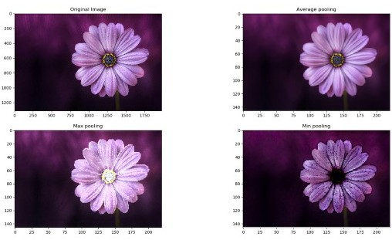
Another type of convolution: pooling/averaging

Slide 41
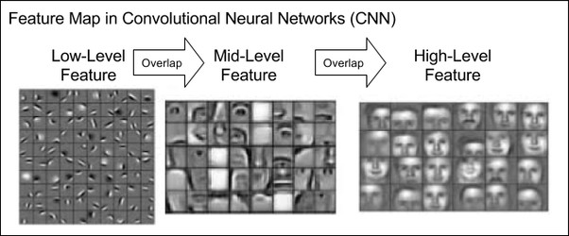
Use in face detection
Since kernels so few parameters: can use many of them per layer → each becomes sensitive to different image features
■

Slide 42
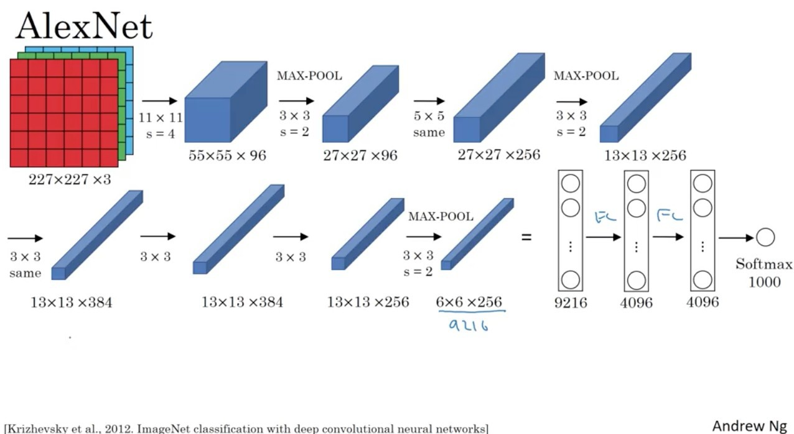
Example AlexNet (2012)

Slide 43
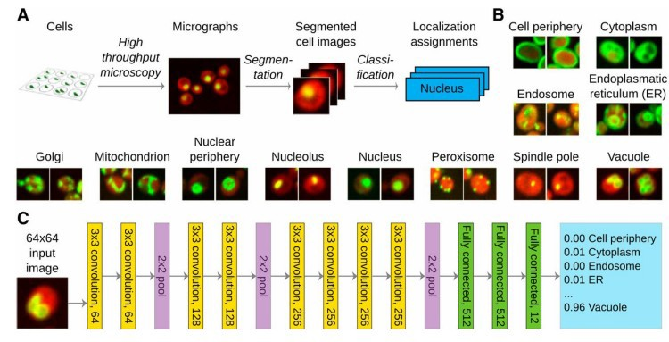
Biological use
Pärnamaa, T., & Parts, L. (2017). Accurate classification of protein subcellular localization from high-throughput microscopy images using deep learning. G3: Genes, Genomes, Genetics, 7(5), 1385-1392.

Slide 44
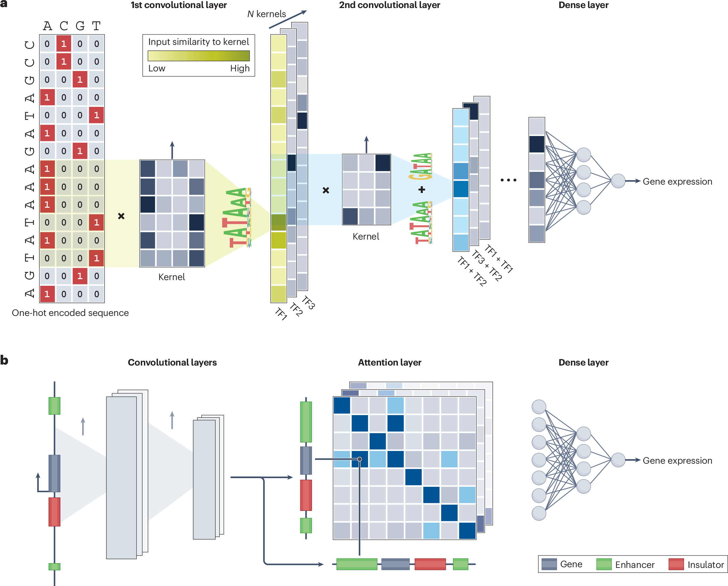

Biological use
https://www.nature.com/articles/s41576-025-00841-2

Slide 45
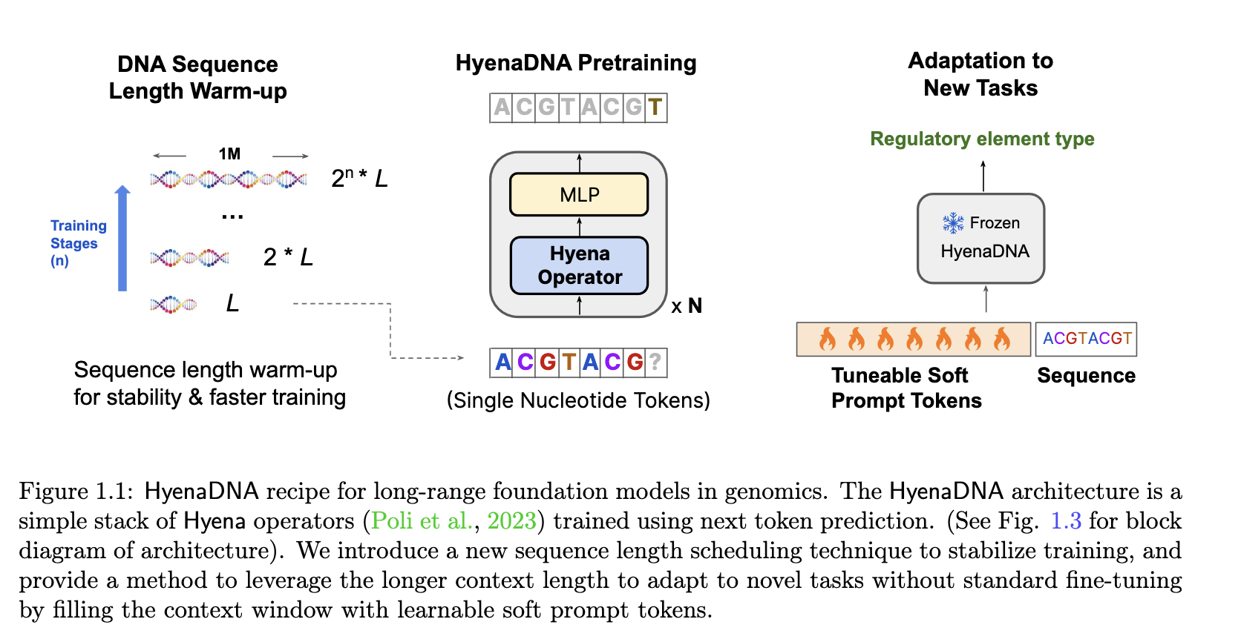
Biological use

Slide 46
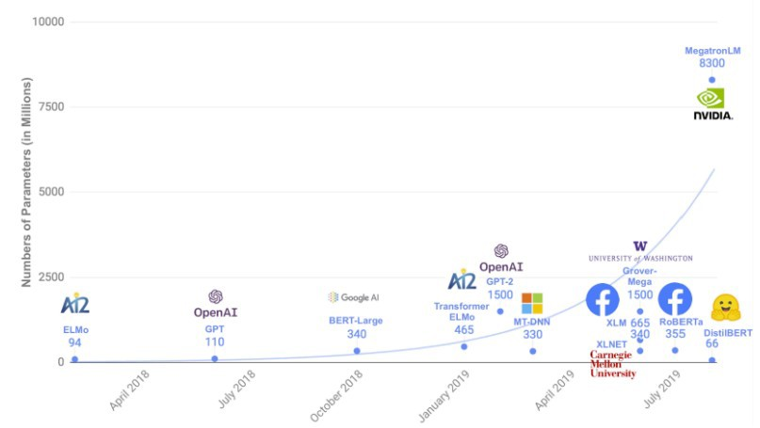
There’s a lot more
Batch normalisation Vanishing gradient problem Dropout
Recurrent neural nets
■
■
■
■

Slide 47
Implementation
We are not going to implement convolutional neural networks ourselves: implementing backpropagation properly on a simple dense network is already taxing enough.
Still, doing that should give you a solid basis for understanding convolutional neural networks, and we’ll introduce the Keras library for building (convolutional) neural networks next Monday.
■
■

Slide 48
Afternoon practical
Implement backpropagation yourself
Train a dense neural network on the MNIST dataset
■
■

