Slide 1

de ridder lab
Lab Memory Atlas
Why we made this
Lab knowledge disappears
after meetings
The gap
Useful context exists, but it is not structured.
Transcript
?
memory gap
Meetings create decisions, ideas, and follow-up tasks. Without a shared memory layer, they become hard to find, hard to follow, and hard to connect.
decisions
tasks
helpers
progress
Ideas
Actions
Connections
Good suggestions stay in the room.
Tasks are not assigned, revisited, or closed.
People miss who can help with what.

Slide 2
de ridder lab
Lab Memory Atlas
Why this gets worse over time
As the lab grows, informal memory stops scaling
The coordination gap
Activity rises faster than shared context.
context
projects + activity
More people, SIGs, and projects are a strength. But without a shared map, it becomes harder to keep cohesion: who is doing what, which ideas are active, and where progress is stuck.
cohesion gap
29
11
3
people to keep in view
active groups and projects
SIGs with overlapping work
shared context
lab size

Slide 3
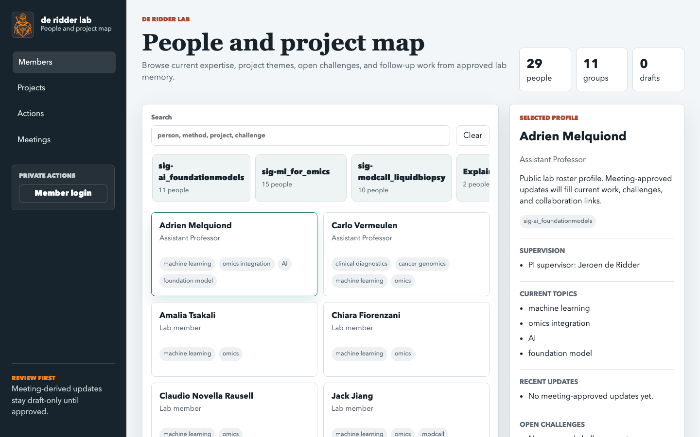
de ridder lab
Lab Memory Atlas
What this solves
A living map for the lab
Meeting transcripts become reviewed lab memory: people, projects, SIGs, supervisors, actions, progress, and suggested helpers.
Capture meeting transcript and context
Draft AI proposes summaries, actions, and profile updates
Review lab members approve or reject changes
Connect people, projects, supervisors, and follow-ups
People
Projects
Actions
current work and helpers
progress and context
visible to the right people
Transcript
AI draft
Human review
Lab Atlas
The demo starts from the map, then follows one meeting into reviewed memory.

