Slide 1
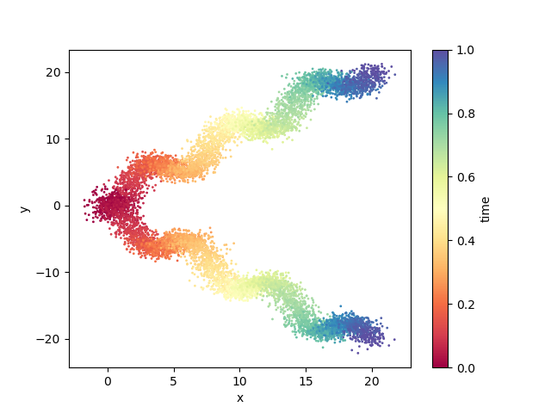
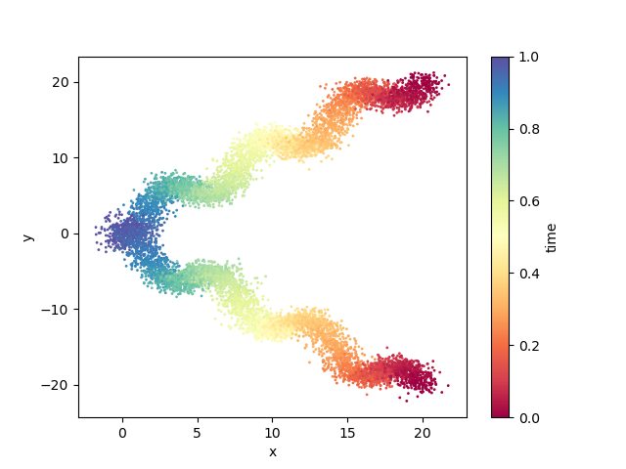








TrajectoryNet
Forward model: $dX_{t}=v dt+σ dW_{t}$
$${\left\{X_{t,i}\right\}}_{0≤t≤1,1≤i≤m}$$
input
output
$$v:ℝ^{d}×\left[0,1\right)→ℝ^{d}$$
sample generation
score estimation
$$v′:ℝ^{d}×\left[0,1\right)→ℝ^{d}$$
$$u′:ℝ^{d}×\left[0,1\right)→ℝ^{d}$$
score estimation
sample generation
output
input
$$u:ℝ^{d}×\left[0,1\right)→ℝ^{d}$$
$${\left\{Y_{t,i}\right\}}_{0≤t≤1,1≤i≤m}$$
Backward model: $dY_{t}=u dt+σ dW_{t}$

