Slide 1
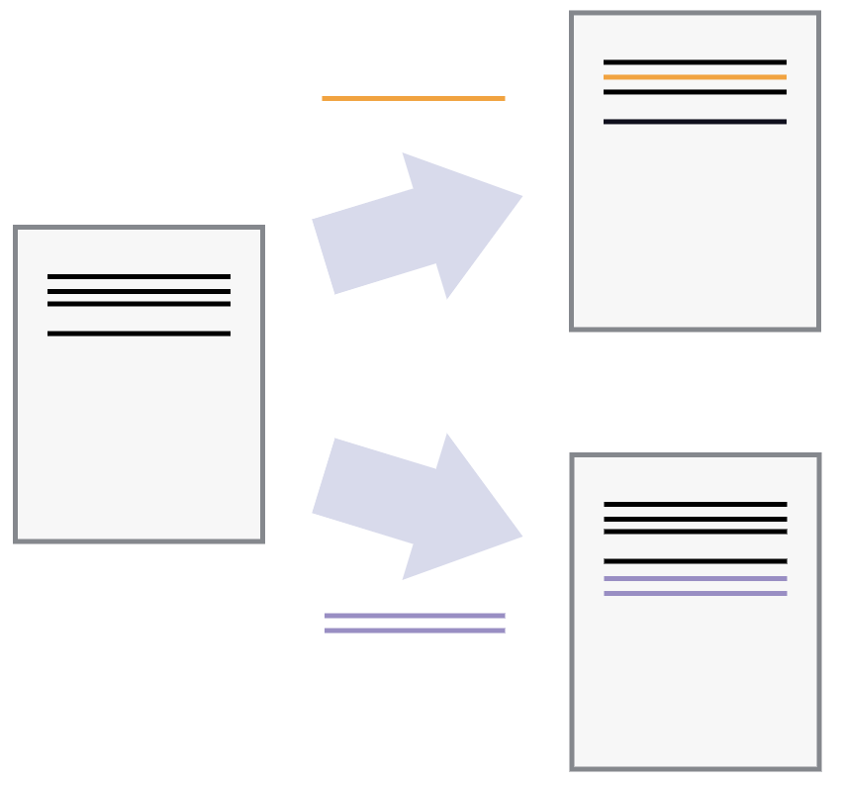

Slide 2
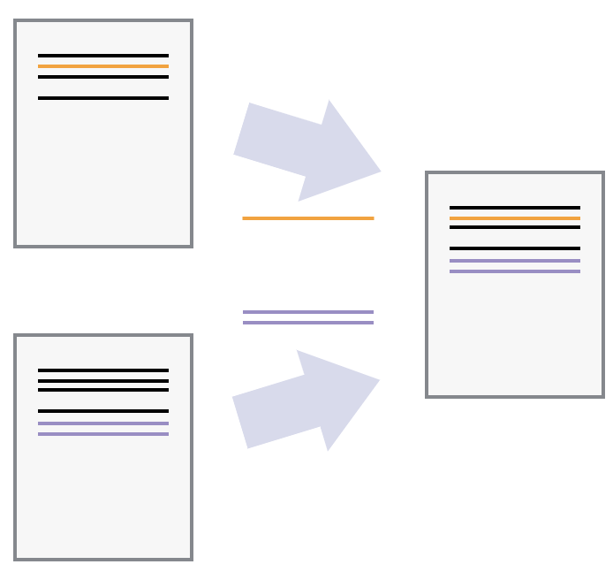

Slide 3
Local Computer (i.e. Your Desktop)
Remote Computer
(i.e. GitHub server)
Local Repository
.git folder
Working
Directory
Staging Area
(Index)
HEAD of Local Repository
Remote Repository
git add
git commit
git push
git checkout
git pull

Slide 4
Local Computer
(i.e. Your Desktop)
Remote Computer
(i.e. GitHub server)
Working
Directory
Staging Area
(Index)
Local Repository
(HEAD)
Remote Repository
add
commit
push
checkout
pull

Slide 5
Typical workday
Remote
Repository
pull
push
Local
Repository
commit
commit
commit
Staging
Area
checkout
add
add
add
Working
Directory
Work on
File1.R
Work on
File2.R
Work on
File1.R
Work on
File2.R
Work on
File3.R
Work on
File1.R
Work on
File3.R
0 1 2 3 4 5 6 7
Time (hours)

Slide 6
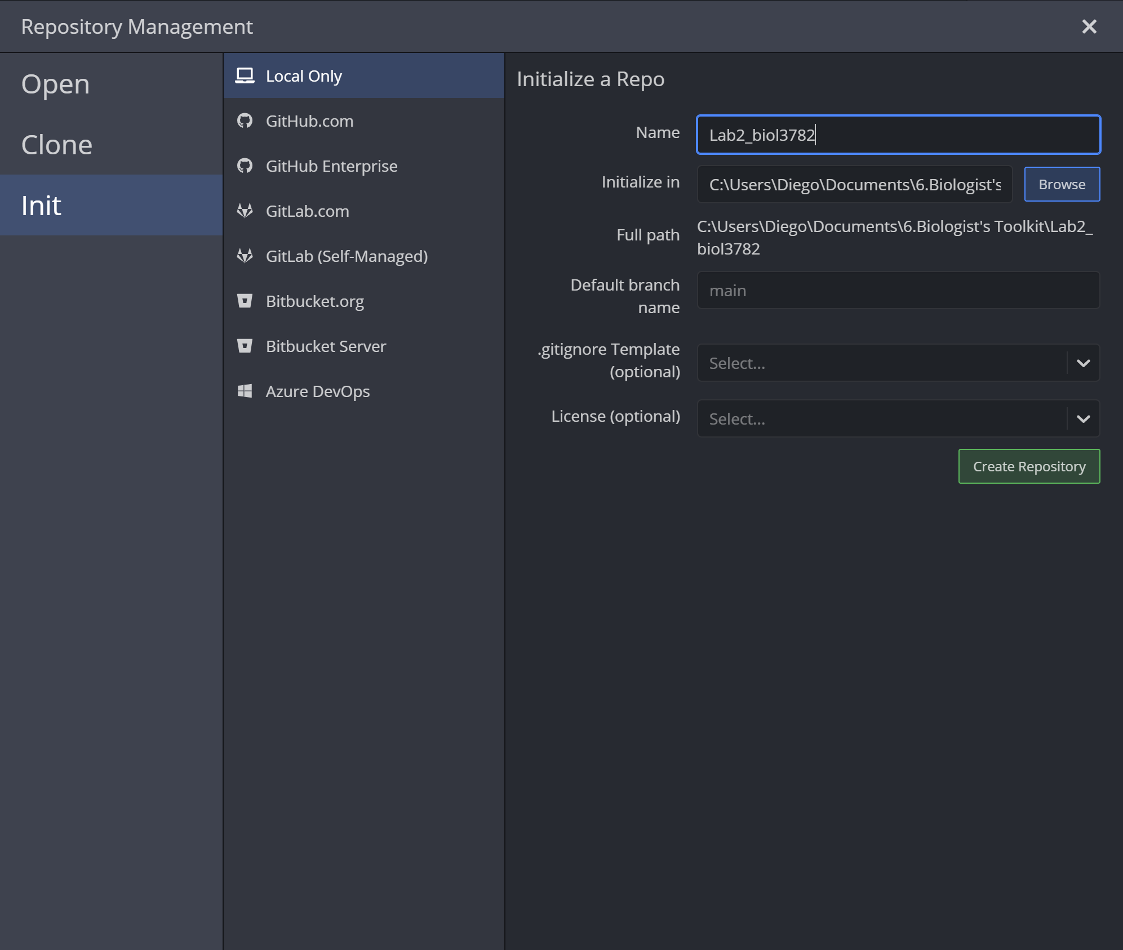

Slide 7
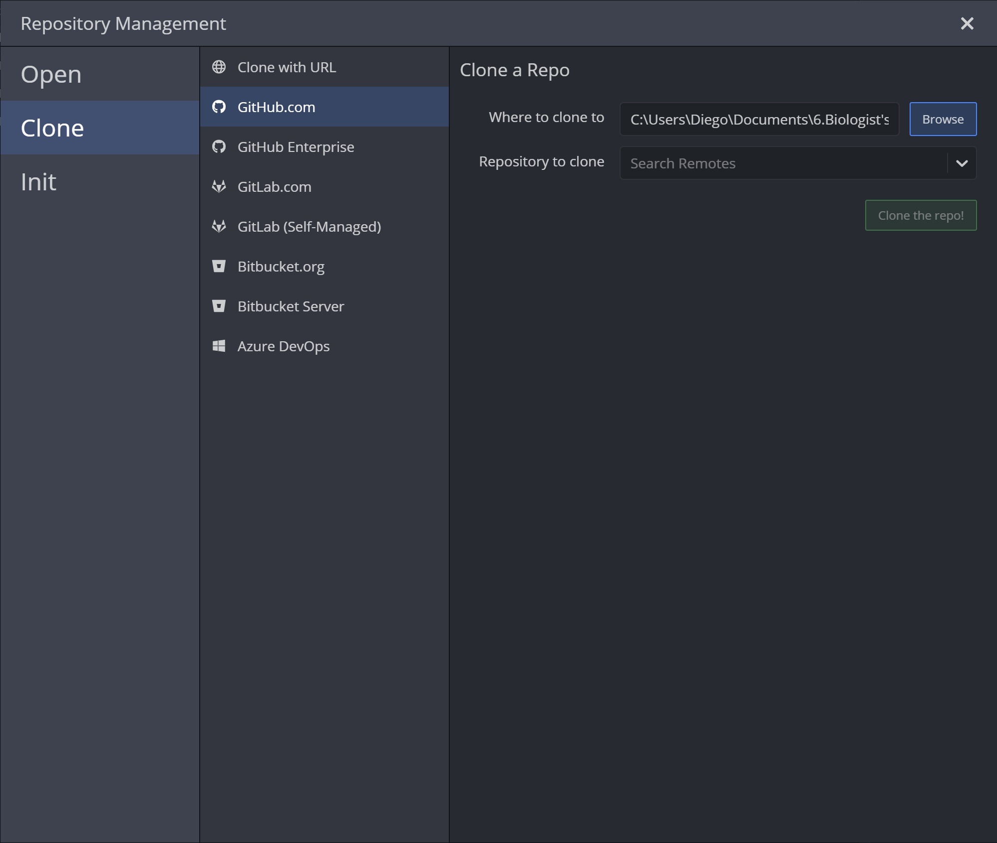

Slide 8
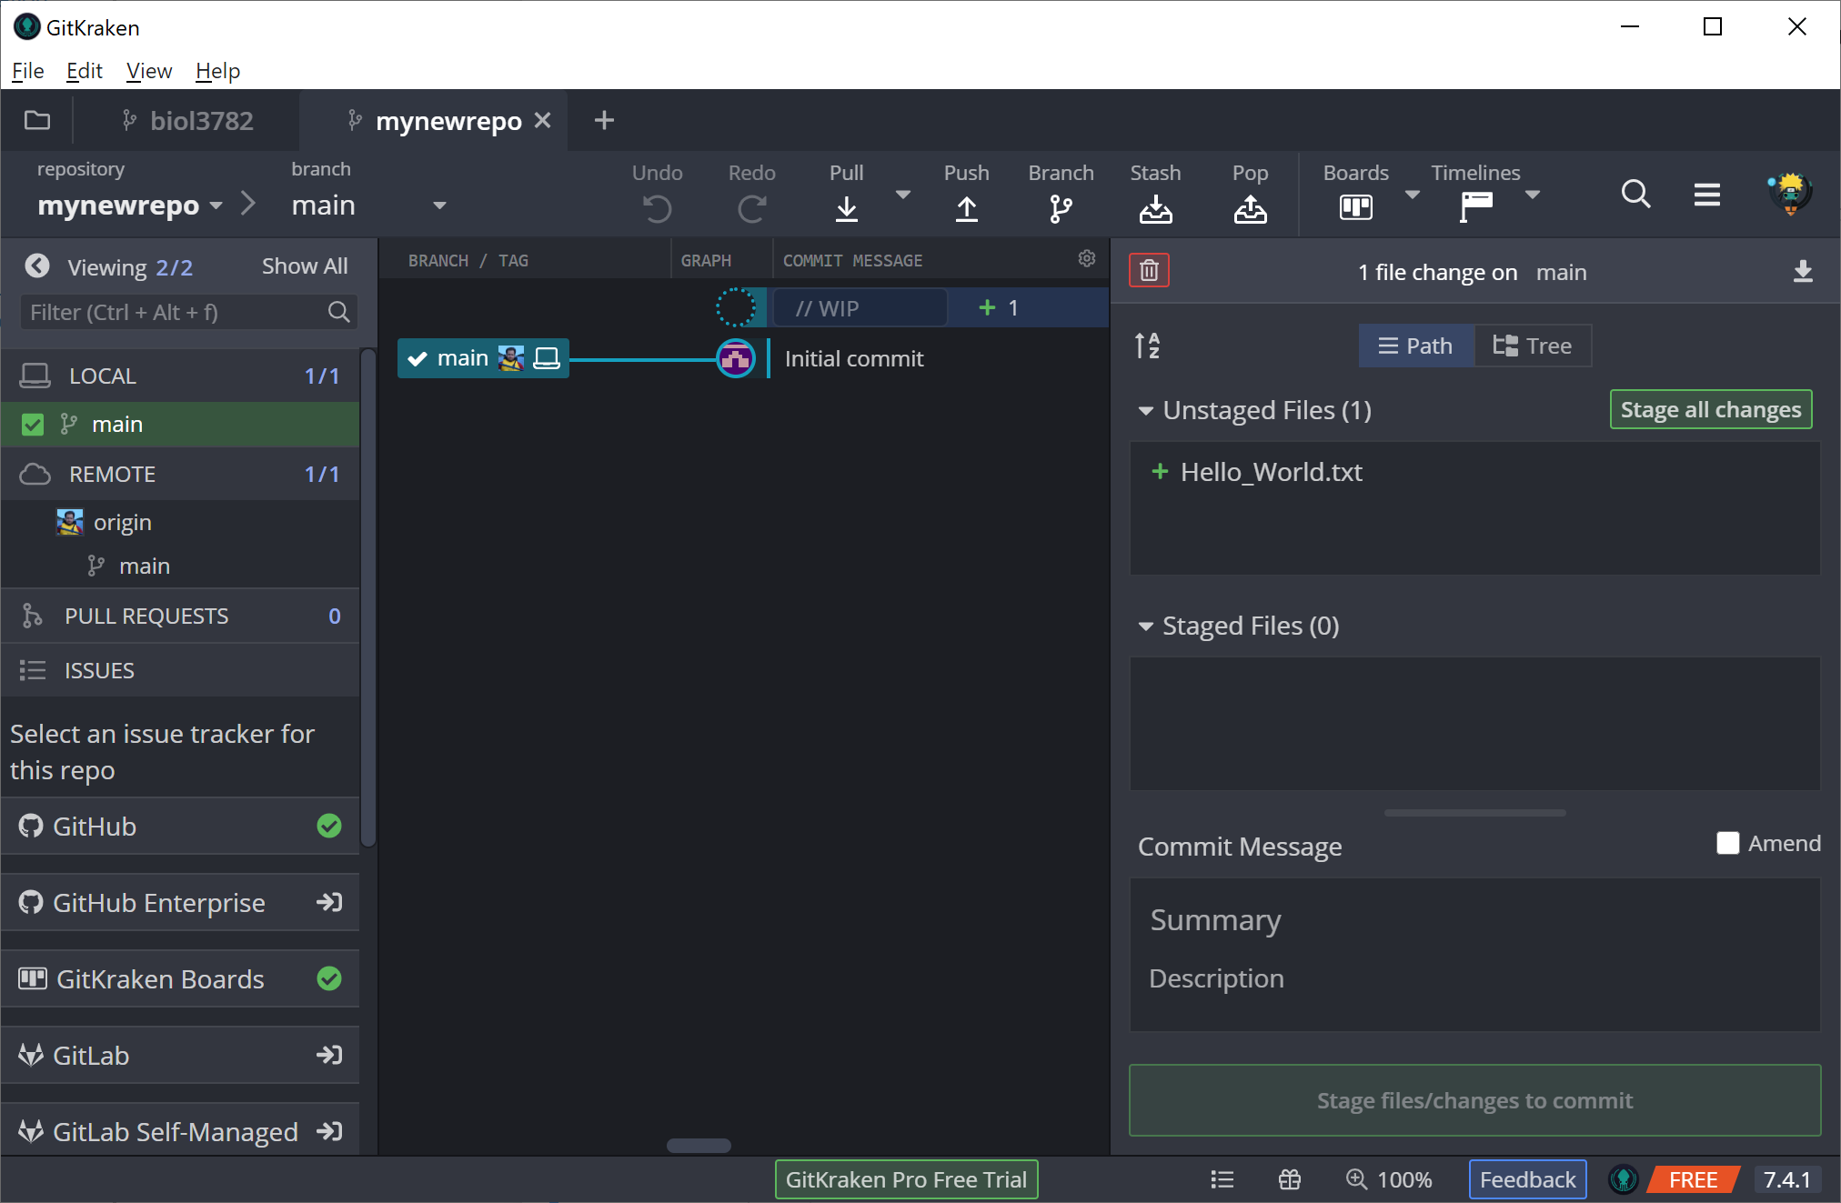

Slide 10
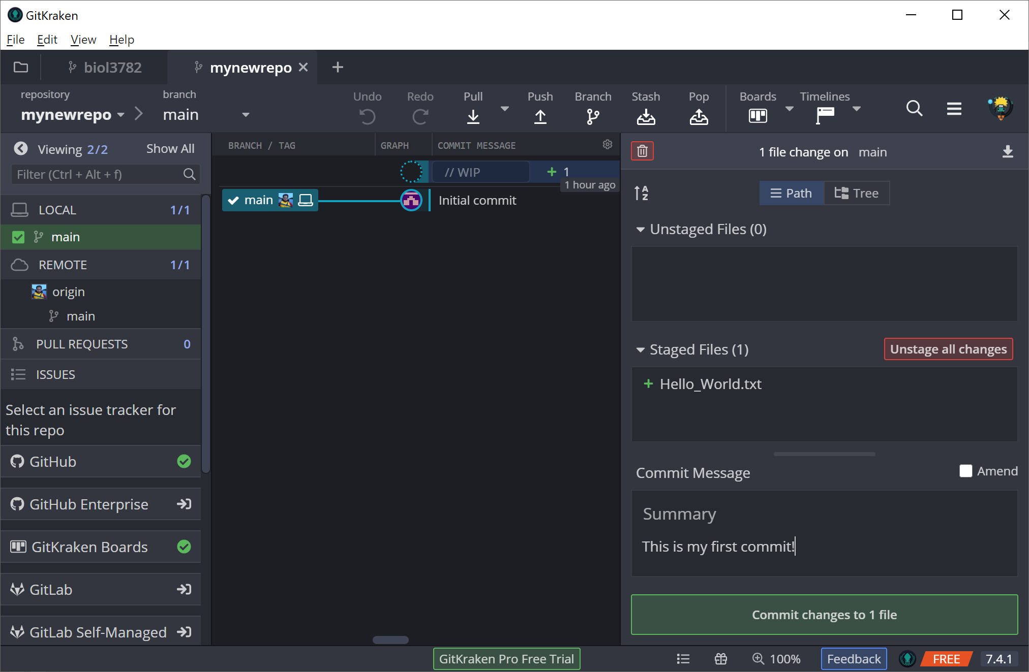

Slide 11
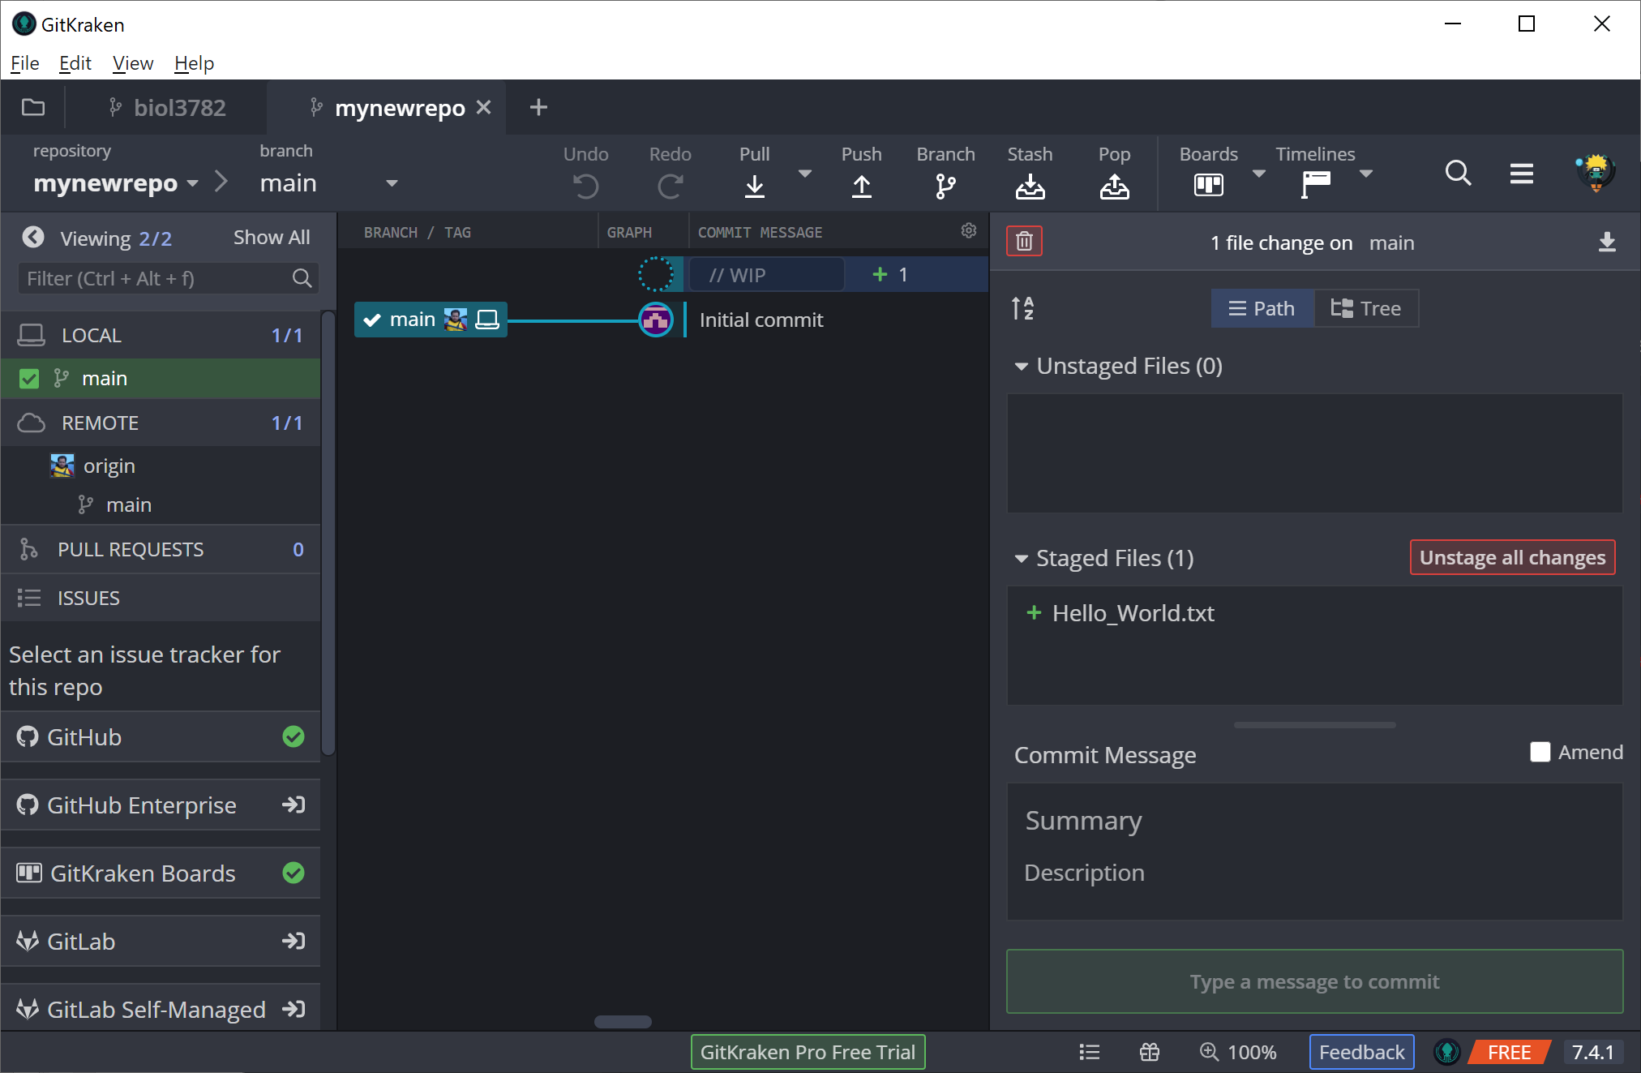

Slide 12
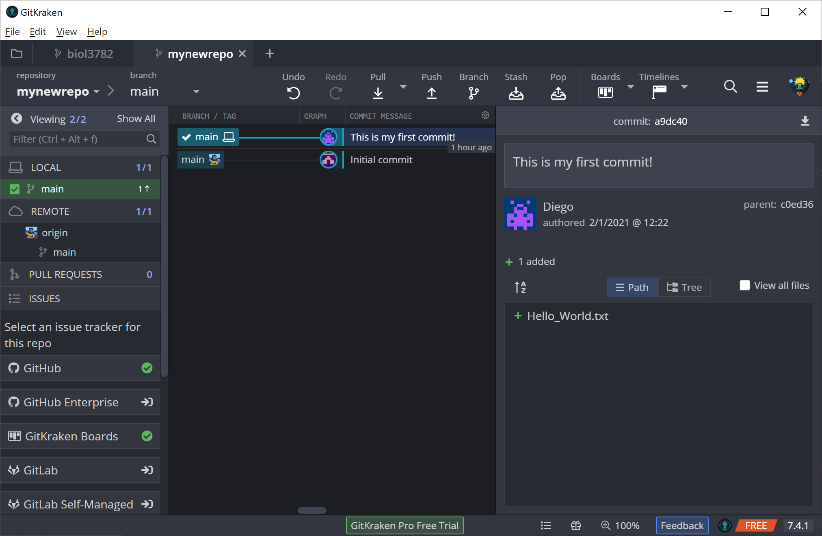

Slide 14


Slide 15
Create branch
Merge branch
Master
comm
comm
comm
comm
comm
comm
comm
comm
comm
comm
comm
comm
comm
Feature1
comm
comm
comm
comm
comm
comm
comm
comm
Feature2
comm
comm
comm
comm
comm
comm
comm

Slide 16
Create branch
Merge branch
Main
comm
comm
comm
comm
comm
comm
comm
comm
comm
comm
Feature1
comm
comm
comm
comm
comm
comm
comm
comm
Feature2
comm
comm
comm
comm
comm
comm
comm

Slide 17
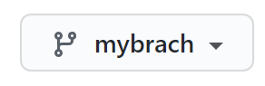

Slide 18


Slide 19
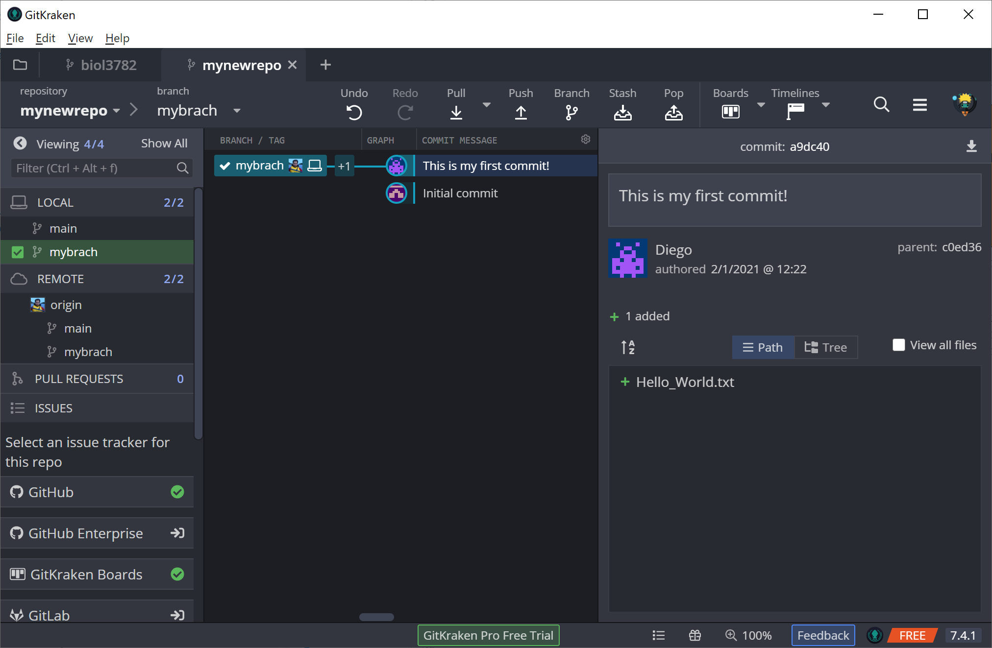

Slide 20
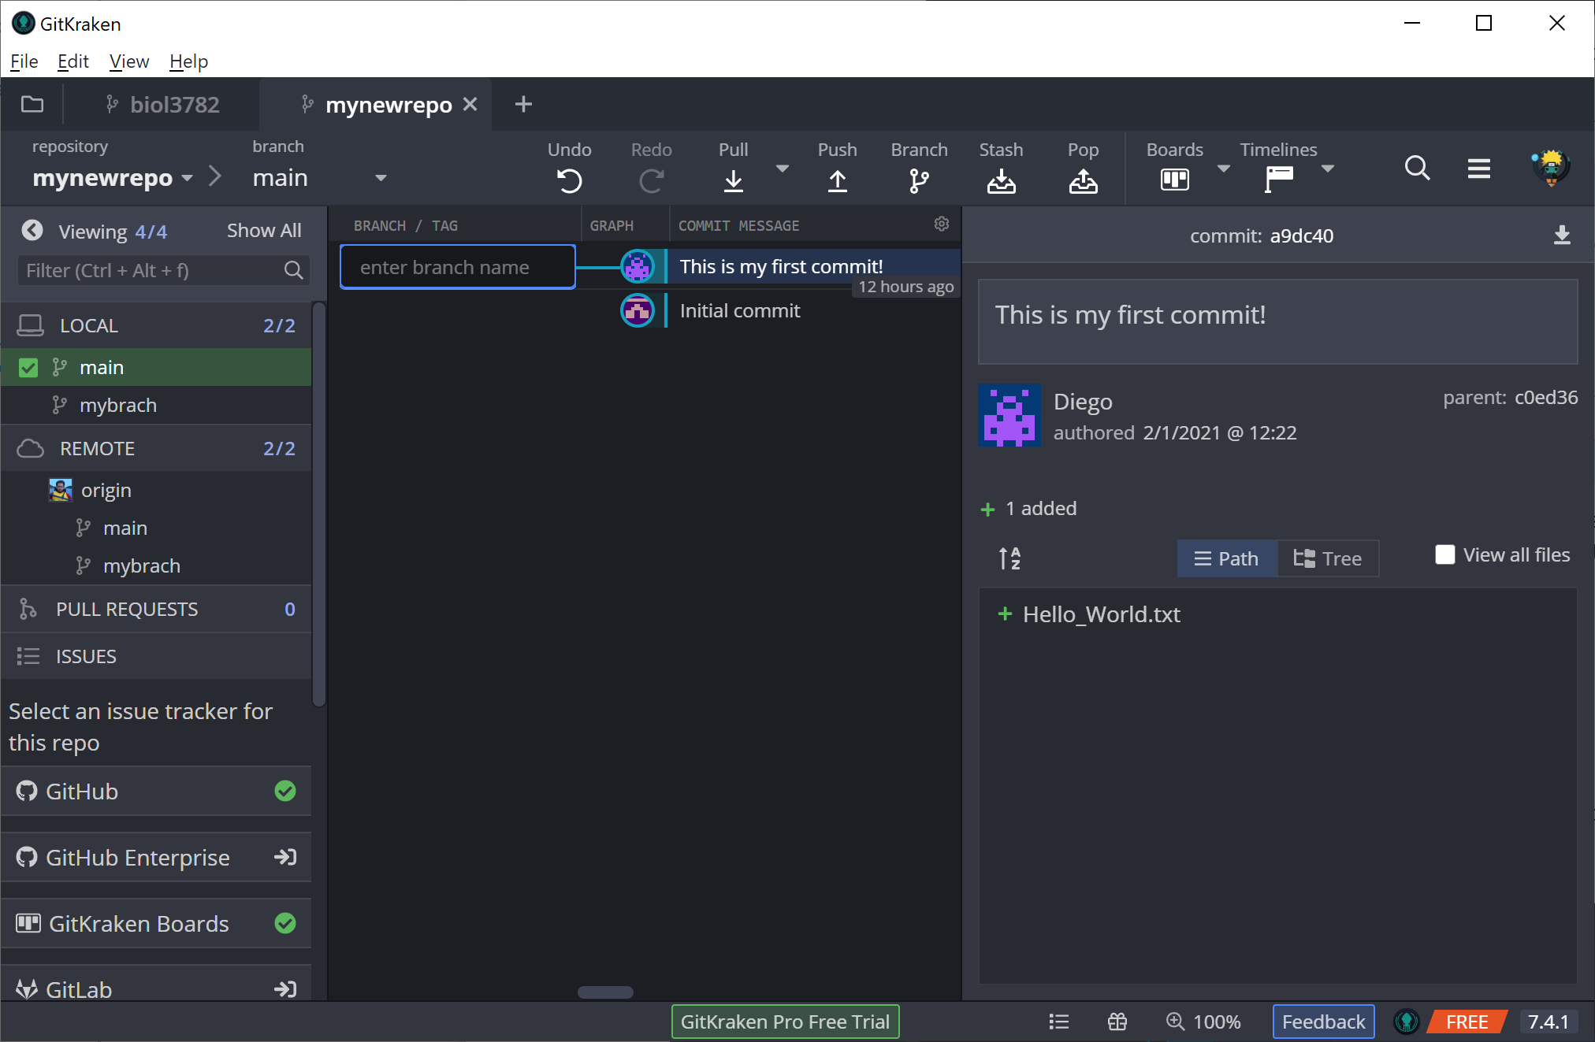

Slide 21
