Slide 1
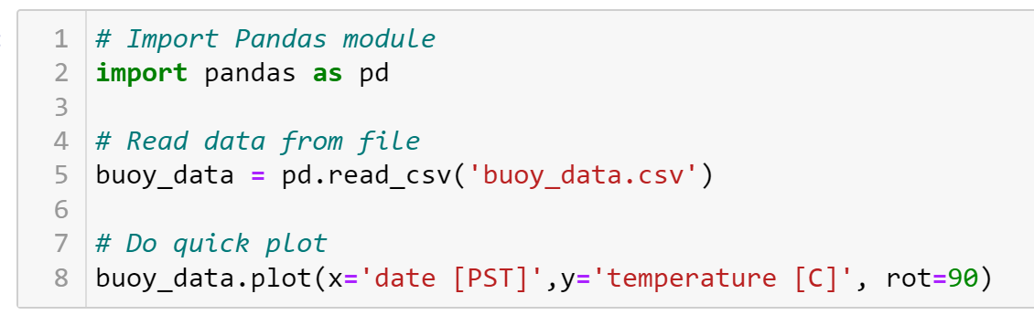
Comments
Comments
Comments

Slide 2
Statement
Statement
Statement

Slide 3
Making a variable
Using our newly made variable

Slide 4
Module
Function
String
Method
Float
Strings

