Slide 1
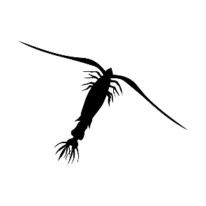
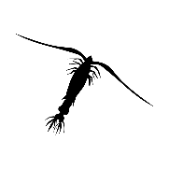
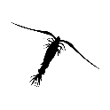
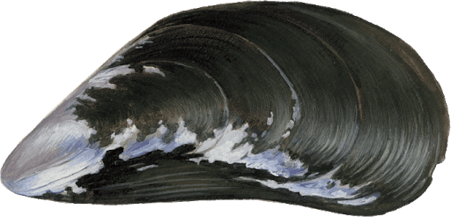
NPZD2_SHELLE model
1 m
1 m
1 m

Slide 2
NPZD2_SHELLE_pond model: Top view
100 m
Pond
Water
2000 m
Land

Slide 3
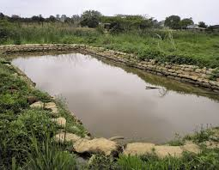
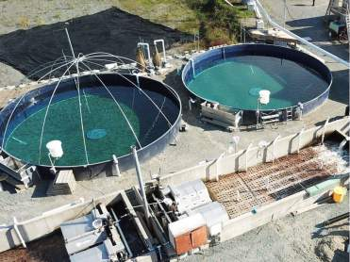
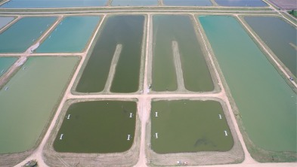
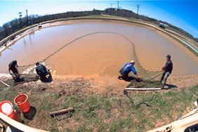
NPZD2_SHELLE_pond model
This model can be used to simulate growth of mussels in a pond or tank of any size (from small to very large)

Slide 4
NPZD2_SHELLE_pond model: Top view
Pond
1 m
1 m
Land

Slide 5
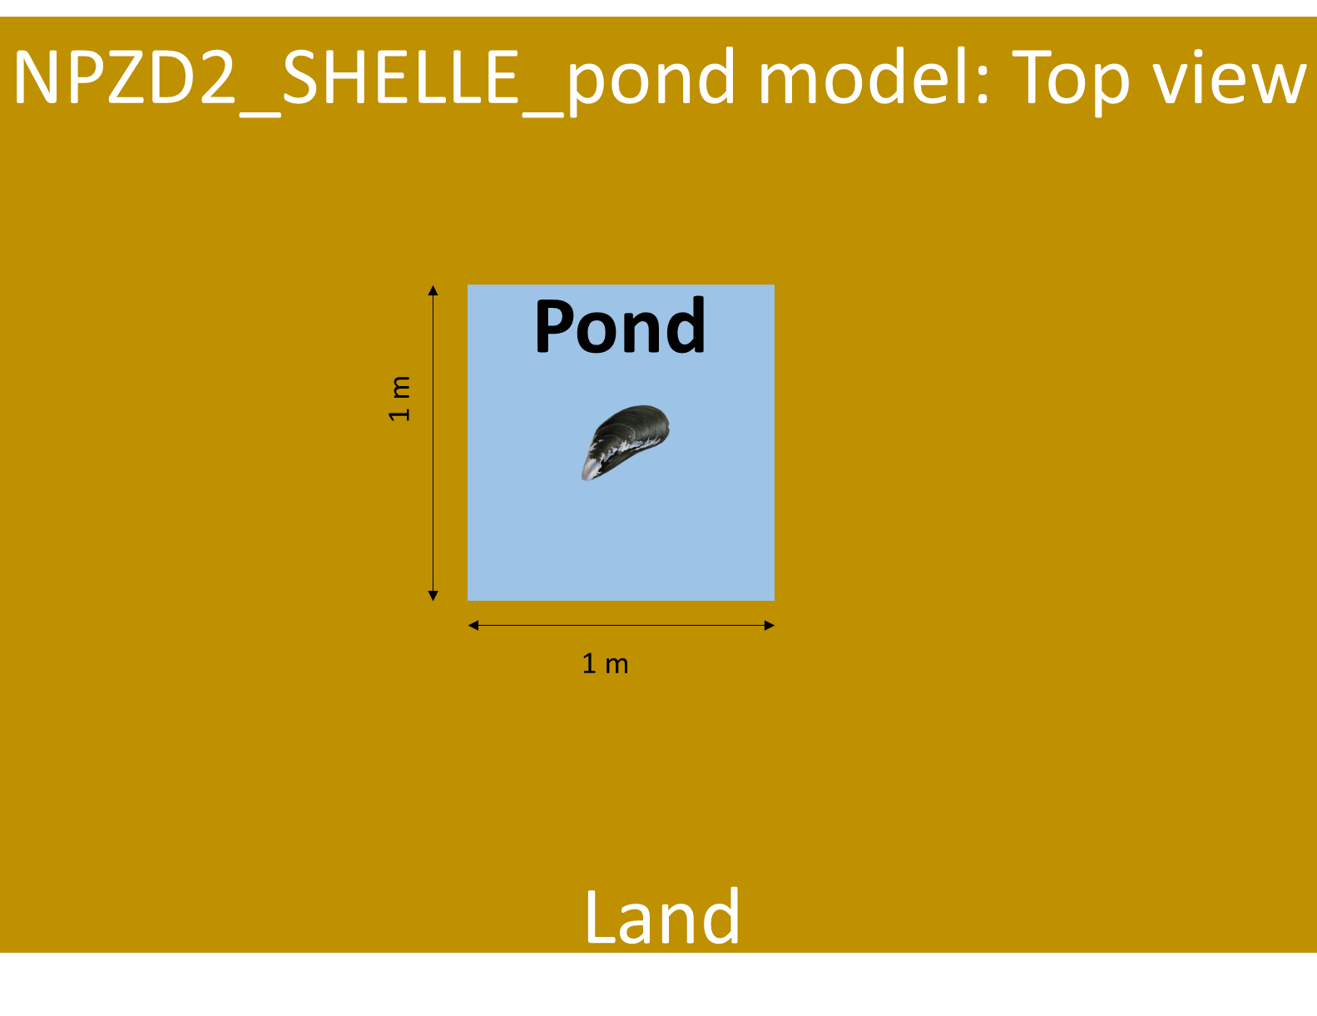
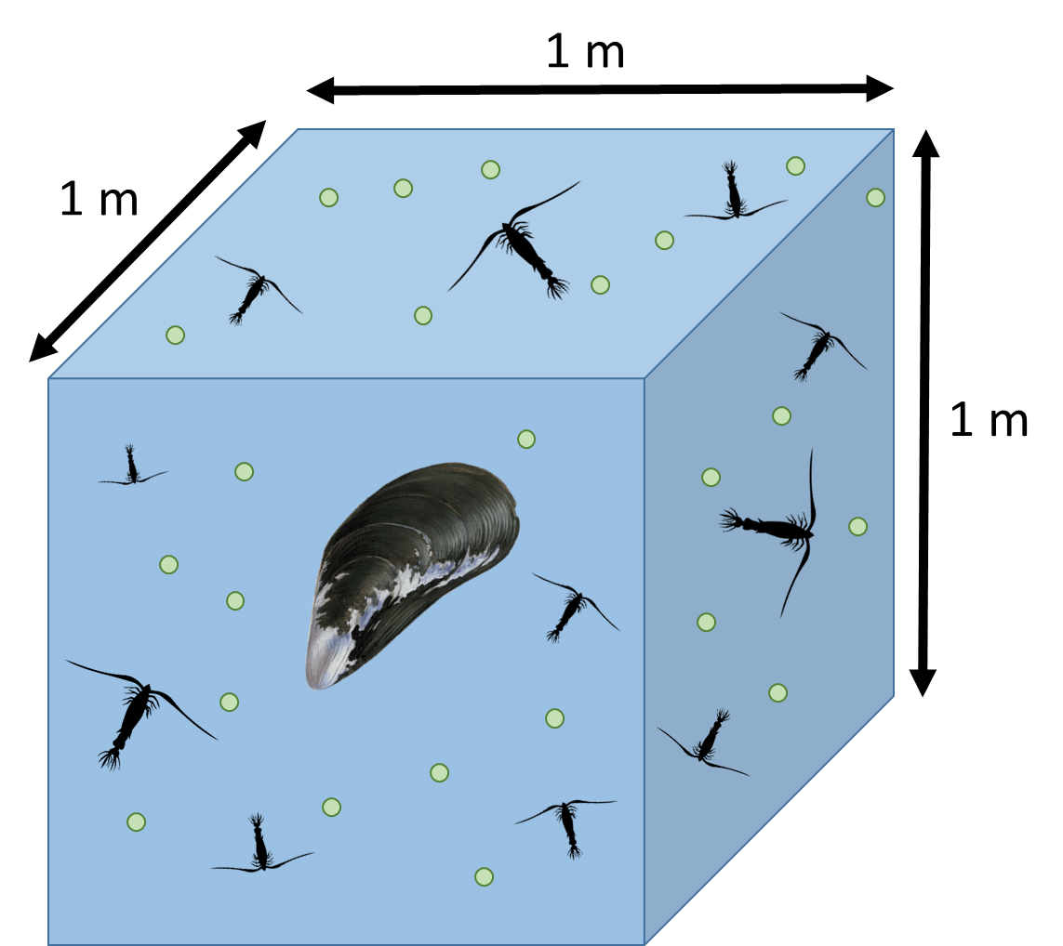
NPZD2_SHELLE model
≈

Slide 6
NPZD2_SHELLE_pond model: Top view
100 m
Pond
Water
2000 m
Land

Slide 7
NPZD2_SHELLE_pond model: Top view
Oxygen Dynamics
O₂
O₂
100 m
O₂
Pond
O₂
O₂
O₂
O₂
Water
2000 m
Land

Slide 10
Tank model: Side view
Outflow
1 m
Tank
Pump
1 m
Land
Ocean

Slide 11
Embayment model: Top view
Narrow mouth
(i.e. small exchange)
100 m
Embayment
2000 m
Land
Ocean

Slide 12
Embayment model: Top view
Wide mouth
(i.e. large exchange)
100 m
Embayment
2000 m
Land
Ocean

Slide 13
