Slide 1


Python Programming for Ocean Management: Real-time mapping of the fishing footprint in Atlantic Canada
Dr. Diego Ibarra
INSTRUCTIONS: https://github.com/Diego-Ibarra/workshop_IOI_2018
BIO - June 7, 2018
Notes:
Welcome
My name is Diego… that is my email… and my office is just around the corner
Don't worry If you don't feel like taking notes… all you need to write is: OceanPython.org
I'll be explaining more about OPo a bit later and at the end of the class… but for now you need to know if all materials, updates and announcements will be made in OPo.
This is Tutorial 1 … there will be likely 2 or 3 more tutorials. But there may be more depending on how fast we progress and on the perceived demand or enthusiasm of the audience (i.e. you).

Slide 2
Objectives for today…
1) Spark an interest in “Programming”
2) Demonstrate some of the programming work I do here (in hopes to further intrigue you to look into programming)
Notes:
This slide is for those who know nothing about programming… the next slide is for those who know some programming languange

Slide 3
What is programming?
Notes:
This slide is for those who know nothing about programming… the next slide is for those who know some programming languange

Slide 4
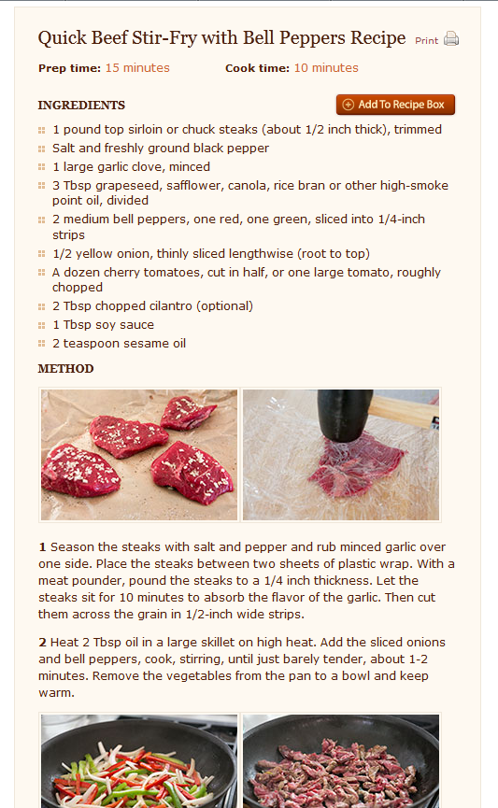


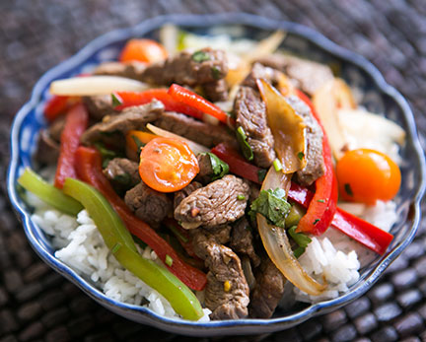
What is programming?
“Programming” would be like writing a recipe,
where you can then click the “run” button to
“execute” the recipe…
…to automatically prepare food
Click “RUN” button
Notes:
This slide is for those who know nothing about programming… the next slide is for those who know some programming languange

Slide 5
Why do you need to learn programming?
Notes:
This slide is for those who know nothing about programming… the next slide is for those who know some programming languange

Slide 6
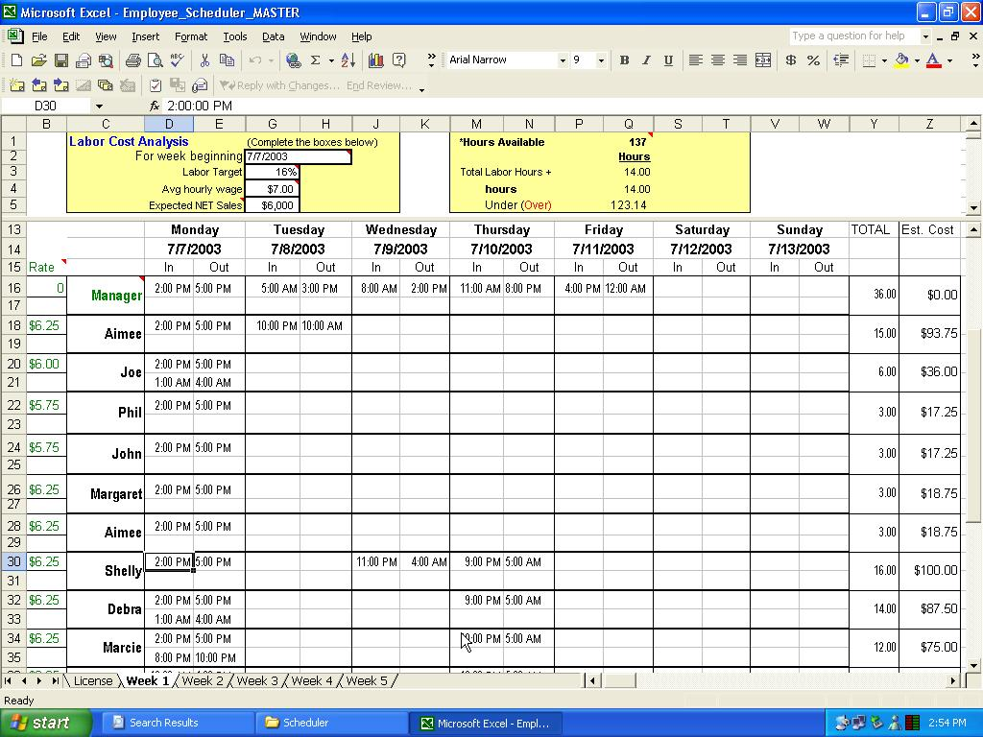
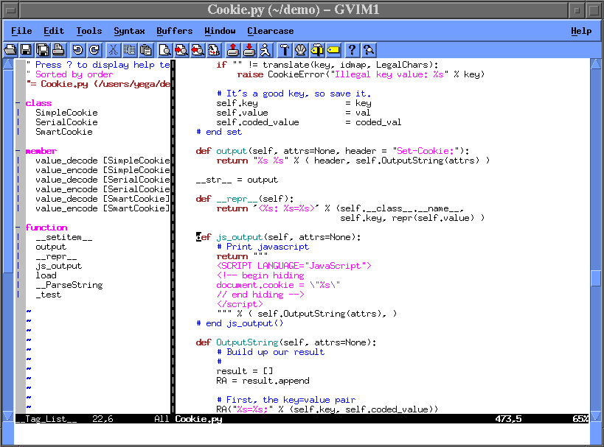
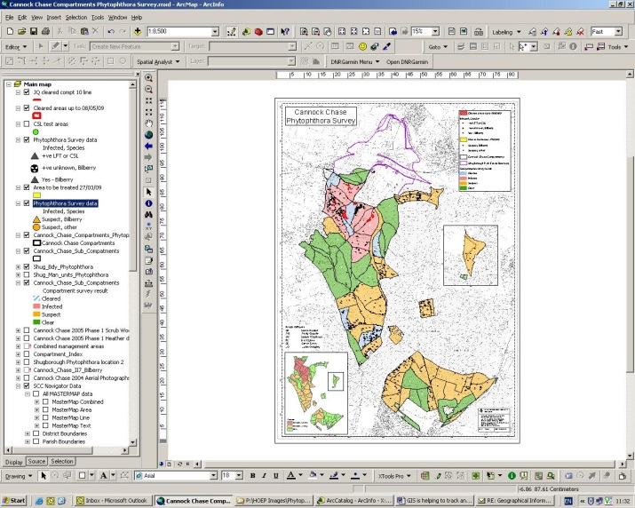
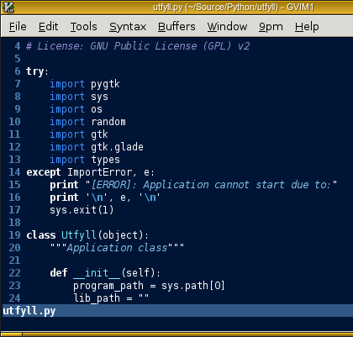
Why do you need to learn programming?
“button-based” (GUI)
software
vs
“programming-based” software
Notes:
This slide is for those who know nothing about programming… the next slide is for those who know some programming languange

Slide 7
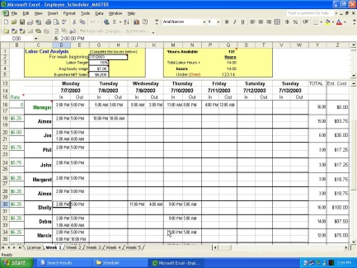
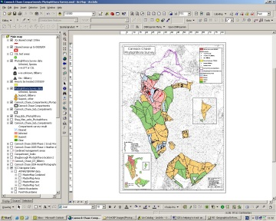
Why do you need to learn programming?
“button-based” (GUI) software
vs
“programming-based” software
Number of users needing the application
Number of applications
Notes:
This slide is for those who know nothing about programming… the next slide is for those who know some programming languange

Slide 8
Why do you need to learn programming?
“button-based” (GUI) software
vs
“programming-based” software
- Browse WEB
- Write emails
Number of users needing the application
Make map of
Sea Surface Temperature
Number of aplications
Notes:
This slide is for those who know nothing about programming… the next slide is for those who know some programming languange

Slide 9
Why do you need to learn programming?
“button-based” (GUI) software
vs
“programming-based” software
“Button-based”
Software
- Browse WEB
- Write emails
Number of users needing the application
Make map of
Sea Surface Temperature
Programming
Number of aplications
Notes:
This slide is for those who know nothing about programming… the next slide is for those who know some programming languange

Slide 10
Why do you need to learn programming?
“programming-based” software
Students that know a programming language are more employable than students who don’t
As programming becomes more main stream… future generations of students will be expected to know programming
Notes:
This slide is for those who know nothing about programming… the next slide is for those who know some programming languange

Slide 11
My story…
ALL jobs I got after graduating, I got because I knew programming
Currently I do programming for a living
I did not do a “Computer Science” degree, nor I ever taken a “programming” course. I taught myself programming because of shear necessity
Notes:
This slide is for those who know nothing about programming… the next slide is for those who know some programming languange

Slide 12
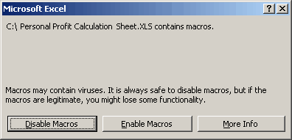

My story…
ALL jobs I got after graduating, I got because I knew programming
Currently I do programming for a living
I did not do a “Computer Science” degree, nor I ever taken a “programming” course. I taught myself programming because of shear necessity
Excel cannot open files with more than
30,000,000 rows. Excel is out of memory!
What do you want to do?
Kill myself
Switch to a music degree
Switch to MatLAB
Notes:
This slide is for those who know nothing about programming… the next slide is for those who know some programming languange

Slide 13
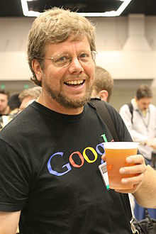







Brief history of Python
1989: Started by Guido van Rossum (Netherlands) as a hobby
He named it after Monty Python
Python is currently used everywhere, including:
Notes:
This slide is for those who know nothing about programming… the next slide is for those who know some programming languange

Slide 14
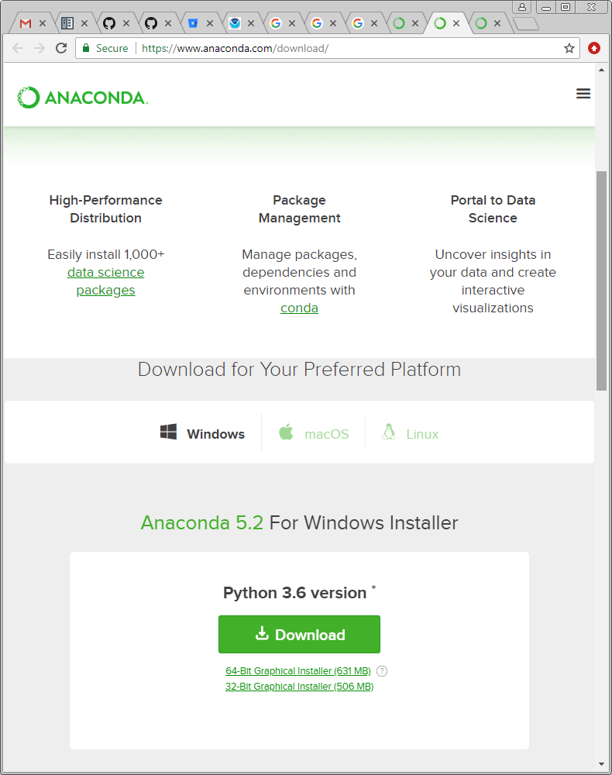
How to install Python?
Anaconda
https://www.anaconda.com/download/
Notes:
This slide is for those who know nothing about programming… the next slide is for those who know some programming languange

Slide 15
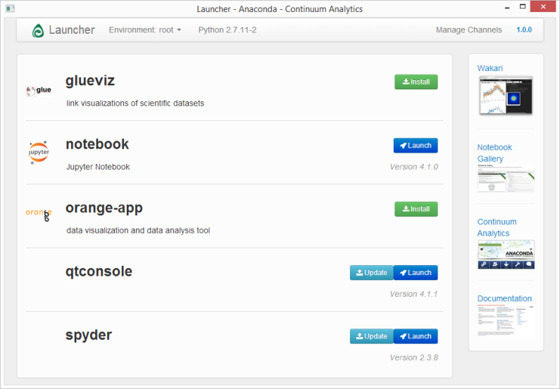
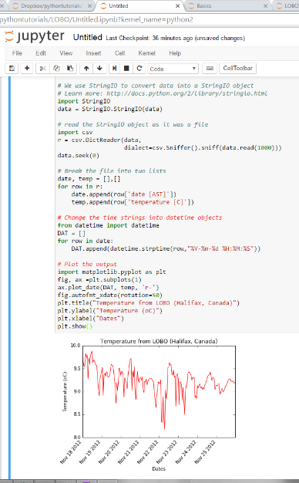
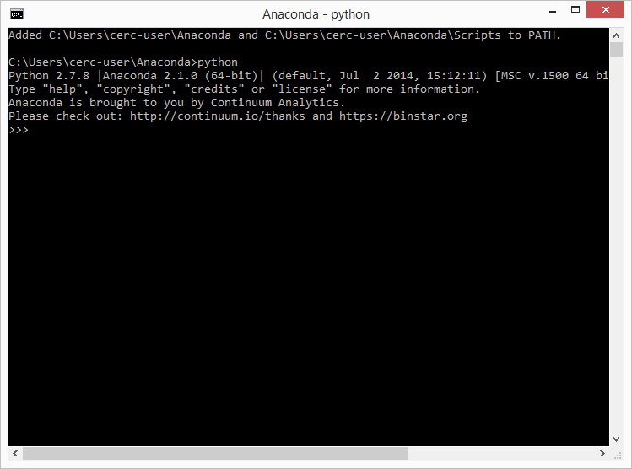
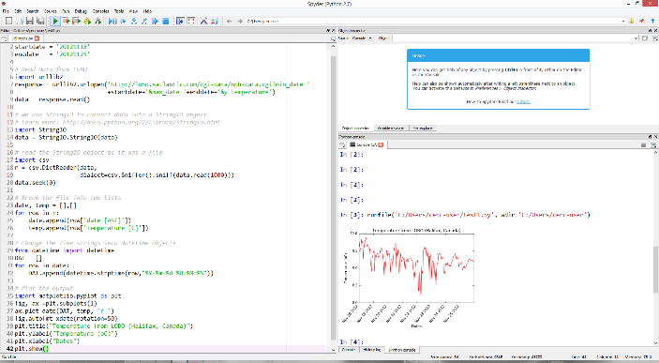
Where to “do” Python?
Anaconda
“Launcher”
Terminal
IDE (Spyder)
Notebook
Notes:
This slide is for those who know nothing about programming… the next slide is for those who know some programming languange

