Slide 1

Applied Data Science Capstone
Project: Opportunity to open new Restaurant around Covent Garden in London England

Slide 2

Introduction City Target: London Country Target: England Project: Opportunity to open new Restaurant around Covent Garden in London England
Everyday people must be eat food , it's basic factors for living specially when you are visiting another country like London lot of restaurant open and close a lot for 2 years , Now a lot of them still open but if it already have it a lot, is it still have an opportunity to open new restaurant into Covent Garden or around.
So this is my my project "Opportunity to open new restaurant into Covent Garden in London"

Slide 3
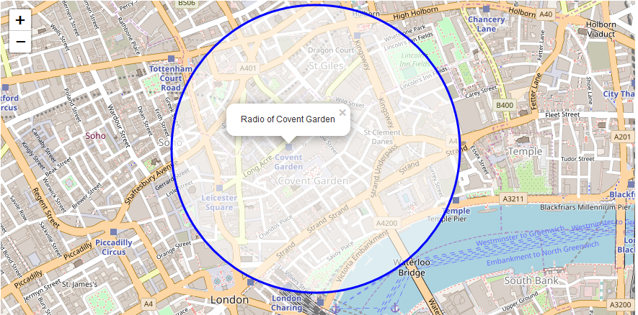
Business Problem
with a view on tourism
Location of Restaurants
Popular Restaurants
Kind of Restaurants
Where is the location for open new restaurant ?
How many is restaurant around Covent Garden ?
What is popular food for tour or resident ?
How many kind of restaurant around Covent Garden ?

Slide 4
What data is necessary for this ? The data will have API FOURSQUARE as the principal item and use geopy to get the location: project "Opportunity to open new restaurant around Covent Garden London ".
Trends on demand
Geo-location to Restaurants
Kind of Restaurants
Data number of restaurant around Covent Garden.
Trends of demands food from Covent Garden.
Number of tourist or local residents on Covent Garden
Data geo location of restaurant around Covent Garden.
Geo Location of Restaurants far from Covent Garden with Range 300km.
Data geo location of most popular tourism spot in this case Convent Garde
What is the kind of restaurants near and far from garden?
What is the most popular restaurant?
What is the opportunity to open a restaurant an what is the kind of food is most required ?

Slide 5
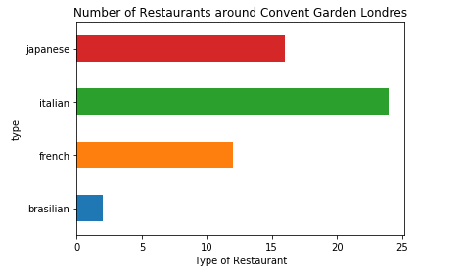
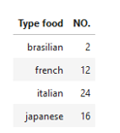
Results Data Summary: 1- Number of Restaurants near from Convent Garden - London

Slide 6
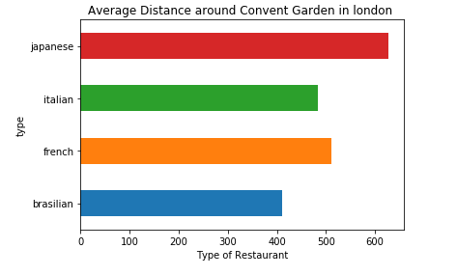
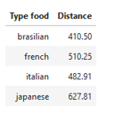
Results Data Summary: 2 - Average of distance of each restaurant near from Convent Garden London

Slide 7
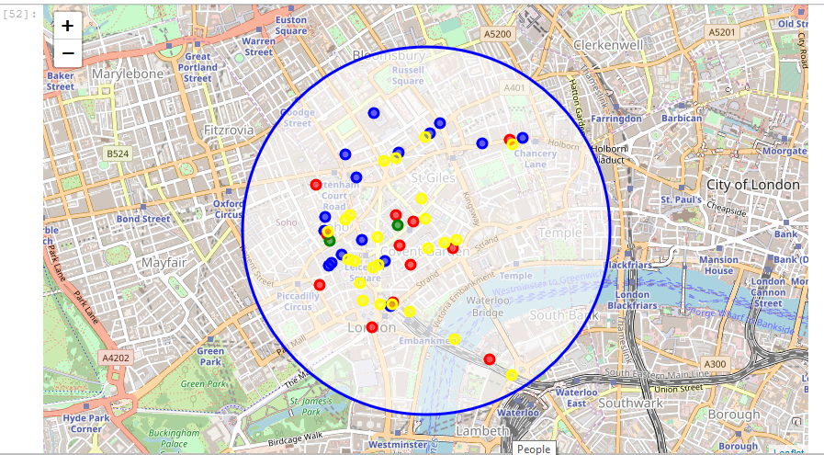

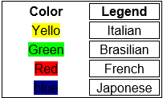
Results Data Summary: 3 – Map Results of the Data Range.
Convent Garden

Slide 8
Conclusion of Project The business problem here is clear that no have much choice to clients, or they will eat Japanese food or Italian food or will need walk a long time to find another type of food.
Now I was able to identify all the data necessary to know how what is the most popular restaurant on that region and what restaurant is near from Convent Garden, with this data I can now plan my project business to open a New restaurant to clients and local Residents.
So using the data, the most popular restaurant is: Italian, followed by Japanese and French, in the last place Brazilian food. so with this information we can proceed open a Brazilian restaurant near from Convent garden.
Solution: open More restaurants with different types of food near Convent garden, using the data visualization generated by this exercise to build a business plan or project plan.

Slide 9

Thank you. If you have any questions or Any double please feel free to contact me on email contact below:
Contact: digas.pereira@Hotmail.com
DBA & Data Specialist.

