Slide 1
FoodXchange
Where AI meets food waste!

Slide 2
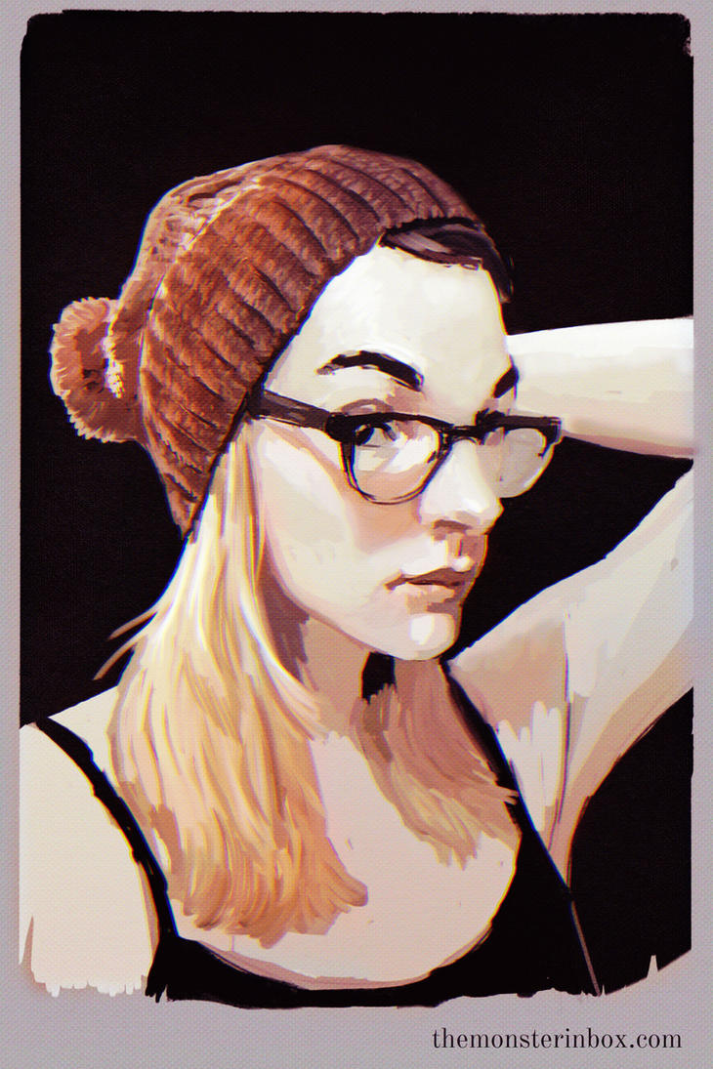
mEET Ava, from earhart-strasse 7, 5th floor
Ava is a 30 year old single, working mom!
She gets along with her neighbours and during their conversations and hangouts , a common problem comes up:
HOUSE FOOD WASTE!!!!
They all want to be more sustainable and reduce their waste? But how????

Slide 3
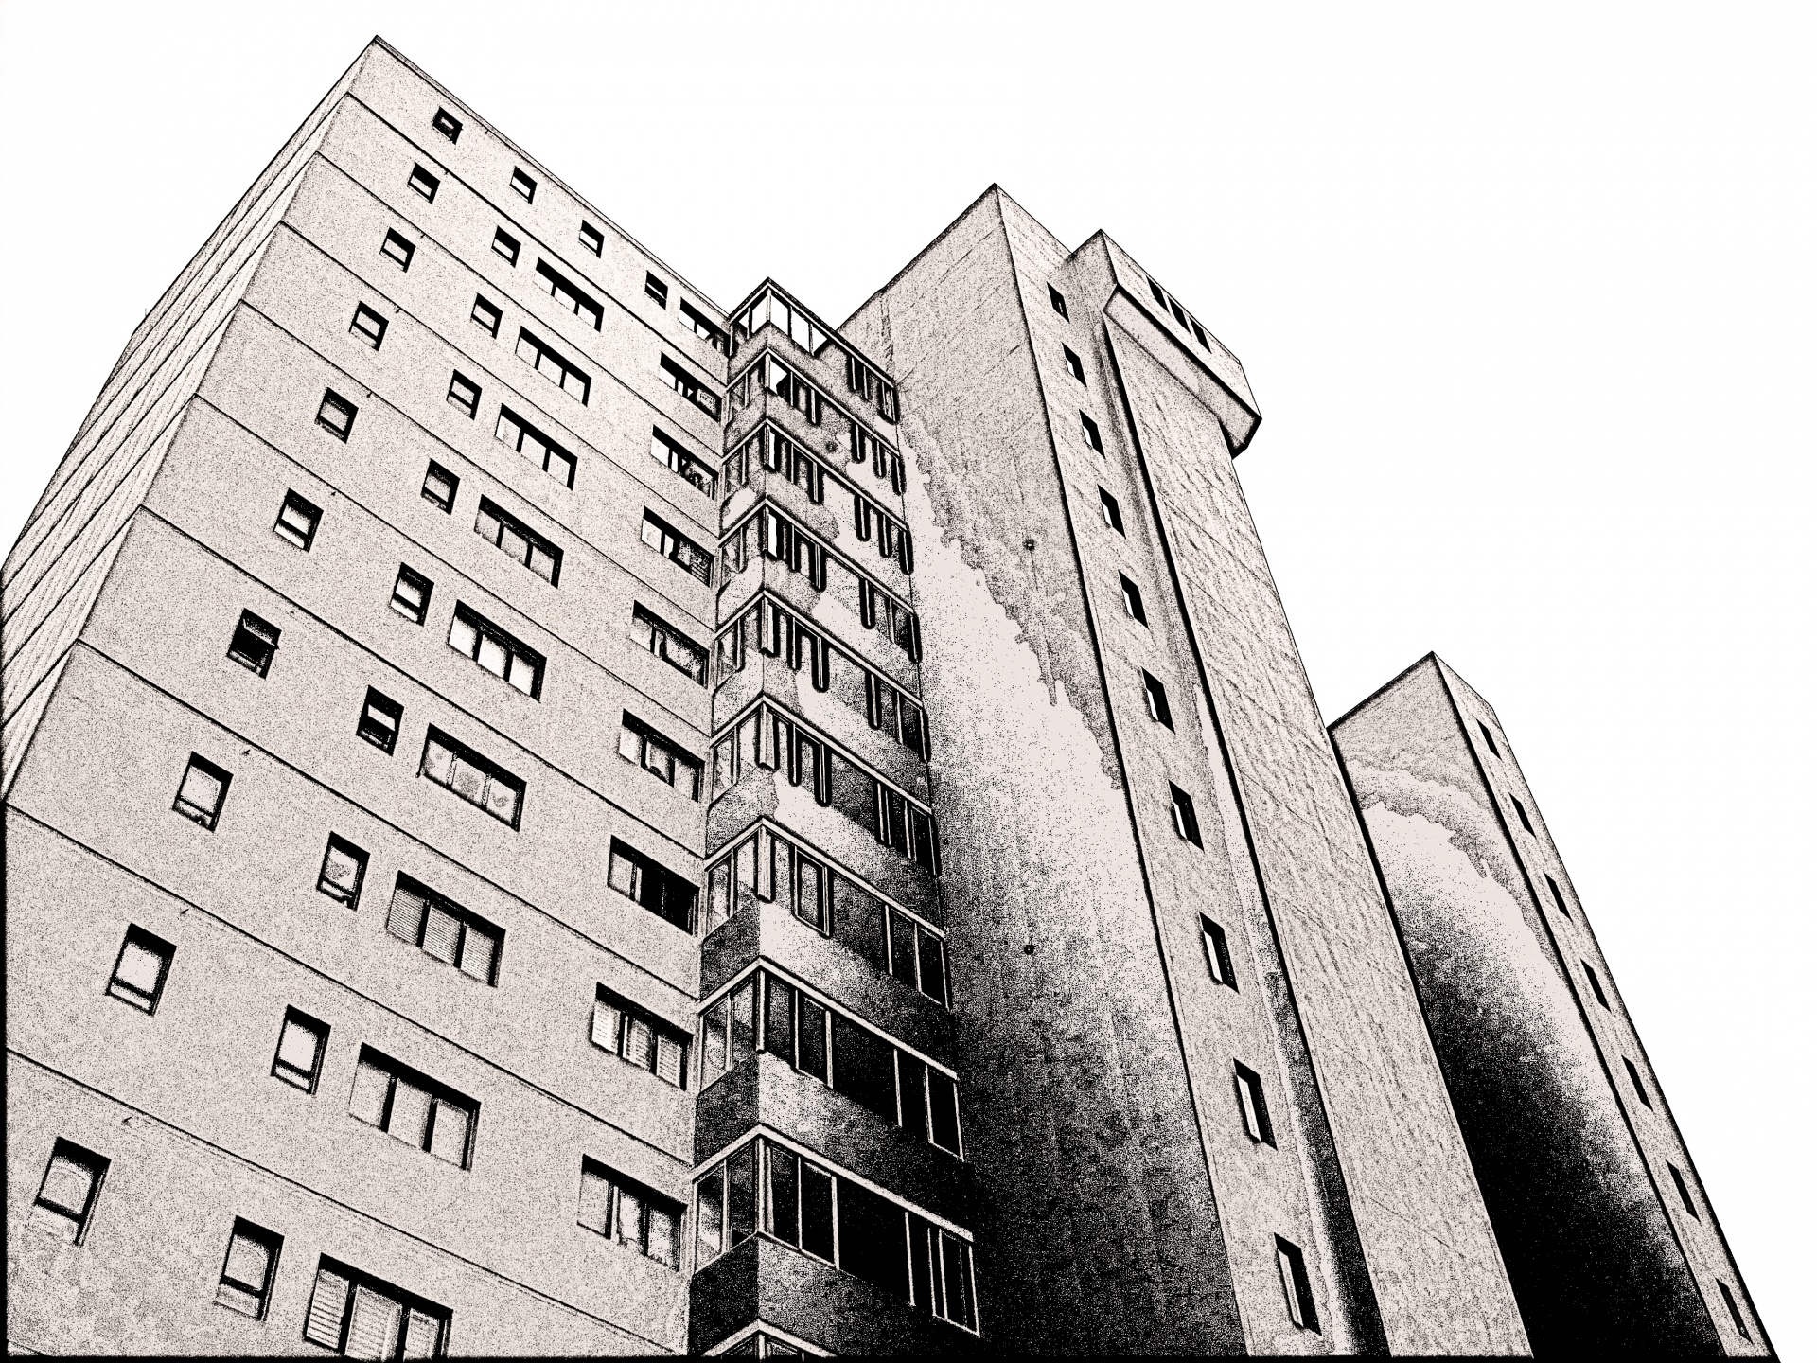
How about reducing food waste with your neighbours????
They realised that a lot of the times they buy food but it ends up staying in fridge, they either buy to much or buy to less…
What if they could exchange within themselves? What if there was a way the neighbours from the building could see when one of them has too much of a specific grocery that they won’t use and exchange???

Slide 4
ENTER FOODXCHANGE APP
WITH FOODXCHANGE UP:
YOU KNOW WHAT EVERYONE BOUGHT AND HOW MUCH THEIR USING
YOU KNOW EVERYONE’S WASTE AND YOU CAN ASK TO EXCHANGE THE FOOD BEFORE IT’S WASTED
IT’S FIGHT WASTE AS A GROUP, WITH YOUR NEIGHBOURS

Slide 5
HOW IT WORKS
The user periodically adds his shopping list to the app, either manually or through OCR on the receipt
When the system detects that there might be some food waste in the near future a notification is sent
The user can confirm the system hypothesis, they are then given a set of other users to exchange food with, on a scale based on eating habits similarity

Slide 6
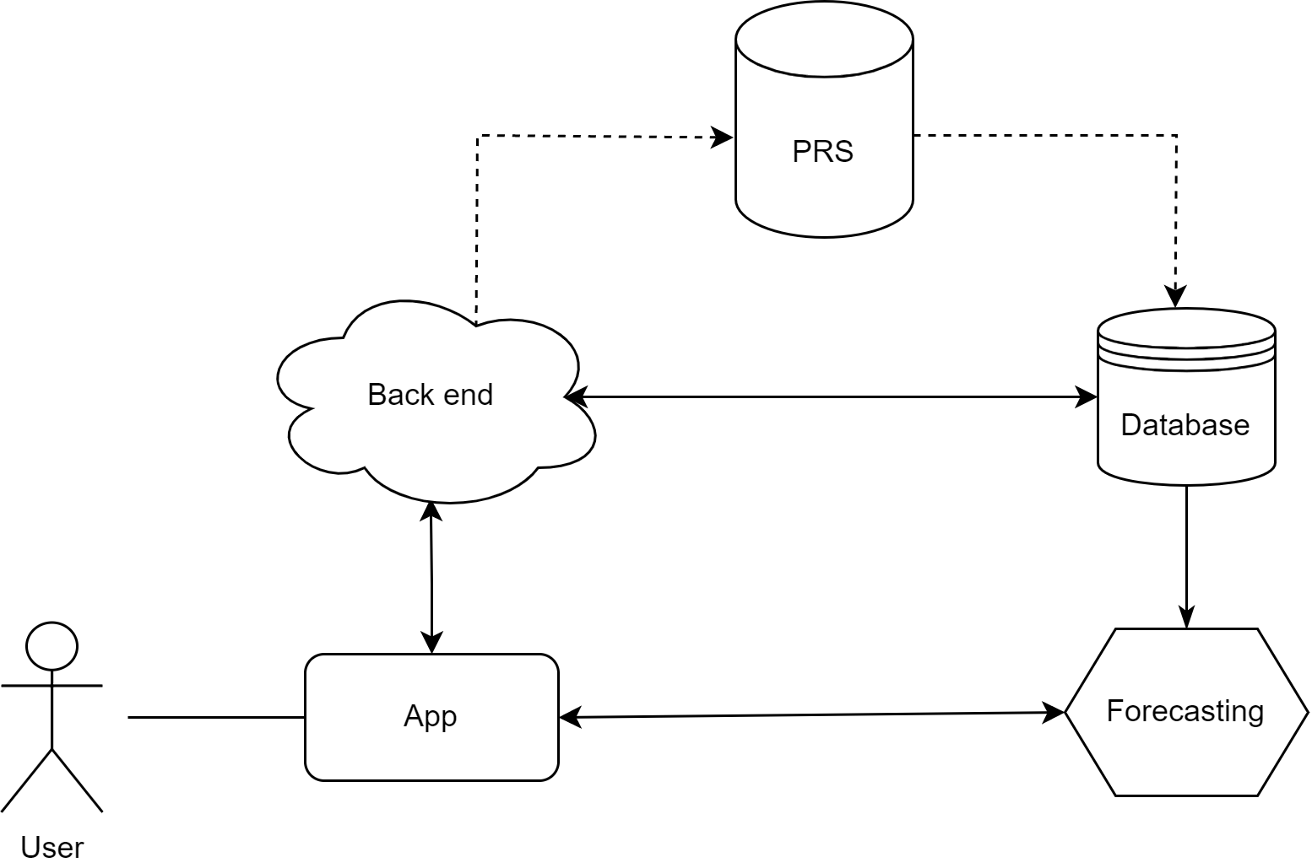
A POssible system architecture

Slide 7
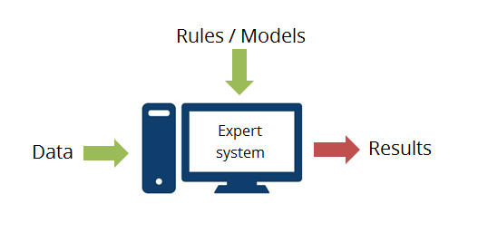
Notifying the user
A production rule system (a classical AI paradigm) is constantly listening for new user input and placing deadlines for food expiration
When a deadline is close the user is notified
Rules could be based on food typology and the family size of the user

Slide 8
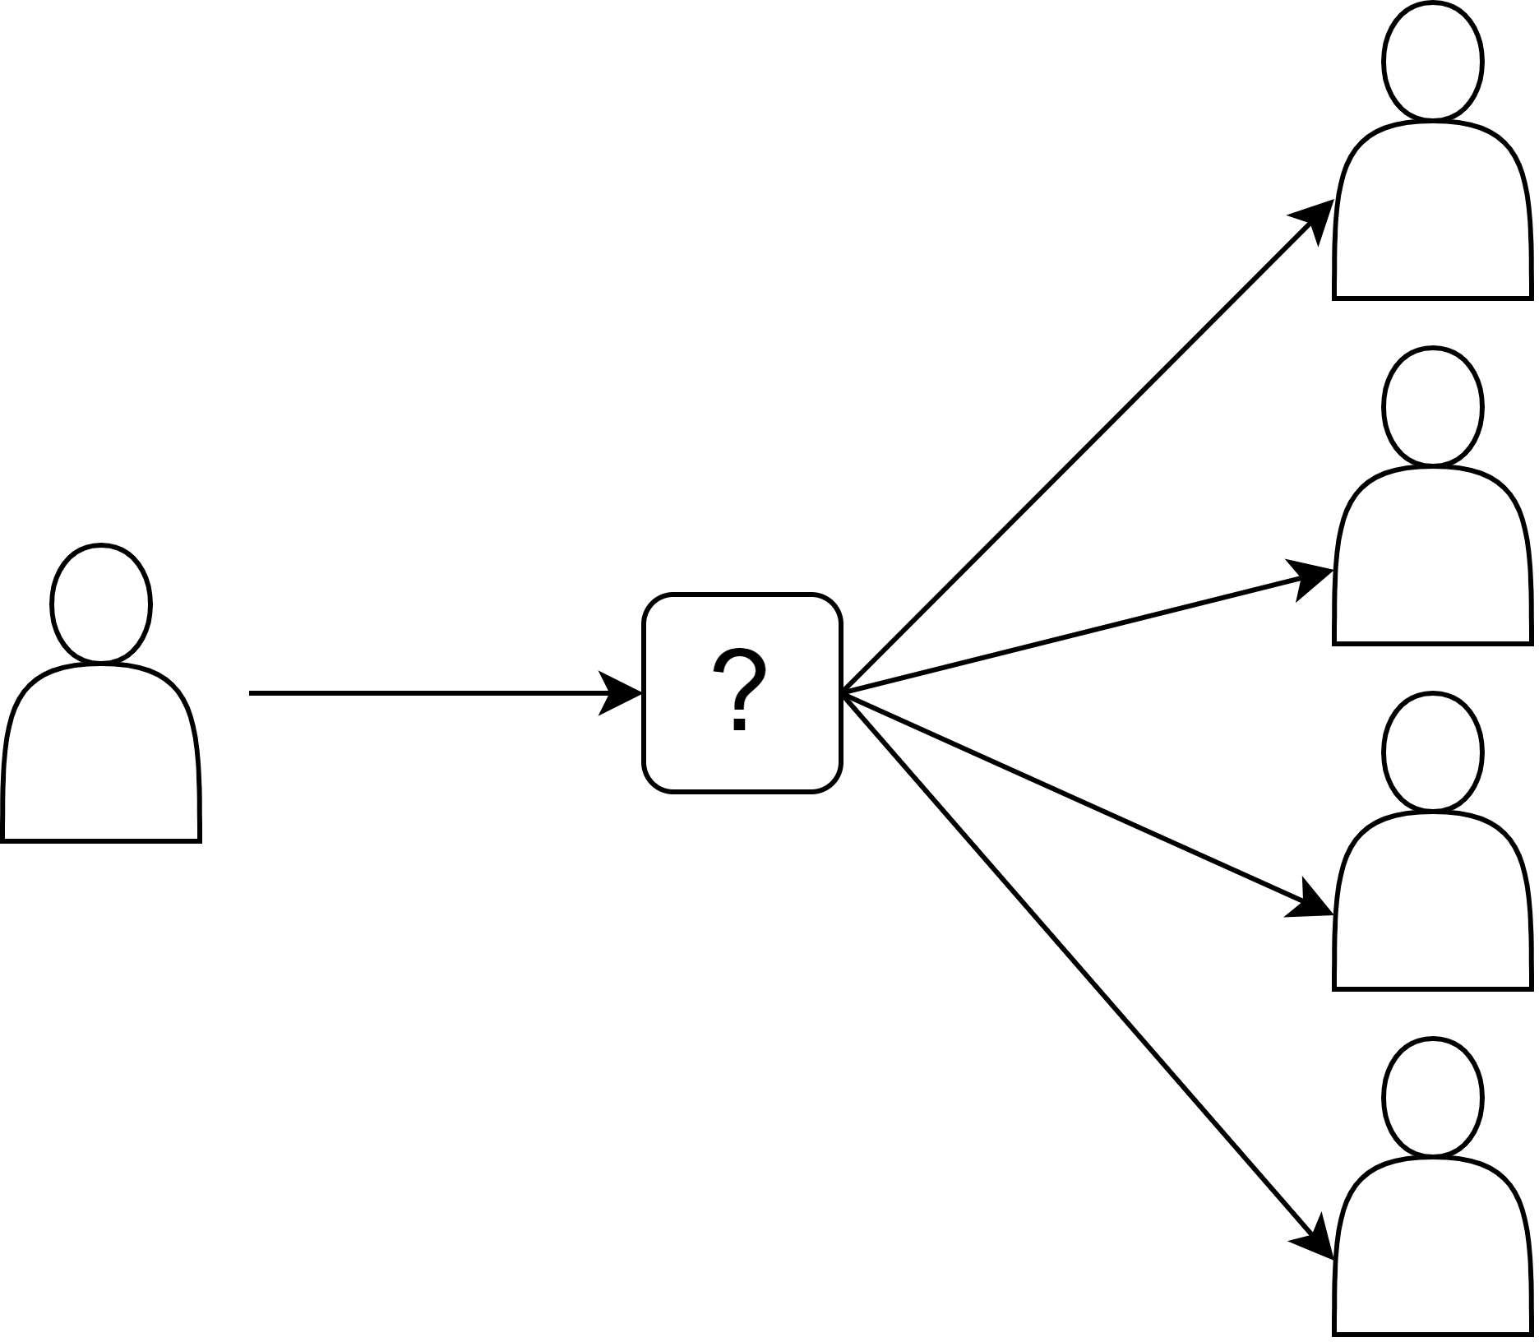
FInding the best match
Given a set of users and their purchase history a prediction is made on what they will need
The system matches the user's offering with those needs

Slide 9
What is performing the prediction
Future user needs are forecasted based on the user's history and a general population trend
This trend is learned by a neural network
The model implemented in the demo is based on the SimplifiedInstaCart dataset
The model follows an autoencoder architecture, given a list of highly dimensional features they are encoded in a lower dimensional latent space, processed in a recurrent section and finally expanded to express a possible future order

Slide 10
Front end demo
DEMO

Slide 11




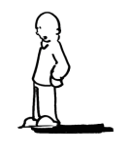
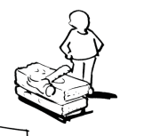
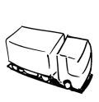



Business Model Canvas -
Key Partners Real estates agencies Suppermarkets Grocery stores | Key Activities Meet ups and live demos | Value Propositions Allows the inhabitants of a building to exchange their excess groceries between each other to save waste Thanks to AI , it can predict what waste you will have and proposes with which of your neighbours to exchange Needs minimum of 2 neighbours/inhabitants of a building to register |  | Customer Relationships Automated services (ai predicts your excess consumption and with of your neighbours to exchange it with) Community – set up only for each building Co-creation because the all neighbours need to register | Customer Segments Buildings and neighbourhood Adults from 20 to 65
 | Key Resources Software engineers server |  |  | Channels Social media :Instagram, pinterest, twitter. facebook Online and printed media
Cost Structure Server Software engineers Ml/ai engineers/specialists Marketing campaigns Staff (comms manager, project coordinators) |  |  | Revenue Streams Advertisement Membership Partnership with supermarkets and groceries
Social & Environmental Cost |  |  | Social & Environmental Benefit less home waste, community building. Where the inhabitants of the building support each other on theit sustainability journey
http://www.businessmodelgeneration.com

