Slide 1
Walkover
Tablut Challenge 2021
Diego Biagini, Ildebrando Simeoni

Slide 2
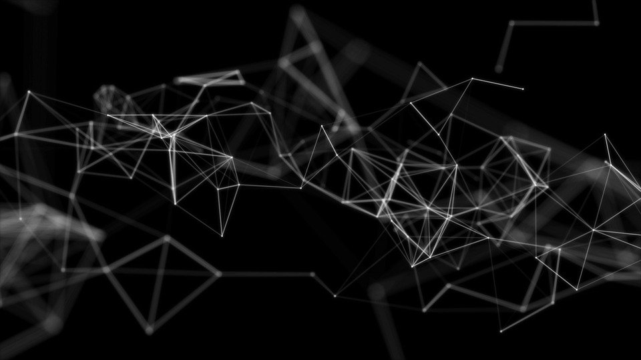
Black Heuristics
Piece Metric: number of white (rescaled) minus number of black pieces King Surrounded: number of blacks, throne and citadels surrounding king King Freedom: number of opponents along the four directions from king position King Support: number of whites in the 3x3 window around the king King Good Squares: goodness of the king position in the board
Piece Metric
King Surrounded
King Freedom
King Support
King Good Squares

Slide 3

White heuristics (early game)
Piece Metric: number of white (rescaled) minus number of black pieces King Surrounded: number of blacks, throne and citadels surrounding king King Good Squares: goodness of the king position in the board Free Cross: number of pawns in the cross passing through throne
Piece Metric
King Surrounded
King Good Squares
Free Cross

Slide 4
White heuristics (endgame)
Piece Metric: number of white (rescaled) minus number of black pieces King Surrounded: number of blacks, throne and citadels surrounding king King Freedom: number of opponents along the four directions from king position King Support: number of whites in the 3x3 window around the king Free Cross: number of pawns in the cross passing through throne
Piece Metric
King Surrounded
King Freedom
King Support
Free Cross

Slide 5
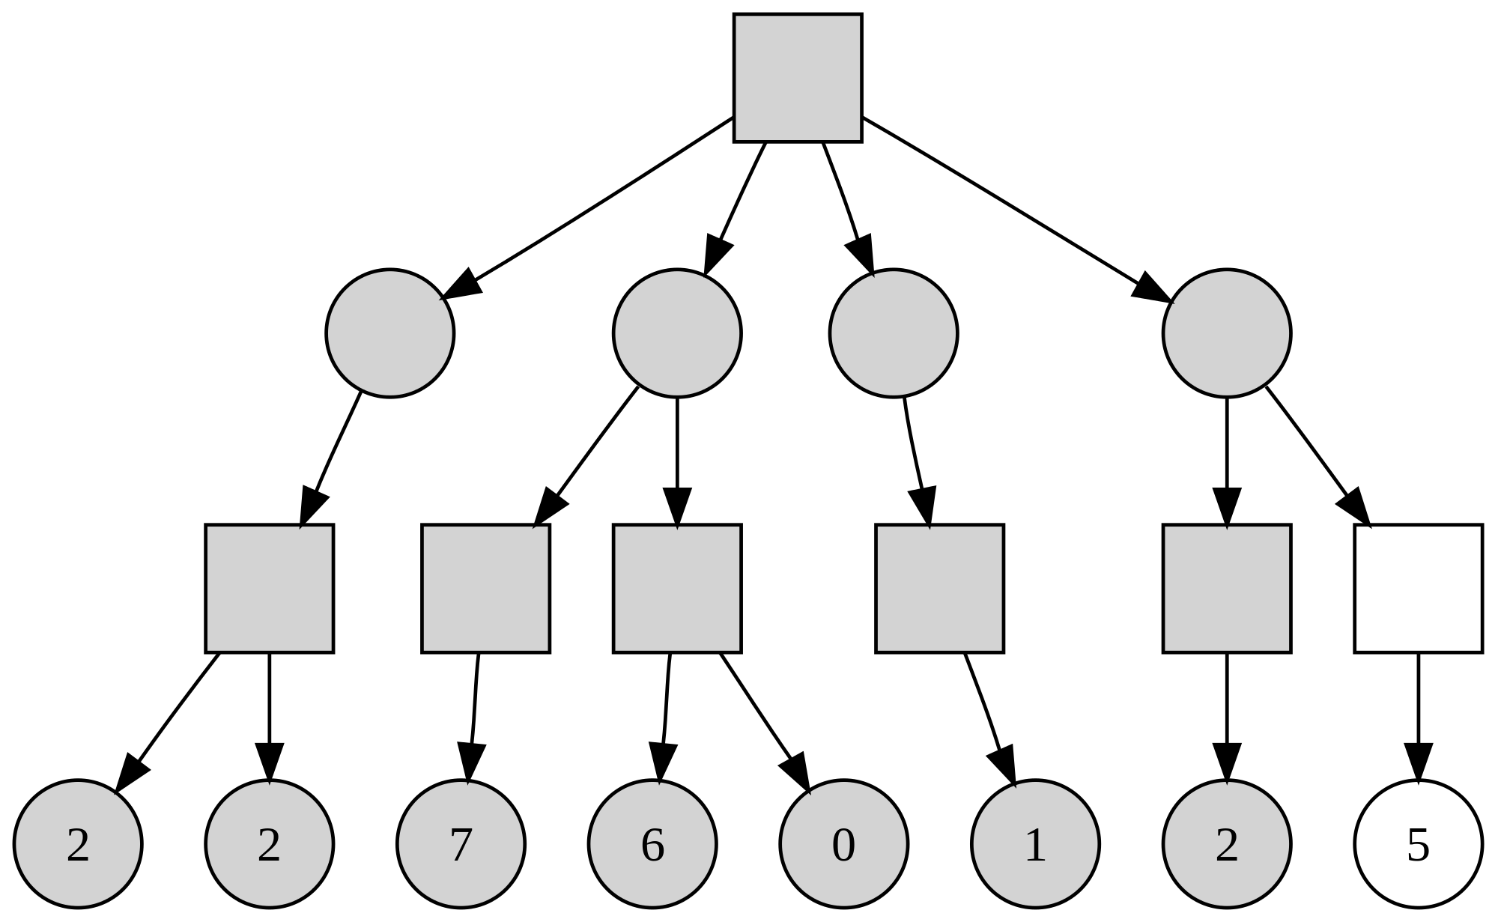
Search Algorithm
MinMax with alpha-beta pruning and iterative deepening has been used in order to explore as much of the tree as possible before the time allocated for the player runs out.

Slide 6
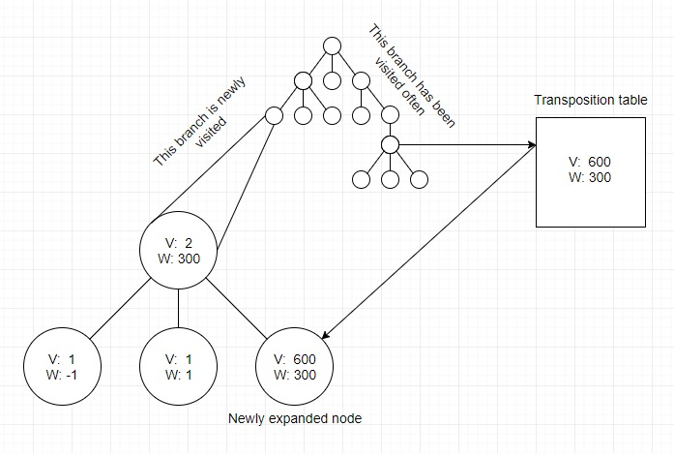
Transposition
tables
Zobrist hashing is used to implement transposition tables, a special kind of hash table that is indexed by a board position and used to avoid analyzing the same position more than once.

Slide 7
THANKS FOR YOUR
ATTENTION
WALKOVER

