Slide 1
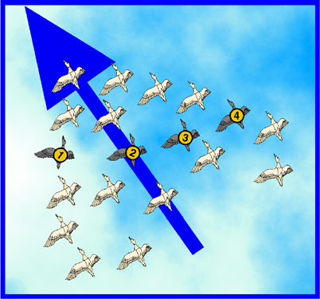
The Particle Swarm Optimization Algorithm
Decision Support
2010-2011
Andry Pinto
Hugo Alves
Inês Domingues
Luís Rocha
Susana Cruz

Slide 2
Summary
Introduction to Particle Swarm Optimization (PSO)
Origins
Concept
PSO Algorithm
PSO for the Bin Packing Problem (BPP)
Problem Formulation
Algorithm
Simulation Results

Slide 3


Introduction to the PSO: Origins
Inspired from the nature social behavior and dynamic movements with communications of insects, birds and fish

Slide 4
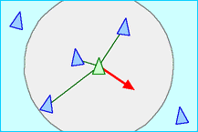
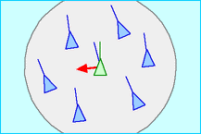
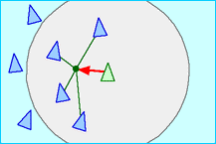
Introduction to the PSO: Origins
In 1986, Craig Reynolds described this process in 3 simple behaviors:
Separation
avoid crowding local flockmates
Alignment
move towards the average heading of local flockmates
Cohesion
move toward the average position of local flockmates

Slide 5

Introduction to the PSO: Origins
Application to optimization: Particle Swarm Optimization
Proposed by James Kennedy & Russell Eberhart (1995)
Combines self-experiences with social experiences

Slide 6
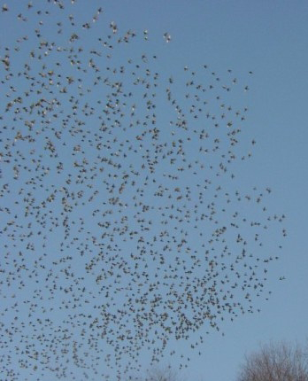
Introduction to the PSO: Concept
Uses a number of agents (particles) that constitute a swarm moving around in the search space looking for the best solution
Each particle in search space adjusts its “flying” according to its own flying experience as well as the flying experience of other particles

Slide 7
Introduction to the PSO: Concept
Collection of flying particles (swarm) - Changing solutions
Search area - Possible solutions
Movement towards a promising area to get the global optimum
Each particle keeps track:
its best solution, personal best, pbest
the best value of any particle, global best, gbest

Slide 8
Introduction to the PSO: Concept
Each particle adjusts its travelling speed dynamically corresponding to the flying experiences of itself and its colleagues
Each particle modifies its position according to:
its current position
its current velocity
the distance between its current position and pbest
the distance between its current position and gbest

Slide 9
Introduction to the PSO: Algorithm - Neighborhood
geographical
social

Slide 10
Introduction to the PSO: Algorithm - Neighborhood
global

Slide 11
Introduction to the PSO: Algorithm - Parameterss
Algorithm parameters
A : Population of agents
p_{i} : Position of agent a_{i} in the solution space
f : Objective function
v_{i} : Velocity of agent’s a_{i}
V(a_{i}) : Neighborhood of agent a_{i} (fixed)
The neighborhood concept in PSO is not the same as the one used in other meta-heuristics search, since in PSO each particle’s neighborhood never changes (is fixed)

Slide 12

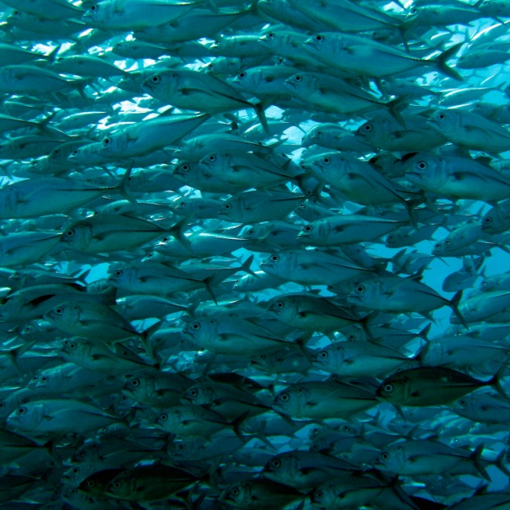
Introduction to the PSO: Algorithm
[x*] = PSO()
P = Particle_Initialization();
For i=1 to it_max
For each particle p in P do
fp = f(p);
If fp is better than f(pBest)
pBest = p;
end
end gBest = best p in P;
For each particle p in P do
v = v + c1*rand*(pBest – p) + c2*rand*(gBest – p);
p = p + v; end end

Slide 13
Introduction to the PSO: Algorithm
Particle update rule
p = p + v
with
v = v + c₁ * rand * (pBest – p) + c₂ * rand * (gBest – p)
where
p: particle’s position
v: path direction
c₁: weight of local information
c₂: weight of global information
pBest: best position of the particle
gBest: best position of the swarm
rand: random variable
Notes:
c1, c2 : The balance factors between the effect of self-knowledge and social knowledge in moving the particle towards the target. Usually the value 2 is suggested for both factors in the literature)
rand :A random number between 0 and 1, and different at each iteration
w : Inertia weight
pbest : The best position of a particle
gbest : The best position within the swarm
prtvel : The velocity of jth particle in ith iteration
prtpos : The position of jth particle in ith iteration

Slide 14
Introduction to the PSO: Algorithm - Parameters
Number of particles usually between 10 and 50
C₁ is the importance of personal best value
C₂ is the importance of neighborhood best value
Usually C₁ + C₂ = 4 (empirically chosen value)
If velocity is too low → algorithm too slow
If velocity is too high → algorithm too unstable

Slide 15
Introduction to the PSO: Algorithm
Create a ‘population’ of agents (particles) uniformly distributed over X
Evaluate each particle’s position according to the objective function
If a particle’s current position is better than its previous best position, update it
Determine the best particle (according to the particle’s previous best positions)

Slide 16
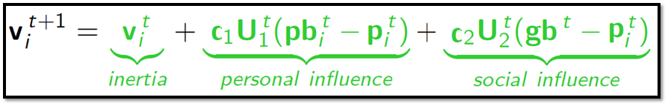

Introduction to the PSO: Algorithm
Update particles’ velocities:
Move particles to their new positions:
Go to step 2 until stopping criteria are satisfied

Slide 17
Introduction to the PSO: Algorithm
Particle’s velocity:
1. Inertia
Makes the particle move in the same direction and with the same velocity
Improves the individual
Makes the particle return to a previous position, better than the current
Conservative
2. Personal Influence
3. Social Influence
Makes the particle follow the best neighbors direction

Slide 18
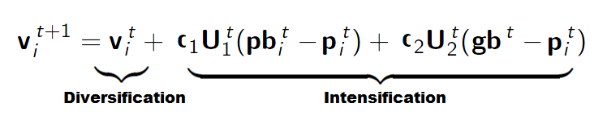
Introduction to the PSO: Algorithm
Intensification: explores the previous solutions, finds the best solution of a given region
Diversification: searches new solutions, finds the regions with potentially the best solutions
In PSO:

Slide 19
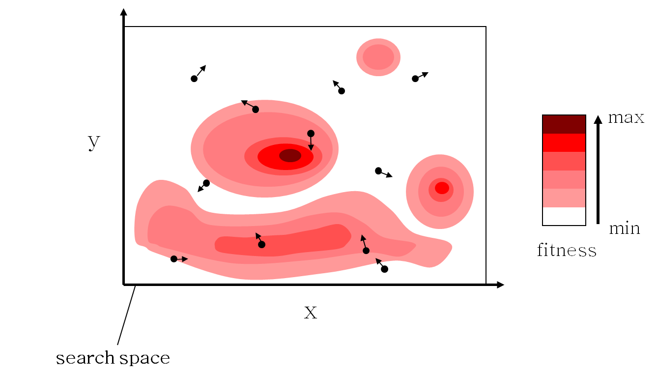
Introduction to the PSO: Algorithm - Example

Slide 20
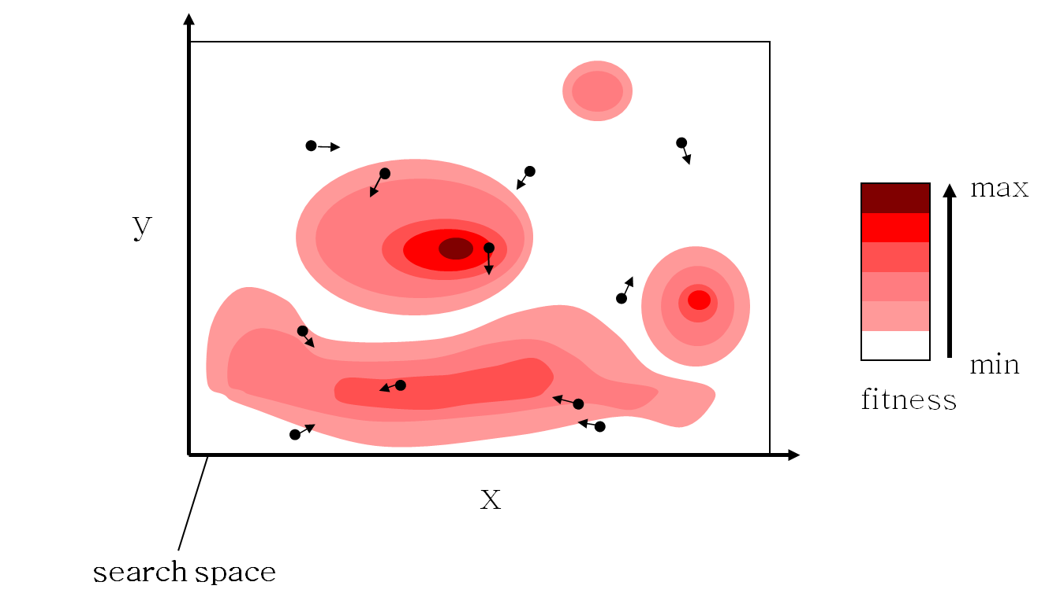
Introduction to the PSO: Algorithm - Example

Slide 21
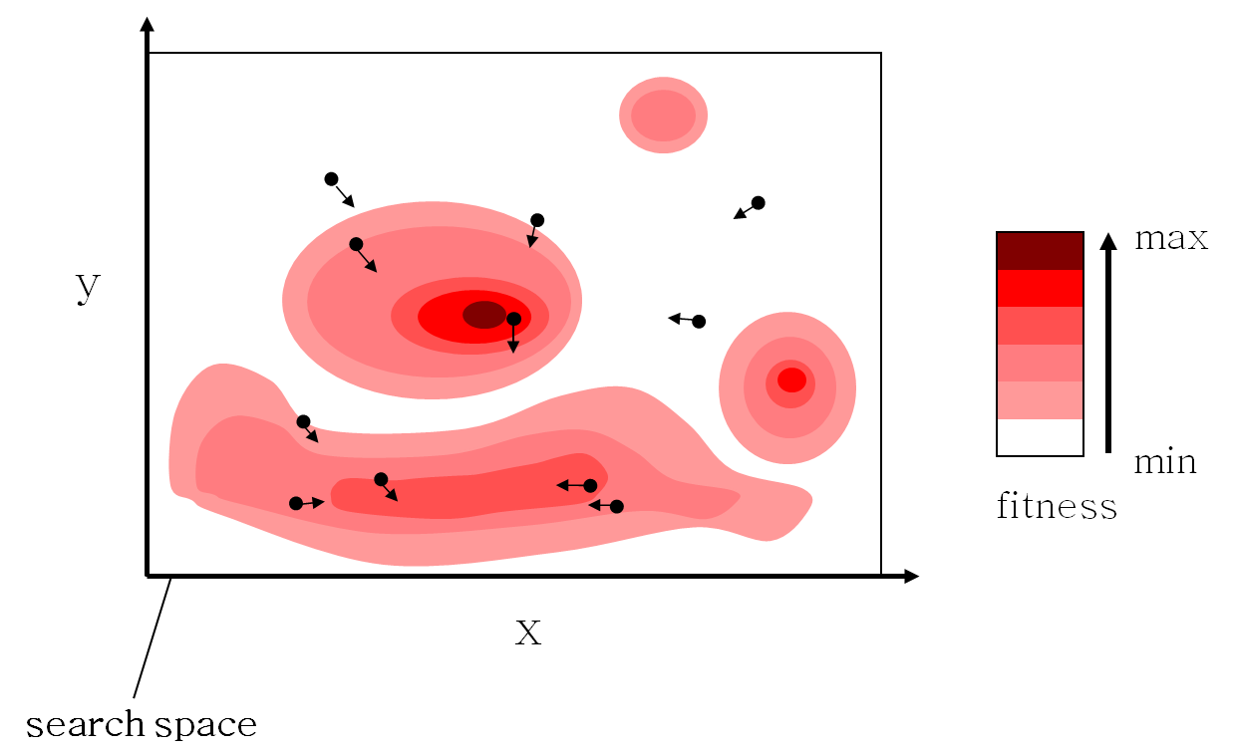
Introduction to the PSO: Algorithm - Example

Slide 22

Introduction to the PSO: Algorithm - Example

Slide 23

Introduction to the PSO: Algorithm - Example

Slide 24
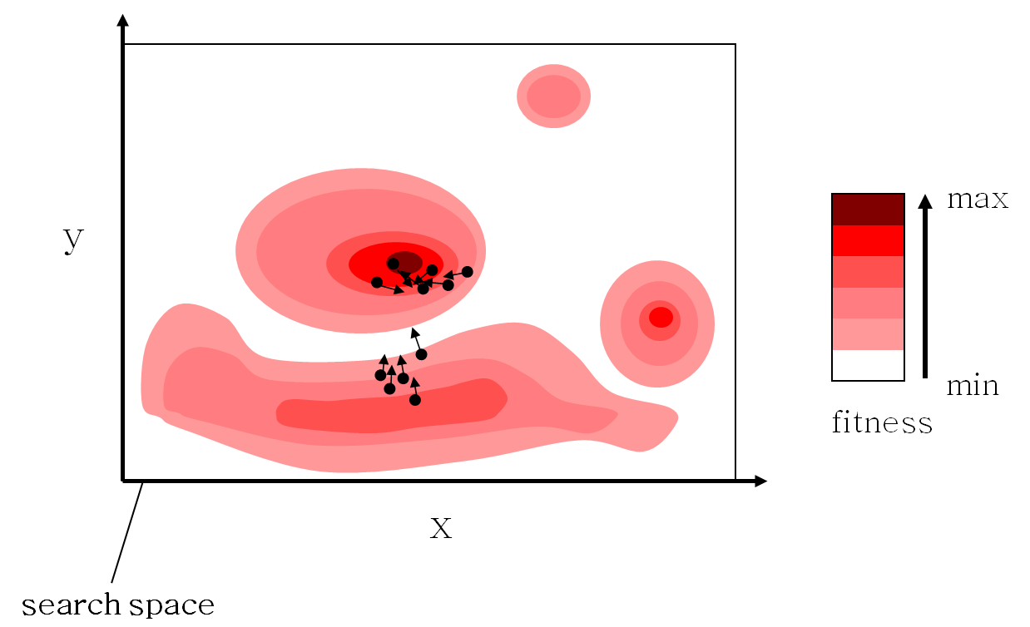
Introduction to the PSO: Algorithm - Example

Slide 25
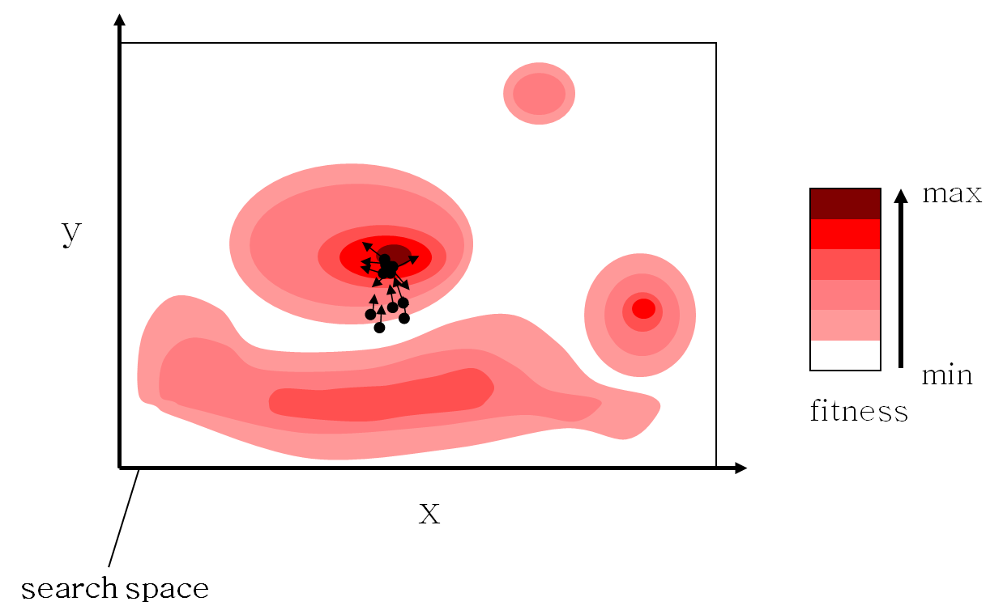
Introduction to the PSO: Algorithm - Example

Slide 26

Introduction to the PSO: Algorithm - Example

Slide 27
Introduction to the PSO: Algorithm Characteristics
Advantages
Insensitive to scaling of design variables
Simple implementation
Easily parallelized for concurrent processing
Derivative free
Very few algorithm parameters
Very efficient global search algorithm
Disadvantages
Tendency to a fast and premature convergence in mid optimum points
Slow convergence in refined search stage (weak local search ability)

Slide 28
Introduction to the PSO: Different Approaches
Several approaches
2-D Otsu PSO
Active Target PSO
Adaptive PSO
Adaptive Mutation PSO
Adaptive PSO Guided by Acceleration Information
Attractive Repulsive Particle Swarm Optimization
Binary PSO
Cooperative Multiple PSO
Dynamic and Adjustable PSO
Extended Particle Swarms
…
Davoud Sedighizadeh and Ellips Masehian, “Particle Swarm Optimization Methods, Taxonomy and Applications”.
International Journal of Computer Theory and Engineering, Vol. 1, No. 5, December 2009

Slide 29
PSO for the BPP: Introduction
On solving Multiobjective Bin Packing Problem Using Particle Swarm Optimization
D.S Liu, K.C. Tan, C.K. Goh and W.K. Ho
2006 - IEEE Congress on Evolutionary Computation
First implementation of PSO for BPP

Slide 30
PSO for the BPP: Problem Formulation
Multi-Objective 2D BPP
Maximum of I bins with width W and height H
J items with w_{j} ≤ W, h_{j} ≤ H and weight ψ_{j}
Objectives
Minimize the number of bins used K
Minimize the average deviation between the overall centre of gravity and the desired one

Slide 31
PSO for the BPP: Initialization
Usually generated randomly
In this work:
Solution from Bottom Left Fill (BLF) heuristic
To sort the rectangles for BLF:
Random
According to a criteria (width, weight, area, perimeter..)

Slide 32
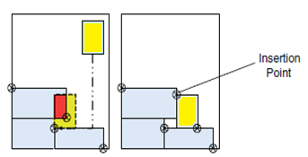
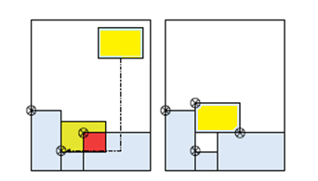
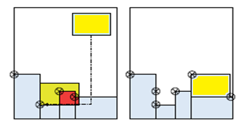
PSO for the BPP: Initialization BLF
Item moved to the right if
intersection detected at the top
Item moved to the top if
intersection detected at the right
Item moved if there is a lower available space for insertion

Slide 33
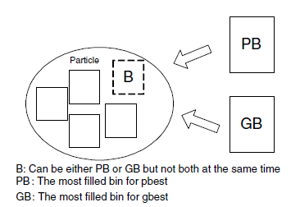


PSO for the BPP: Algorithm
Velocity depends on either pbest or gbest: never both at the same time
OR

Slide 34
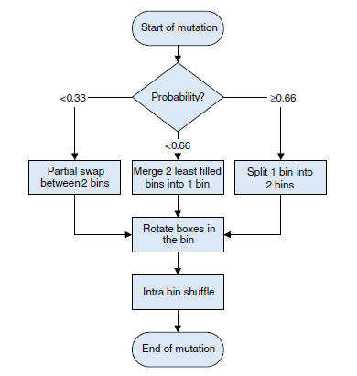
PSO for the BPP: Algorithm
1st Stage:
Partial Swap between 2 bins
Merge 2 bins
Split 1 bin
2nd Stage:
Random rotation
3rd Stage:
Random shuffle
Mutation modes for a single particle

Slide 35
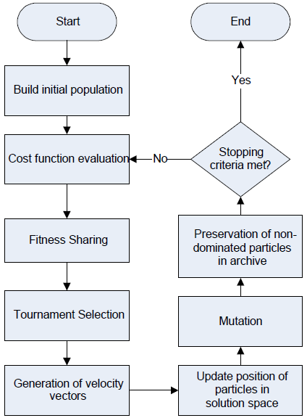
PSO for the BPP: Algorithm
H hybrid
M multi
O objective
P particle
S swarm
O optimization
The flowchart of HMOPSO

Slide 36
PSO for the BPP: Problem Formulation
6 classes with 20 instances randomly generated
Size range:
Class 1: [0, 100]
Class 2: [0, 25]
Class 3: [0, 50]
Class 4: [0, 75]
Class 5: [25, 75]
Class 6: [25, 50]
Class 2: small items → more difficult to pack

Slide 37
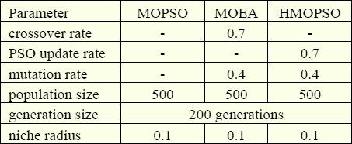
PSO for the BPP: Simulation Results
Comparison with 2 other methods
MOPSO (Multiobjective PSO) from [1]
MOEA (Multiobjective Evolutionary Algorithm) from [2]
Definition of parameters:
[1] Wang, K. P., Huang, L., Zhou C. G. and Pang, W., “Particle Swarm Optimization for Traveling Salesman Problem,” International Conference on Machine Learning and Cybernetics, vol. 3, pp. 1583-1585, 2003.
[2] Tan, K. C., Lee, T. H., Chew, Y. H., and Lee, L. H., “A hybrid multiobjective evolutionary algorithm for solving truck and trailer vehicle routing problems,” IEEE Congress on Evolutionary Computation, vol. 3, pp. 2134-2141, 2003.

Slide 38
PSO for the BPP: Simulation Results
Comparison on the performance of metaheuristic algorithms against the branch and bound method (BB) on single objective BPP
Results for each algorithm in 10 runs
Proposed method (HMOPSO) capable of evolving more optimal solution as compared to BB in 5 out of 6 classes of test instances

Slide 39
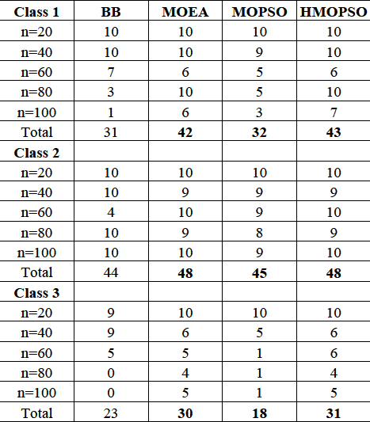
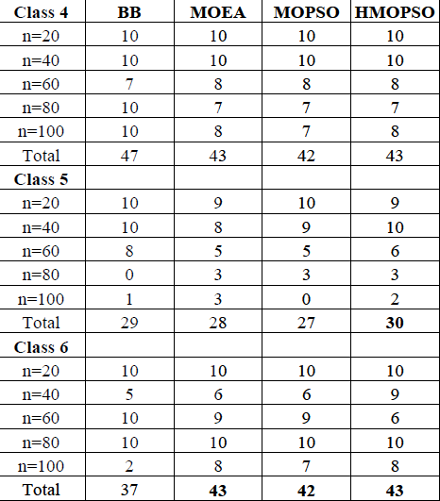
PSO for the BPP: Simulation Results
Number of optimal solution obtained

Slide 40
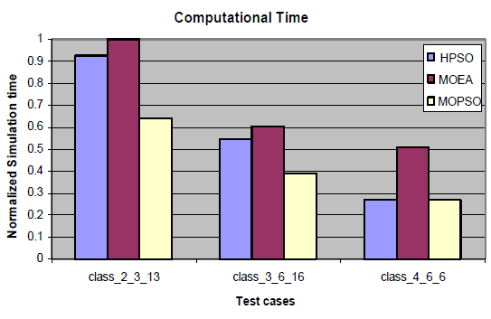
PSO for the BPP: Simulation Results
Computational Efficiency
stop after 1000 iterations or no improvement in last 5 generations
MOPSO obtained inferior results compared to the other two

Slide 41
PSO for the BPP: Conclusions
Presentation of a mathematical model for MOBPP-2D
MOBPP-2D solved by the proposed HMOPSO
BLF chosen as the decoding heuristic
HMOPSO is a robust search optimization algorithm
Creation of variable length data structure
Specialized mutation operator
HMOPSO performs consistently well with the best average performance on the performance metric
Outperforms MOPSO and MOEA in most of the test cases used in this paper

Slide 42
The Particle Swarm Optimization Algorithm
?

