Slide 1
Federated Learning with Pretrained Text DNNs
Sponsor: Google
Data Scientists: Arjun Singh, Joel Stremmel

Slide 2

Stack Overflow Data
Host: Kaggle
Owner: Stack Overflow
License: CC BY-SA 3.0
Access API: Tensorflow Federated Datasets
Image Source: https://images.app.goo.gl/VrkTzXGHXBdi2A6X9

Slide 3
Access
The tff.simulation.ClientData class
Holds a dataset and maps clients to examples for Federated SGD
Data is not brought into memory until training starts
Access a dataset from tff.simulation.datasets, i.e. tff.simulation.datasets.stackoverflow

Slide 4
Attributes
Content: Body text of all Stack Overflow Questions and Answers (Updates Quarterly)
Metadata:
Creation date
Question title
Question tags
Question score
Type (Question or Answer)
Data Splits:
Train: Data before 2018-01-01 UTC except the held-out users. 342,477 unique users with 135,818,730 examples.
Held-out: All examples from users with user_id % 10 == 0 (all dates). 38,758 unique users with 16,491,230 examples.
Test: All examples after 2018-01-01 UTC except from held-out users. 204,088 unique users with 16,586,035 examples.
Slide Text Source: https://www.tensorflow.org/federated/api_docs/python/tff/simulation/datasets/stackoverflow/load_data

Slide 5
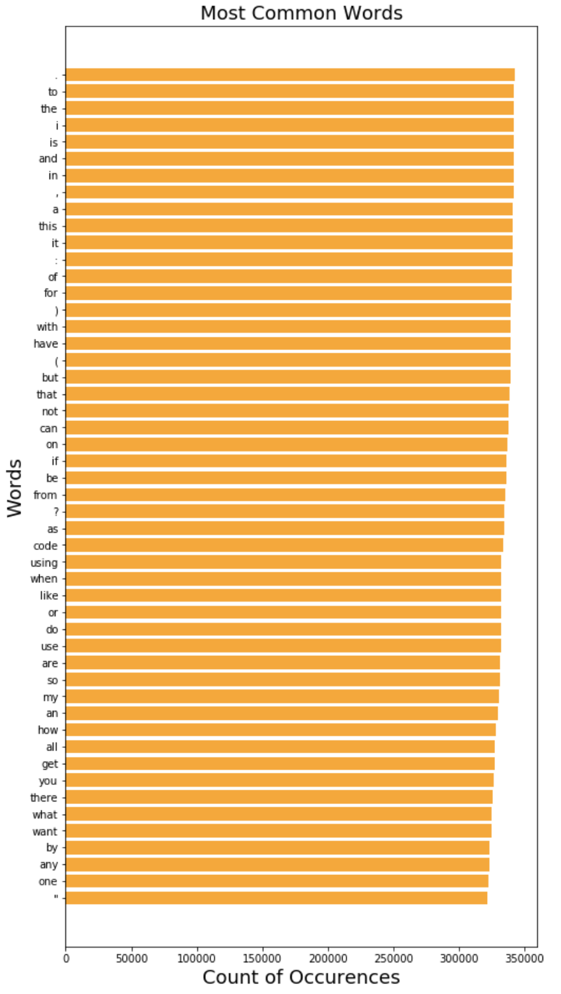
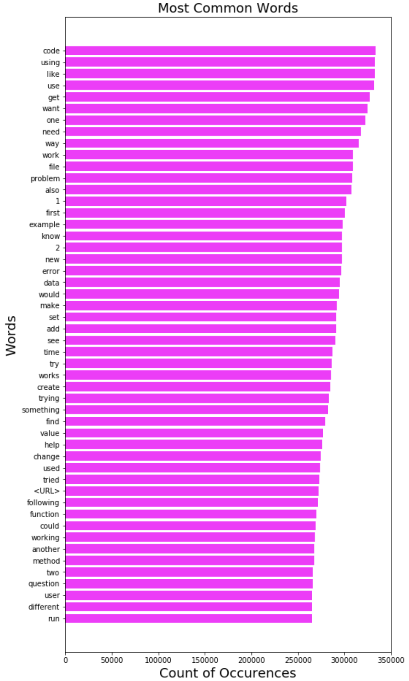
Exploratory Analysis: The Most Common Words Used on Stack Overflow
Before stopwords and punctuation filter.
After stopwords and punctuation filter.

