Slide 1
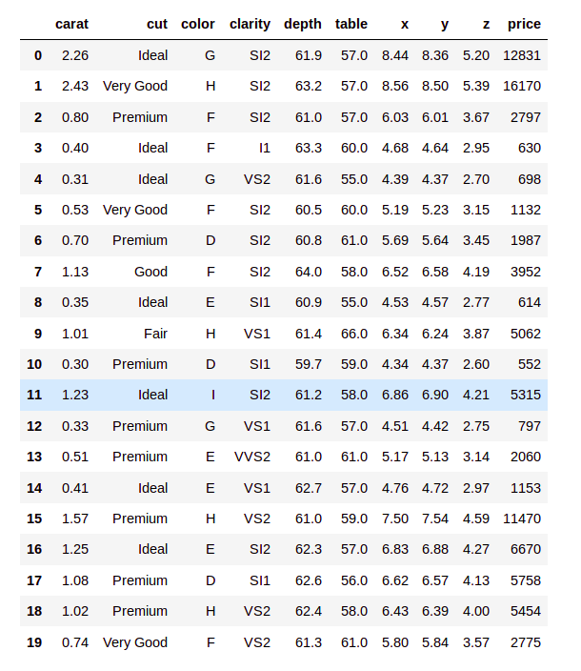
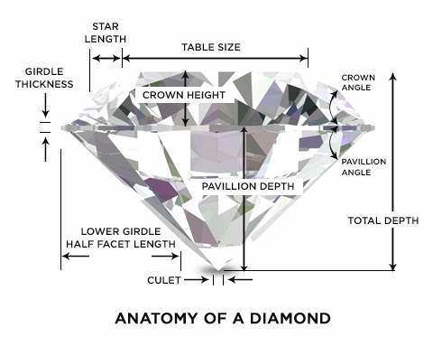
Diamonds Dataset

Slide 2
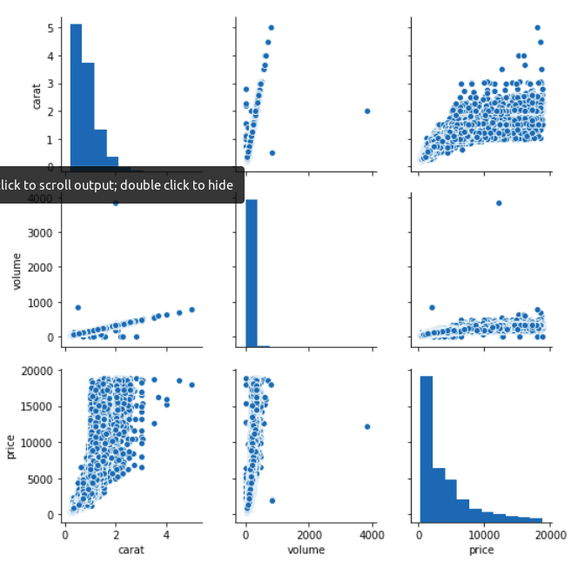
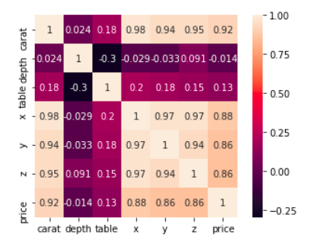
Feature extractions
numerical

Slide 3
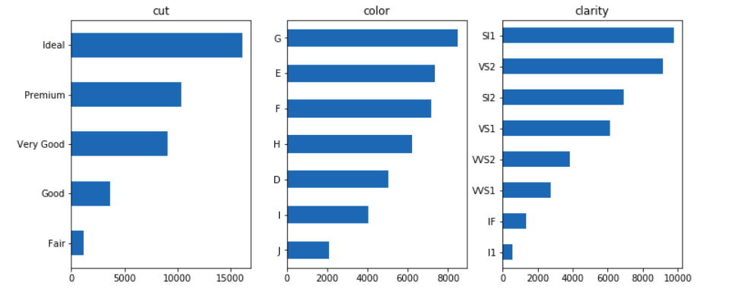
Dealing with categorical features
Increasing encoding
Hot encoding

Slide 4
MODEL DESIGN
Preprocessing -> standarization + normalization
Test size = 20% / 10%
Model evaluation -> RMSE

Slide 5




MODELS
RandomForestRegressor
DecisionTreeRegressor
AdaBoostRegressor
KNeighborsRegressor

Slide 6
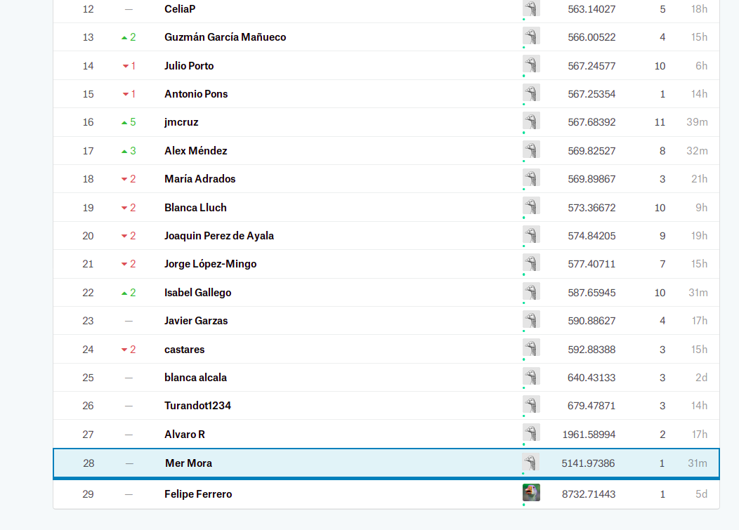

Uploading....

