Slide 1
OAuth 2.0 Access Tokens
are bearer tokens

Slide 2
No correlation between
an access token and
an OAuth client.

Slide 3
Source Code
https://github.com/Sathyaish/Training/tree/master/OAuth2/Thief

Slide 4


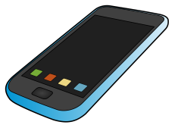

access_token = kjfgkjfgkj459845
OAuth Provider
Get/user/data?access_token = kjfgkjfgkj459845
access_token = kjfgkjfgkj459845
Android native app
OAuth Client (browser)

Slide 5

access_token = kjfgkjfgkj459845
OAuth Provider
Get/user/data?access_token = kjfgkjfgkj459845
access_token = kjfgkjfgkj459845
Hacker’s bad application
OAuth Client (browser)

Slide 6
OAuth 2.0 Server Best Practices
Make sure access tokens expire.
Make sure that the fields being requested and serviced are within the requested scope.
Make sure the request is on HTTPS
Moot point: Whitelist request origins

Slide 7
OAuth 2.0 Access Tokens
are bearer tokens

Slide 8
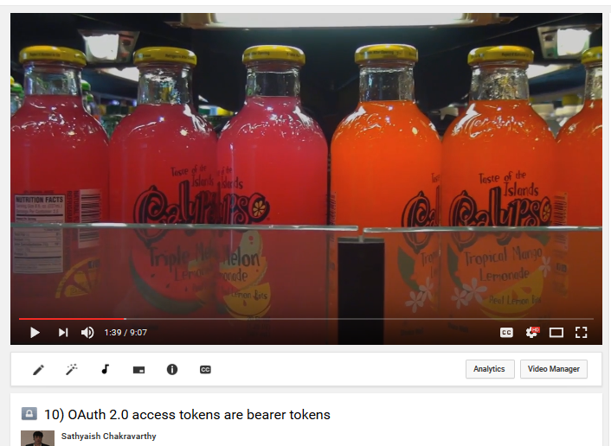
Watch this on YouTube
10) OAuth 2.0 access tokens are bearer tokens
https://www.youtube.com/watch?v=fBCHbSmzZzg

Slide 9
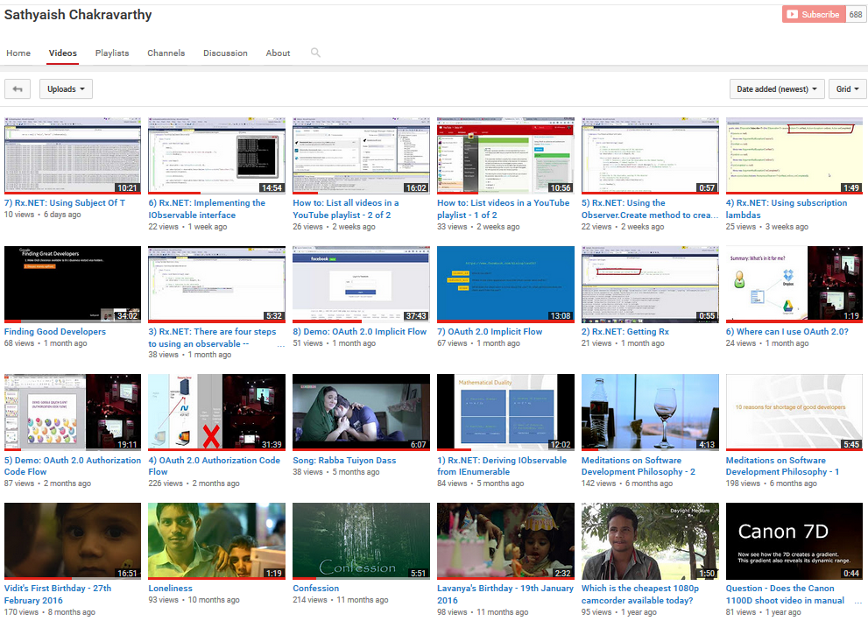
Hire me for training and/or software development
https://www.youtube.com/user/Sathyaish
Sathyaish Chakravarthy
Sathyaish@gmail.com
Stack Overflow
http://stackoverflow.com/users/
303685/water-cooler-v2
Sathyaish Chakravarthy
https://github.com/Sathyaish

