Slide 1
OAuth 2.0 Client for Google –
Implicit Flow

Slide 2
Source Code
https://github.com/Sathyaish/Training/tree/master/OAuth2/Google

Slide 3
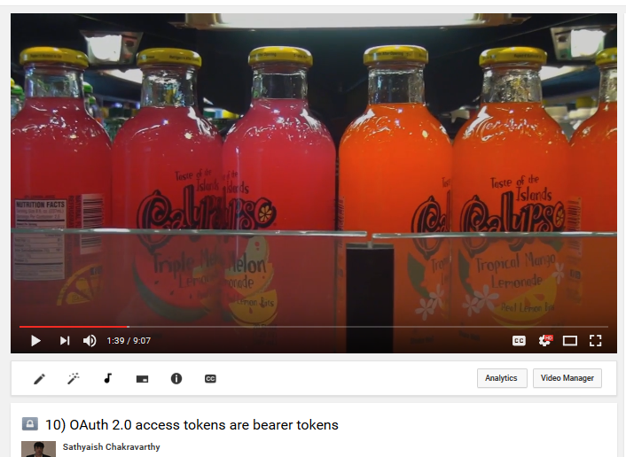
Watch this on YouTube
10) OAuth 2.0 access tokens are bearer tokens
https://www.youtube.com/watch?v=fBCHbSmzZzg

Slide 4
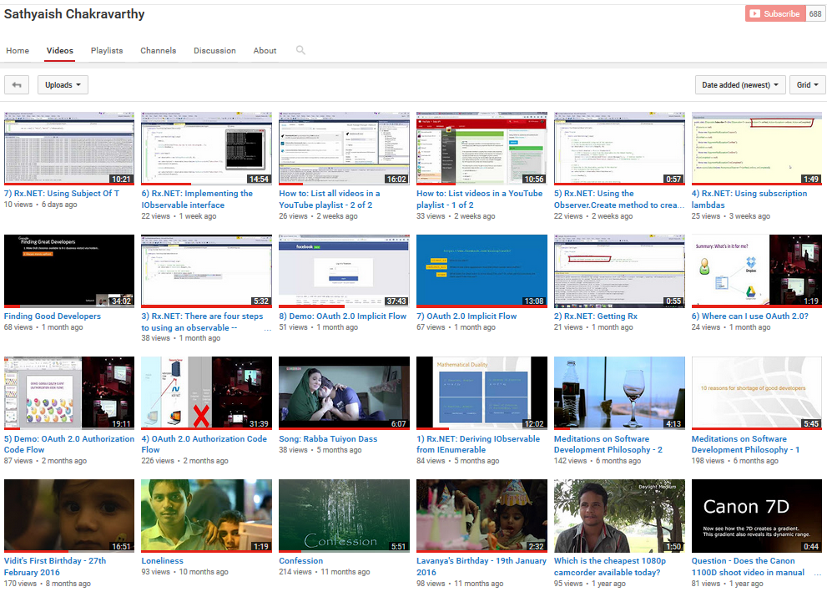
Hire me for training and/or software development
https://www.youtube.com/user/Sathyaish
Sathyaish Chakravarthy
Sathyaish@gmail.com
Stack Overflow
http://stackoverflow.com/users/
303685/water-cooler-v2
Sathyaish Chakravarthy
https://github.com/Sathyaish

