Slide 1
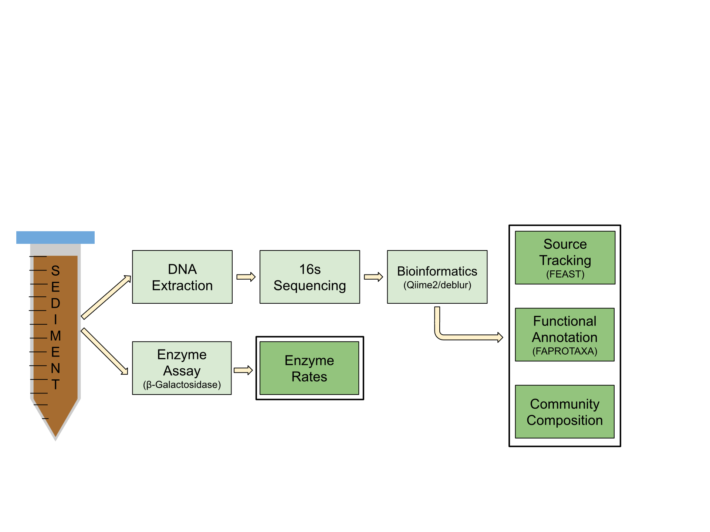
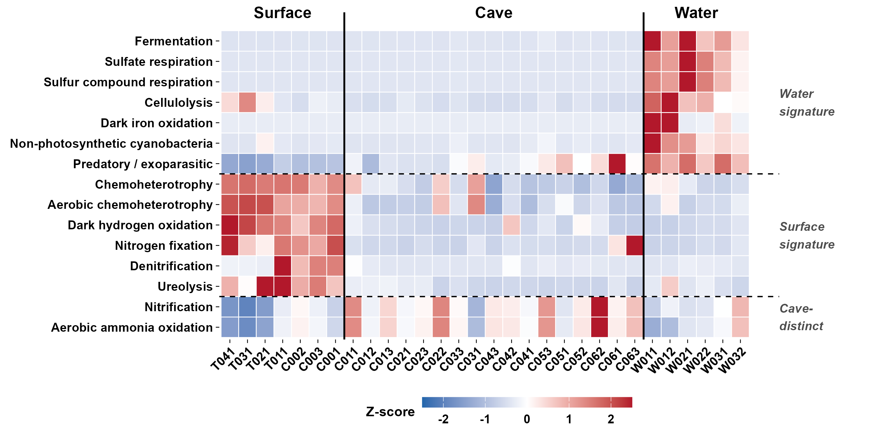
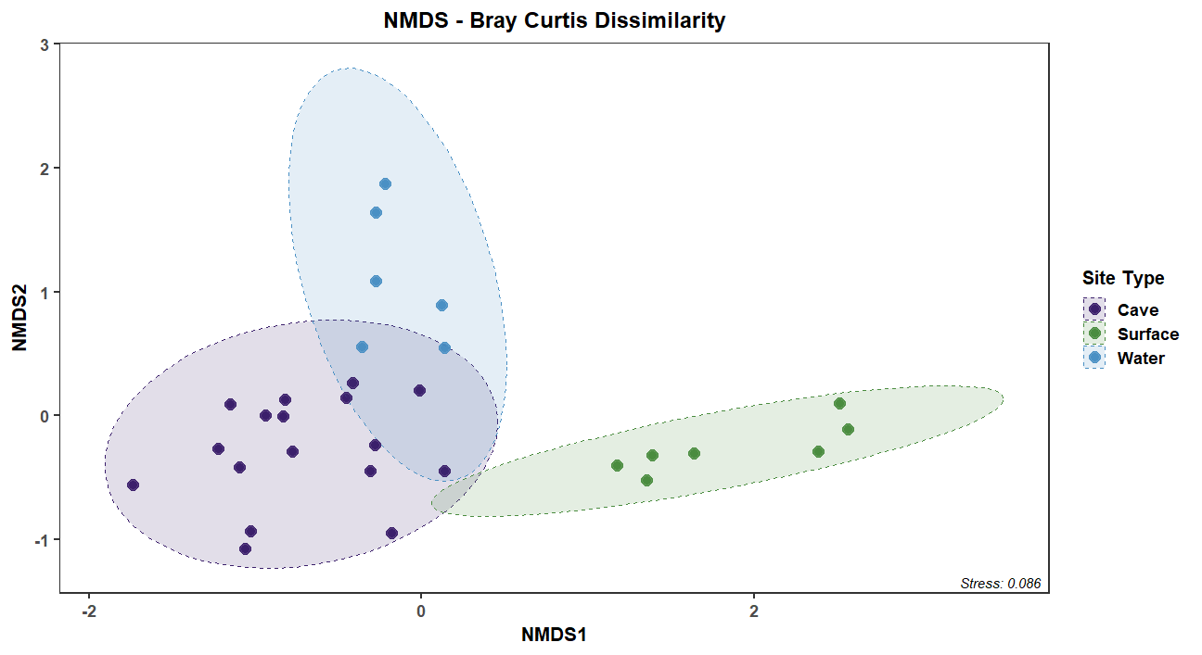
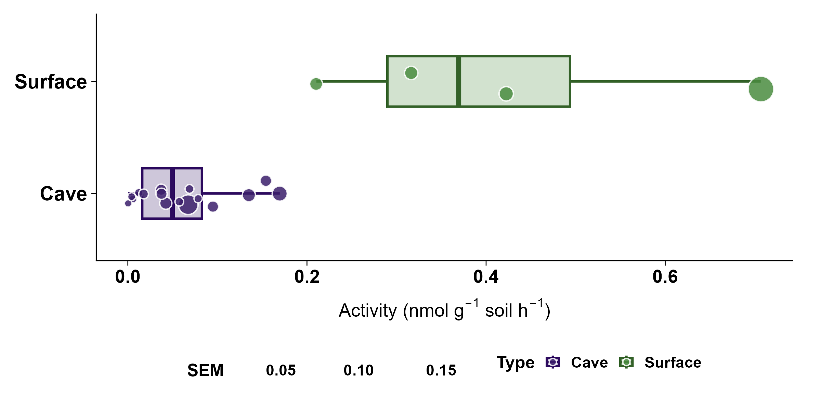
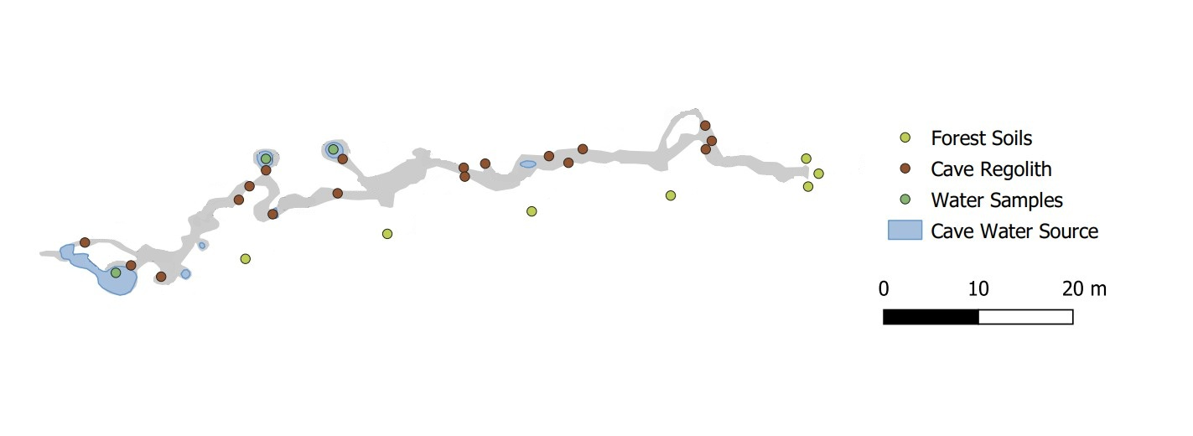
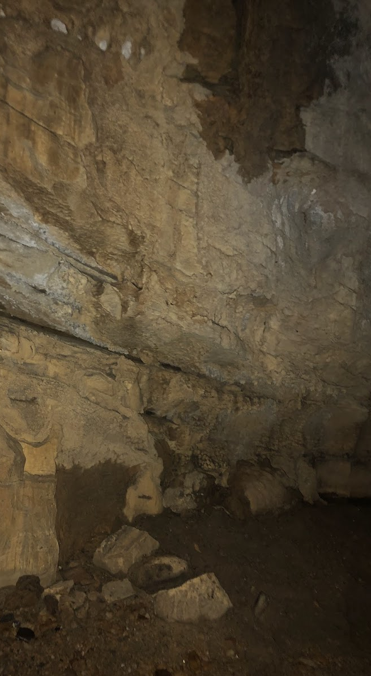
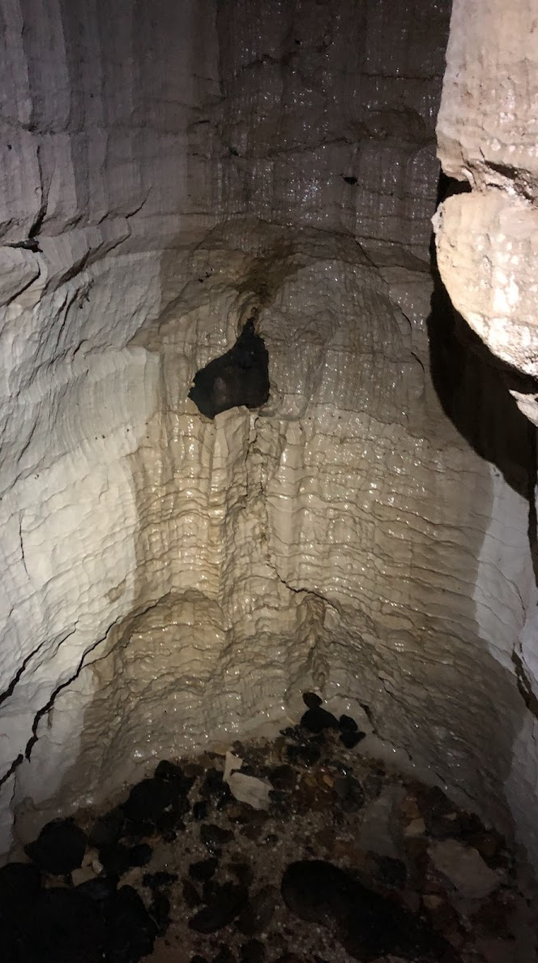
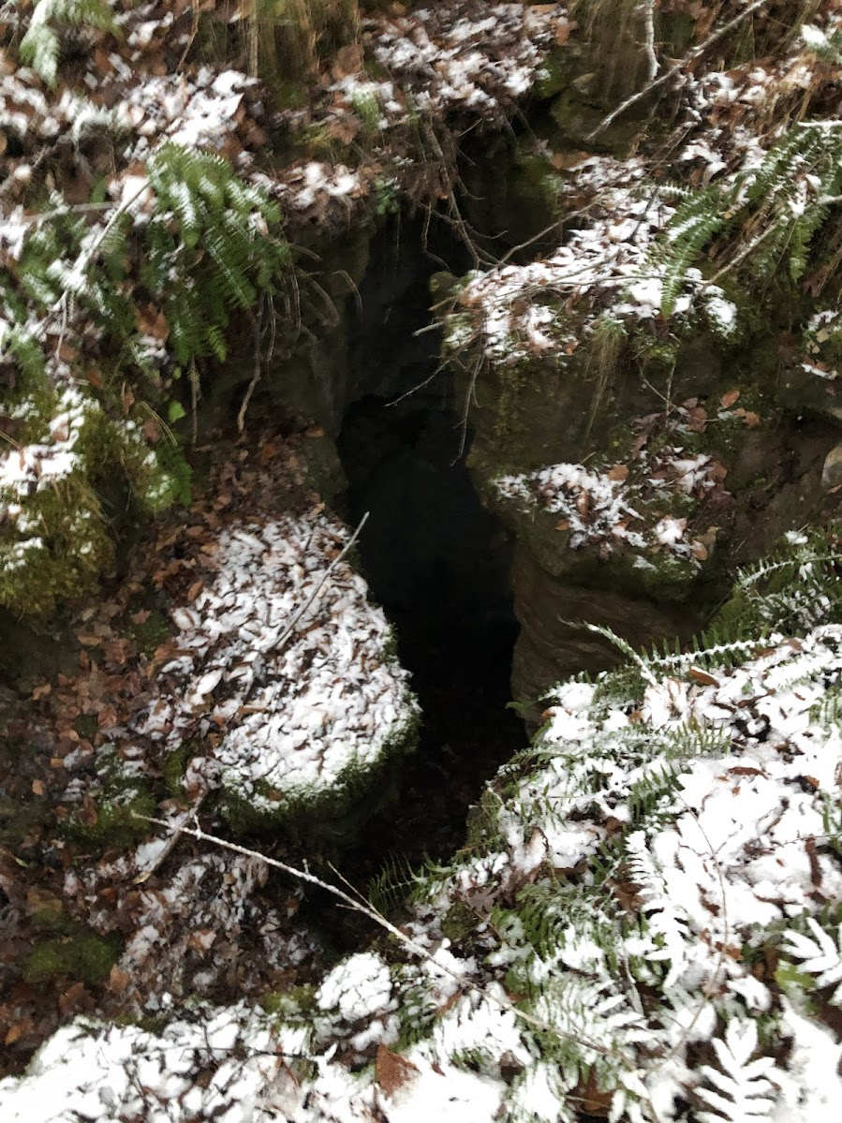
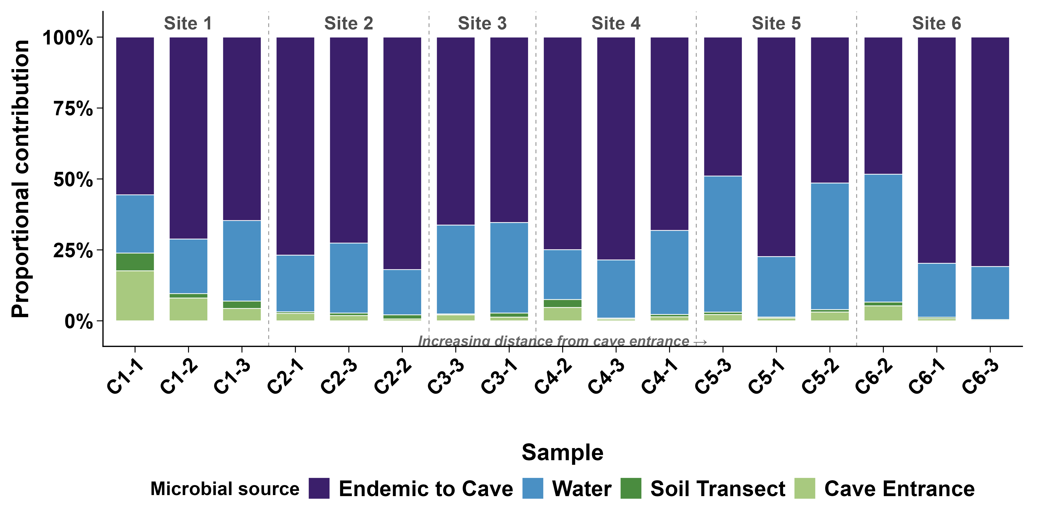

Cave-Surface Connectivity Influences Cave Microbiome Ecology
Diego Dilley, School of Environment and Natural Resources, The Ohio State University
Introduction
Methods
Results
How do microbial community structure and function shift with increasing isolation from surface inputs in a karst cave system?
Caves are nutrient limited systems, yet they host diverse microbial communities.
Karst systems are porous, enabling surface water, organic matter, and microbes to percolate or stream into the system.
Predicted Functional Profiles Across Samples
Water
Signature
Surface
Signature
Field Site
Results
Cave
Distinct
Moonshiner Cave:
Located In Rockcastle County, Kentucky
Comprised of a single canyon-like passage
Status as a private restricted access cave
Sampling Strategy:
Cave sediment collected along passage floor at regular intervals
Cave drip pool and streams samples were collected
Overlaying forest soils collected at regular intervals
Environment Type Drives Community Structure
Surface soils are dominated by aerobic heterotrophs, water by anaerobic functions, and caves are enriched in nitrification and ammonia oxidation. Function Z-Score enrichment denoted by red coloring.
Enzyme Activity
Cave Map
Samples from different environments have drastically different microbial communities, and within the cave, distance from the entrance explains 78.5% of community variation.
Activity (nmol/g/hour)
Preliminary β-galactosidase assay results indicate greater labile carbon degradation in surface soils compared to cave sediments.
Source Contributions to Cave Samples
Conclusion
- Distance Decay: The steep compositional gradient suggests the cave filters against surface-adapted taxa as organic carbon inputs signature decrease with depth.
Core Cave Community: The stable ~68% resident microbiome is a specialized oligotrophic assemblage. As surface-derived microbes and aerobic functions decline with depth, they are replaced by nitrification and predatory activity.
- Karst Connectivity: Distance from the entrance acts as a composite proxy for surface connectivity, highlighting how karst hydrogeology mediates microbial exchange from surface to subsurface ecosystems.
Moonshiner Cave features a narrow entrance, variable sediment types, and several groundwater pools and streams throughout the passage.
Cave conditions sustain a relatively stable endemic microbiome (~68%), supplemented by groundwater inputs (~26%) and a relatively small surface soil contribution (~6%).
Acknowledgments:
Special Thanks to Dr. Alex Michaud for his support and advisership. Funding provided by URAP and the McKenzie Brecher Undergraduate Scholarship Fund. Thanks to the Polar Geomicrobiology Lab for support, and huge thanks to Joe Trusski for providing cave access.

