Slide 1
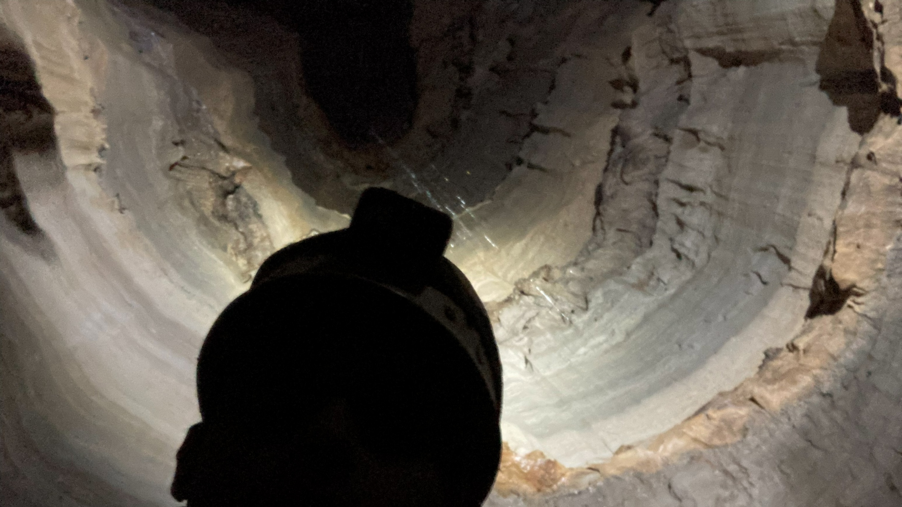
Cave Microbial Ecology: A Study of Moonshiner Cave, Kentucky
Undergraduate Thesis - Diego Dilley

Slide 2
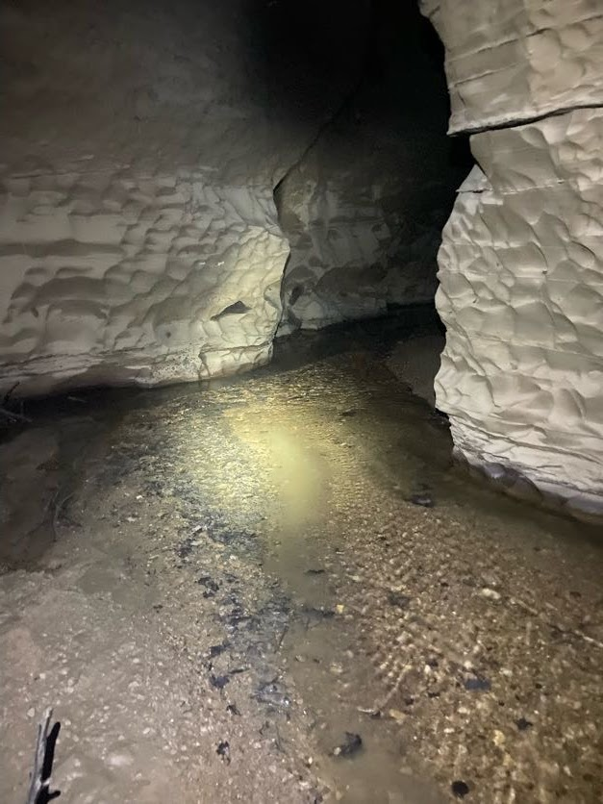
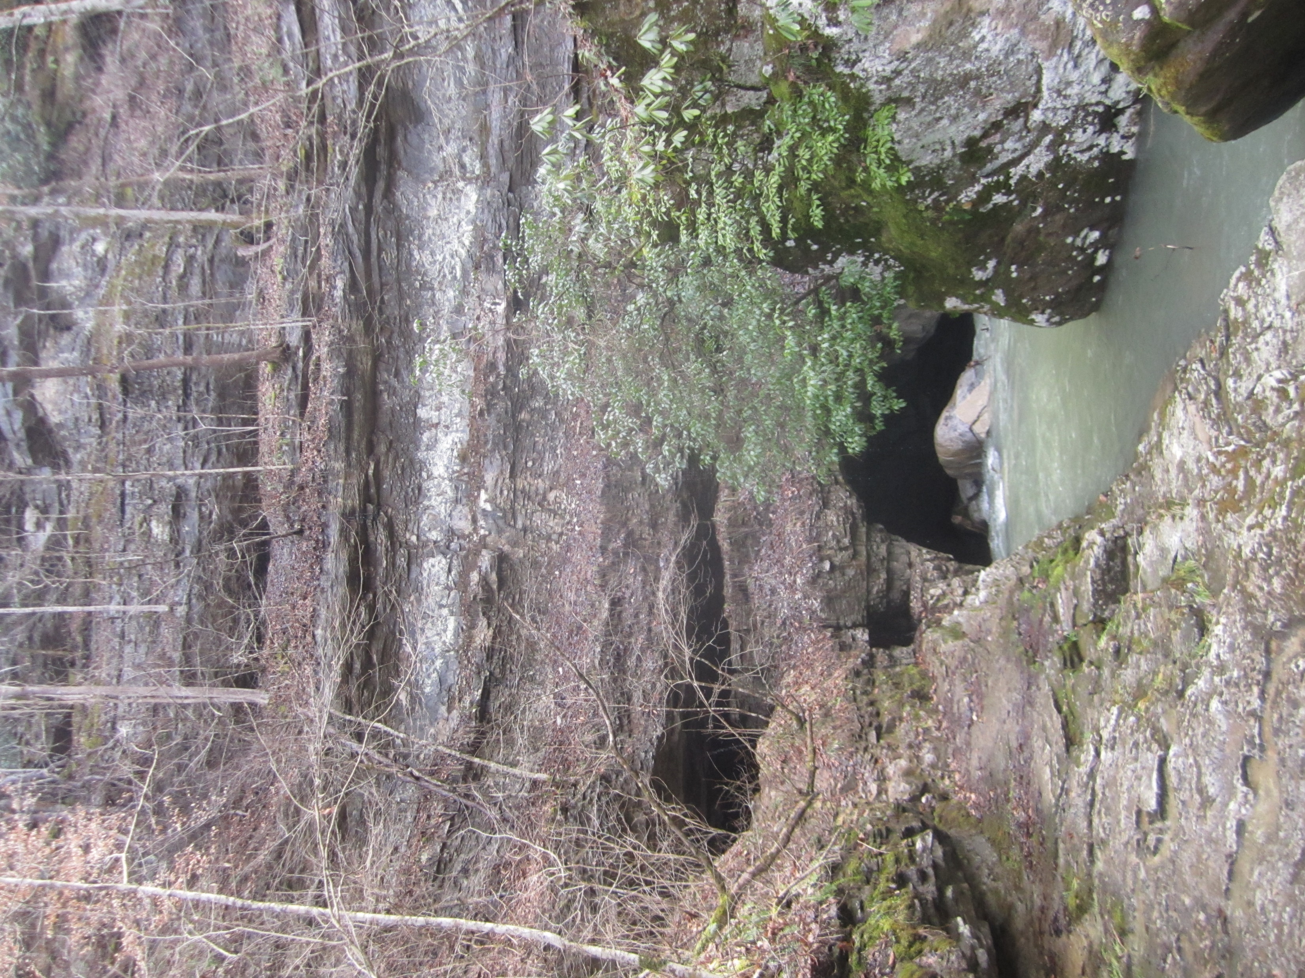
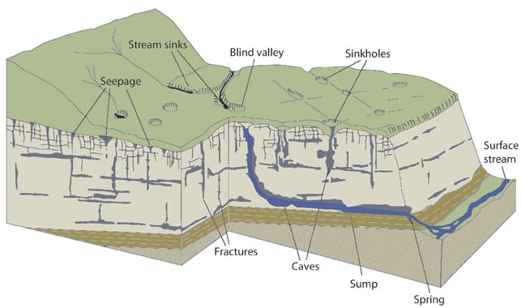
Caves and Karst
Widely distributed landscapes
Defined by high bedrock porosity
Hydrologically interconnected
Karst leads to cave formation

Slide 3

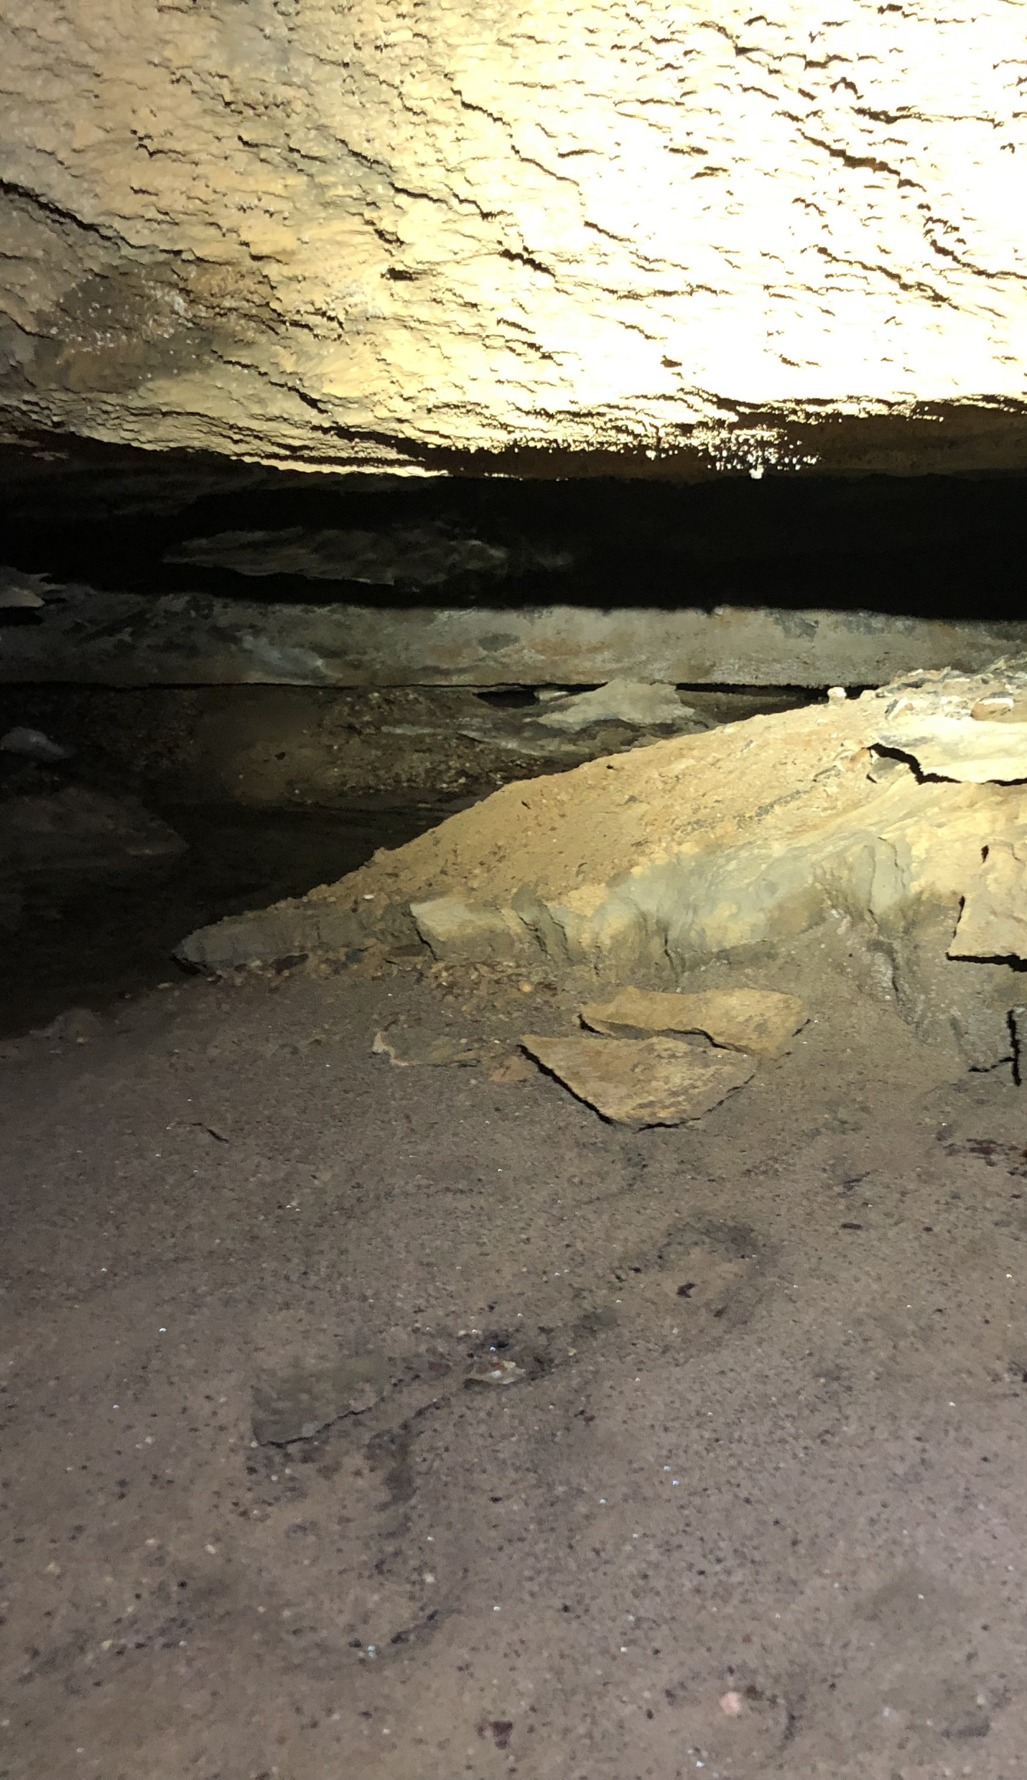
Caves vs. Surface
Caves are dark and lack nutrients
Surfaces provide C and N inputs
Caves host a wide array of life
Widest diversity is in microbes
Nitrogen
Carbon
Water
Life ?

Slide 4
Ecology
Distance Decay
Biological similarity decreases with increasing spatial distance
Driven by dispersal limitation and environmental gradients
Spatial Gradient
Environmental Filtering
Selection based on function, not taxonomy
Caves filter out surface-adapted taxa, select for oligotrophic specialists
Environmental Gradient

Slide 5
Cave as Microbial Sinks
Surface Soil Microbial Community
Cave Entrance Soil Microbial Community
Microbes
Cave Microbial Community
Microbes
Cave Ground Water Microbial Community
Microbes

Slide 6
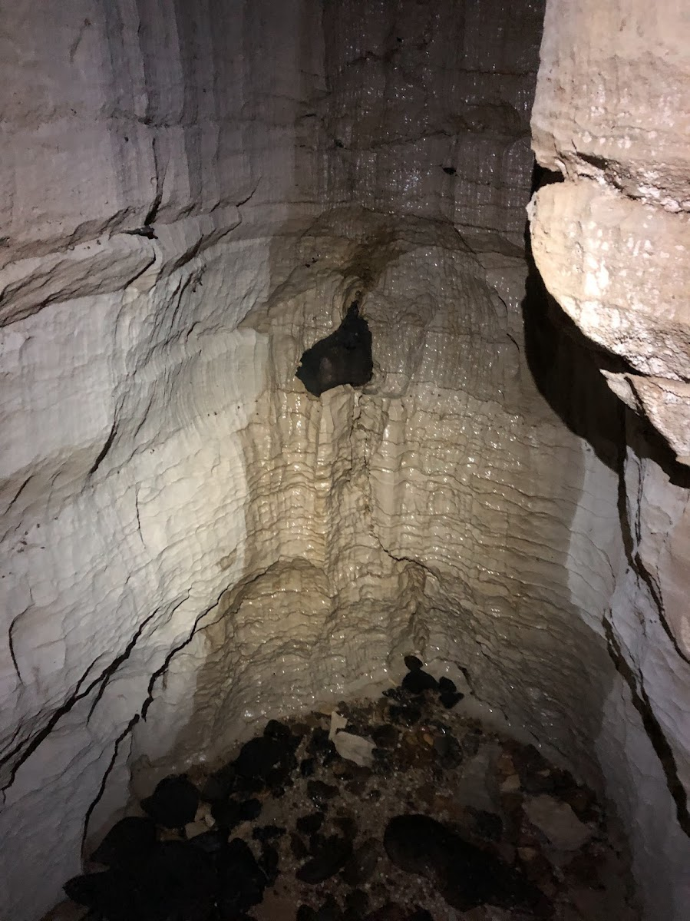
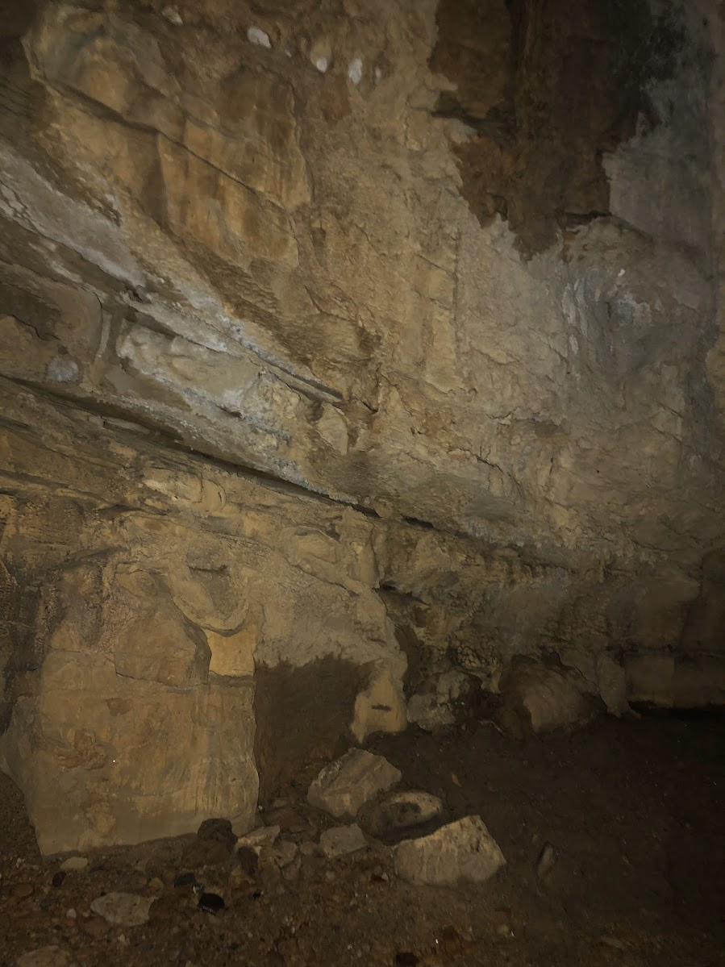
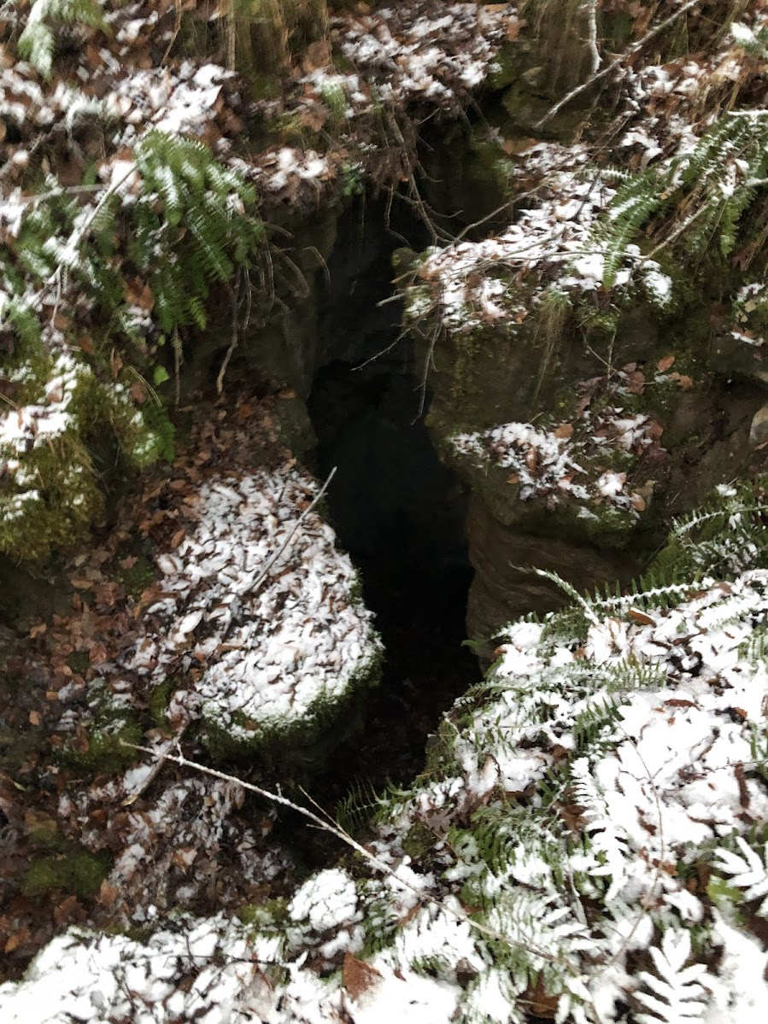
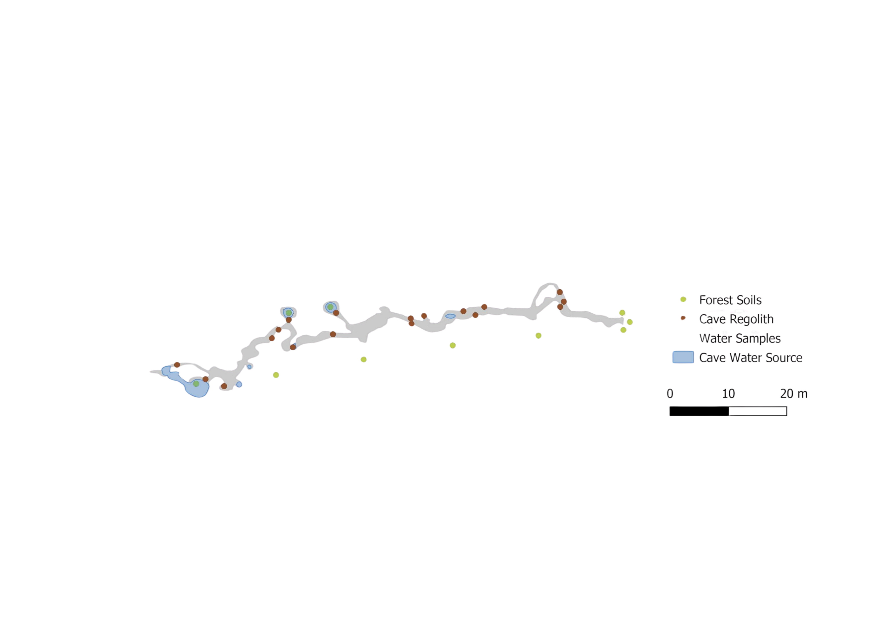


Moonshiner Cave
Depth from Surface
Cave Entrance
30m
15m
90m
45m
60m
75m
Distance from Cave Entrance

Slide 7
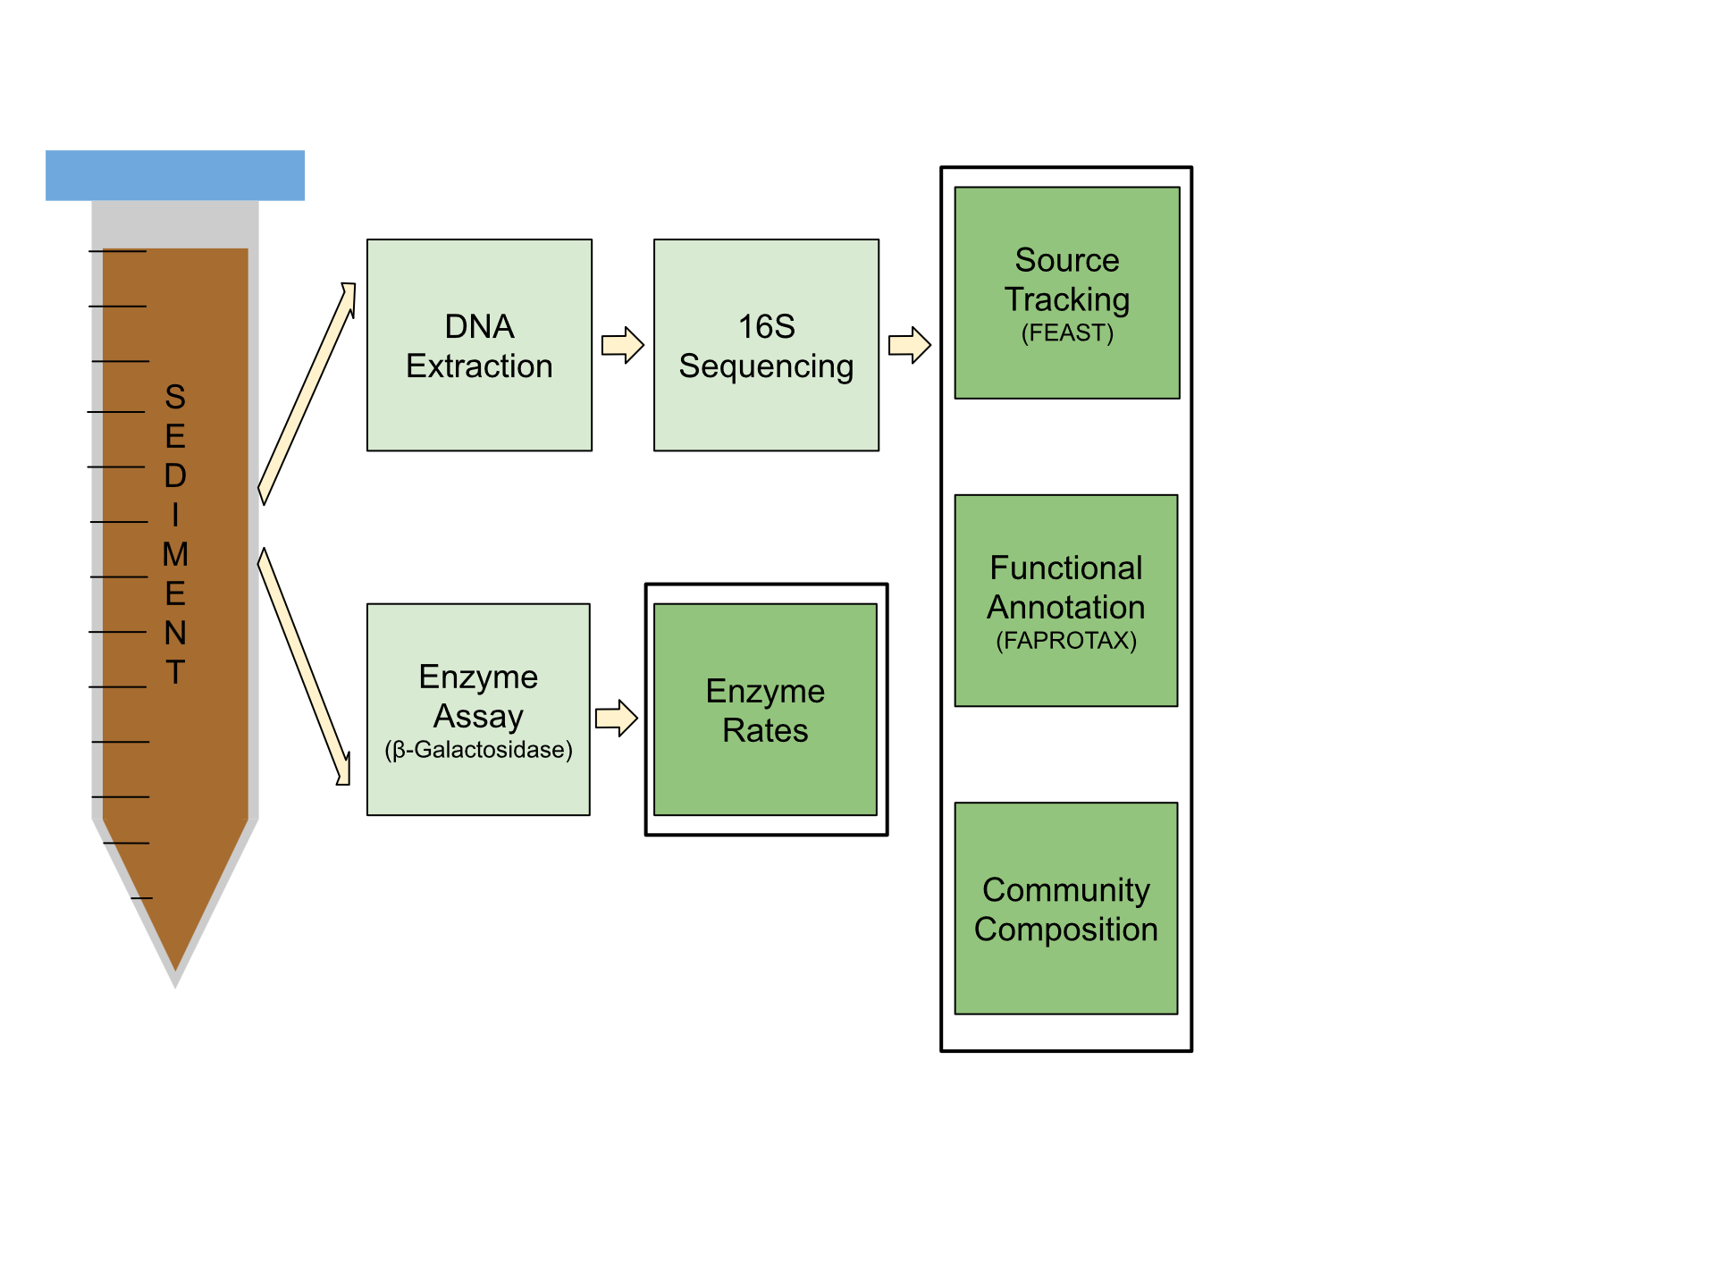
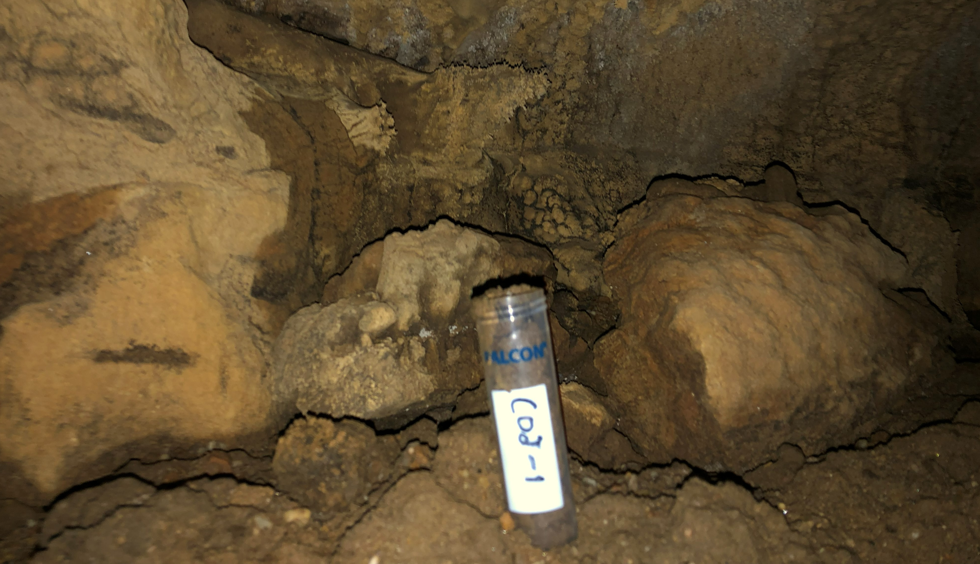
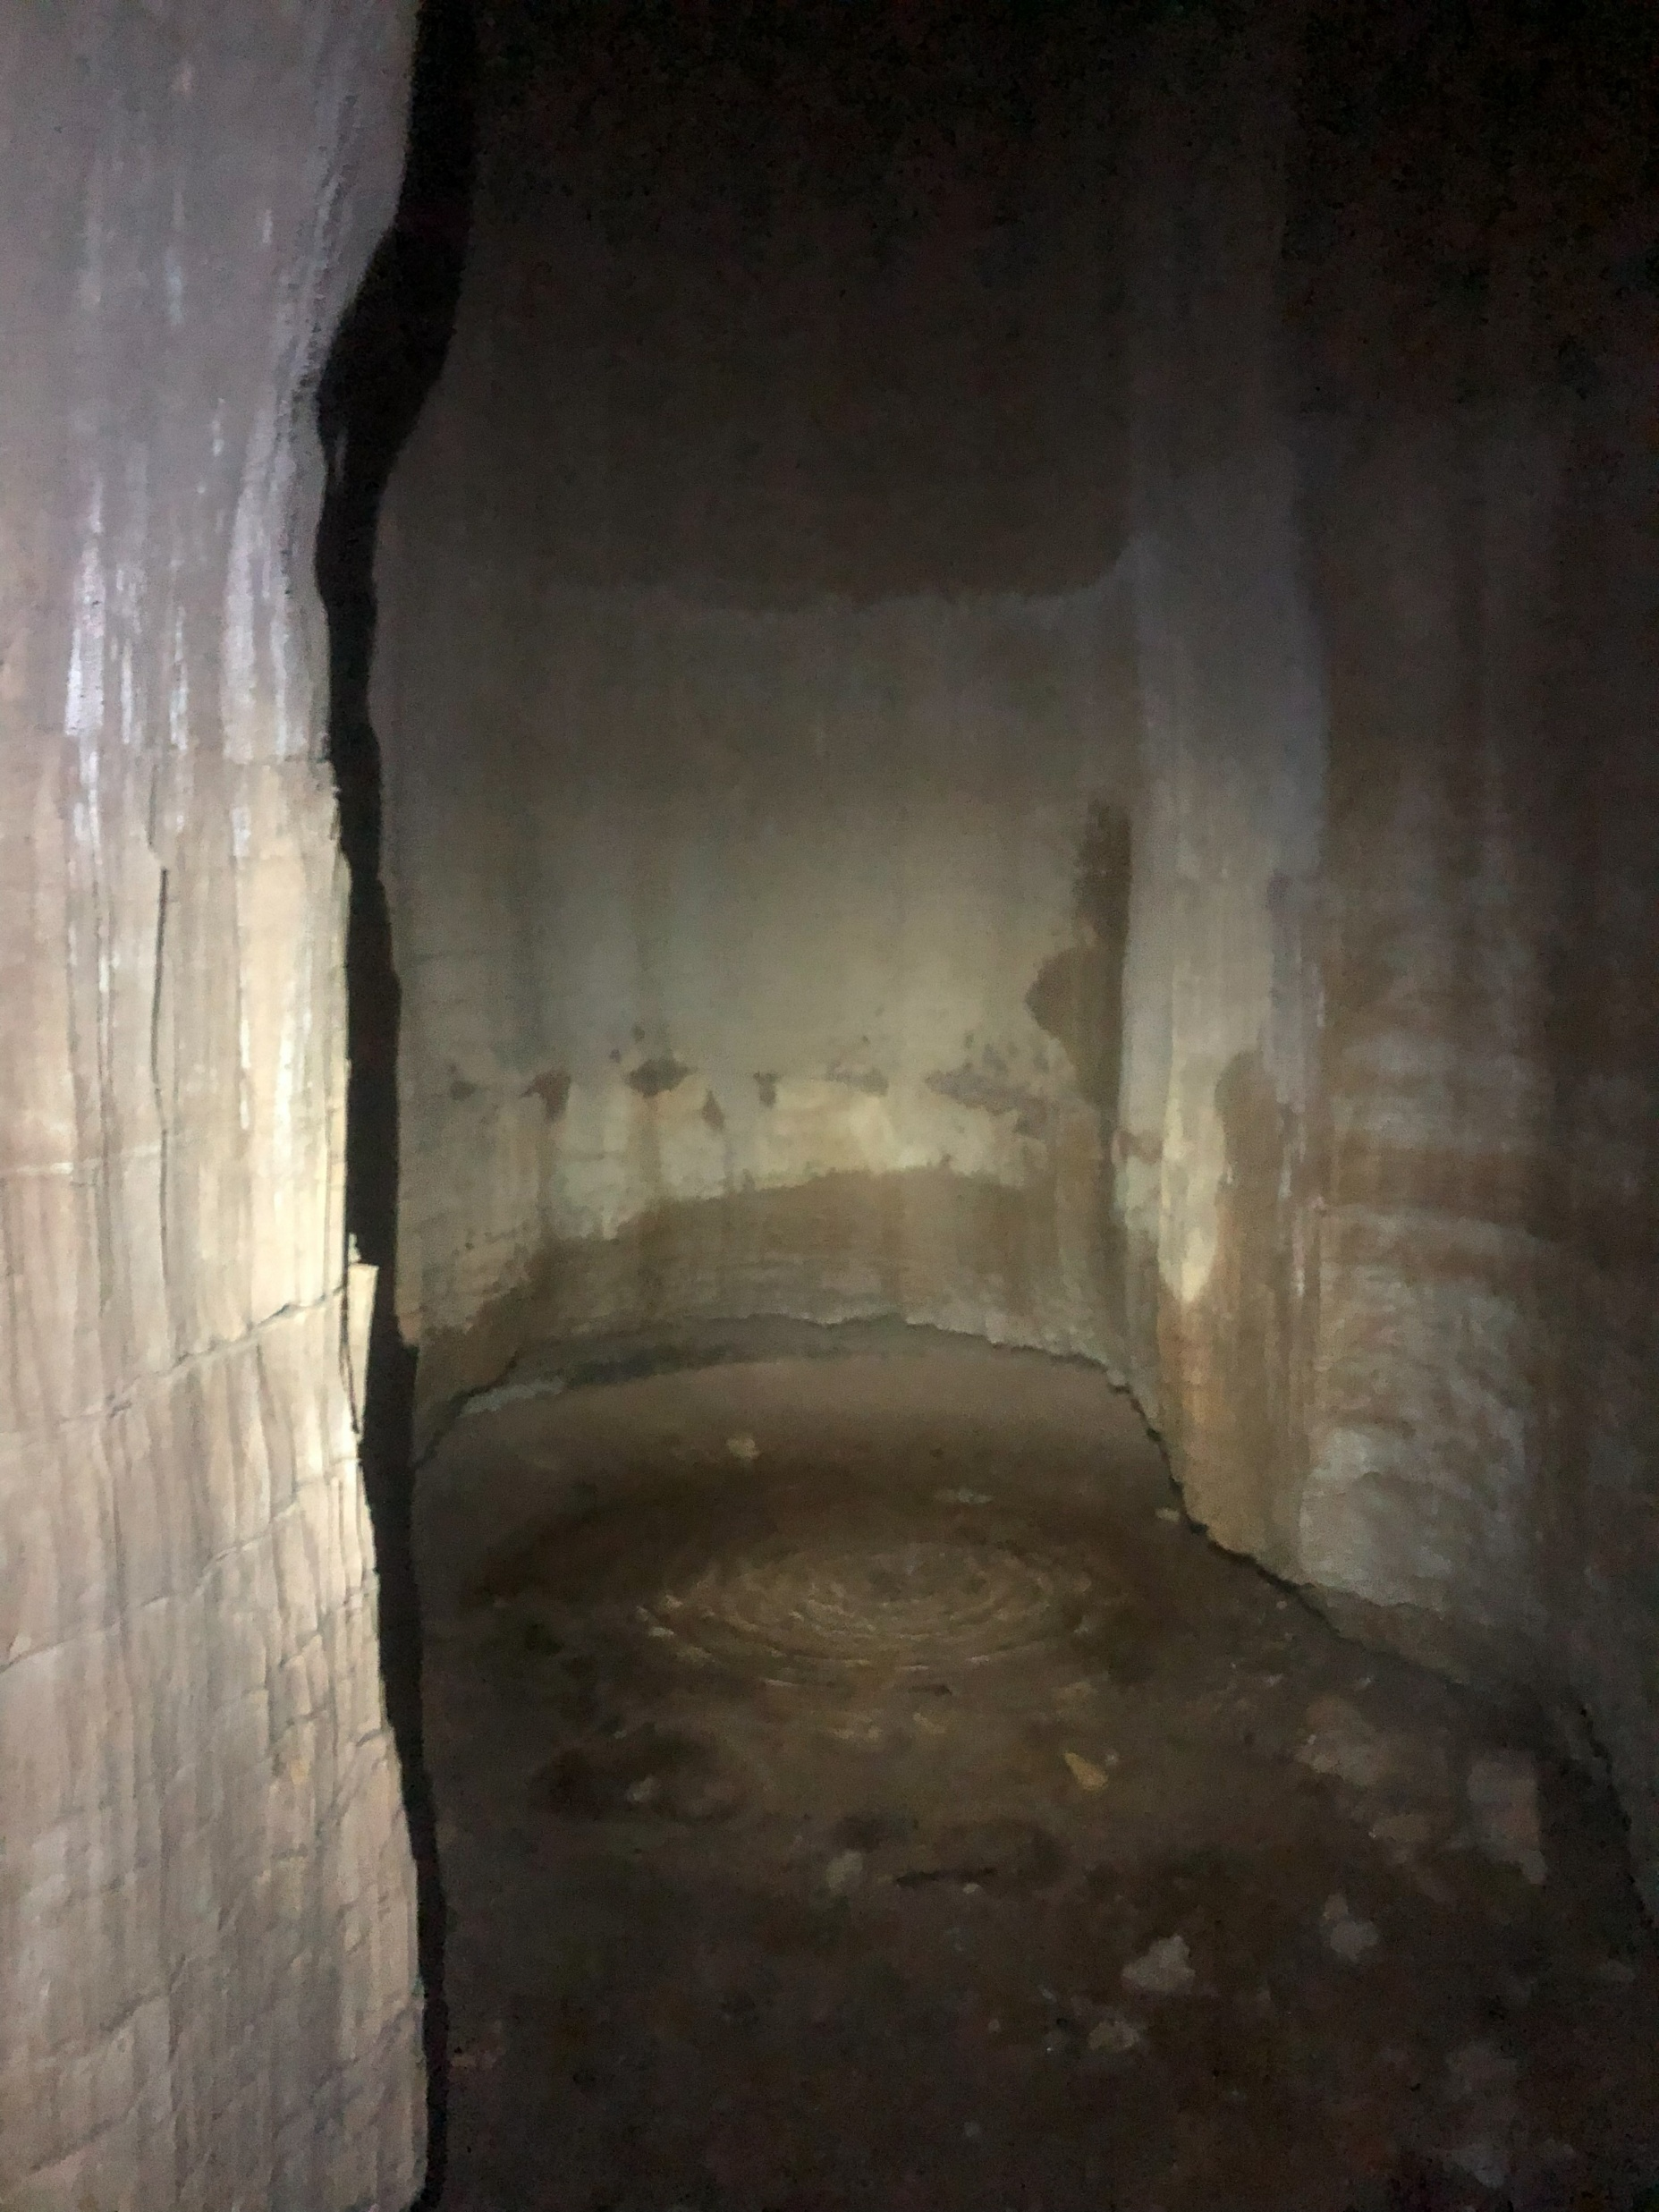
Methods

Slide 8
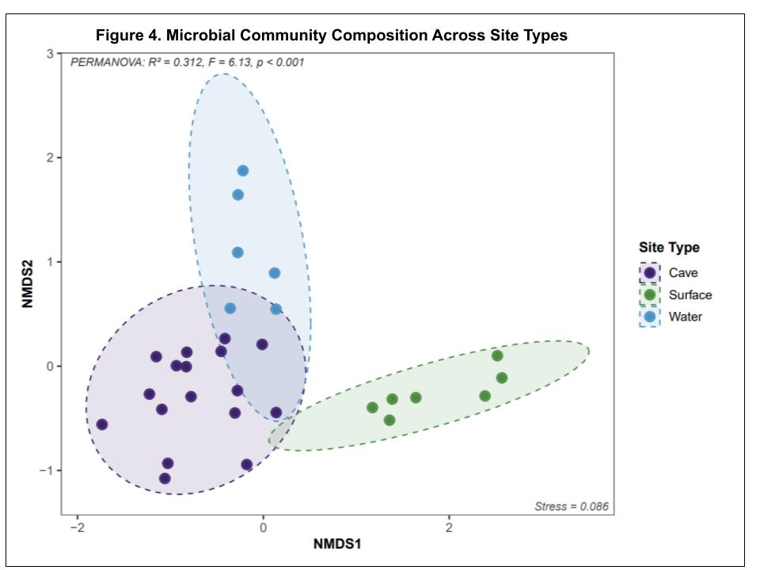
Cave Communities are Distinct
Bacterial communities are comprised of thousands of different species
We can compare compositional similarity between samples
Environment type explains 31% of community variation
All three environments significantly differ from each other
Notes:
Slow down

Slide 9
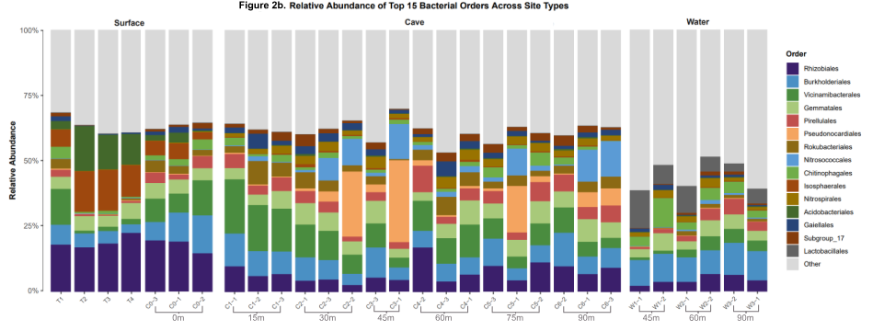
Distinct Cave Communities
Cave enriched in Actinobacteriota, Chloroflexi, Nitrospirota
Caves harbor higher ASV richness than surface soils despite energy limitations
Distance from Cave Entrance

Slide 10
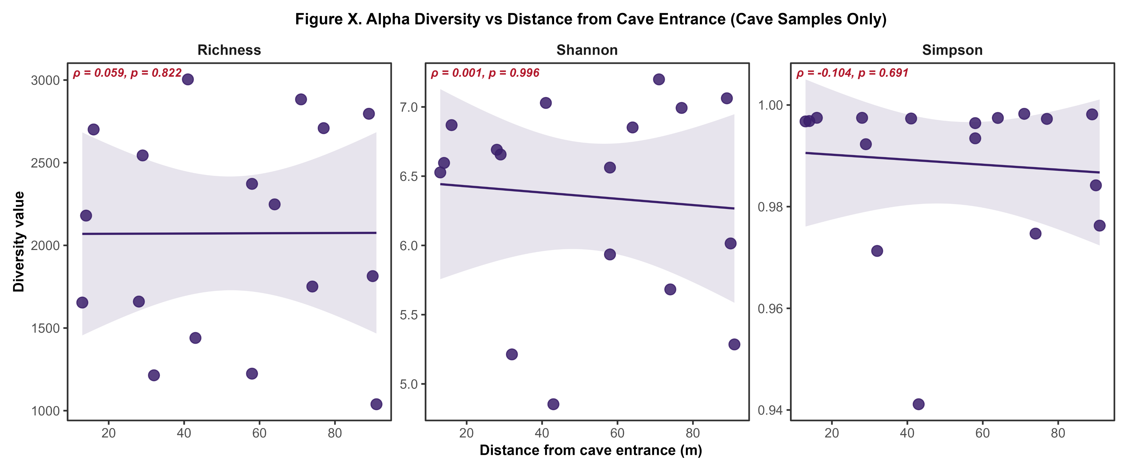
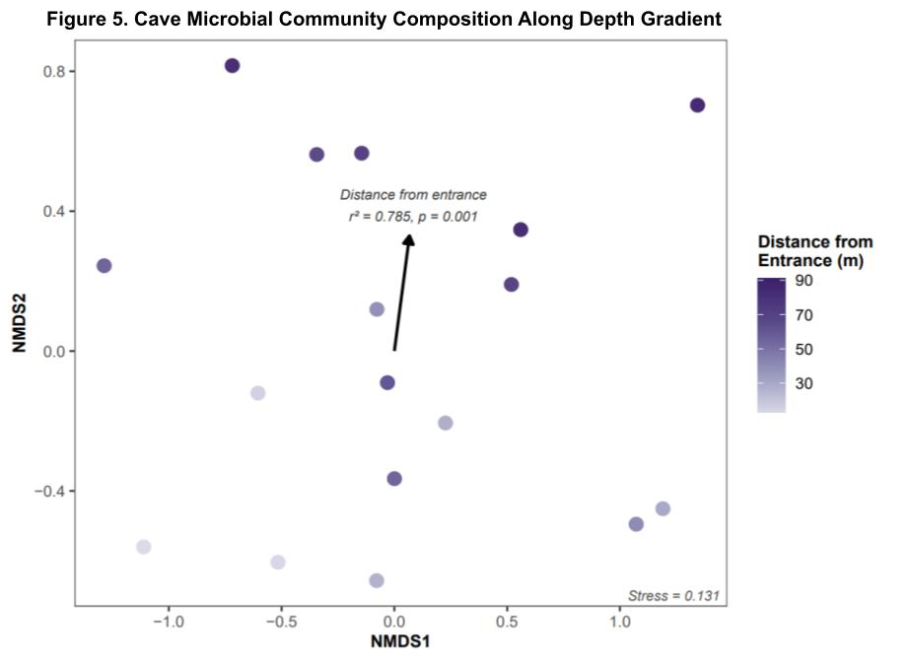
Distance From Cave Entrance
Community composition shifts significantly with depth
Within single sample, diversity does not shift with depth

Slide 11
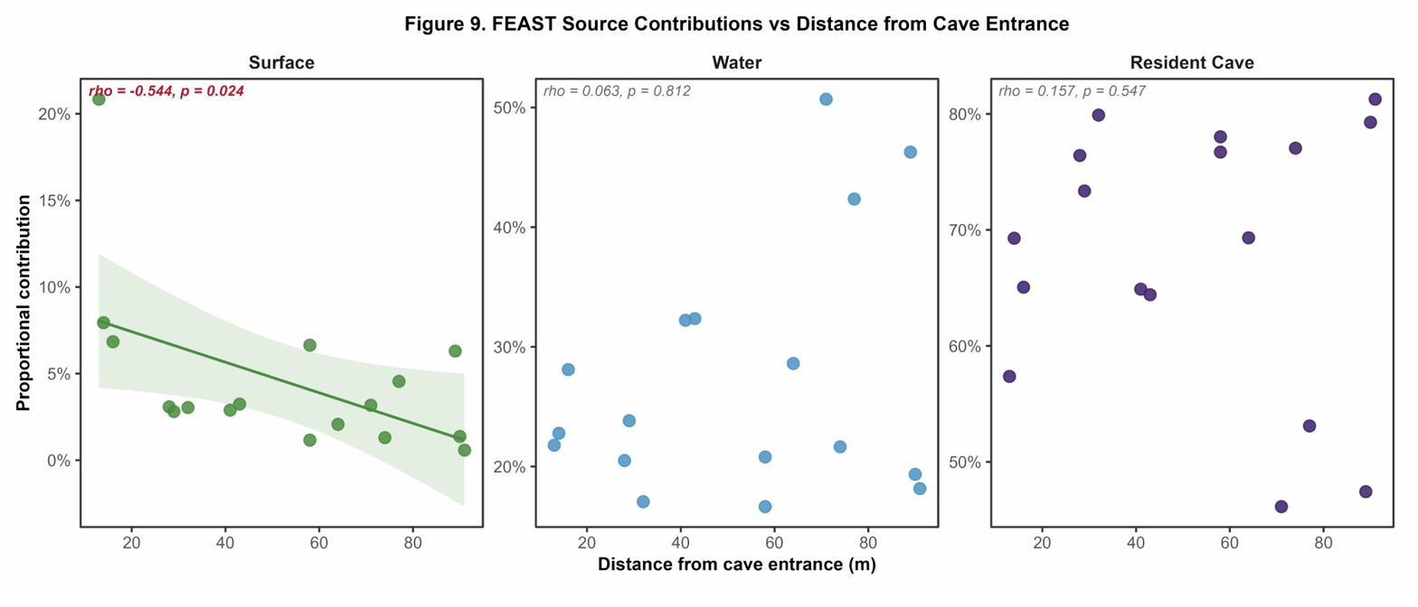
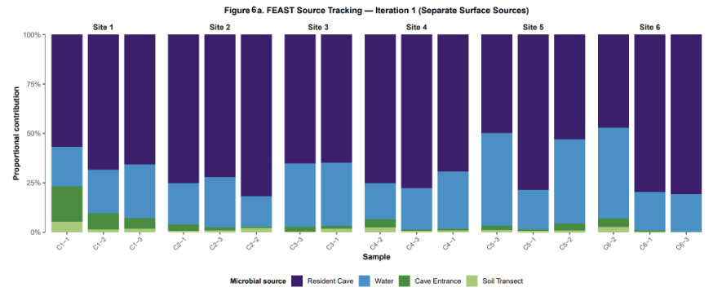
Tracing Cave Communities Sources
Endemic resident cave community
Surface inputs decrease over depth into cave
Sinking streams deliver surface microbes to deep sites regardless of distance
Sample + Distance from Cave Entrance

Slide 12
Microbial Source: Cave Groundwater
Groundwater is a stable source of microbes
Sites near water sources up to 50% water-sourced
Prevents distance from predicting resident cave proportion

Slide 13
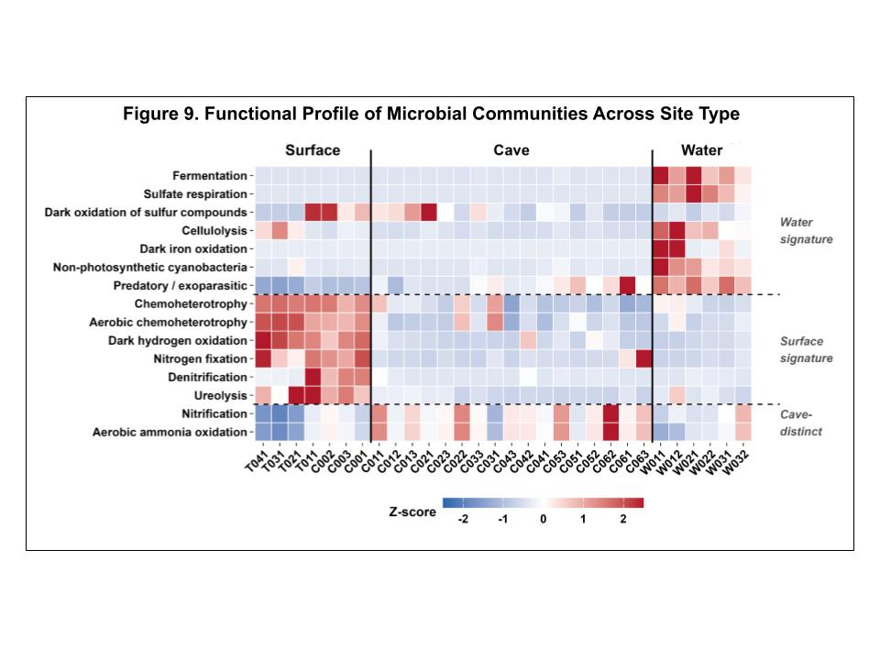
Predicted Microbial Function

Slide 14
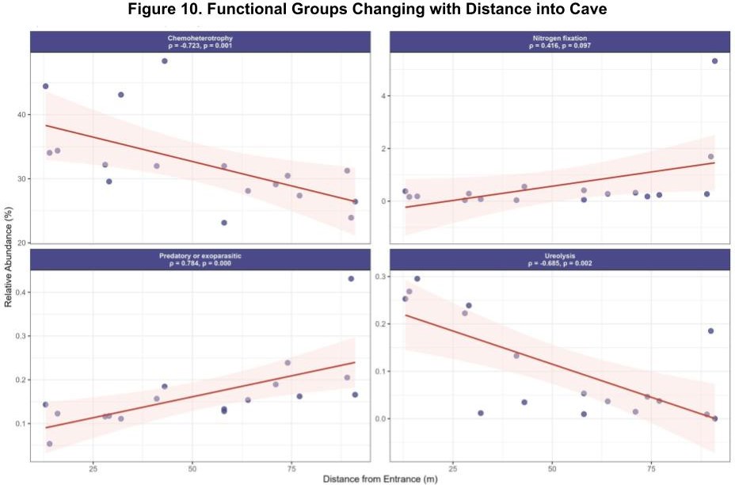
Predicted Function within the Cave
4 of 34 functional groups shift depth
Chemoheterotrophy and Ureolysis taxa decline with depth
Predatory/Exoparasitic taxa increases with depth
Entering the cave is a bigger functional shift than going deeper in it
Chemoheterotrophy
Nitrogen Fixation
Chemoheterotrophy
Nitrogen Fixation
Predatory or Exoparasitic
Ureolysis
Predatory or Exoparasitic
Ureolysis
Notes:
Slow down!

Slide 15
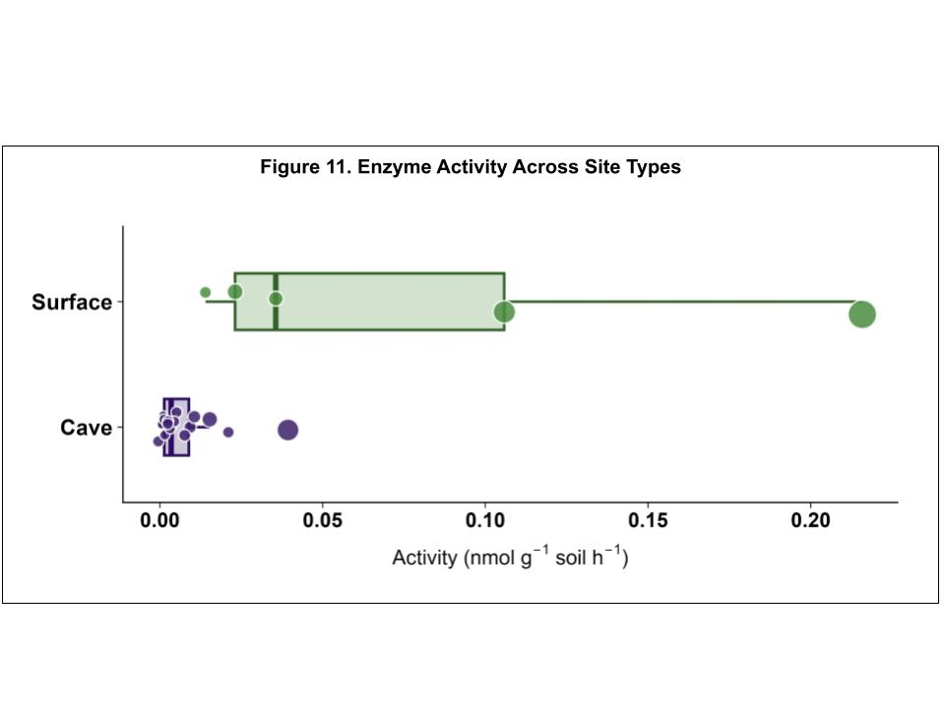
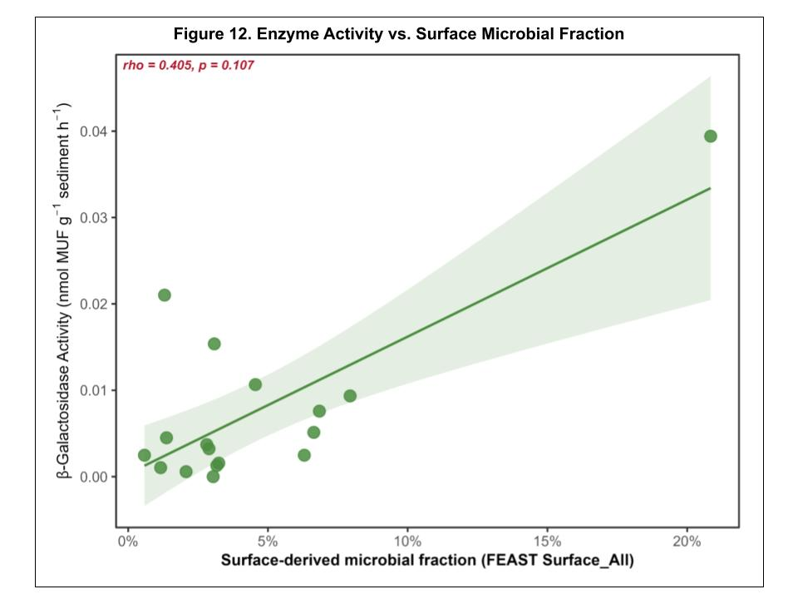
Enzyme Data
Surface soils have higher enzyme activity rates than Cave sediments
10-fold difference
Greater surface microbial input trends toward higher enzyme activity
Supports the FAPROTAX data
Notes:
Explain the connection more

Slide 16
Summing It Up
As surface connectivity declines with depth, the cave filters out heterotrophic surface taxa and selects for a stable, oligotrophic resident community
Sinking streams disrupt this gradient, delivering surface microbes to deep sites regardless of distance
The transition from surface to cave represents a greater ecological shift than any gradient within the cave

Slide 17
Acknowledgments
OSU Undergraduate Research Apprenticeship Program &McKenzie Brecher Undergraduate Scholarship Fund → financial support
Dr. Alex Michaud → mentorship and guidance
Dr. Brian Lower → thesis committee service
Polar Geomicrobiology Lab Group → laboratory support
Joe Truskowski and RKC → site access

Slide 18
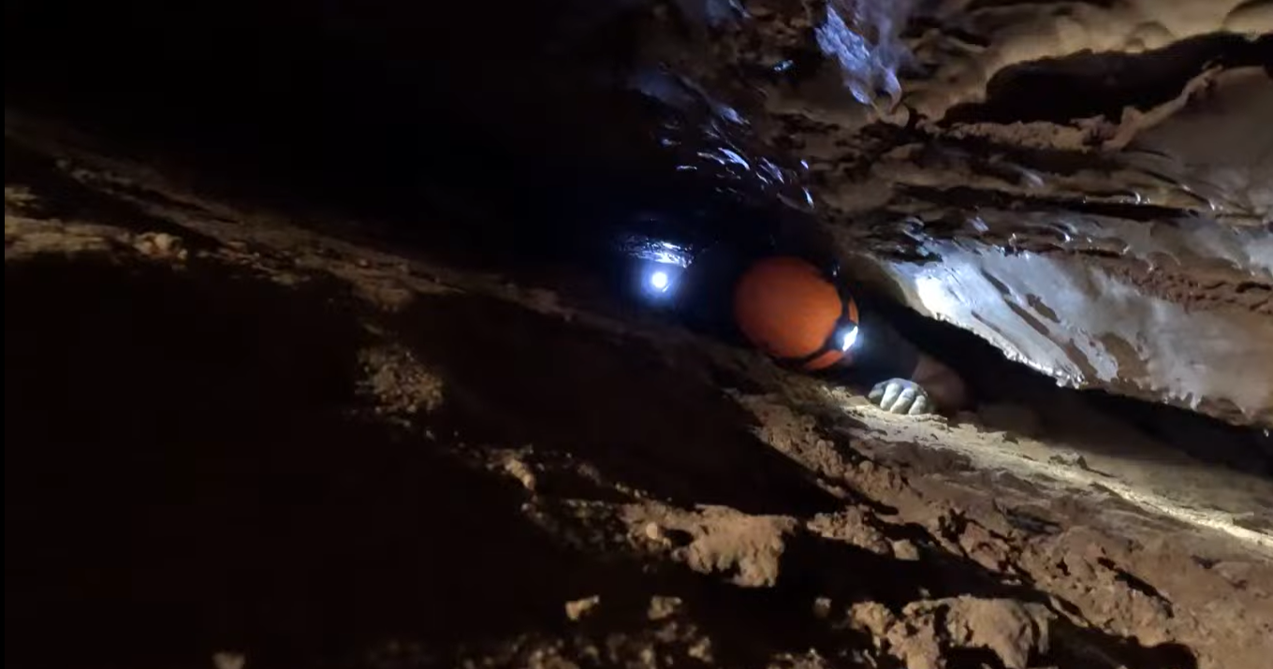
Questions?

Slide 19
Surface Soil Microbial Assemblage
Cave Entrance Soil Microbial Assemblage
Microbes
Cave Microbial Assemblage
Microbes
Cave Ground Water Microbial Assemblage
Microbes
Notes:
Single figure of cave map labeld with entrance, mark meter marks, define distance and depth with arrows. Quickly define consistent drip water and surface stuff.
- For this one pivot to source tracking showing paths on maps

Slide 20

Moonshiner Cave
Depth from Surface
Cave Entrance
30m
15m
90m
45m
60m
75m
Distance from Cave Entrance

Slide 21
Depth from Surface
Distance from Cave Entrance
Notes:
Single figure of cave map labeld with entrance, mark meter marks, define distance and depth with arrows. Quickly define consistent drip water and surface stuff.
- For this one include pictures of sites

Slide 22
Functional Differences Between Environments
Surface dominated by chemoheterotrophy, denitrification, Ureolysis
Cave switches to ammonia oxidation and nitrification
Cave water dominated by fermentation and sulfate respiration
Taxonomy and function tell same story

