Slide 1


GLA SYSTEM
GROUP 3 : DUVINA MAXIMILIEN
GUO YANGMING
NARAYANANE ADRIEN
SUAREZ DIEGO

Slide 2
SYSTEM DEFINITION - INTRODUCTION
The software we offer is designed to provide users with a fast and efficient way to mark places of interest. It is therefore presented in the form of a map manager that allows you to record locations using markers. The markers are customizable, such as adding comments and photos, and can be classified into various categories. The user can create multiple maps and share them with friends or the entire community. Finally, a GPS system allowing the user to know the best itinerary between his location and the place of interest he has selected is also available.

Slide 3
SYSTEM DEFINITION - FUNCTIONALITIES
From the specifications we list the functionalities of the system:
Multiple maps storage (each user can have several maps).
Allows you to mark locations.
Customize markers (comments and photos).
Sharing maps to all or some other users
Database for available maps and friends
GPS system and route planner

Slide 4
USER
The system is use by two kind of people. All users need to be log to use the website. The Creator is the owner of a map. A Visitor is a user that is not the owner of a map belonging to a Creator (a Visitor is a Creator on the maps he created).
 | Reader access | Writer access
Creator
Visitor

Slide 5
BUSINESS OBJECT
User
Name Password List Maps List access Position
Marker
Name Type List Message List Image Position
User
Map
Map
Name Access List Pointer List Event
<<inheritance>>
Event
Date
Event
Marker

Slide 6
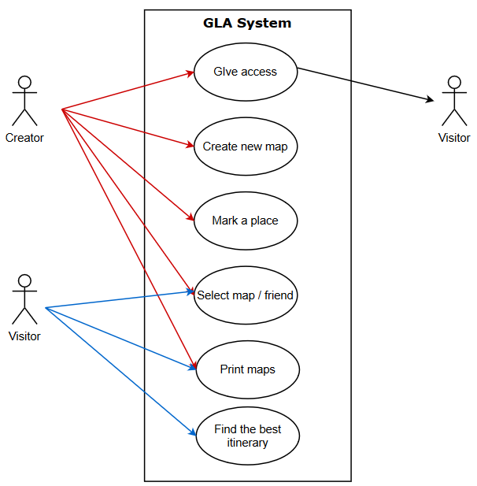
USE CASE DIAGRAM

Slide 7
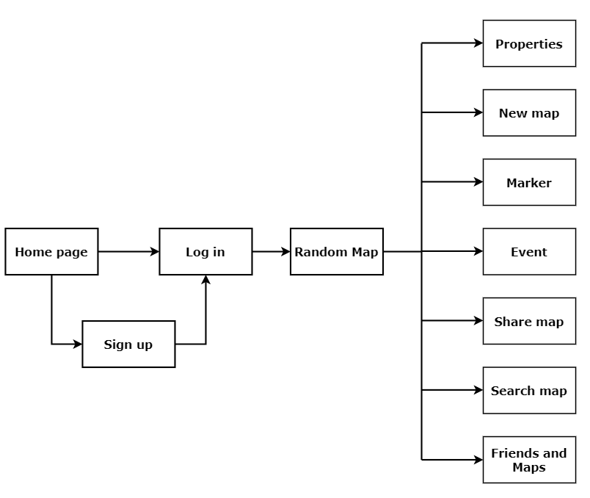
BROWSING DIAGRAM

Slide 8
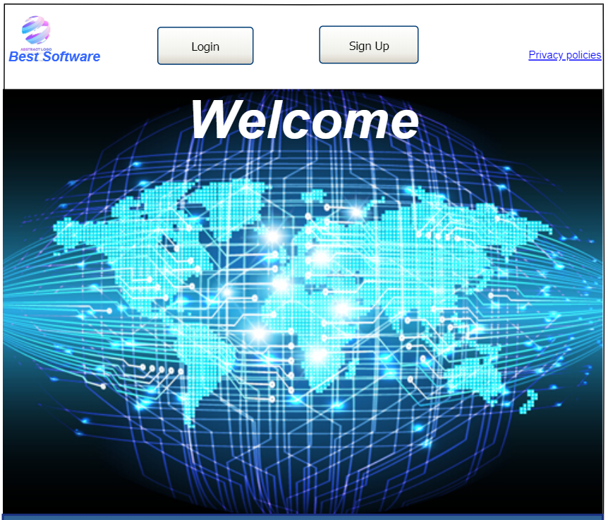
MOCK UP
Homepage with login option and registration option..

Slide 9
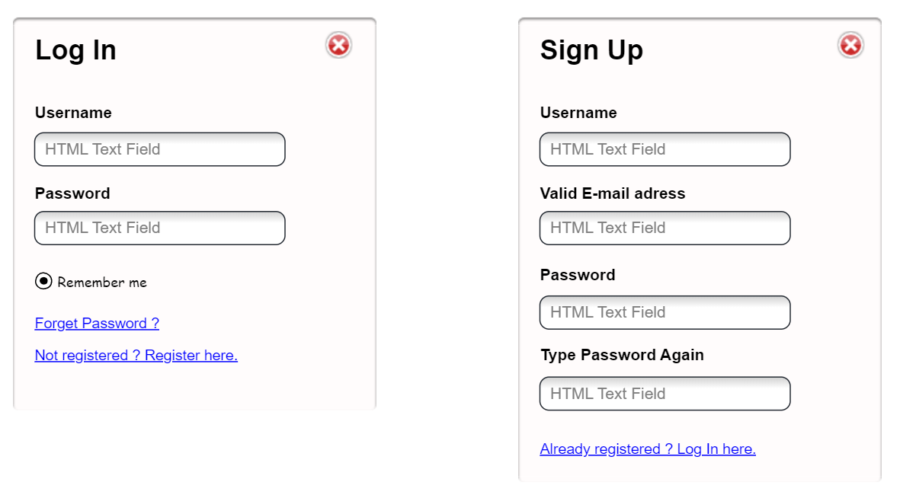
MOCK UP
Log In and Sign Up options.

Slide 10
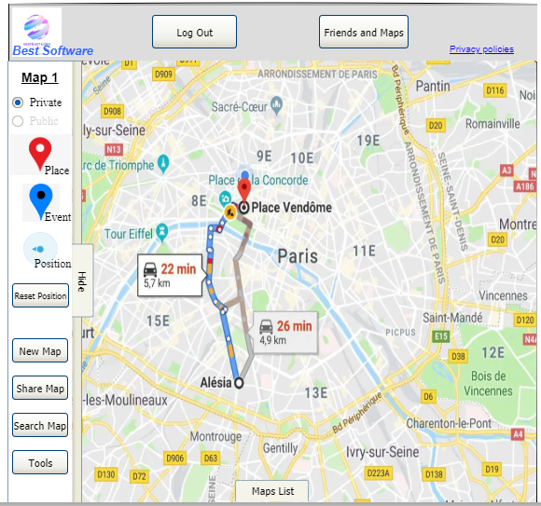
MOCK UP
Map Editor.
User can select the option or use shortcut (simple clic to set location, double clic to create a new location/event).

Slide 11
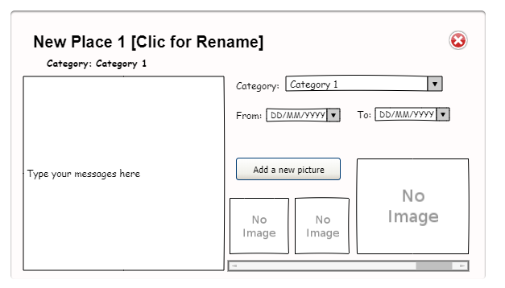
MOCK UP
Place/Event Editor.
User can type messages or load images.

Slide 12
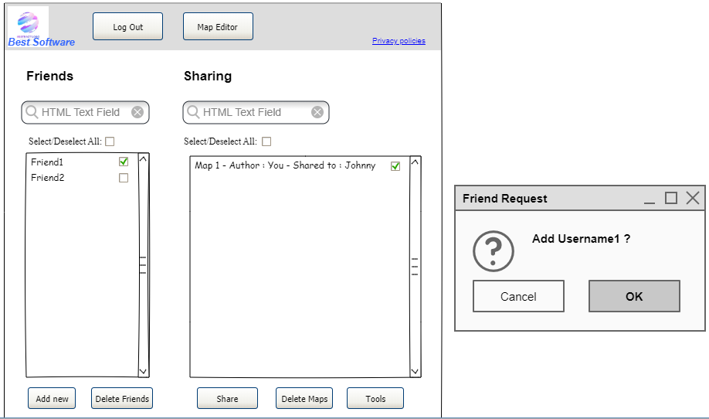
MOCK UP
Friend and sharing system.
Tool to manage friends (add and delete) and share maps to selected friends.
Provides a tool to search for friends and maps in the case of a large collection.

Slide 13
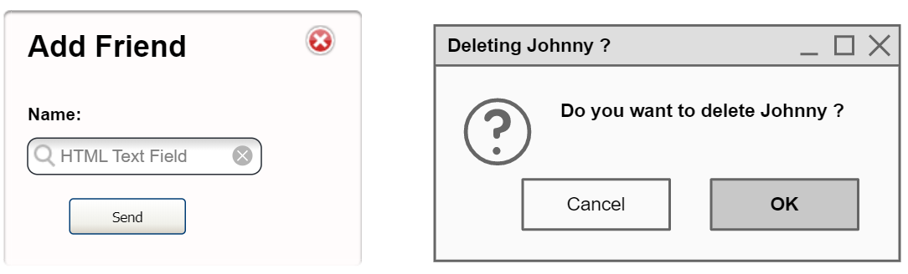
MOCK UP

Slide 14
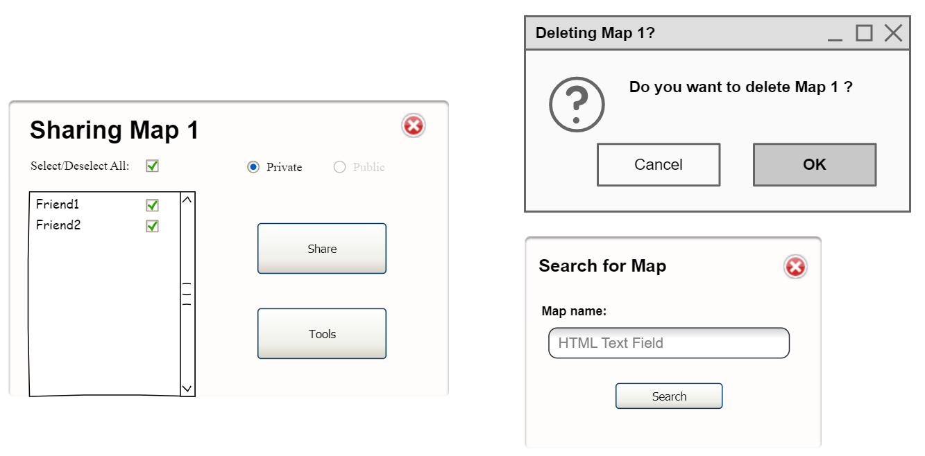
MOCK UP

Slide 15
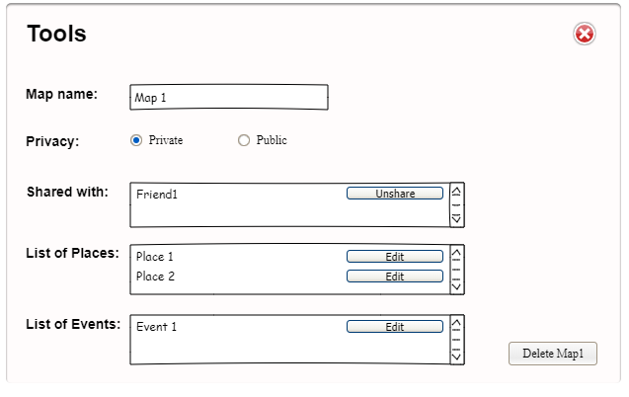
MOCK UP
Advanced map manager. Used to see and manage in a single screen all the characteristics of the map.

Slide 16
BACKLOG
Function | Desription | Priority | Workload
Print map | Print a chosen map | 5 | 2
Marking | Mark a place | 5 | 3
Edit marker | Customize pointer | 4 | 3
Share map with friends | Share your maps with your friends | 4 | 2
Add friends | Add friends | 3 | 4
Calculate itinerary | Calculate the best itinerary | 4 | 1
Add event | Add an event on a map (it disappear when the event is finished) | 4 | 4
Authentication system | Log in or Sign in, in the website | 3 | 3
Delete friend | Delete a friend from the list | 2 | 4
Delete map | Delete a map from the list | 2 | 4
Share map with everybody | Share map with all members of the community | 4 | 2
Filter | Filter that simplify the search of a map or a friend | 2 | 3
Categorize place | Classification of a marker | 3 | 3
Create new map | Create a new map | 5 | 2
Add map | Add a new map to the list | 5 | 3
Edit map | Edit an already existing map | 5 | 2
Locate | Give the actual position of the user | 1 | 1
Edit profil | Add a picture, description | 1 | 3
 | Priority | Workload
5 | Very urgent | Very easy
4 | Urgent | Easy
3 | Medium | Medium
2 | Not urgent | Hard
1 | Not a priority | Very hard

