Slide 1
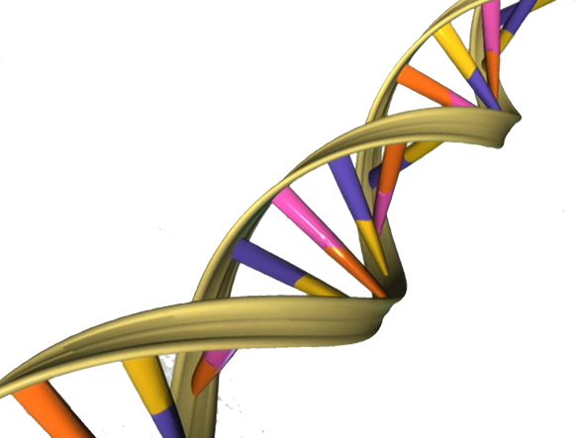

PROJECT OF AAPP K-mer counting
Diego Gaboardi and Giorgio Giardini
Politecnico di Milano

Slide 2
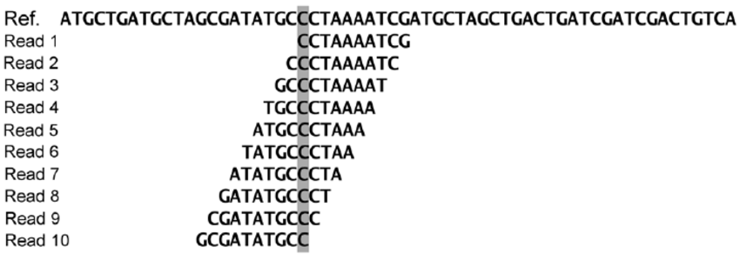


PROBLEM
Counting the number of occurrences of every k-mer in a long string
K-mer substring of length k
USAGE
genome assembly
alphabet = {A,C,G,T}
statistics
knowledge

Slide 3
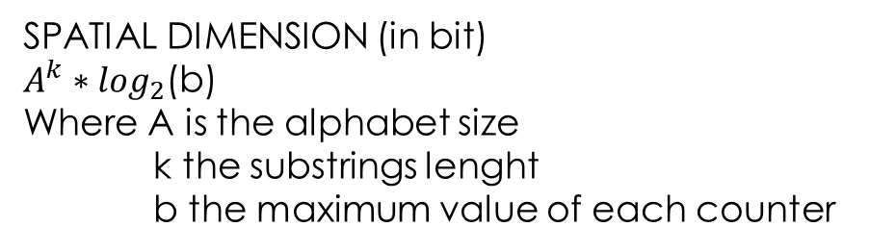
STANDARD IMPLEMENTATION
Hash table
Key: substring (k-mers)
Value: counter
Key
CCTA | ACGT | TTGC | ATCC | AATG | GAAC | TCCG | AGTC | CCAG | TGAA
567 | 234 | 456 | 567 | 234 | 567 | 123 | 673 | 578 | 198
Value
SPATIAL DIMENSION (in bit)
$A^{k}∗\log_{2}$(b)
Where A is the alphabet size
k the substrings lenght
b the maximum value of each counter
TEMPORAL DIMENTION
|S|* table_access_time
Where S is the input string

Slide 4
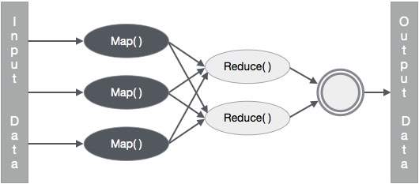
ON MAP REDUCE
Every node process a substring
Straightforward implementation -> map operation emits a series of couples < k-mer , 1 > for each node -> large overhead
Efficient implementation -> map operation includes a counter and emits a series of couples < k-mer , count >
How to obtain efficiently?
Jellyfish parallel algorithm on each node

Slide 5


JELLYFISH
GOALS:
Fast and multithreaded
Memory efficient
SOLUTION:
Lock free Hash-table with CAS assembly instruction
Merging intermediate hash tables
Reduced memory usage of hash entry
Space-efficient encoding of keys

Slide 6
PARALLELISM: SIMD
Single Instruction
Same code with a loop cycle
Each iteration of the loop is executed by one of the threads in the team
Multiple Data
Partitioning of the string between the threads
Each thread process a contiguous sequence of characters
!
Border issue: overlapping at border
Thread 1
Thread 2
Thread 3
Thread 4

Slide 7
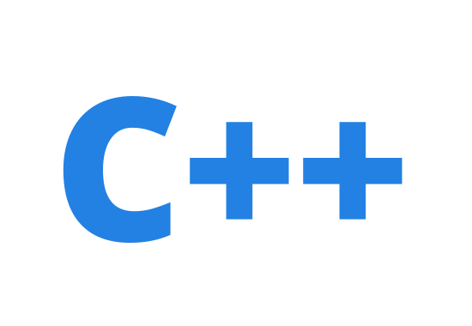



OUR IMPLEMENTATION
Language: C++ & open mp
Support shared memory multiprocessing
Easy to use simply adding some commands to standard C++ code
GIT and GIT HUB
For working in group

Slide 8
WORK PLAN
Parser of the DNA sequence
Serial version of the hash table
Multithreaded hash table with locks
Multithreaded hash table without locks
Make the program memory efficient
Evaluation of the algorithm

Slide 9

OUR IMPLEMENTATION

Slide 10
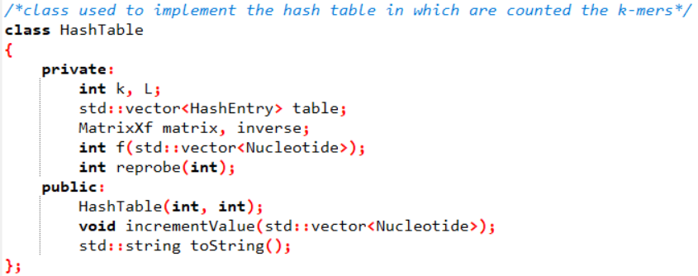
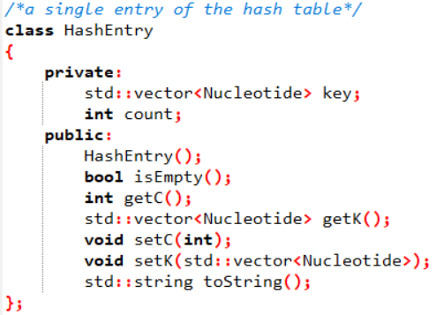
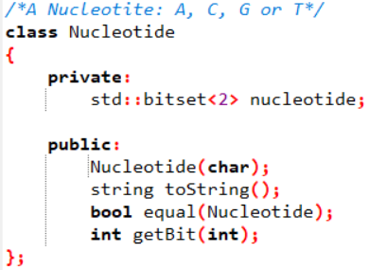
SERIAL IMPLEMENTATION
Class model
HashTable
HashEntry
Structures

Slide 11
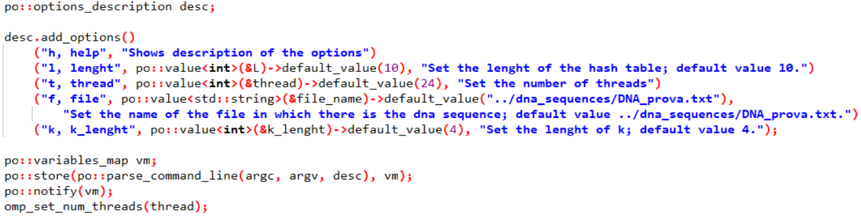
SERIAL IMPLEMENTATION
Program option
Program options let user set the following parameters at execution time:
l– hash table lenght
t – number of thread
f – source file
k – k-mer lenght

Slide 12
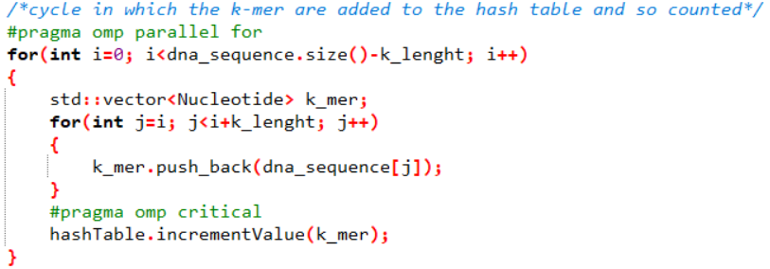
LOCK MULTITHREAD IMPLEMENTATION
OUR CHOICE: use of a critical call of increment function, in an openmp parallel cycle

Slide 13

OPTIMIZATIONS

Slide 14
LOCK-FREE HASH TABLE
CAS instruction:
Reads a memory location
Compare the read value with the second parameter of the instruction
If they are equal write the memory with the 3rd parameter
Return the previously held value
Possibility to detect simultaneous access to shared resources
USED TO:
Finds the location in the hash table
Increments the value associated with the key

Slide 15

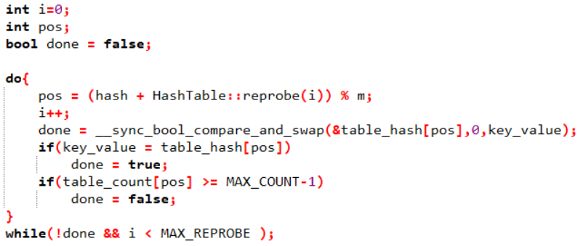
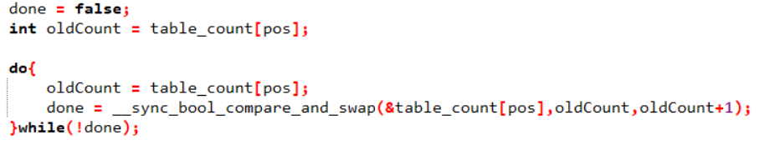
IMPLEMENTATION
OUR CHOICE: use the GCC function __sync_bool_compare_and_swap()
Find the location in the hash table
Increments the value associated with the key

Slide 16
MERGING INTERMEDIATE HASH TABLE
Once computed the hash table is written to disk in order
In this way it is possible to:
Query quickly using binary search
Merge two hash table
If there isn’t enouth memory for the entire computation:
Intermediate results are saved to disk
The hash table is cleared and we begin counting afresh
At the end intermediate results are merged

Slide 17
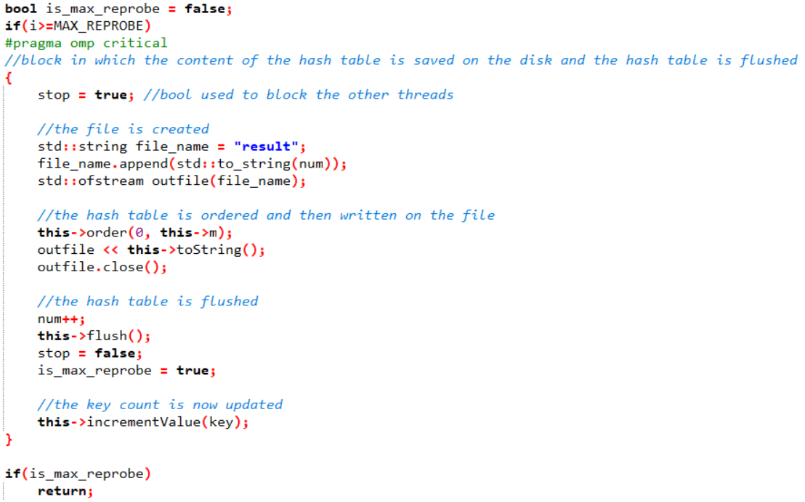
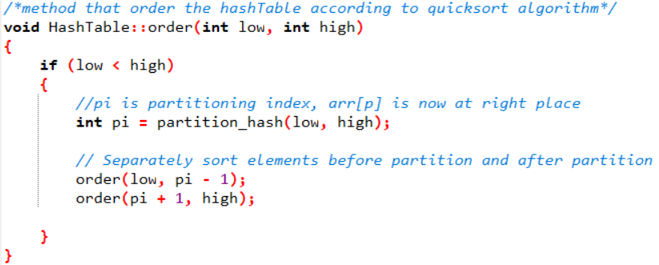
IMPLEMENTATION
OUR CHOICE: use an openmp critical section in order to avoid writing conflicts
order the table efficently using quicksort algorithm

Slide 18
REDUCED MEMORY USAGE
Using a value field large enough for the most repeated k-mer: INEFFICIENT
Most of the k-mers appear:
1 sequencing error
C sequencing coverage
IDEA:
Small value field
Allow key to have more than one entry

Slide 19
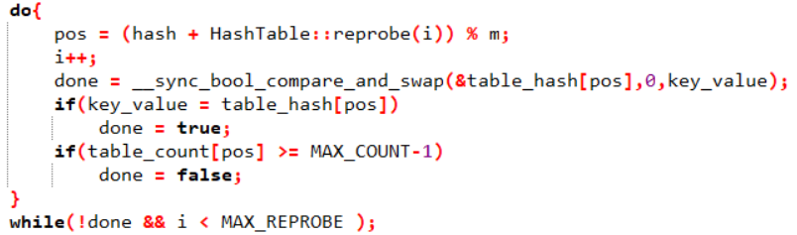
IMPLEMENTATION
Small value field
Allow keys to have more than one entry
Definition of count attribute as an int (32bit)

Slide 20
KEY ENCODING
M = 2l lenght of hash-table
pos(m, i) = ( hash(m) + reprobe(i) ) mod M
The position of the key give as information about the l-lower bits
IDEA: store only 2k-l higher bits and the reprobe count
In many application we can obtain a space per key that is independent of the lenght of the l-mers and of the input string

Slide 21

IMPLEMENTATION
OUR CHOICE: do not implement, not fully compatible with other optimizations
Why?
The optimization is based on the fact that the key is encoded in the smallest possible field.
In order to take advantage from this optimization we must use a key value field that is the minimum large to encode a k-mer.
The dimension of this field is variable and depends on k.
The CAS function is an assembly primitive. It does not work with non-primitive data type.
Primitive data types have all fixed lenght, minimum 16bit for short int.
The only way to implement this optimization is to use CAS with short int, but this do not improve so much the performance of the algorithm so we do not include this optimization in our final implementation

Slide 22

TIME EVALUATION
3 Version of the algorithm:
Serial version
Multithreaded hash-table with locks
Multithreaded hash-table without locks
We want to:
Show the speed up with respect to the number of threads
How much time it takes with respect to the lenght of the sequence
We did each execution of the programs three times and then calcolate the average

Slide 23

DATASET
DNA randomly generated
gbbct155.seq: complete genome of Escherichia Coli
gbbct367.seq: complete genome of Lactococcus lactis
gbgss116.seq: Chlorocebus aethiops genomic clone CH252-491O17, genomic surveey sequence
hs_alt_CHM1_1.1_chr22.gbk: Homo sapiens chromosome 22 genomic scaffold

Slide 24
RESULT
Execution time using different datasets

Slide 25
RESULT
Execution time compered to dataset length (random dna sequence)

Slide 26
RESULT
Speedup with respect to dataset length (random dna sequence)

Slide 27
RESULT
Execution time compered to K
L = 2*K THREADS = 24 DS = gbg116

Slide 28
RESULT
Execution time compered to number of thread

Slide 29
RESULT
Memory usage compered to dataset length (random dna sequence)

Slide 30
RESULT
Memory usage compered to K (all version have a similar behaviour with respect to k)
L = 2*K THREADS = 24 DS = gbg116

Slide 31

CONSIDERATIONS
Lock-parallel-version has always very bad performances
Optimised version is always better than the other algorithms
Lock-parallel-version scales bad with the number of threads
Optimised version scales well with the number of threads
Execution time grows linearly with the input length
Speedup grows with the input length
Execution time grows linearly with k
Memory usage grows linearly with the input length
Memory usage grows exponential with k

Slide 32
REFERENCES
[National Center for Biotechnology Information https://www.ncbi.nlm.nih.gov/genbank/release/145/]
[Random DNA Generator
http://www.faculty.ucr.edu/mmaduro/random.htm]
[A fast, lock-free approach for efficient parallel counting of occurrences of k-mers Guillaume Marçais1, and Carl Kingsford]
[GitHub repository
https://github.com/DiegoGabo/ProgettoAAPP/tree/master/dna_sequences]
[Compare and swap documentation
http://www.cplusplus.com/reference/atomic/atomic/compare_exchange_strong/]

