Slide 1
Inheritance
CS 1501 Metaprogramming
Maxwell Patek
(mtp4be)

Slide 2
First, Let’s Watch Our Prisoners

Slide 3
Today: Python Inheritance
The Syntax
Some examples
Subclassing tuple
namedtuple
A Method Resolution Order (MRO)
Multple Inheritance
The Diamond Problem
C3 Linearization
The Method Resolution Order (MRO)
Super()

Slide 4
First, note: This is for “New Style Classes”
Inheritance works differently for “old style classes”
New style classes inherit from “object”
This is the default in Python3
So let’s just all use Python3

Slide 5
Syntax:
Superclass(s) go here
“is a …”
>>> class Person:
... def __init__(self, name):
... self.name = name
... def __str__(self):
... return "I'm "+self.name
...
>>> print(Person('Max'))
I'm Max
>>> class Student(Person):
... def __init__(self, name, id):
... self.id = id
... super().__init__(name)
... def report(self):
... return self.id
>>> print(Student('Max', 'mtp4be'))
I'm Max
>>> print(Student('Max', 'mtp4be').report())
mtp4be
>>> class Person(object):
...
>>> class Student(Person):
... def __init__(self, name, id):
... self.id = id
... Person.__init__(self, name)
Can also explicitly inherit from object
Use super() to access the superclass
(kind of)
Or explicitly reference the superclass you want
(note: you need self here)

Slide 6
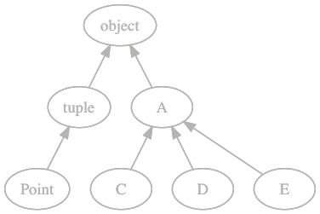
Let’s Practice a Bit
>>> class A(object):
... pass
...
>>> class C(A):
... pass
...
>>> class D(A):
... pass
...
>>> class E(A):
... pass
...
>>> C.__bases__
(<class '__main__.A'>,)

Slide 7
Let’s Practice a Bit
>>> class Point(tuple):
... def __init__(self, x, y):
... self[0] = x
... self[1] = y
... def __getattr__(self, name):
... if name == 'x':
... return self[0]
... if name == 'y':
... return self[1]
... else:
... raise AttributeError
...
>>> a = Point(1, 2)
Traceback (most recent call last):
File "<stdin>", line 1, in <module>
TypeError: tuple() takes at most 1 argument (2 given)

Slide 8
Let’s Practice a Bit
>>> class Point(tuple):
... def __new__(cls, x, y):
... return tuple.__new__( \
... cls, (x, y))
... def __getattr__(self, name):
... if name == 'x':
... return self[0]
... if name == 'y':
... return self[1]
... else:
... raise AttributeError
...
>>> a = Point(1, 2)
>>> a[0]
1
>>> a.y
2

Slide 9
Ok… that was weird
You don’t have to understand every detail of that example
__new__ is difficult to work with
However, it will come back up when we start talking about meta classes
Subclasses of tuple, like Point, are very nice
but a pain to make,
so, we have a built in function that makes classes like Point automatically

Slide 10
namedtuple
>>> from collections import namedtuple
>>> Point = namedtuple('Point', ['x', 'y'])
>>> a = Point(1, 2)
>>> a[0]
1
>>> a.y
2
>>> type(a)
<class '__main__.Point'>
>>> Point.__bases__
(<class 'tuple'>,)

Slide 11
The Method Resolution Order (MRO)
Suppose we call foo() on an instance of C
We need to find a version of foo() to call
Where do we look first?
C
Then,
A
object
So the MRO is “search up from the type of the object.
Here, [C, A, object]
This works because it’s a tree.

Slide 12
You May Have Noticed…
that I said “superclass(s)”
that super() usually means superclass
that I checked the superclass of Point by saying “Point.__bases__”
Which brings us to…

Slide 13
Multiple Inheritance

Slide 14
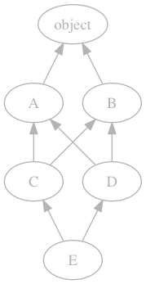
Let’s Just Try It
>>> class A(object):
... pass
>>> class B(object):
... pass
>>> class C(A, B):
... pass
>>> class D(B, A): # note
... pass
>>> class E(C, D):
... pass
>>> E.__bases__
(<class '__main__.C’>, (<class '__main__.D'>)

Slide 15
The Diamond Problem
Suppose we call foo() on an instance of E
We need to find a version of foo() to call
Where do we look first?
E
Then,
C or D?
we defined E as E(C, D)
lets search in that order
C
A, B, or D?
we want to stay close to E if possible
lets search bottom-up
D
A or B?
not clear, we need an algorithm

Slide 16
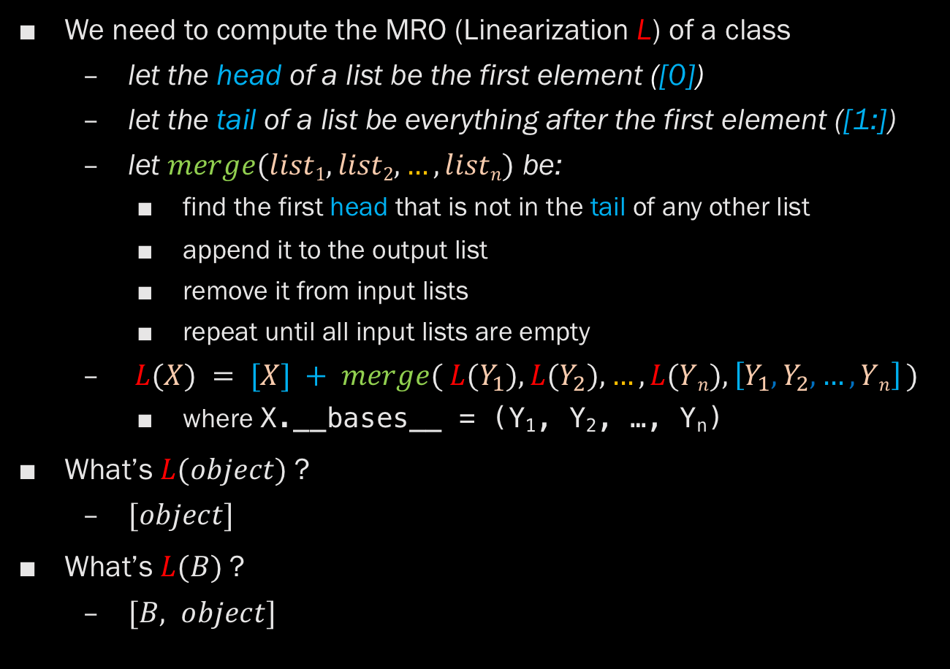
C3 Linearization
We need to compute the MRO (Linearization L) of a class
let the head of a list be the first element ([0])
let the tail of a list be everything after the first element ([1:])
let $merge(list1, list2, …, listn)$ be:
find the first head that is not in the tail of any other list
append it to the output list
remove it from input lists
repeat until all input lists are empty
$L(X) = [X] + merge( L(Y_{1}), L(Y_{2}), …, L(Yn), \left[Y_{1},Y_{2}, …, Yn\right] )$
where X.__bases__ = (Y₁, Y₂, …, Y_{n})
What’s $L(object)$?
$[object]$
What’s $L(B)$?
$[B, object]$

Slide 17
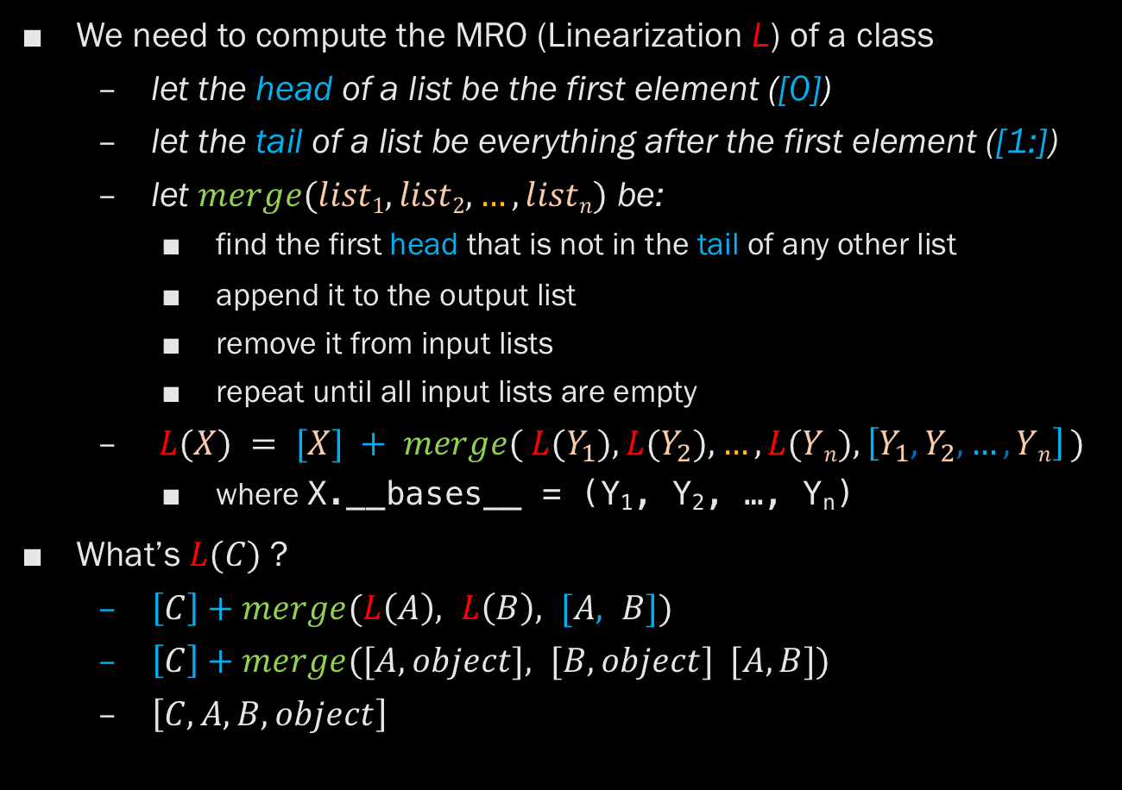
C3 Linearization
We need to compute the MRO (Linearization L) of a class
let the head of a list be the first element ([0])
let the tail of a list be everything after the first element ([1:])
let $merge(list1, list2, …, listn)$ be:
find the first head that is not in the tail of any other list
append it to the output list
remove it from input lists
repeat until all input lists are empty
$L(X) = [X] + merge( L(Y_{1}), L(Y_{2}), …, L(Yn), \left[Y_{1},Y_{2}, …, Yn\right] )$
where X.__bases__ = (Y₁, Y₂, …, Y_{n})
What’s $L(C)$?
$\left[C\right]+merge(L\left(A\right), L\left(B\right), [A, B])$
$\left[C\right]+merge([A, object], [B, object] [A, B])$
$\left[C, A, B, object\right]$

Slide 18

C3 Linearization
We need to compute the MRO (Linearization L) of a class
let the head of a list be the first element ([0])
let the tail of a list be everything after the first element ([1:])
let $merge(list1, list2, …, listn)$ be:
find the first head that is not in the tail of any other list
append it to the output list
remove it from input lists
repeat until all input lists are empty
$L(X) = [X] + merge( L(Y_{1}), L(Y_{2}), …, L(Yn), \left[Y_{1},Y_{2}, …, Yn\right] )$
where X.__bases__ = (Y₁, Y₂, …, Y_{n})
What’s $L(D)$?
$\left[D\right]+merge(L\left(B\right), L\left(A\right), [B, A])$
$\left[D\right]+merge([B, object], [A, object] [B, A])$
$\left[D, B, A, object\right]$

Slide 19
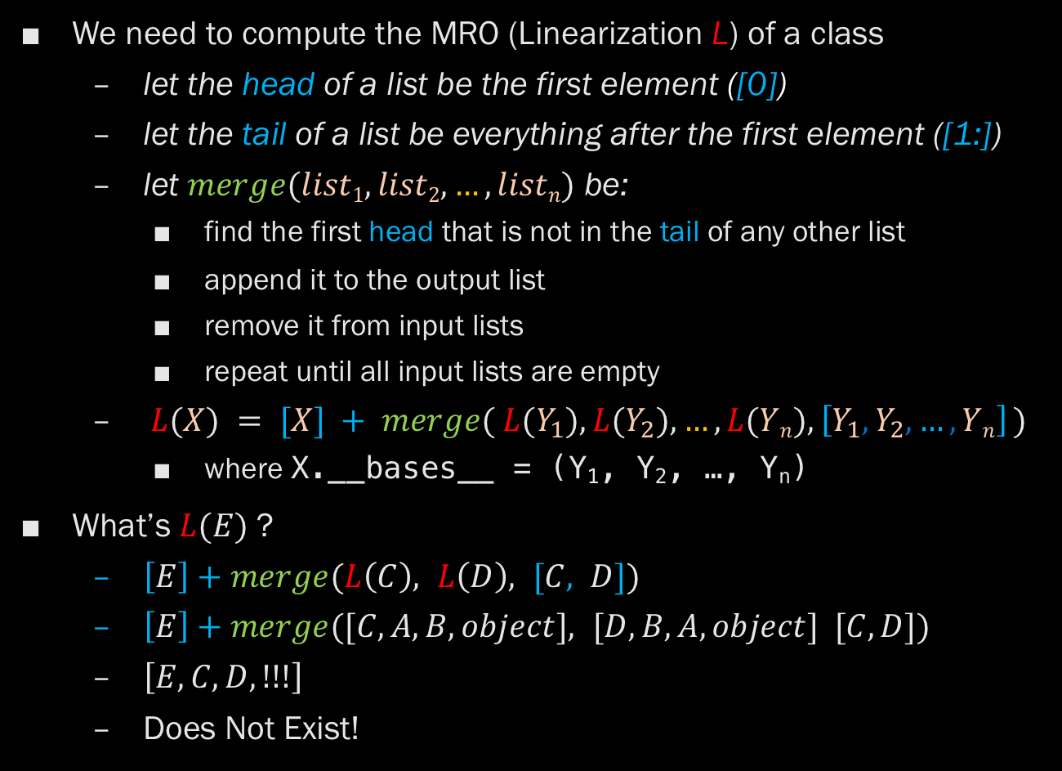
C3 Linearization
We need to compute the MRO (Linearization L) of a class
let the head of a list be the first element ([0])
let the tail of a list be everything after the first element ([1:])
let $merge(list1, list2, …, listn)$ be:
find the first head that is not in the tail of any other list
append it to the output list
remove it from input lists
repeat until all input lists are empty
$L(X) = [X] + merge( L(Y_{1}), L(Y_{2}), …, L(Yn), \left[Y_{1},Y_{2}, …, Yn\right] )$
where X.__bases__ = (Y₁, Y₂, …, Y_{n})
What’s $L(E)$?
$\left[E\right]+merge(L\left(C\right), L\left(D\right), [C, D])$
$\left[E\right]+merge([C,A,B, object], [D,B,A, object] [C, D])$
$\left[E, C, D, !!!\right]$
Does Not Exist!

Slide 20
C3 Linearization -> The MRO
Sometimes it is not possible to compute the merge function
The inheritance is too ambiguous
If you try this example, you will get:
… # all the other class declarations
>>> class E(C, D):
... pass
...
Traceback (most recent call last):
File "<stdin>", line 1, in <module>
TypeError: Cannot create a consistent method resolution
order (MRO) for bases A, B
C3 Linearization produces the MRO
But C3 fails, so there is no MRO, so this doesn’t compile

Slide 21
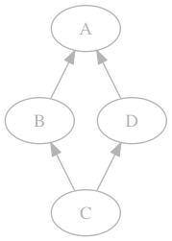
But What About super()?
>>> class A:
... def foo(self):
... print('A')
>>> class B(A):
... def foo(self):
... super().foo()
>>> class D(A):
... def foo(self):
... print('D')
>>> class C(B, D):
... pass
>>> B().foo()
A
>>> C().foo()
D
It cant just mean “acces the superclass”
Which one?
We should use the MRO
It actually means “next in the MRO”
But which MRO?
We can’t know
Who’s B’s super()?
A?
Keep this in mind
for the homework

