Slide 1
Metaprogramming
Maxwell Patek
(mtp4be)
Notes:
Add a welcome page... about me (brief).

Slide 2
Welcome!
I’m Max
4th Year, SEAS Computer Science
Big Metaprogramming Fan
from personal projects
internship in Data Infrastucture at Facebook
I want to share some of these techniques with you!
impressive in interviews
useful on the job

Slide 3
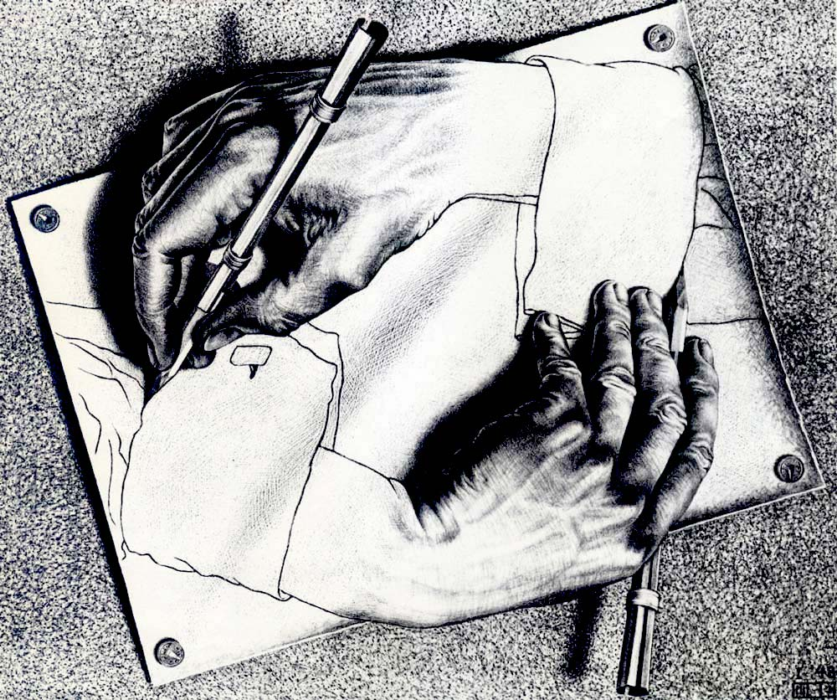
What Is Metaprogramming?
Code that manipulates code
Reads code
Modifies code
Outputs code
Compilers
Compiler Compilers… what!?
Servers
Server Builders… !!
DRY
Don’t Repeat Yourself
You should never have to copy and paste

Slide 4

What Will We Learn? (schedule)
Object Oriented Python Today and week after MLK day
First-Class Functions Feb 3rd
Closures and Decorators Feb 10th and 17th
The Metaclass Feb 24th
Reflection March 2nd and 16th
Compile-time Computation March 23rd
Code Generation March 30th
Language Meta April 6th
Homoiconicity April 13th
Applications April 20th
Conclusion and “Final” April 27th
Notes:
"reflection", add dates

Slide 5
What Will We Do?
Lectures will be pretty standard
I’ll recap last week
by going over the homework (therefore no credit for late homework)
and then do slides
which are designed like live coding
Homework each week
will taper off as we get more abstract
Python puzzles
that require some metaprogramming to solve
Metaprogramming is best understood by just doing it
Not hard, just abstract
homework will demystify
Cheating Policy… Lack Of
Work with each other!
Read each others’ code!
Google liberaly!
Notes:
Add: homework easy. no more than 30 minutes. No such thing as cheating
Add WHY

Slide 6
Today: Object Oriented Python
Classes
Constructors
Fields
Methods
__init__ vs __new__
Duck Typing
Ubiquity and Homogeneity
__dict__
Group Coding

Slide 7
Making Our Own Objects
class keyword
class name
methods are just functions inside the class
>>> class foo:
... def hi(self):
... print(self)
...
>>> f = foo()
>>> f.hi()
<__main__.foo object at 0x103729cf8>
>>> f
<__main__.foo object at 0x103729cf8>
self is first parameter by convention
self == this from Java
blank line to end block in shell
don’t need new from java
same exact thing

Slide 8
Constructor
It’s called __init__
take in parameters after self
>>> class person:
... def __init__(self, a_name, an_age):
... self.name = a_name
... self.age = an_age
... def __str__(self):
... return str(self.name) + ', ' + str(self.age) + ' years old'
...
>>> a = person('Alice', 153)
>>> str(a)
'Alice, 153 years old'
save parameters in self
(similar to populating a dictionary)
toString() from Java
Note: calling str(obj) calls obj.__str__()
Notes:
Don't mention repr and omit ">>> a"

Slide 9
Fields
>>> class person:
... def __init__(self, a_name, an_age):
... self.name = a_name
... self.age = an_age
... def grow_up(self):
... self.age += 1
...
>>> a = person('Alice', 153)
>>> a.age
153
>>> a.grow_up()
>>> a.age
154
these are fields
accessed with dot

Slide 10
Methods
No modifiers
no public static void
Everything is non-static (almost)
Start name with _ to mark private
We’ve already seen
__init__
__str__
grow_up
Methods that start with “__” are built-in
“__” is refered to as “dunder” for double underscore
Java | Python Method | Python Syntax
.equals | __eq__ | ==
.compareTo | __cmp__ | <, >, ==
.toString | __str__ | str()
.contains | __contains__ | in
 | __add__ | +
new | __new__
Notes:
Look into __new__

Slide 11
__init__ vs __new__
__init__ is used to initialize the instance, self
sets up fields
non-static
__new__ is used to create that instance in the first place
static
takes in cls instead of self
if superclass’s __new__ is called, __init__ will also be called
Sometimes comes up when Googling
Just be aware
will become important later

Slide 12
__init__ vs __new__
>>> class test:
... def __new__(cls, x):
... print(f"__new__, cls = {cls}")
... return super().__new__(cls)
... def __init__(self, x):
... print(f"__init__, self = {self}")
... self.x = x
...
>>> t = test(2)
__new__, cls = <class '__main__.test'>
__init__, self = <__main__.test object at 0x1022715f8>
Notes:
1) introduce the fact that I'm about to get into code
2) Example of MRO first and take out "stands for"

Slide 13
Everything is an Object
Let’s look at some code to be sure:
type(thing) returns the type of the parameter.
.mro() shows us the inheritance heirachy
>>> type(1)
<class 'int’>
>>> type(1).mro()
[<class 'int'>, <class 'object'>]
>>> type('hi').mro()
[<class 'str'>, <class 'object'>]
>>> type([]).mro()
[<class 'list'>, <class 'object'>]
>>> type(print).mro()
[<class 'builtin_function_or_method'>, <class 'object'>]
Notes:
1) introduce the fact that I'm about to get into code
2) Example of MRO first and take out "stands for"

Slide 14
Examples
(tuple can be keys, functions and dict can be values, etc.)
(bad in Java, good in Python)
>>> 'hi' == 'hi'
True
>>> 'hi'.__eq__('hi')
True
>>> 1 == 2
False
>>> (1).__eq__(2)
False
>>> dict = {}
>>> dict['a'] = 0
>>> dict[1] = 'hello'
>>> dict[(1, 'hi')] = {'show' : print}
>>> dict
{ 'a': 0,
1: 'hello’,
(1,'hi'): {'show': <built-in function print>}
}
Takeaway: Nothing is special; Python is homogenous

Slide 15
How are these objects typed?

Slide 16
Duck Typing
>>> def reverse(string):
... out = ''
... for i in string:
... out = i + out
... return out
...
>>> print(reverse('hello'))
olleh
>>> print(reverse(5))
Traceback (most recent call last):
File "<stdin>", line 1, in <module>
File "<stdin>", line 3, in reverse
TypeError: 'int' object is not iterable
>>> print(reverse(['a', 'b', 'cd']))
cdba
.
“When I see a bird that walks like a duck and swims like a duck and quacks like a duck, I call that bird a duck.”
James Whitcomb Riley
We don’t care what the official type an object is, we just care how it behaves.
Unexpected behavior: dangerous.
Be “self-conscious” (haha get it?)

Slide 17
>>> type([]).__dict__
{ '__add__': <slot wrapper '__add__' of 'list' objects>,
'__contains__': <slot wrapper '__contains__' of 'list' objects>,
'__delitem__': <slot wrapper '__delitem__' of 'list' objects>,
'__doc__': 'list() -> new empty list\n’
'list(iterable) -> new list initialized from ‘
"iterable's items",
'__iter__': <slot wrapper '__iter__' of 'list' objects>,
'__len__': <slot wrapper '__len__' of 'list' objects>,
'__lt__': <slot wrapper '__lt__' of 'list' objects>,
'__mul__': <slot wrapper '__mul__' of 'list' objects>,
...
'append': <method 'append' of 'list' objects>,
'clear': <method 'clear' of 'list' objects>,
'copy': <method 'copy' of 'list' objects>,
'count': <method 'count' of 'list' objects>,
'extend': <method 'extend' of 'list' objects>,
'index': <method 'index' of 'list' objects>,
'insert': <method 'insert' of 'list' objects>,
'pop': <method 'pop' of 'list' objects>,
'remove': <method 'remove' of 'list' objects>,
'reverse': <method 'reverse' of 'list' objects>,
'sort': <method 'sort' of 'list' objects>
}
Warning: Wall of Text Coming
Do not try to memorize
Takeaway: Even code and descriptions of code are objects.
Takeaway: Our first glimpse at metaprogramming
Notes:
Start with Disclaimer: Dont have to understand > DO NOT MEMORIZE
More directly deescribe that the wall of text actually is.

Slide 18
Summary
Objects are everywhere in Python
Python is dynamically typed
Use assertions and warning to counteract
Make your own types of objects with “class”
methods must take “self” as first parameter!
__init__ is the constructor
”dunder” means “__” means built-in method
str() calls __str__()
__new__ is static
makes self
__init__ is non-static
populates self

Slide 19
The Prisoner’s Dilemma
You and your accomplice are both arrested for a crime.
You both did commit the crime.
3 years of jail time
There is only evidence for conviction of a lesser crime:
1 year of jail time
You’re both interrogated seperately
You can:
Confess and rat out your accomplice, or…
Not confess
You can’t know what your accomplice will say
The jailtime you receive depends what you both say:
You…
your jailtime: | don’t confess | confess
doesn’t confess | 1 | 0
confess | 3 | 2
Accomplice…

Slide 20
Group Coding Prisoner’s Dilemma
Make a prisoner class
Implement __init__(self
, both_confess_sentence
, none_confess_sentence
, self_confess_sentence
, other_confess_sentence)
Implement decide(self)
return True to confess and False to keep your mouth shut
Implement sentence(self, years)
so you know the outcome of your decision
Notes:
Add slide about What the prisoners dilema is!
Add what the takeaway is and a summary slide

