Slide 1
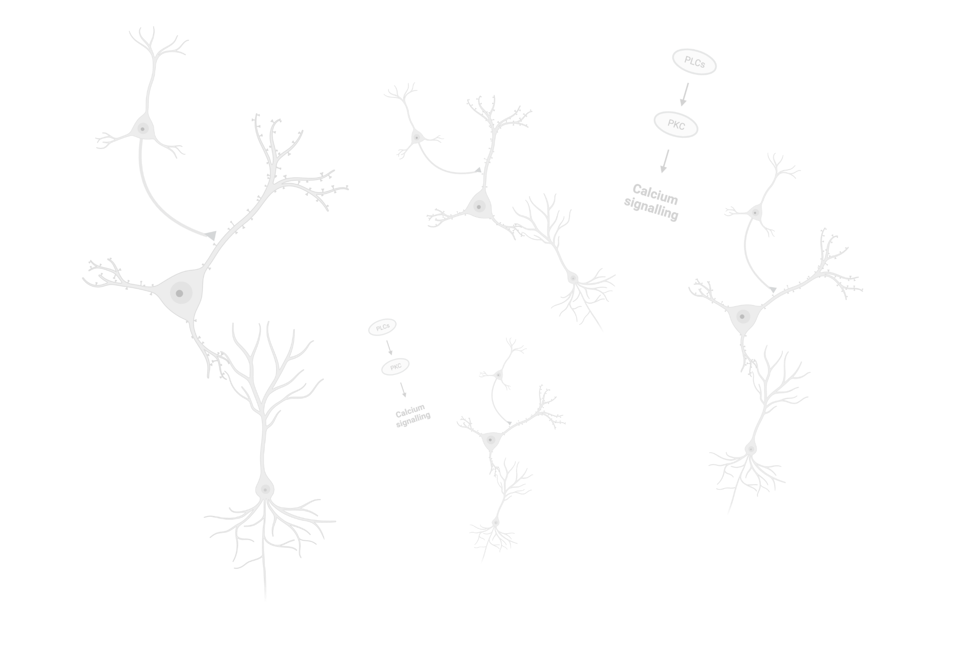


Calcium signals from VIP and SST neurons of the primary visual cortex as decoders of familiar and novel visual stimuli
Gonzalez-Rangel, NA., Heredia-Franco, DA., Lopez-Castro, A., Millar-Santelices, F., Venegas, S., Zorzet, B.

Slide 2


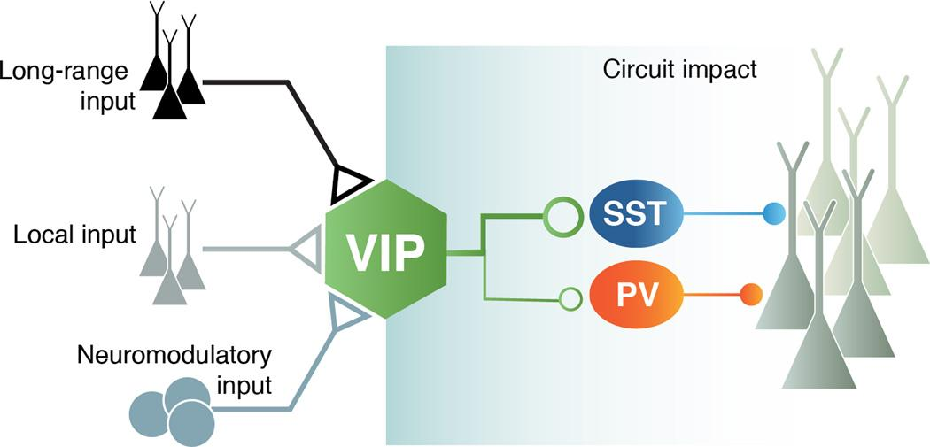
Introduction
Images
What do we know?
Higher activity
Processing
(Homann et al., 2017 y Homann et al., 2021)
Pyramidal neurons
V1 ⅔ cortex layer
Kepecs, A., & Fishell, G. (2014)
Dynamics between neurons?
Modulate activity
(Heintz et al., 2022).
Notes:
Francisco
This is a characteristic circuit of the primary visual cortex. It's made up of neurons VIP-SST-PV and pyramidal neurons. During visual processing tasks, neurons in the primary visual cortex of mice constantly modulate their activity depending on the task and the context in which visual stimulus processing occurs. Among these, populations of VIP and SST neurons are key regulators of pyramidal neuron activity. The dynamics of these neural network in V1 cortex are not fully understood, but there is evidence that these neurons markedly modify their activity during novel vs familiar image processing, which has been investigated by measuring calcium activity in mice performing familiar vs novel image discrimination tasks

Slide 3
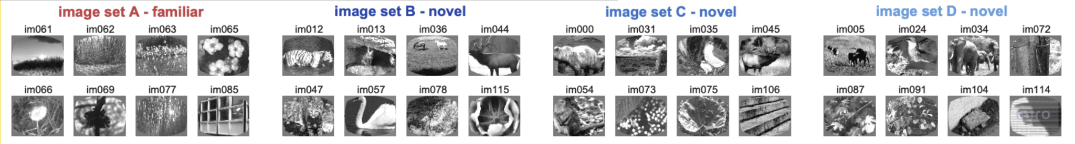
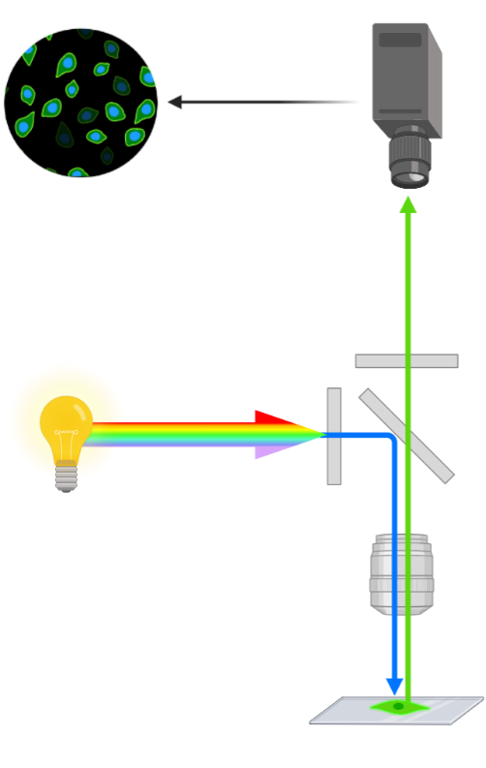
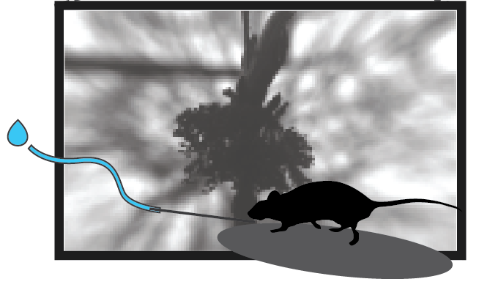
Introduction
What do we have?
Allen SDK dataset
Stimuli set-images
Calcium trace
13 mice
Cre line
Cell specimens
VIP
Timestamps
n = 10666
n =5598
Stimulus
SST
n = 5068
0
0.750 sec
exposure_level = novel (0) familiar (1)
Notes:
Ale - In order to explore the behavior of VIP and SST neurons, we worked with the Allen SDK dataset, which consists of data from the experiment performed with the help of 13 mice. Its basically a task that show familiar and novel images while recording their calcium activity in 10666 cells of the cre line VIP and SST with a two focal microscope. We took the traces at the stimulus presentation until 0.750 seconds later.

Slide 4

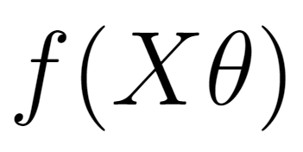

Hypothesis and model
What do we want to know and how?
VIP
SST
Calcium trace
Timestamps
X
y
Stimulus
Matrix of features
Vector of choices
Calcium changes over time (after stimulus)
Logistic regression as the nonlinearity
Image type
0
1 sec
(cre_line, trace, trace_timestamps)
(exposure_level)
Classify the outcome of our dependent variable, the type of image by means of calcium activity data.
Notes:
Nicole - Given the previous we want to be able to, given the calcium activity of VIP and SST neurons, classify the type of image presented. So we organized in a feature matrix the calcium activity at the chosen timestamp, cre line and the stimulus presented as our X. And a vector of experiments conformed by the stimulus presented or the behavior we want to classify as our Y.
For this we hypothesize that the fluorescence values of the VIP, SST neuronal populations are NON linearly related to the type of novel or familiar image presented. And a binary logistic regression is a good model to Classify the outcome of our dependent variable, the type of image, by means of calcium activity data.

Slide 5
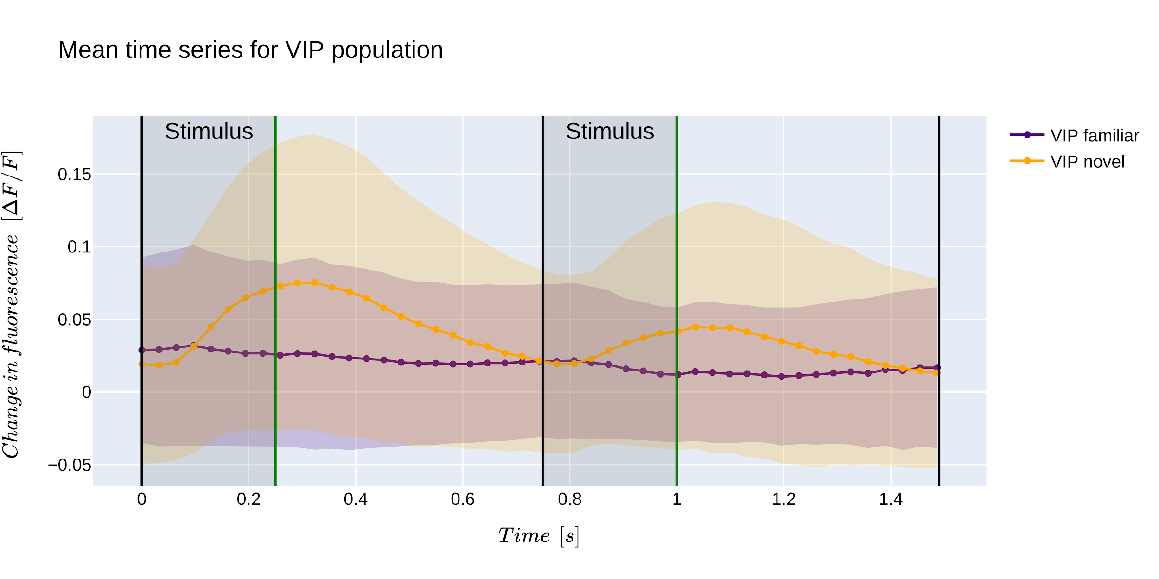
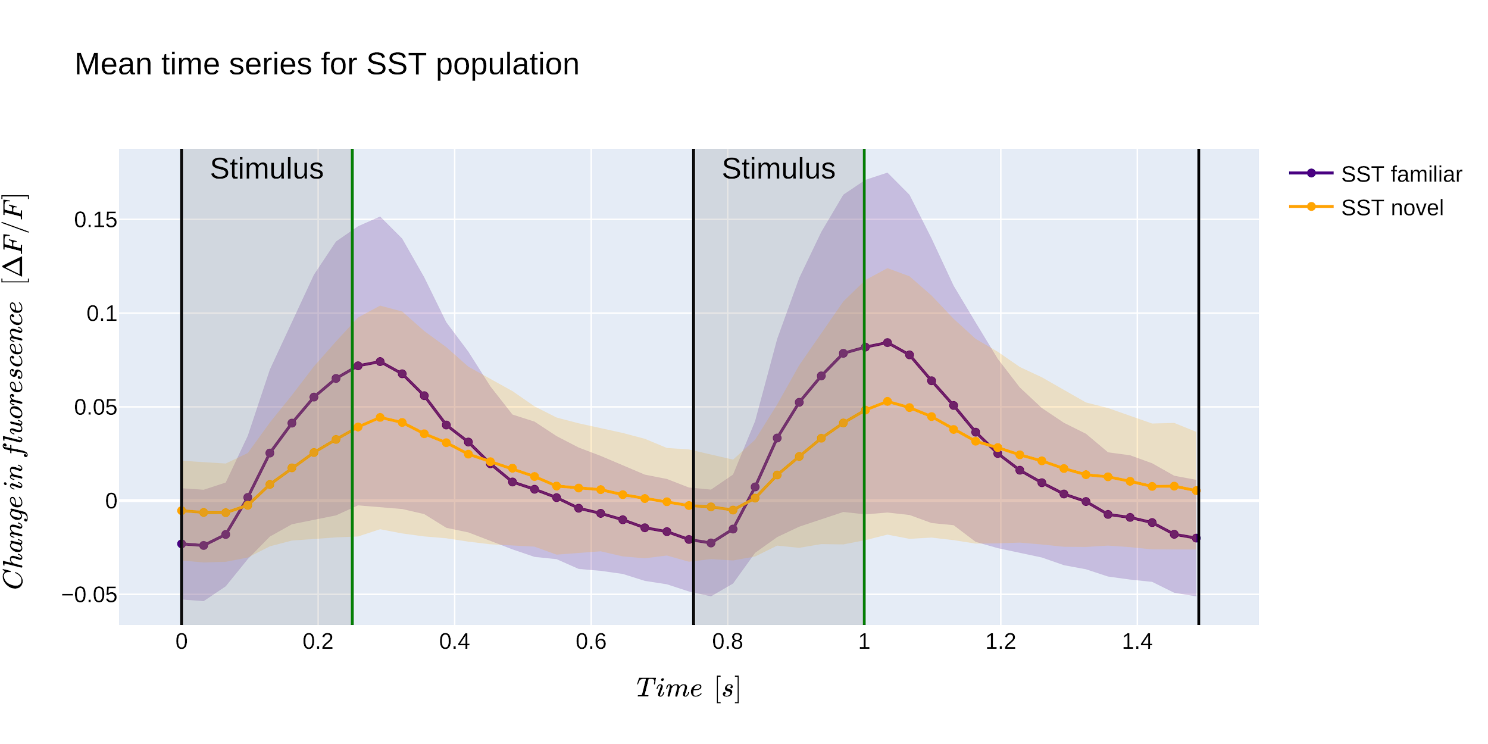
Model Results
VIP
SST

Slide 6
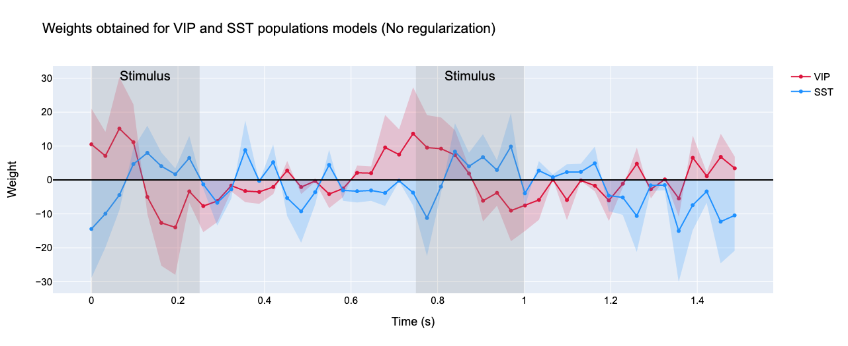
Model Results
Notes:
Seba->We then proceeded to visualize the “importance” assigned by our model to each temporal feature. Thus we plotted the weight values against the features. According to this, the model mainly uses time features close to the stimulus window for both VIP and SST populations, highlighting the temporality of visual processing. It also appears that the VIP and SST weights tend to be inverted with respect to each other. This makes a lot of sense considering the network, that is, VIP neurons tend to fire in favor of new stimulus whereas SST fire in response to “older” stimulus. It is also interesting to note that after the stimulus, the weights of both populations tend to progressively decrease, and even change sign. Hence, the initial perturbation seems to have repercussions well beyond its time frame.

Slide 7
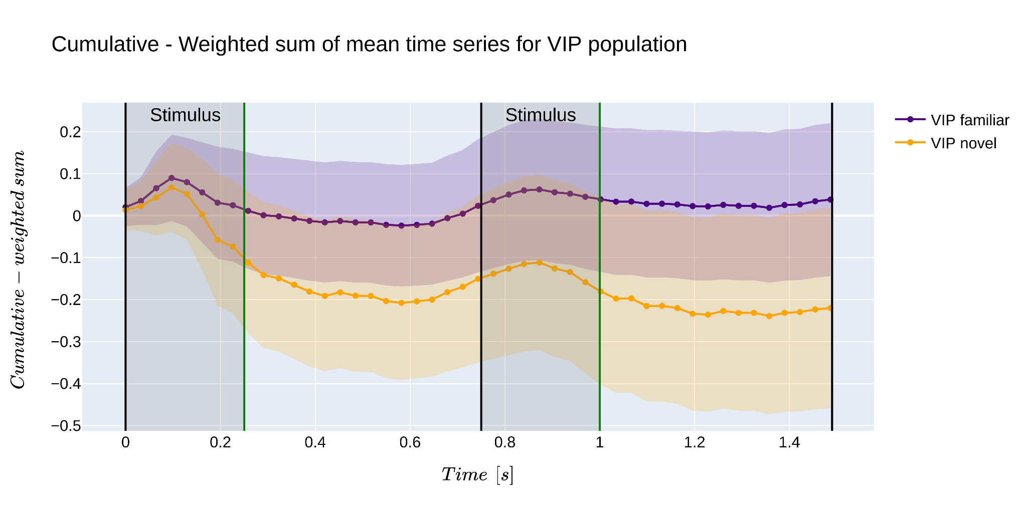
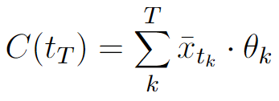
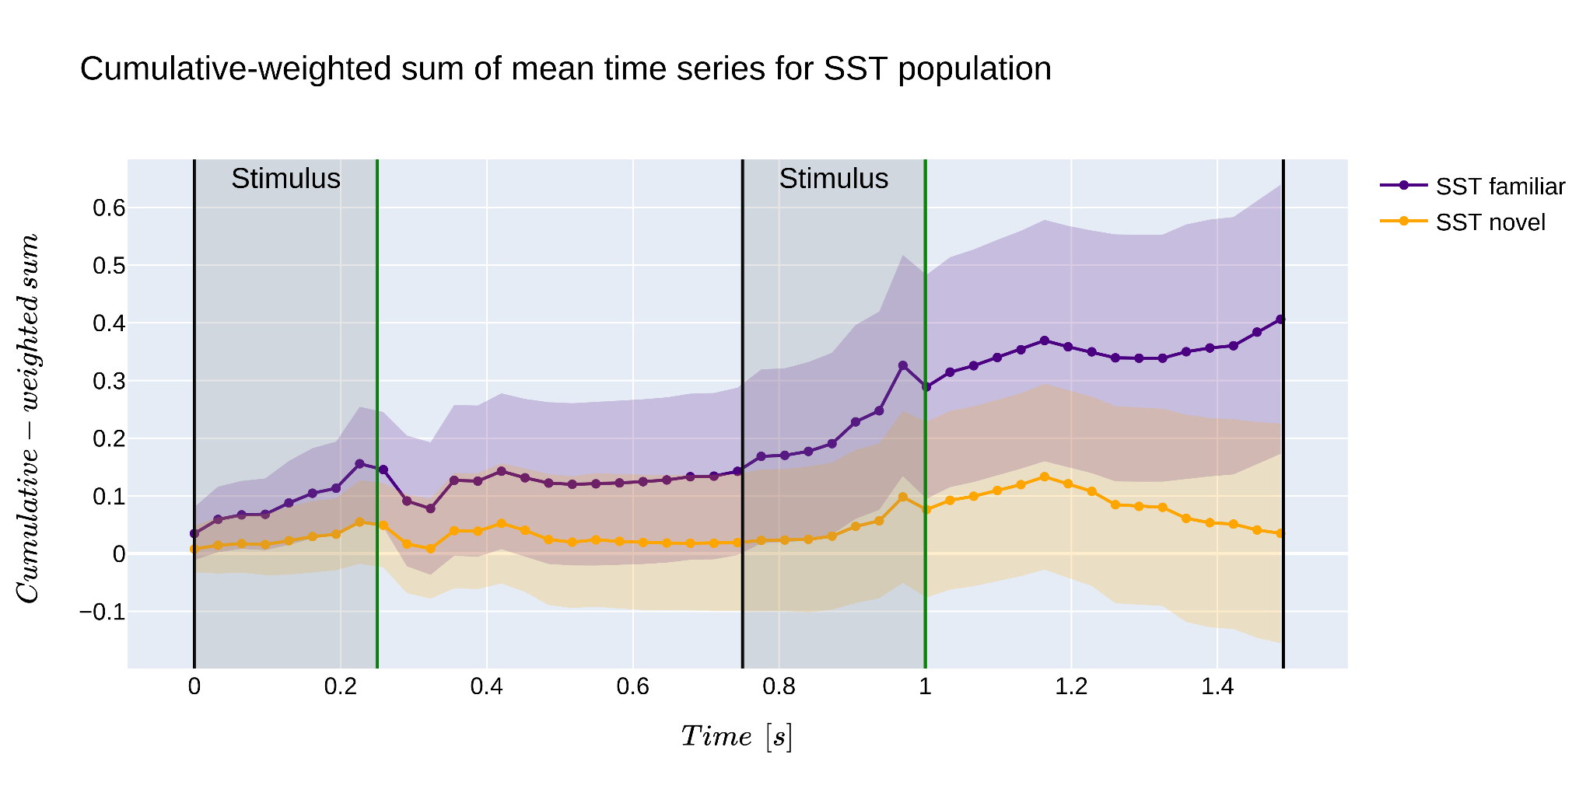
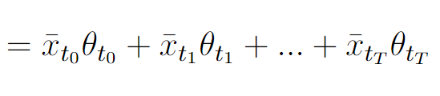
Model Results
VIP
Linear part of the model
Cumulative-weighted sum
SST
Notes:
Diego-> A la izquierda se ven las graficas de la señal de fluorescencia en promedio con sus desviaciones estandares, para las poblaciones VIP y SST cuando se presenta un estimulo nuevo y familiar , en amarillo y morado respectivamente. A la derecha se presenta la suma acumulativa de las señales multiplicadas por los parámetros del modelo. Como una forma de visualizar el comportamiento de la parte lineal del modelo, antes de aplicar la regresion logistca, y determinar cómo clasifica los dos diferentes estímulos, es interesante, pues se observa que los promedio de la suma acumulativa señales novedosas y familiares quedan por fuera de la desviacion estandar, LO QUE INFLUYE EN LA PRECISIÓN DEL MODELO.
Aca lo que se puede mencionar es que estamos visualizando la parte lineal del modelo. Y que a medida que vamos sumando los parámetros con la señal se van separando las medias para cada tipo de estímulo. Lo que se ve reflejado en la precisión del clasificador
si bien ambas graficas se solapan, se puede ver que la media, queda por fuera de los desvios estandar
medias superpuestas e incertidumbras que luego se separan con los parametros

Slide 8
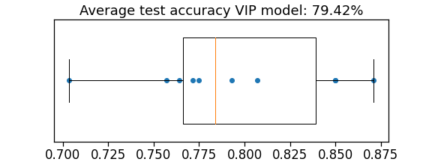
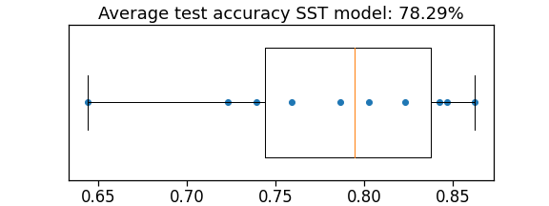
Model Results
Cross-validation accuracy
VIP (P<0.001)
SST (P<0.001)
Notes:
we used cross-validation to calculate the accuracy of the models and compute the probabilities of obtaining this accuracies in a random distribution, so as to determinate how trusted they are. Box splots are displayed in this slides, for the VIP Model the accuracy is 79.42, for the SST Model the accuracy is 78.29 per cent, both with a probability of less than 0.001 of it being by chance, indicating that the accuracies are good.
Regularization was not necessary because the accuracy test and train were similar.
So we can say that both models are good at classifying the type of stimulus
######maybe we could obtain better results if we fit the model with more data.

Slide 9



Conclusions
What we wanted? Classify the outcome of our dependent variable, the type of image by means of calcium activity data.
What we did? A cross-validated model with 78.24% of average accuracy for SST neurons, 79.42% for VIP neurons.
What we achieved? Learn a bunch of stuff, coffee is undervalued, lots of practice with python, get to know a group of great people ¨Frittata VIP¨ .
Special thanks
Marco Peña
Raul Hernandez
Boaz Mohar

Slide 10
Limitations and perspectives.
Method limits Calcium imaging is by no means a perfect technique.
How could we improve our model? Either by increasing the data volume or including additional variables.
Future steps? Test our model against different data sets so as to generalize it.

Slide 11
Calcium signals from VIP and SST neurons of the primary visual cortex as decoders of familiar and novel visual stimuli.
Gonzalez-Rangel, NA., Heredia-Franco, DA., Lopez-Castro, A., Millar-Santelices, F., Venegas, S., Zorzet, B.

