Slide 1
Clase AA

Slide 2
OPC - Early computers
PROGRAM-CONTROLLED COMPUTERS – These computers (1938-1949) were programmed by setting switches and inserting patch cables.
Primitive architecture –CPU, ALU, registers, I/O devices, storage units?, etc.,….
Every configuration of switches and patch cables conformed an instruction. Each instruction was wired, then the program.
The electric storage units and I/O devices ranged from very primitive to something better, for a short time.
No OS.

Slide 3
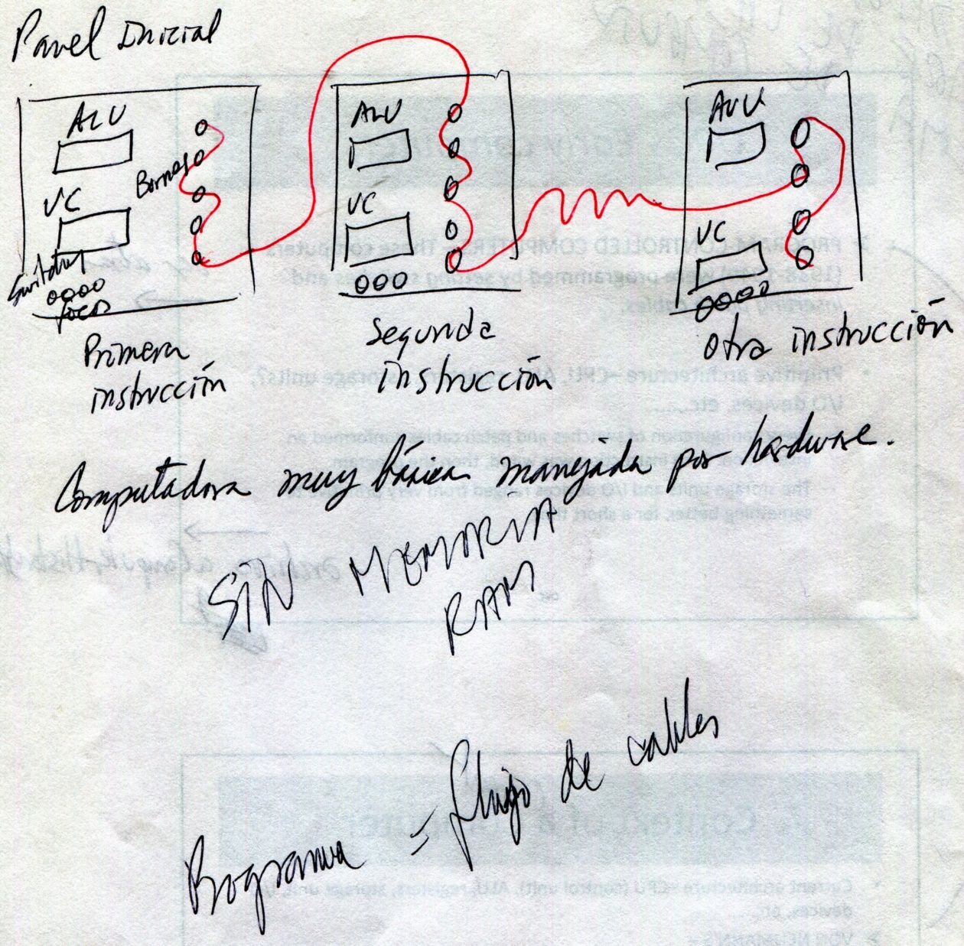
PROGRAM-CONTROLLED COMPUTERS
Sin SO

Slide 4
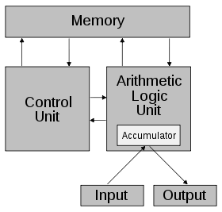
Context of a current Computer
Current architecture –CPU (control unit), ALU, registers, storage unit, I/O devices, etc.,….
VON NEUMANN’S –
The addition of a stored-program in a single separate memory structure that keeps both instructions and data.
The computers that follow the "von Neumann architecture" are also known as the "stored-program computer“.
Registers

Slide 5
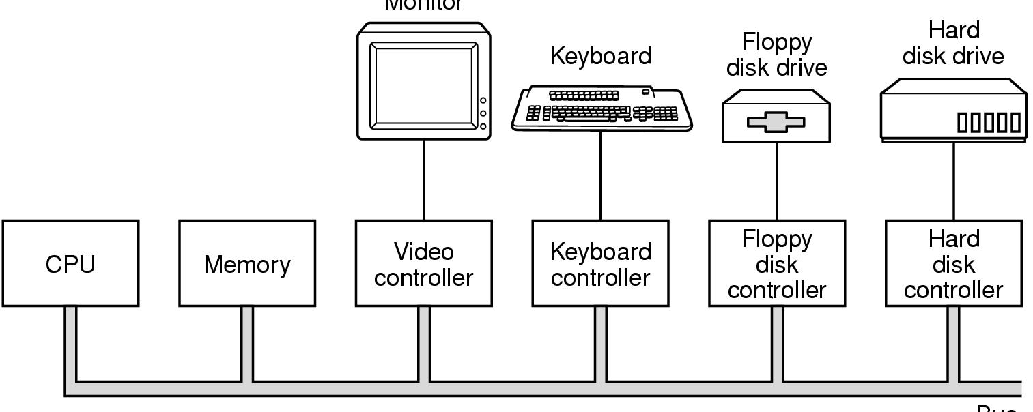
Hardware moderno con Bus
Monitor
controller
BUS
Componentes de una computadora básica
Exceptuando el CPU, cada uno de los componentes tiene un controlador
Cada controlador posee: registros y un buffer, para realizar las entradas y / o las salidas.
El bus tiene tres canales: datos, direcciones de memoria y señales de control.

Slide 6
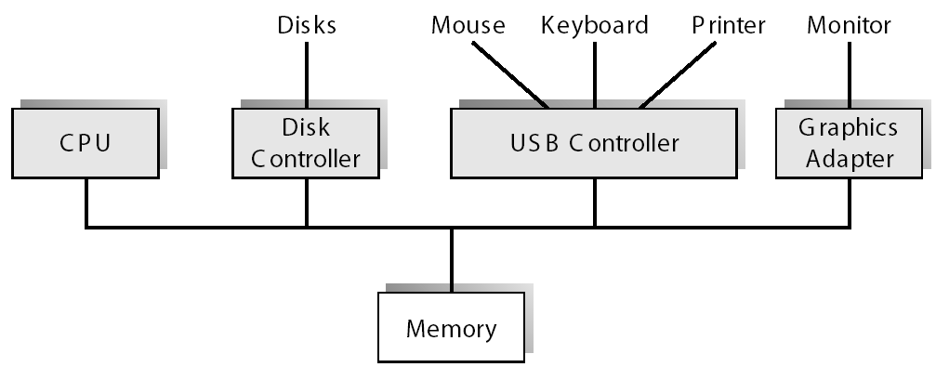
A Desktop Computer with USB
controller
BUS
Controlador
Permite hacer intercambio de información entre los distintos dispositivos.
El CPU se comunica con los controladores.
Driver: subrutina (software) del Kernel que maneja al controlador de un dispositivo.

Slide 7
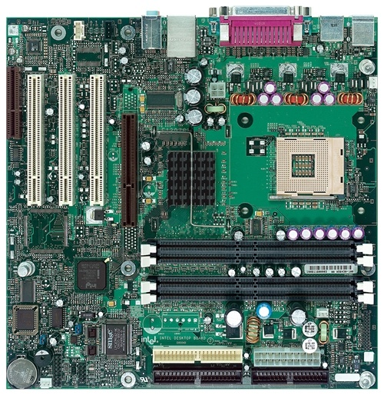
Intel D850MD Motherboard
mouse, keyboard, parallel, serial, and USB connectors
Video
Audio chip
PCI slots
memory controller hub
Pentium 4 socket
AGP slot
dynamic RAM
Firmware hub
I/O Controller
Speaker
Power connector
Battery
Diskette connector
IDE drive connectors

Slide 8
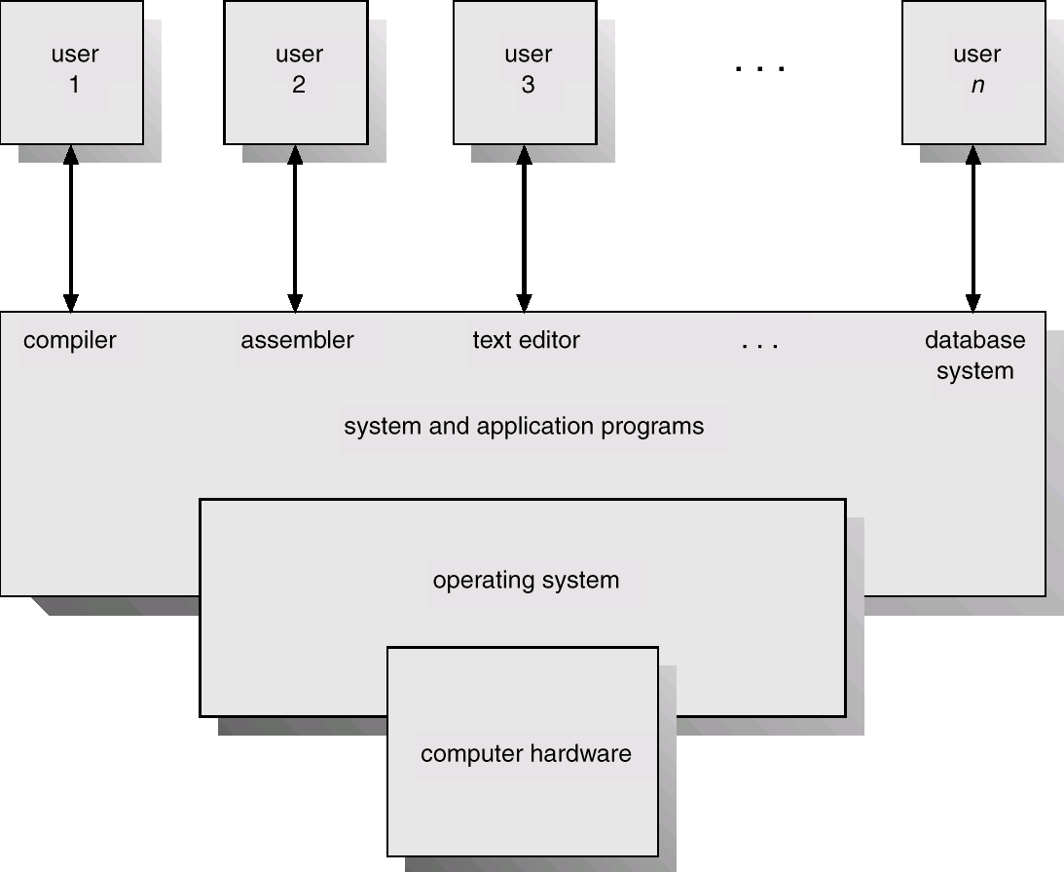
Computer System Components (layers)
Command Interpreter?
Kernel
Instructions?
Software
O.S.
Basic Routines

Slide 9
Computer System Components
Users (people, machines, other computers) captcha: distinguishes human from machine input
System and Applications programs : System programs – help the users to develop applications (compilers, assemblers, database systems, line text editors, etc.), Command Interpreter. Applications programs – help the users to solve their computing problems (spreadsheets, web explorers, video games, business programs, word processors, function libraries). -Software-.
Basic Routines – controls and coordinates the use of the hardware among the various application programs for the various users. For these tasks contains programs and subprograms (kernel) -Software-.
Hardware – provides basic computing resources (CPU, memory, I/O devices)

Slide 10
Computer Hardware
Which ones are the main functions / services of the Computer Hardware?
__________________
__________________
__________________

Slide 11
Clase AB

Slide 12
OPC - Basic Concepts: Overview
Computer Structure - hardware
Assembly Language
Data Representation

Slide 13
General Computer Structure
.
0
CPU
*PC
MAR
Central
Memory
.
Stored-program
.
1
IR
MBR
Instruction
*SP
I/O AR
Instruction
I/O BR
Instruction
execution
unit
.
.
*PSW
BUS
.
PC - Program Counter
IR - Instruction Register
SP – Stack Pointer
PSW – Process Status Word
*Must be saved and restored
Data
Data
Data
Data
I/O Module Controllers
.
.
.
.
N
.
MAR - Memory Address Register
MBR - Memory Buffer Register
I/O AR - I/O Address Register
I/O BE - I/O Buffer Register
Buffers

Slide 14
Central Memory
Conformed by RAM
Ordered collection of bytes (like a vector)
Memory address as index of a byte
Each byte of the memory has a memory address for access

Slide 15
Ejecución de Programas en Leng. Alto Nivel
Flujo para ejecutar programas en C / C++:
Compilar con el Compilador, prog.cc a prog.obj
Ligado o vinculado (linking) con el Linker, prog.obj a prog.exe
Ejecución de programa prog.exe
Programa fuente
prog.cc
Compilador
prog.obj
Linker
Programa objeto
prog.exe
Programa ejecutable

Slide 16
Translating Languages
English: Display the sum of A times B plus C.
C++: F = A * B + C;
cout << (F);
Intel Machine Language:
A1 00000000
F7 25 00000004
03 05 00000008
- - - -
E8 00500000
Assembly Language:
mov EAX, A
mul B
add EAX, C
mov F, EAX
call WriteInt

Slide 17
Compilación de Alto Nivel a Ensamblador
Flujo para producir programas Ensamblador desde C / C++:
Compilar con el Compilador, con opción ensamblador,
de prog.cc a prog.asm
Programa fuente
prog.cc
Compilador
prog.asm
Programa ensamblador

Slide 18
Ejecución de Programas en Leng. Ensamblador
Flujo para ejecutar programas en Ensamblador:
Ensamble con el Ensamblador, prog.asm a prog.obj
Ligado o vinculado (linking) con el Linker, prog.obj a prog.exe
Ejecución de programa prog.exe
Programa fuente
prog.asm
Ensamblador
prog.obj
Linker
Programa objeto
prog.exe
Programa ejecutable

Slide 19
Assembly Language (AL)
What is an Assembler (Ensamblador)?
What background should I have?
How does Assembly Language (AL) relate to machine language?
How do C++ and Java relate to AL?
Is AL portable?

Slide 20
Assembly Data Representation
Binary Numbers
Binary Addition
Integers
Storage Sizes
Unsigned Integers
Hexadecimal Integers

Slide 21

Binary Numbers
Binary Digits are 1 and 0
1 = true
0 = false
MSB – most significant bit
LSB – least significant bit
Bit numbering:

Slide 22
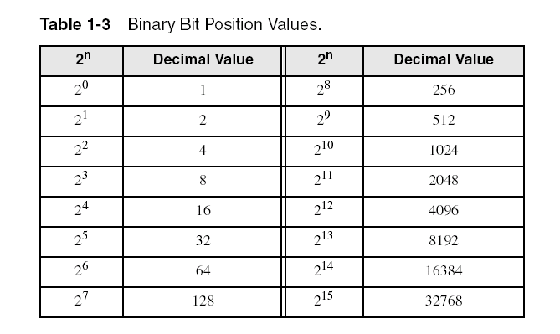
Unsigned Binary Numbers
Each digit (bit) is either 1 or 0
Each bit represents a power of 2:
Every binary number is a sum of powers of 2

Slide 23
Translating Binary to Decimal
Weighted positional notation shows how to calculate the decimal value of each binary bit:
dec = (B_{n-1} × 2^{n-1}) + (B_{n-2} × 2^{n-2}) + ... + (B₁ × 2¹) + (B₀ × 2⁰)
B = binary digit
binary 00001001 = decimal ??:
(0₂ × 2⁷) + (0₂ × 2⁶) + (0₂ × 2⁵) + (0₂ × 2⁴) +
(1₂ × 2³) + (0₂ × 2²) + (0₂ × 2¹) + (1₂ × 2⁰) = 9₁₀

Slide 24
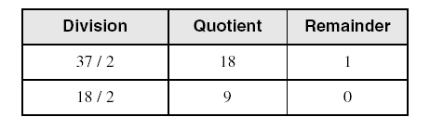
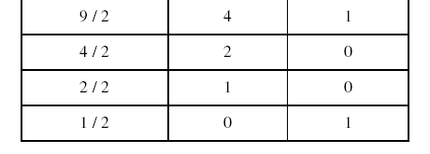
Translating Unsigned Decimal to Binary
Repeatedly divide the decimal integer by 2. Each remainder is a binary digit in the translated value:
B₀
B₁
B₂
B₃
B₄
B₅
37 = 100101
37₁₀ = 100101₂

Slide 25
Binary Addition
Starting with the LSB, add each pair of digits, include the carry if present.

Slide 26
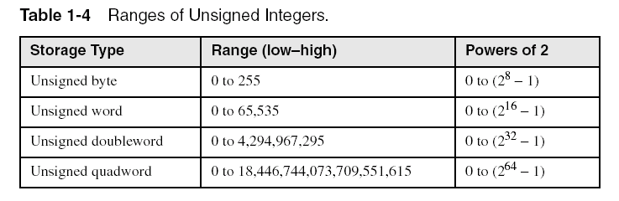
Integers and Storage Sizes
Standard sizes:
What is the largest unsigned integer that may be stored in 20 bits?

Slide 27
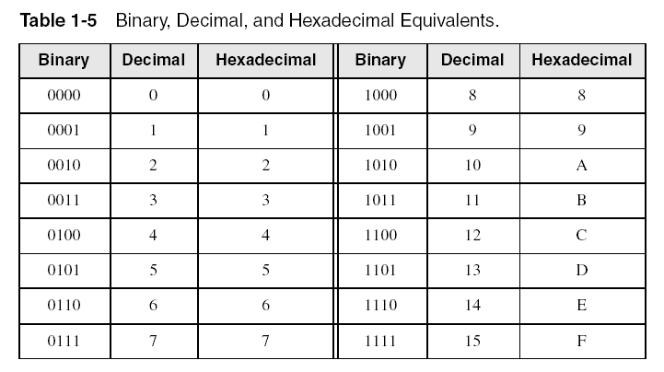
Hexadecimal Integers
Binary values are represented in hexadecimal.

Slide 28

Translating Binary to Hexadecimal
Each hexadecimal digit corresponds to 4 binary bits.
Example: Translate the binary integer
0001 0110 1010 0111 1001 0100₂ to hexadecimal:

Slide 29
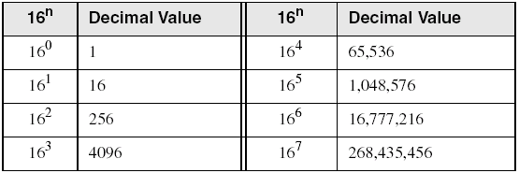
Powers of 16
Used when calculating hexadecimal values up to n digits long:

Slide 30
Converting Hexadecimal to Decimal
Multiply each digit by its corresponding power of 16:
dec = (H₃ × 16³) + (H₂ × 16²) + (H₁ × 16¹) + (H₀ × 16⁰)
Hex 1234₁₆ equals (1 × 16³) + (2 × 16²) + (3 × 16¹) + (4 × 16⁰), or decimal 4,660₁₀.
Hex 3BA4₁₆ equals (3 × 16³) + (11 * 16²) + (10 × 16¹) + (4 × 16⁰), or decimal 15,268₁₀.

Slide 31
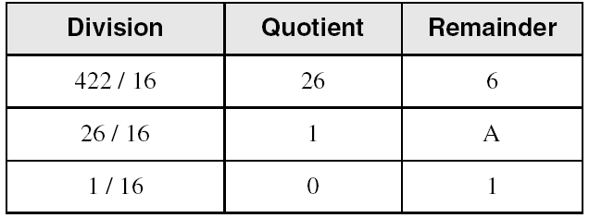
Converting Decimal to Hexadecimal
H₀
H₁
H₂
decimal 422₁₀ = 1A6₁₆ hexadecimal

Slide 32
Hexadecimal Addition
Divide the sum of two digits by the number base (16). The quotient becomes the carry value, and the remainder is the sum digit.
1
1
36 28 28 6A
42 45 58 4B
78 6D 80 B5
21 / 16 = 1, rem 5
Important skill: Programmers frequently add and subtract the addresses of variables and instructions.

Slide 33
Binary Subtraction
Subtract A – B
0 0 0 0 1 1 0 0
– 0 0 0 0 0 0 1 1
Practice: Subtract 0101 from 1001.

Slide 34
Hexadecimal Subtraction
When a borrow is required from the digit to the left, add 16 (decimal) to the current digit's value:
16 + 5 = 21
−1
C6 75
A2 47
24 ??
Practice: The address of var1 is 00400020. The address of the next variable after var1 is 0040006A. How many bytes are used by var1?

Slide 35
Clase AC

Slide 36
Ranges of Unsigned Integers
Standard sizes:

Slide 37
Signed Integers
The highest bit (MSB) indicates the sign. 1 = negative, 0 = positive
If the highest digit of a hexadecimal integer is > 7, the value is negative. Examples: F5, 8A, C5, A2, 9D

Slide 38
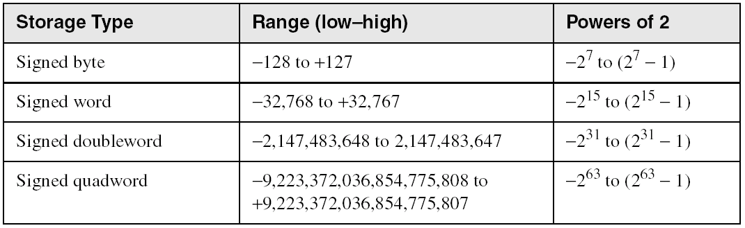
Ranges of Signed Integers
The highest bit is reserved for the sign. This limits the range:
Practice: What is the largest positive value that may be stored in 20 bits?

Slide 39
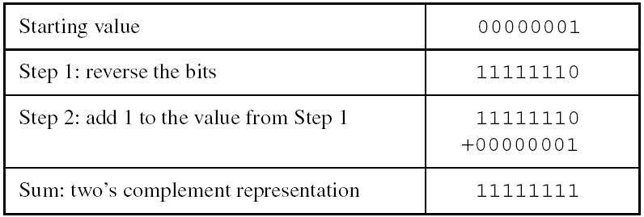
Forming the Two's Complement
Negative numbers are stored in Two’s Complement notation
1st : do One’s Complement with the number
2nd: add 1 to the One’s Complemented number
Represents the additive Inverse
Note that 0000 0001 + 1111 1111 = 0000 0000

Slide 40
Binary Subtraction
When subtracting A – B, convert B to its Two’s Complement.
Add A to (–B)
0 0 0 0 1 1 0 0 0 0 0 0 1 1 0 0
– 0 0 0 0 0 0 1 1 + 1 1 1 1 1 1 0 1
0 0 0 0 1 0 0 1

Slide 41
Learn How To Do the Following:
Converting UNSIGNED and SIGNED Integers
Form the two's complement of a hexadecimal integer
Convert signed binary to decimal
Convert signed decimal to binary
Convert signed decimal to hexadecimal
Convert signed hexadecimal to decimal

Slide 42
Hex One’s Complement
Hex |  | Bin |  | Bin C1s |  | Hex C1s
0 | > | 0000 | C1s | 1111 | > | F
1 | > | 0001 | C1s | 1110 | > | E
2 | > | 0010 | C1s | 1101 | > | D
3 | > | 0011 | C1s | 1100 | > | C
4 | > | 0100 | C1s | 1011 | > | B
5 | > | 0101 | C1s | 1010 | > | A
6 | > | 0110 | C1s | 1001 | > | 9
7 | > | 0111 | C1s | 1000 | > | 8
8 | > | 1000 | C1s | 0111 | > | 7
9 | > | 1001 | C1s | 0110 | > | 6
A | > | 1010 | C1s | 0101 | > | 5
B | > | 1011 | C1s | 0100 | > | 4
C | > | 1100 | C1s | 0011 | > | 3
D | > | 1101 | C1s | 0010 | > | 2
E | > | 1110 | C1s | 0001 | > | 1
F | > | 1111 | C1s | 0000 | > | 0

Slide 43
Clase AD

Slide 44
Arithmetic Operator Precedence
HLL operator precedence in evaluation of Arithmetic Expressions
1- ( )
2- - unary
3- *, /
4- +, -
Examples:
X = 6 - Y * 5 + 2;
R = -8 - T * (7 + M);

Slide 45
Character Interpretation & Storage
Character sets
Standard ASCII (0 – 127), 8 bits
‘u’, ‘U’, ‘A’, ‘8’, ‘2’
Extended ASCII (0 – 255), 8 bits
ANSI (0 – 255), 8 bits
Unicode (0 – 65,535), 16 bits in Java

Slide 46
Characters application
To type down a text command in a computer
To write down a computer program in a text file
To send messages
To send e-mails
. . .

Slide 47
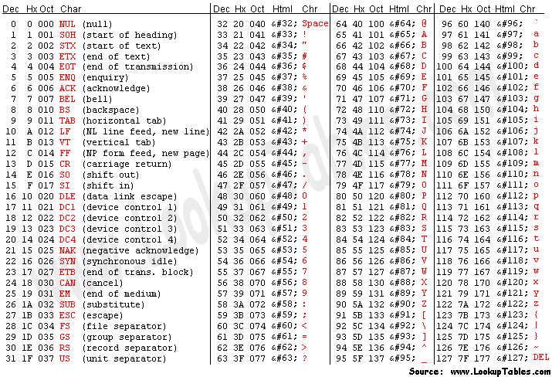
ASCII Code (7-bit) American Standard Code for Information Interchange

Slide 48
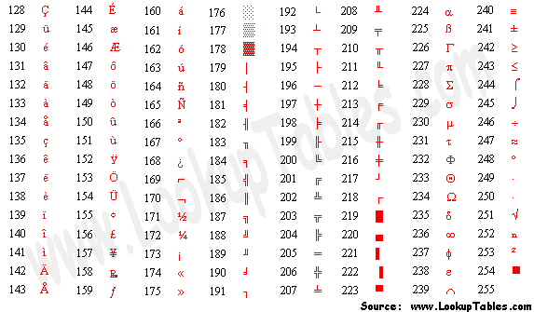
Extended ASCII Code (8-bit)

Slide 49


Characters use
Hello
Chars stream
48₁₆
65₁₆
6C₁₆
6C₁₆
6F₁₆
Typing down “Hello”.

Slide 50
HLL Strings in central memory
Two components
String
Array of consecutive characters
“Laura”
Null-terminated String
A null (zero) character ending String
Interpretation and Storage
Central memory ????

Slide 51
Numeric Data Representation
pure binary
can be calculated directly
ASCII char binary
string of digits: "01010101"
ASCII char decimal
string of digits: "65"
ASCII char hexadecimal
string of digits: "9C"

Slide 52
Boolean Operations
Easy to operate for ALU
Bit-to-bit
True:1, False:0
NOT
AND
OR
Operator Precedence
Truth Tables

Slide 53
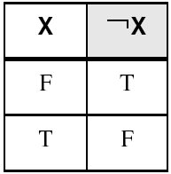
NOT
Inverts (reverses) a boolean value
One operand
If operator is T, then F; if F, then T
Truth table for Boolean NOT operator:
Digital gate diagram for NOT:

Slide 54
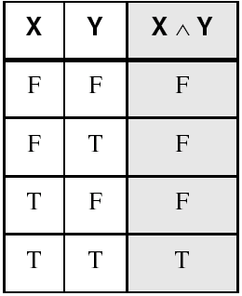
AND
Two operands
Both must be T for T; otherwise F
Truth table for Boolean AND operator:
Digital gate diagram for AND:

Slide 55
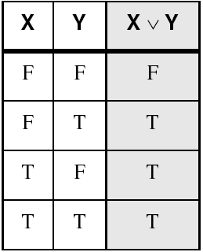
OR
Two operands
Both must be F for F; otherwise T
Truth table for Boolean OR operator:
Digital gate diagram for OR:

Slide 56

Boolean Operator Precedence
The HLL order of evaluation is:
1.
Parentheses ( )
2.
NOT
3.
AND
4.
OR v
Example 1: F = A ^ (B v C) ^ (C v D)
Example 2: F = A ^ B v C ^ C v D
56

Slide 57
NAND
Two operands
Both T, then F; otherwise T
Truth table for Boolean NAND operator:
X
Y
X NAND Y
F
F
T
Digital gate diagram for NAND:
F
T
T
T
F
T
NAND
T
T
F

Slide 58
NOR
Two operands
Any T, then F; otherwise T
Truth table for Boolean NOR operator:
X
Y
X NOR Y
F
F
T
Digital gate diagram for NAND:
F
T
F
T
F
F
NOR
T
T
F

Slide 59
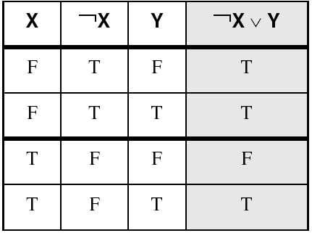
Truth Tables
A Boolean function has one or more Boolean inputs, returns a single Boolean output.
A truth table shows all the inputs and outputs of a Boolean function
Example: ¬X ∨ Y

Slide 60
Clase AEa

Slide 61
General Concepts
The Microprocessor
Cache Memory
Instruction execution cycle
Reading from Memory

Slide 62
The Microprocessor - 1
Also called Central Processor Unit (CPU), the controlling element in a computer system
Control unit (CU) coordinates sequence of execution steps
Controls memory and I/O through connections called buses
Arithmetic and Logic Unit (ALU) performs arithmetic and bitwise processing
Clock synchronizes CPU operations (oscillator)
channel
controller
controller
controller
channel
channel
Block diagram of a microcomputer

Slide 63
The Microprocessor - 2
CU performs:
data transfer between itself and the memory or I/O systems
program flow via simple decisions, PC
ALU does:
simple arithmetic and logic operations
The resulting states of the ALU operations are placed in FLAGS (psw)

Slide 64
Registers inside the CPU
Registers are hard-wired inside the CPU.
They can storage, 8-bit, 16-bit, 32-bit, 64-bit, or 128-bit long information (data or address).
Their speed access is very fast, and is the fastest in the computer hardware.

Slide 65
Memory Storage Unit
Called Central or Main Memory
Mostly, made out of RAM chips
Storage, Addresses, Instructions and / or Data
Stored programs make the microprocessor and computer system very powerful devices
Conventional memory is outside the CPU, and it responds more slowly to access requests than registers

Slide 66
Bus
A common group of wires that interconnect CPU, memory and I/O devices
Transfer control information, addresses, and data between components
Bus, containing three channels or sub-buses
Control channel: determines where data comes from and goes, and ALU activities
Address channel: selects where data comes from or goes to
Data channel: moves data between memory bytes, I/O and CPU registers
channel
controller
controller
controller
channel
channel

Slide 67
Clock (Oscillator)
Synchronizes all CPU and BUS operations
A tick every cycle
Machine (clock) cycle measures time of a single operation / instruction
Clock is used to trigger events

Slide 68
Computer BUS
BUS has became a content element between all the components attached up
CPU has to compete, against other devices, to seize the memory unit (main, central, or RAM memory)
CPU needs to access the main memory to fetch next instruction and execute it up

Slide 69
Cache Memory
Closer to the CPU
Access time: faster than Main Memory (RAM)
Storage size: smaller than Main Memory
Time to time: a block of Main Memory locations is copied, by CPU, to Cache Memory

Slide 70
Main Memory <> Cache Memory
Memory
Address
Slot
Number
Tag
Block
0
0
1
1
2
Block
(k words)
2
3
C - 1
Block Length
(k words)
(b) Cache Memory
Block
2^{n} - 1
Word Length
(a) Main Memory
Sistemas Operativos
70

Slide 71
Issue
What issue arises from having a Main Memory and a Cache Memory? _____

Slide 72
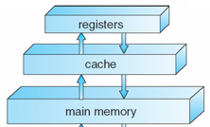
Storage Hierarchy
Storage systems organized, in hierarchy, by
Access Speed ____
Cost per bit ____
Storage Size _____

Slide 73
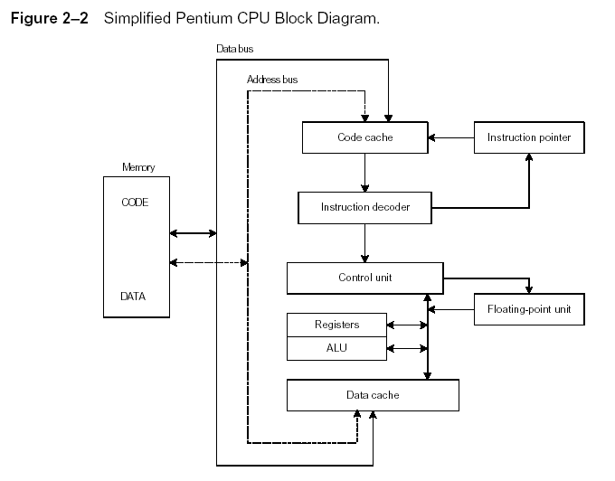
Instruction Execution Cycle
Boot
|
↓
Loop
Instrucion Fetch Caché <- Memoria
Instruction Decode
Fetch operands
Execute
Store output
Repeat Loop until
HALT
HALT no es ejecutable directamente. Primero hay que usar shutdown para cerrar los programas correctamente.
https://tools.withcode.uk/cpu/?ram=00000000000000000000000000000000

Slide 74
Reading from Memory
Multiple machine cycles are required when reading from memory, because it responds much more slowly than the CPU. The steps are:
Execution step
Cycle 1: address placed on address bus
Cycle 2: Read Line (RD) set low (0), changing the value of processor’s RD
Cycle 3: CPU waits one cycle for memory chips to respond
Cycle 4: Read Line (RD) goes to 1, indicating that the data is on the data bus and can be copied
Memory Read Cycle

Slide 75
Clase AEb

Slide 76
Main, or Central, Memory
Main Memory structure
A Linear Vector of Memory Bytes (content), with the indexes being the memory addresses to Access the content of the Memory Bytes
Hardware components
EEPROMs
xRAMs (e.g. DRAM)
Device Controllers: each one with Control Registers and a Data Buffer

Slide 77
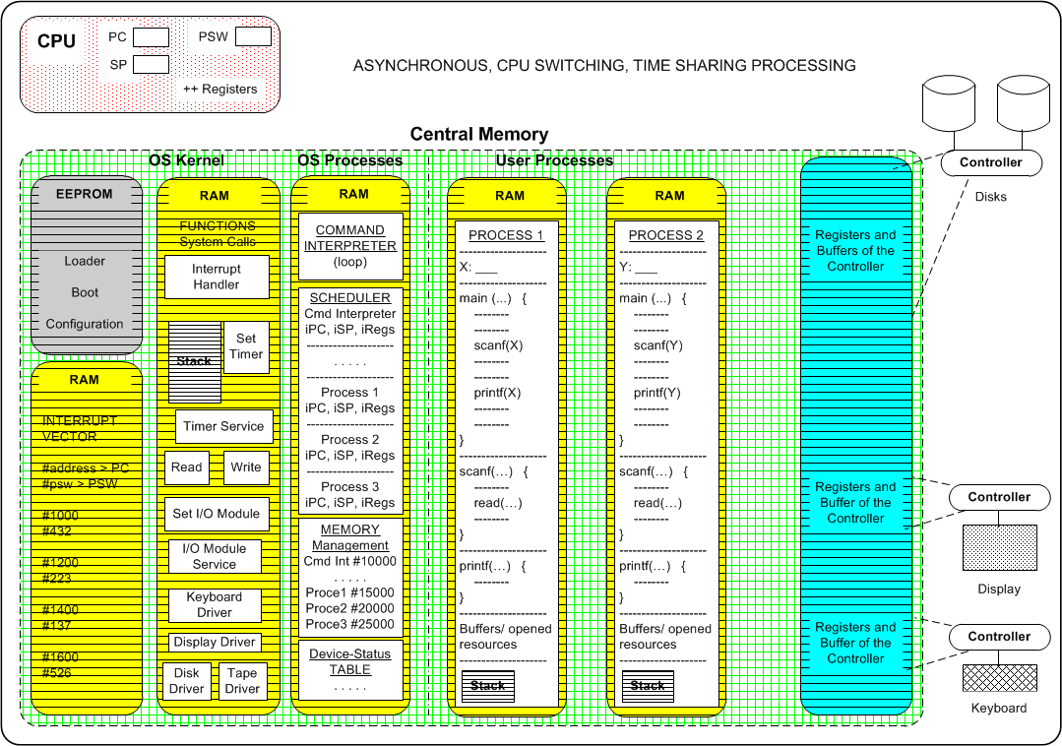
Memory Layout for Multiprogrammed System

Slide 78
Numerical Values: meanings
Data content: unsigned and signed values
Registers
Memory Byte locations
Memory Addresses
To Access Memory Byte locations
Represented as numerical unsigned values

Slide 79
Multiple Memory Byte Values
Byte Values used as Data
One-byte content
Two-byte content
Four-byte content
Eight-byte content
Always Powers of 2, content

Slide 80
Main Memory Addressing

Slide 81
Clase AF

Slide 82
Intel Microprocessor Evolution
Intel 8080, 8088
Intel 8086
Intel 80286
IA-32 processor family
Data and Addresses in BUS´s channels
Microprocessors / Computer Systems

Slide 83
Early Intel Microprocessors
Intel 8080
8-bit registers, 32-bit integers
64KB addressable RAM (____-bit addressing)
S-100 BUS architecture, 8-bit data bus
MS-DOS Operating System
8-inch floppy disks!
Intel 8086
IBM-PC Used 8086
16-bit registers
1 MB addressable RAM (___-bit addressing)
16-bit data bus
Separate floating-point unit (8087)
Backward-Compatibility: this approach allows older software programs (binary) to run on newer computers.

Slide 84
The IBM-PC/AT
Intel 80286
16-bit microprocessor registers
16 MB addressable RAM (___-bit addressing)
24-bit address bus
Protected memory mode
Several times faster than 8086
Introduced IDE (Integrated Drive Electronics) BUS architecture
Separate 80287 floating point unit (FPU)

Slide 85
Intel IA-32 (32-Bit x86) Family
Intel386 (80386)
32-bit data registers
32-bit address, paging (virtual memory)
_4_ GB addressable RAM
Windows NT and Linux Operating System
Intel486
Instruction pipelining
FPU, inside the main chip
Pentium, +Pro, +II, +III, +4, +5
32-bit address bus, 64-bit data
Instruction superescalar
Notes:
La memoria protegida permitió tener más de un proceso a la vez. La memoria virtual sirve para tener muchos más procesos.

Slide 86
IA-32 (32-Bit x86) Processor Architecture
Modes of operation
Basic execution environment
Floating-Point Unit FPU

Slide 87
IA-32 Modes of Operation -1
Protected Mode
native state for 80x86 CPUs (Windows NT, Linux)
every resource can be used
all the instructions, and devices
4GB of central memory, 32-bit addresses
the whole main memory
programs (processes) given separate memory (processes) areas
security: every process can not address other process area
Notes:
SO’s multiusuarios

Slide 88
IA-32 Modes of Operation -2
Real-Address Mode
implements programming environment of Intel 8086 processor
1 MB of central memory, 20-bit addresses
only 1 MB out of the 4GB
native MS-DOS
backward compatibility
it runs on the 80x86 processor
the MS-DOS works like a virtual machine
program can cause MS-DOS crash
None, the other Windows NT processes
Notes:
Real-Address Mode sólo acepta correr programas en el 8086. Sirve para agregar compatibilidad hacia atrás

Slide 89
IA-32 Modes of Operation - 3
System Management Mode
Provides OS with:
boot configuration
power management (power-on, battery level, shutdown)
system security
diagnostics
main memory, disks unit, graphical cards, nic cards, mouse, keyboard, usb unit, monitors, …
disks defragmenter
This functions are implemented by computer (hardware) manufacturers

Slide 90
IA-32 Modes of Operation - 4
Virtual-8086 sub-mode
hybrid of Protected Mode
allow several sessions of Real-Address Mode
each session is a MS-DOS virtual machine
each program has its own 8086 computer
if a MS-DOS virtual machine crashes, it does not affect the other process
every MS-DOS virtual machine uses 1 MB of the central memory

Slide 91
Clase AG

Slide 92
Basic Execution Environment
IA-32
Addressable memory
General-purpose registers
Index and base registers
Specialized register uses
Status flags

Slide 93
IA-32 Addressable Memory
Protected mode
4 GB
32-bit address (0 - 4,294,967,295), 4-Byte address
Real-address mode and Virtual-8086 sub-mode
1 MB space
20-bit address (0 - 1,048,575), 2.5-Byte address
In Protected Mode running multiple (Virtual-8086 sub mode) programs, each program has its own 1 MB memory area

Slide 94
Protected Mode Memory

Slide 95
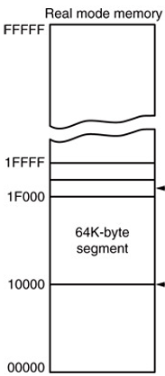
Real-address Mode Memory

Slide 96
Program Execution Registers
Named storage locations inside the CPU, optimized for high-speed.

Slide 97
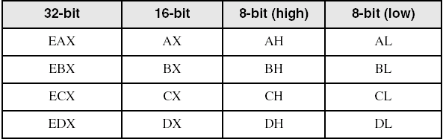
General-Purpose Registers (1/2)
32 bit-Registers: EAX, EBX, ECX, and EDX
Primarily used for arithmetic and data movement
Lower half of these registers can be broken down as:
two 8-bit values, or / and
one 16-bit value (both for backward-compatibility)

Slide 98
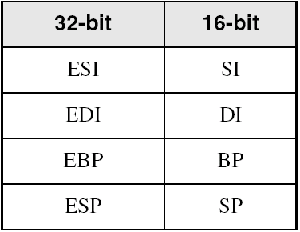
General-Purpose Registers (2/2)
32 bit-Registers: ESI, EDI, EBP, and ESP
These registers are used for addressing
Lower half of these registers can be broken down as:
one 16-bit value

Slide 99
Some Specialized Register Uses (1 / 3)
32-bit General-Purpose Registers
EAX – extended accumulator (mult, divi)
ECX – CPU loop counter
ESP – CPU extended stack pointer or SP
ESI, EDI – index registers
EBP – extended frame pointer (stack, for high-level languages parameters)
Should not be used for arithmetic or data transfer

Slide 100
Some Specialized Register Uses (2 / 3)
EIP – 32-bit Instruction Pointer (traditional PC, Program Counter)
Contains address of next instruction to be executed
EFLAGS – 32-bit Processor Status Flags
status and control flags
each flag is a single binary bit
A flag is set when it equals 1; it is clear (or reset) when it equals 0
The flags are affected after exec instructions

Slide 101
Status 1-bit Flags / EFLAGS
Carry
unsigned arithmetic out of range
Overflow
signed arithmetic out of range
Sign
result is negative
Zero
result is zero
Auxiliary Carry
carry from bit 3 to bit 4, in 8-bit operand
Parity
sum of 1 bits, is an even number (in LSB)

Slide 102
Some Specialized Register Uses (3 / 3)
16-bit Segment Registers (for processes)
CS – code segment, holds code; programs and procedures
DS – data segment, contains most data used by a program
SS – stack segment, defines the area of memory used for the stack
ES, FS, GS - additional segments for extra data

Slide 103
Process memory schema
0xFFFFFFFF
OS resources
(open files, network connect.,
Sound channels, …)
CPU
General Registers
SS >
stack
(storage call returns, etc.)
SP
ESP
Memory address space
heap
(dynamic allocated mem)
CS >
Code section
(text segment)
PC
EIP
DS >
static data section
(data segment)
0x00000000

Slide 104
Memory Addressing Schemes
Higher address
Higher address
EXEC
FLOW
EXEC
FLOW
Lower address
Lower address

Slide 105
Data allocation
32-bit Registers
For 32-bit data values, signed or not.
MSB: bit 31; LSB bit 0.
8-bit Memory Locations
How come a 32-bit value is allocated in 8-bit memory locations?

Slide 106
1- Byte Data allocation
1-Byte Example, AL register and byte variable alfa:
AL: containing a numerical value of 12_{h}
alfa, has a memory address location of 00000100₂

Slide 107
Endianness memory storage
Is the sequential order in which Bytes (more than one), representing a numerical value, are stored in main memory.
Numerical value storage > 1 Byte
Two formats for Endianness
Big-endian, MSB stored first, … LSB stored last
Little-endian, LSB stored first, … MSB stored last

Slide 108
Little Endian Order
2-Byte Example, BX register and short variable beta:
BX: containing a numerical value of 1234_{h}
beta, has a memory address location of 00000100₂

Slide 109
Little Endian Order
4-Byte Example, ECX register and integer variable delta:
ECX: containing a numerical value of 12345678_{h}
delta, has a memory address location of 00000100₂

Slide 110
64-bit x86-64 Processors - 1
Intel64 (x86-64 specification)
P6 series, extended to 64 GB (___-bit addressing)
64-bit linear address space
64-bit Mode, Windows 64 uses this
Protected, Real-address and System Management Modes.
IA-32e Mode (backward-compatibility) has two sub-modes
Compatibility Mode for legacy 16- and 32-bit applications, Windows supports only 32-bit apps in this mode
64-bit Mode uses 64-bit addresses and 64-bit (and 32-bit) operands

Slide 111
64-bit x86-64 Processors - 2
64-bit Operating Systems over x86-64 Processors
E.g. Windows v7, v10, servers v2012, …
What exec programs are installed inside the next folders and Why Are these folders Split Up?:
“C:\Program Files”? ________
“C:\Program Files (x86)” ? ________
Task Manager display it up > (32 bits)

Slide 112
64-bit x86-64 Processors
Basic Execution Environment
addresses can be 64 bits
16 64-bit general purpose registers RAX-R15
A 64-bit status flags named RFLAGS
64-bit instruction pointer (Program Counter) named RIP

Slide 113
64-Bit General Purpose Registers
64-bit general purpose registers:
RAX, RBX, RCX, RDX, RDI, RSI, RBP, RSP, R8-R15
32-bit general purpose registers:
EAX, EBX, ECX, EDX, EDI, ESI, EBP, ESP, R8D-R15D
16-bit general purpose registers:
AX, BX, CX, DX, DI, SI, BP, SP, R8W-R15W
8-bit general purpose registers:
AL, BL, CL, DL, AH, BH, CH, DH, R8B-R15B

Slide 114
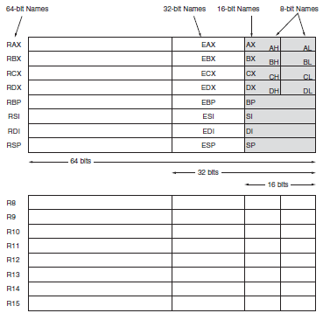
64-Bit Registers RAX-R15

Slide 115
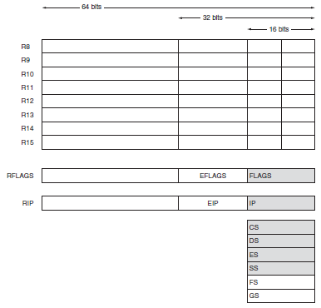
64-Bit Registers RFLAGS, RIP

Slide 116
Multipurpose Registers - 1
RAX - a 64-bit register (RAX), a 32-bit register (accumulator) (EAX), a 16-bit register (AX), or as either of two 8-bit registers (AH and AL).
The accumulator is used for instructions such as multiplication, division, and some of the adjustment instructions.
RBX, addressable as RBX, EBX, BX, BH, BL.
BX register (base index) sometimes holds offset address of a location in the memory system in all versions of the microprocessor

Slide 117
Multipurpose Registers - 2
RCX, as RCX, ECX, CX, CH, or CL.
a (count) general-purpose register that also holds the count for various instructions
RDX, as RDX, EDX, DX, DH, or DL.
a (data) general-purpose register
holds a part of the result from a multiplication or part of dividend before a division
RBP, as RBP, EBP, or BP.
points to a memory (base pointer) location for memory data transfers

Slide 118
Multipurpose Registers - 3
R8 - R15.
data are addressed as 64-, 32-, 16-, or 8-bit sizes and are of general purpose
bits 8 to 15 are not directly addressable as a byte

Slide 119
Multipurpose Registers - 4
RDI addressable as RDI, EDI, or DI.
often addresses (destination index) string destination data for the string instructions
RSI used as RSI, ESI, or SI.
the (source index) register addresses source string data for the string instructions
like RDI, RSI also functions as a general- purpose register

Slide 120
Special-Purpose Registers
RIP addresses the next instruction in a section of memory.
defined as (instruction pointer) a code segment
RSP addresses an area of memory called the stack.
the (stack pointer) stores data through this pointer
RFLAGS indicate the condition of the microprocessor and control its operation.

Slide 121
Little Endian Order
8-Byte Example, RAX register and integer*8 variable omega:
RAX: containing a numerical value of D9B356341278A2AF_{h}
omega, has a memory address location of 00000100₂

Slide 122
Clase AH

Slide 123
Assembly Language vs High-Level L
Assembly
One phrase per line
One instruction per line
Operations (+,-,*,/,…) are represented by mnemonics (representing instructions).
Is not structured
Very short object programs
Runs faster

Slide 124
Example Program
;Add two numbers and displays the result
.CODE
main PROC
mov eax, 24 ; move 24 to the EAX register
add eax, 17 ; add 17 to the EAX register
call WriteInt ; display EAX content value
exit ; to end execution
main END
;”.CODE”, ”main”: directives of MASM
;”WriteInt”: function of the Library Subroutine of MASM (Assembler)
;”exit”: function of Windows; translated to “call exit”

Slide 125
Ejecución de Programas en Leng. Ensamblador
Flujo tradicional para desarrollar y correr programas en Leng. Ensamblador (Assembly):
Ensamble con el Ensamblador (Assembler), prog.asm a prog.obj
Ligado o vinculado (linking) con el Linker, prog.obj a prog.exe
Ejecución de programa prog.exe
Programa fuente
prog.asm
Ensamblador
prog.obj
Linker
Programa objeto
prog.exe
Programa ejecutable

Slide 126
Basic Elements of Assembly Language
Integer constants
Integer expressions
Character and string constants
Identifiers and Reserved words
Directives
Mnemonics and Operands for instructions
Labels
Comments

Slide 127
Integer Constants
[{+ | -}] digits [radix]
Optional leading + or – sign, default +
Radix: Binary, decimal, hexadecimal, or octal digits
Common radix characters:
h – hexadecimal
q | o – octal
d – decimal (default)
b – binary
r – encoded real
t – decimal (alternate)
y – binary (alternate)
If no radix given, assumed to be decimal
Examples: 30d, 30, 6Ah, -42, 1101b, 53o
Hexadecimal beginning with letter, prefix 0 (zero): 0B4h, 0A5h ;Why?

Slide 128
Real Number Constants -1
Represented as decimal reals or encoded (hexadecimal) reals
Decimal real contains optional sign followed by integer, decimal point, and optional integer that expresses a fractional and an optional exponent
[sign] integer.[integer] [exponent]
Sign {+, -}
Exponent E[{+, -}] integer
Examples
2.
+3.0
-44.2E+05
26.E5

Slide 129
Real Number Constants -2
Represented as decimal encoded (hexadecimal) reals
Example
Binary representation of +1.0
0011 1111 1000 0000 0000 0000 0000 0000b
Example
Decimal encoded hexadecimal real of +1.0
3F800000r

Slide 130
Character and String Constants
Enclose character in single or double quotes
'A', "x"
ASCII character = 1 byte
Enclose strings in single or double quotes
"ABC"
'xyz'
Each character occupies a single byte
Embedded quotes:
'Say "Goodnight," Gracias'

Slide 131
Character and String Constants
.DATA
Alfa SDWORD 7 ; allocate a signed 4-Byte memory
Beta SDWORD 11h ; 11h > 17
R SDWORD 0
msgr BYTE "El Resultado R= ", 0 ; bytes allocated?
.CODE
main PROC
mov EAX, Alfa ; EAX:7
neg EAX ; -? EAX: -7
add EAX, 9 ; -? EAX: 2
sub EAX, Beta ; -? EAX: -15
inc EAX ; -? EAX: -14
mov R, EAX ; R = resultado -?
mov EDX, OFFSET msgr
call WriteString ; imprime el String que comienza en msgr
call WriteInt ;imprime el contenido de EAX, o sea de R
exit
main ENDP
END main

Slide 132
Identifiers
Identifiers
Programmer-chosen name to identify a variable, constant, procedure (function), or label
1-247 characters, including digits
not case sensitive
first character must be a letter, _, @, ?, or $
Subsequent characters may also be digits
Cannot be the same as a reserved word
@ is used by assembler as a prefix for predefined symbols, so avoid it identifiers
Examples
var1, Count, $first, _hello, MAX,
open_file, myFile, xVal, _12345

Slide 133
Reserved Words
Reserved words cannot be used as identifiers
Instruction mnemonics
MOV, ADD, MUL,, …
Register names
EAX, EBX, …
Directives –
.data, .code, .stack
PROC, END
BYTE, WORD, SDWORD
See MASM reference in Appendix A; Irvine

Slide 134
Directives 1
Commands embedded in the source code that are recognized and acted upon by the Assembler,
Not part of the Intel instruction set
tells MASM how to assemble programs
Work at assembly time
Do not execute (.exe) at runtime

Slide 135
Directives 2
Commands . . .
Used to declare code, data areas, select memory model, declare procedures, etc.
.code, .data, .DATA, .Data, .stack
flat
PROC, END
Type attributes – provides size and usage information
BYTE, WORD, DWORD, SDWORD
one DWORD 34 ; DWORD directive, set aside
; enough space for double word
mov eax, one ; MOV instruction

Slide 136
Instructions
An instruction is a statement that becomes executable when after a program is assembled.
Assembled into machine code ( 0s and 1s ) by assembler
Loaded and executed at runtime by the CPU
We use the Intel IA-32/64 instruction set
An instruction contains four basic parts:
Label (optional)
Mnemonic (required)
Operand (depends on the instruction)
Comment (optional)
Basic syntax
[ label[:] ] [ mnemonic [operands] ] [ ; comment ] ?

Slide 137
Labels
Act as place markers or addresses
marks the address (offset) of code and data
Follow identifier rules
Data label
must be unique
example: temp (not followed by colon)
temp DWORD 100
Code label
target of some type of jump
example: here: (followed by colon)
here:
mov ebx, temp
…
jmp here

Slide 138
Mnemonics and Operands
Instruction Mnemonics
short word that identifies an instruction
examples: MOV, ADD, SUB, MUL, INC, DEC, NOP, JUMP, CALL, IMUL
describe the type of operation
Operands
each instruction can have between 0 and tree operands
constant 96
constant expression 4+5*2 ; in the Assembly time 14
register EAX
memory (data label) temp ; variable alike temp+2
Constants and constant expressions are often called immediate values (at assembly time)

Slide 139
Mnemonics and Operands Examples
STC instruction
stc ; set Carry flag
INC instruction
inc eax ; add 1 to EAX
MOV instruction
mov temp, ebx ; move EBX to temp
; first operation is destination
; second is the source
IMUL instruction (three operands)
imul eax, ebx, 5 ; EBX multiplied by 5, product in EAX

Slide 140
Comments 1
Comments are good!
explain the program's purpose
when it was written, and by whom
revision information
Technical notes about coding (programming) techniques
application-specific explanations
Single-line comments
begin with semicolon (;)
Multi-line comments
begin with COMMENT directive and a programmer-chosen character
end with the same programmer-chosen character

Slide 141
Comments 2
Single line comment
inc eax ; single line at end of instruction
; single line at beginning of line
Multiline comment
COMMENT !
This line is a comment
This line is also a comment
!
COMMENT &
This is a comment
This is also a comment
&

Slide 142
NOP instruction
Doesn’t do anything, just waste a clock cycle (tick)
Takes up one byte of memory
Sometimes used by compilers and assemblers to align code to even-address boundaries. (as file blocks)
The following MOV generates three machine code bytes. The NOP aligns the address of the third instruction to a doubleword boundary (even multiple of 4)
00000000 66 8B C3 mov ax, bx
00000003 90 nop ; align next instruction
00000004

Slide 143
Instruction Format Examples
No operands
stc, nop ; set Carry flag, no operation
One operand
mul 7 ; constant
inc temp ; memory
Two operands
add ebx, ecx ; register, register
sub temp, 25 ; memory, constant
add eax, 36*25 ; register, constant-expression

Slide 144
Clase AI

Slide 145
IA Directives: Defining Data
DATA SECTION (.data, .DATA) in 32-bit programs
Intrinsic Data Types
Data Definition Statement
Defining BYTE and SBYTE Data
Following the Little-Endian Order
Defining WORD and SWORD Data
Defining DWORD and SDWORD Data
Defining QWORD Data
Defining TBYTE Data
Defining Real Number Data
Declaring Uninitialized Data

Slide 146
IA Directives: Defining Data
These Assembly Directives in DATA SECTION:
Allocate memory space (bytes), and
Can define an initial value in the memory space.
.DATA / .data section:
Fixes the initial address of the user program (.asm file).

Slide 147
Directives of Intrinsic Data Types 1
INTEGERs: size and content (unsigned, signed)
BYTE, SBYTE
8-bit unsigned integer; 8-bit signed integer (1 byte)
WORD, SWORD
16-bit unsigned & signed integer (2 bytes)
DWORD, SDWORD
32-bit unsigned & signed integer (Double word, 4 bytes)
QWORD, SQWORD
64-bit unsigned integer (Quad word, 8 bytes)
64-bit signed integer (not valid in IA-32)
TBYTE
80-bit integer (Ten bytes)

Slide 148
Directives of Intrinsic Data Types 2
REALs, with fractions
REAL4
4-byte IEEE short real
REAL8
8-byte IEEE long real
REAL10
10-byte IEEE extended real

Slide 149
Data Definition Statement
A data definition statement (a directive) sets aside storage in memory for a variable.
May optionally assign a name (data label) to the data
Syntax:
[name] directive initializer [,initializer] . . .
alfa BYTE 10
All initializers become binary data in memory

Slide 150
Defining BYTE and SBYTE Data
Each of the following defines a single byte of storage:
beta BYTE 'A' ; character constant
gamma BYTE 0 ; smallest unsigned byte
omega BYTE 255 ; largest unsigned byte
delta SBYTE -128 ; smallest signed byte
sigma SBYTE +127 ; largest signed byte
eagle BYTE ? ; uninitialized byte
falcon BYTE 10h

Slide 151
Defining Multiple Initializers
Offset | Value (h)
0000 | 0A
0001 | 20
0002 | 1E
0003 | 40
0004 | 10
0005 | 14
0006 | 30
0007 | 40
0008 | 50
0009 | 60
000A | 70
000B | 80
000C | 81
000D | 82
000E | 83
000F | 84
0010 | ?
list1
Examples that use multiple initializers:
list2
list1 BYTE 10,20h,30,40h
list2 BYTE 10h,20,30h,40h
BYTE 50h,60h,70h,80h
BYTE 81,82h,83h,84h
list3 BYTE ?,32,41h,00100010b
list4 BYTE 0Ah,20h,‘A’,22h
Offset = relative address
list3

Slide 152
Defining Strings 1
A string is implemented as an array of characters
For convenience, it is usually enclosed in quotation marks
For HLL It will be null-terminated (ending with ,0)
Examples:
str1 BYTE "Enter your name",0
str2 BYTE 'Error: halting program',0
str3 BYTE 'A','E','I','O','U’
AEQuote BYTE "Imgination is more important than "
BYTE “knowledge, by Albert Einstein.",0

Slide 153
Defining Strings 2
New-Line characters sequence (HLL: “\n”):
0Dh = carriage return (End-of-Line)
0Ah = line feed (Next-Line)
; HLL “\n” example:
; String str4= “Name*\n” +
; “Enter: “;
str4 BYTE “Name*",0Dh,0Ah
BYTE “Enter: ",0
Idea: Define all strings used by your program in the same area of the data segment.

Slide 154
Using the DUP Operator
Use DUP to allocate (create space for) an array or string. Syntax: counter DUP ( argument )
Counter and argument must be constants or constant expressions
v1 BYTE 20 DUP(0) ; 20 bytes, all with zero
v2 BYTE 20 DUP(?) ; 20 bytes, uninitialized
v3 BYTE 4 DUP("STACK") ; 20 bytes: "STACKSTACKSTACKSTACK"
v4 BYTE 10h,3 DUP(0),20 ; 5 bytes
v4
10h
00
00
00
14h

Slide 155
Little Endian Order
All data types larger than one byte, store their individual bytes in reverse order. The least significant byte occurs at the first (lowest) memory address.
2-Byte Example:
val1 WORD 1234h
0000 0000: | 34
0000 0001: | 12

Slide 156
Defining WORD and SWORD Data
Define storage for 16-bit integers
or double characters
single value or multiple values
word1 WORD 65535 ; largest unsigned value
word2 SWORD –32768 ; smallest signed value
word3 WORD ? ; uninitialized, unsigned
word4 WORD "AB" ; double characters
myList WORD 1,2,5 ; array of words
array WORD 5 DUP(25h) ; uninitialized array

Slide 157
Little Endian Order
4-Byte Example:
val2 DWORD 12345678h
0000 0000: | 78
0000 0001: | 56
0000 0002: | 34
0000 0003: | 12

Slide 158
Defining DWORD and SDWORD Data
Storage definitions for signed and unsigned 32-bit integers (4 bytes):
val2 DWORD 12345678h ; unsigned
val3 SDWORD –2147483648 ; signed
val4 SDWORD –3, 2 ; signed array
val5 DWORD “ABCD” ; quad characters
pVal DWORD val4 ;What´s going on here?
val6 DWORD 20 DUP(?) ; unsigned array

Slide 159
Defining QWORD, TBYTE, Real Data
Storage definitions for quadwords, tenbyte values, and real numbers:
quad1 QWORD 123456789ABCDEF0h ;____ Bytes?
val1 TBYTE 102030405060708090A0h
rVal1 REAL4 -2.1
rVal2 REAL8 3.2E-260
rVal3 REAL10 4.6E+4096
ShortArray REAL4 20 DUP(0.0)

Slide 160
Adding Variables to AddSub
TITLE Add and Subtract, Version 2 (AddSub2.asm)
; This program adds and subtracts 32-bit unsigned
; integers and stores the sum in a variable.
INCLUDE Irvine32.inc
.DATA
sal1 DWORD 10000h
sal2 DWORD 40000h
sal3 DWORD 20000h
finalVal DWORD ?
.CODE
main PROC
MOV EAX,sal1 ; EAX 50000h
ADD EAX,sal2 ; EAX 20000h
SUB EAX,sal3 ; EAX 30000h
MOV finalVal,EAX ; store the result (_____?)
CALL DumpRegs ; display the registers
EXIT
main ENDP
END main
1er paso/vuelta
sal1 @0000 0000
sal2 @0000 0004
sal3 @0000 0008
finalVal @0000 000C
2o paso/vuelta. Sustituye:
@0000 0000
@0000 0004
@0000 0008
@0000 000C

Slide 161
Two-pass Assembler
When Assembling, the Assembler parses twice the source code of Assembly program (.asm).
PASS-1: Define identifiers (e.g. labels), allocate each one with a memory address, and remember them in a Symbol Table.
PASS-2: Generate object code (.obj), by converting instructions (nmonics and operands), into respective machine language (binary).

Slide 162

OFFSET Operator Directive
OFFSET works like part of one operand in an instruction (CODE segment)
OFFSET returns the distance, in bytes, between the address of a LABEL and the beginning of its enclosing DATA segment
Protected mode: 32, 64 bits
Real mode: 16 bits

Slide 163
OFFSET Examples
.DATA
BYTE 404000h DUP(?)
bVal BYTE 3
wVal WORD 7
dVal DWORD 4
dVal2 DWORD 5
.CODE
MOV ESI,OFFSET bVal ; ESI = 0040 4000h
MOV ESI,OFFSET wVal ; ESI = 0040 4001h
MOV ESI,OFFSET dVal ; ESI = 0040 4003h
MOV ESI,OFFSET dVal2 ; ESI = 0040 4007h

Slide 164
Relating to C/C++
The value returned by OFFSET is a pointer. Compare the following code written for both C++ and assembly language:
// C++ version:
char array[1000];
char * p = array;
; Assembly language:
.DATA
array BYTE 1000 DUP(?)
p DWORD ?
.CODE
MOV ESI,OFFSET array
MOV p, ESI

Slide 165
Clase AJ

Slide 166
Instruction Format
x86 instruction format
[label:] [mnemonic [operands]] [;comments]
mnemonic [operands]
mnemonic
mnemonic source
mnemonic destination
mnemonic destination, source
mnemonic destination, source-1 , source-2

Slide 167
Operand Types
Imm-ediate – a constant integer (8, 16, or 32 bits)
value is encoded within the instruction
Reg-ister – the name of a register (8, 16, or 32 bits)
register name is converted to a number and encoded within the instruction
Mem-ory – reference to a location in memory (8, 16, or 32 bits)
memory address is encoded within the instruction, or a register holds the address of a memory location

Slide 168
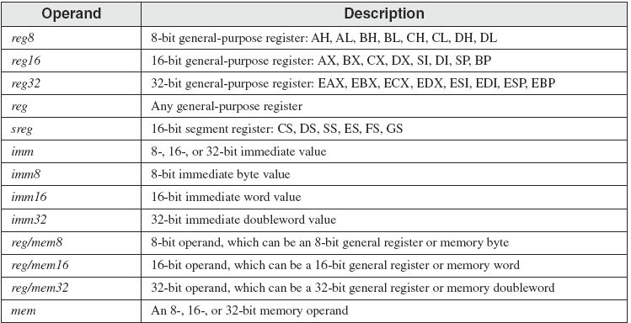
Instruction Operand Notation

Slide 169
Instruction Set
Data Transfer Instruction
MOV
( HLL = )

Slide 170
MOV Instruction
Move from source operand to destination operand.
Syntax:
MOV destination, source
; HLL, destination=source

Slide 171
General Operand-Variants of MOV
MOV reg, reg
MOV mem, reg
MOV reg, mem
MOV mem, imm
MOV reg, imm
No more than one memory operand permitted

Slide 172
Direct Memory Operands
A direct memory operand is a named reference to storage in memory
The named reference (label) is automatically dereferenced by the assembler
.DATA
var1 BYTE 10h
.CODE
MOV EAX,21h ; EAX = 00000021h
MOV ECX,EAX ; ECX = 00000021h
MOV AL,var1 ; AL = 10h
MOV AL,[var1] ; AL = 10h

Slide 173
MOV Instruction 1
Explain why each of the following MOV statements are valid or invalid:
.DATA
count BYTE 100
wVal WORD 2
.CODE
MOV BL,count ; ?
MOV AX,wVal ; ?
MOV count,AL ; ?
MOV AL,wVal ; ?
MOV AX,count ; ?
MOV EAX,count ; ?

Slide 174
MOV Instruction 2
CS, EIP, and IP cannot be the destination
No immediate to segment moves
Explain why each of the following MOV statements are valid or invalid:
.DATA
bVal BYTE 100
bVal2 BYTE ?
wVal WORD 2
dVal DWORD 5
.CODE
MOV DS,45 ?
MOV ESI,wVal ?
MOV EIP,dVal ?
MOV 25,bVal ?
MOV bVal2,bVal ?

Slide 175
Direct-Offset Operands 1
A constant offset is added to a data label to produce an effective address (EA). The address is dereferenced to get the value inside its memory location.
.DATA
arrayB BYTE 10h,20h,30h,40h
.CODE
MOV AL,arrayB+1 ; AL = 20h
MOV AL,[arrayB+1] ; alternative notation
Q: Why doesn't arrayB+1 produce 11h?

Slide 176
Direct-Offset Operands 2
A constant offset is added to a data label to produce an effective address (EA). The address is dereferenced to get the value inside its memory location.
.DATA
arrayW WORD 1000h,2000h,3000h
arrayD DWORD 1,2,3,4
.CODE
MOV AX,[arrayW+2] ; AX = 2000h
MOV AX,[arrayW+4] ; AX = 3000h
MOV EAX,[arrayD+4] ; EAX = 00000002h
; Will the following statements assemble?
MOV AX,[arrayW-2] ; ??
MOV EAX,[arrayD+16] ; ??
What will happen when they run?

Slide 177
ADD and SUB Instructions
ADD, syntax:
ADD destination, source
; HLL, destination= destination+source
SUB, syntax:
SUB destination, source
; HLL, destination= destination-source

Slide 178
Two operand instructions ADD, SUB
ADD reg, reg SUB reg, reg
ADD mem, reg SUB mem, reg
ADD reg, mem SUB reg, mem
ADD mem, imm SUB mem, imm
ADD reg, imm SUB reg, imm

Slide 179
INC and DEC Instructions
INC, syntax:
INC destination
; HLL, destination= destination+1
DEC, syntax:
DEC destination
; HLL, destination= destination-1

Slide 180
One operand instructions INC, DEC
INC reg DEC reg
INC mem DEC mem

Slide 181
Addressing in Operands
Direct Addressing
Register
Memory
Immediate
And many more Addressing …

Slide 182
Instruction Set
Assembly Language of x86 Processors
Appendix B
The x86 Instruction Set.

Slide 183
Clase AKa

Slide 184
Machine Language
Native binary code microprocessor instructions vary in length from 1 to 13 Bytes
Over 100,000 variations of machine language instructions. There is no complete list of these variations
Some bits in a machine language instruction are given (opcode); remaining bits are determined for each variation of the instruction.

Slide 185
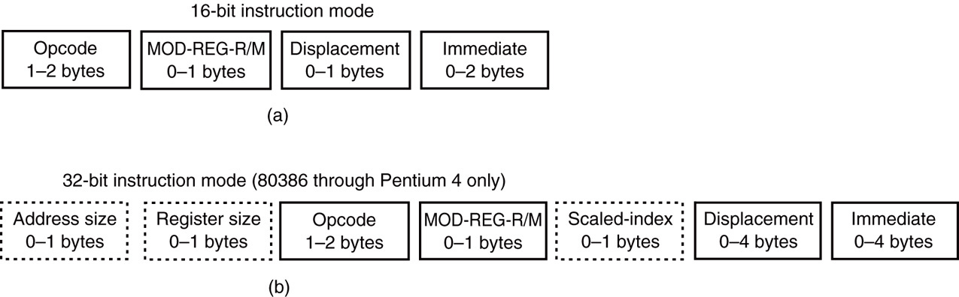
Instruction Formats
In the Real mode (DOS over 8086), 80386 and above assume all instructions are 16-bit mode instructions.
In Protected mode (Windows & Linux), the upper byte of the descriptor contains the bit that selects either the 16- or 32-bit instruction mode

Slide 186
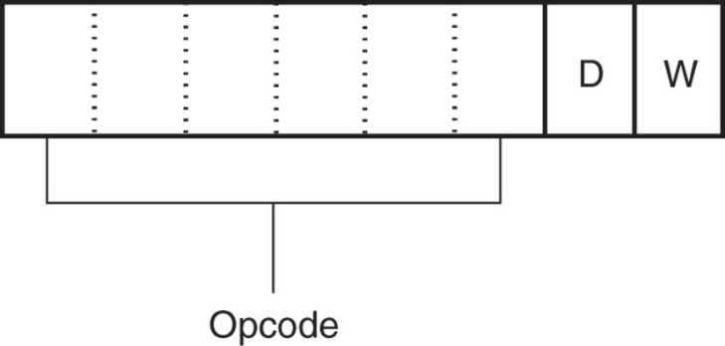
Opcode field, Byte 1
Identifies the operation (mov, add, sub, …).
Either 1 or 2 bytes long for instructions.
Binary Opcode: first 6 bits of the first byte.
D bit, indicates the direction of the data flow:
Into or From, a Register
W bit indicates whether the data are a byte or a word

Slide 187
32-bit instruction examples (1)
ASSEMBLY MEMORY ALLOCATION
NOP ;1 Byte
1st Byte: Opcode&D&W

Slide 188
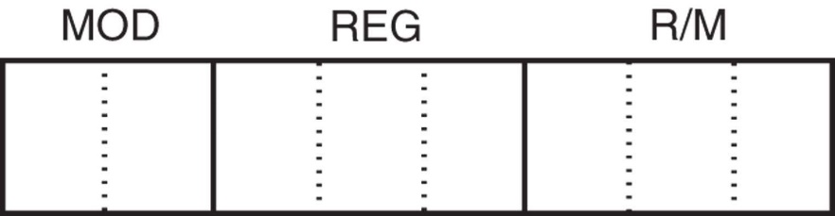
[ Opcode field, Byte 2 ]
MOD field: addressing mode code
REG field:
register code, destination/source operand
R/M field:
Register, memory or immediate operand
If register: register code, source
If memory: code and address, destination/source
If immediate: code and data, source

Slide 189
32-bit instruction examples (1)
ASSEMBLY MEMORY ALLOCATION
NOP ;1 Byte
1st Byte: Opcode&D&W
INC EAX ;2 Bytes
1st Byte: Opcode&D&W
2nd Byte: MOD&REG&R/M

Slide 190
Instruction: [ Bytes 3, 4, … ]
These Bytes exist when R/M field is:
a Memory operand (Displacement, Offset), or
an Immediate operand

Slide 191
32-bit instruction examples (3)
ASSEMBLY MEMORY ALLOCATION
MOV alfa, EBX ;6 Bytes
1st Byte: Opcode&D&W
2nd Byte: MOD&REG&R/M
3rd, 4th, 5th, 6th Bytes: memory address of alfa

Slide 192
32-bit instruction examples (3)
ASSEMBLY MEMORY ALLOCATION
MOV ECX, EDX ; Bytes? ___
1st Byte: Opcode&D&W
2nd Byte: MOD&REG&R/M
?
MOV alfa, 34h ; Bytes? ___
1st Byte: Opcode&D&W
2nd Byte: MOD&REG&R/M
?

Slide 193
Clase AKb

Slide 194
Instruction Set
Data Transfer Instructions (cont…)
Besides MOV

Slide 195
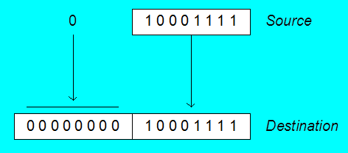
Zero Extension
When you copy a smaller value into a larger destination, the MOVZX instruction fills (extends) the upper half of the destination with zeros.
MOV BL,10001111b
MOVZX AX,BL ; zero-extension
The destination must be a register.

Slide 196
General Variants of MOVZX
MOVZX reg32, reg/mem8
MOVZX reg32, reg/mem16
MOVZX reg16, reg/mem8

Slide 197
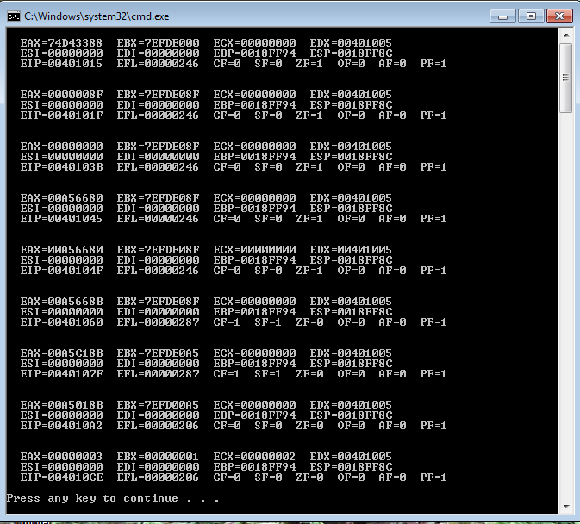
MOVZX with EAX register
CALL DumpRegs
MOV BL,10001111b ; chart Zero Extension BL=__h
MOVZX EAX,BL ; showing MOVZX with EAX register
CALL DumpRegs

Slide 198
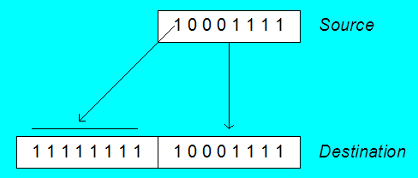
Sign Extension
The MOVSX instruction fills the upper half of the destination with a copy of the source operand's sign bit.
MOV BL,10001111b
MOVSX AX,BL ; sign extension
The destination must be a register.

Slide 199
General Variants of MOVSX
MOVSX reg32, reg/mem8
MOVSX reg32, reg/mem16
MOVSX reg16, reg/mem8

Slide 200
XCHG Instruction
XCHG exchanges the values of two operands. At least one operand must be a register. No immediate operands are permitted.
.DATA
var1 WORD 1000h
var2 WORD 2000h
.CODE
; EAX contains 12345678h, EBX has ABCDEF01h.
XCHG var1,BX ; var1=____h, BX=____h, EBX=________h
XCHG EAX,EBX ; EAX=________, EBX=________
XCHG AX,BX ; AX=____, BX=____
XCHG AH,AL ; AH=__, AL=____
XCHG var1,var2 ; var1=____h, var2=____h

Slide 201
General Variants of XCHG
XCHG reg, reg
XCHG reg, mem
XCHG mem, reg

Slide 202
Your turn. . .
Write a program that rearranges the values of three doubleword values in the following array as: 3, 1, 2.
.data
arrayD DWORD 1,2,3
.code
Step1:
MOV EAX, arrayD
XCHG . . .
Step 2:
XCHG . . .
MOV . . .

Slide 203
XCHG Example
; xchg examples
CALL DumpRegs
MOV EAX, arrayD
XCHG EAX, [arrayD+4]
XCHG EAX, [arrayD+8]
MOV arrayD, EAX
. . .
MOV EAX, [arrayD]
MOV EBX, [arrayD+4]
MOV ECX, [arrayD+8]
CALL DumpRegs

Slide 204
Evaluate this . . .
.data
myBytes BYTE 80h,66h,0A5h
How about the following code. Is anything missing?
; EAX has 00A5668Bh, EBX has 7EFDE08Fh
MOVZX AX, myBytes
MOV BL,[myBytes+1]
ADD AX, BX
MOV BL,[myBytes+2]
ADD AX, BX ; AX = ?

Slide 205
Evaluate this . . . (cont)
CALL DumpRegs
; MOVZX examples EAX: 00A5668Bh, EBX: 7EFDE08Fh
MOVZX AX, myBytes ; EAX: 00A50080h
MOV BL, [myBytes+1] ; EBX: 7EFDE066h
ADD AX, BX ; EAX: 00A5E0E6h
MOV BL, [myBytes+2] ; EBX: 7EFDE0A5h
ADD AX, BX ; AX = EAX: 00A5C18Bh
CALL DumpRegs

Slide 206
Evaluate this . . . (cont)
CALL DumpRegs
; MOVZX examples EAX: 00A5668Bh, EBX: 7EFDE08Fh
MOVZX AX,myBytes ; EAX: 00A50080h
MOV BX,0 ; EBX: 7EFD0000h
MOV BL,[myBytes+1] ; EBX: 7EFD0066h
ADD AX,BX ; EAX: 00A500E6h
MOV BL,[myBytes+2] ; EBX: 7EFD00A5h
ADD AX,BX ; AX = EAX: 00A5018Bh
CALL DumpRegs

Slide 207
Clase AL

Slide 208
Instruction Set
Addition and Subtraction
add, sub, inc, dec, neg

Slide 209
ADD and SUB Instructions
ADD destination, source
destination ← destination + source
SUB destination, source
destination ← destination – source
Same operand rules as for the MOV instruction

Slide 210
Two operand instructions ADD, SUB
ADD reg, reg SUB reg, reg
ADD mem, reg SUB mem, reg
ADD reg, mem SUB reg, mem
ADD mem, imm SUB mem, imm
ADD reg, imm SUB reg, imm

Slide 211
ADD and SUB Examples
.DATA
var1 DWORD 10000h
var2 DWORD 20000h
.CODE ; ---EAX(0000h,AX)
MOV EAX, var1 ; ________ h
ADD EAX, var2 ; ________ h
ADD AX, 0FFFFh ; ________ h
ADD EAX, 1 ; ________ h
SUB AX, 1 ; ________ h

Slide 212
INC and DEC Instructions
Add 1, Subtract 1 from destination operand
operand may be register or memory
INC destination
destination ← destination + 1
DEC destination
destination ← destination – 1

Slide 213
One operand instructions INC, DEC
INC reg INC mem
DEC reg DEC mem

Slide 214
INC and DEC Examples
.DATA
myWord WORD 1000h
myDword DWORD 10000000h
.CODE
INC myWord ; ________ h
DEC myWord ; ________ h
INC myDword ; ________ h
MOV AX, 00FFh ; AX= ____ h
INC AX ; AX= ____ h
MOV AX, 00FFh ; AX= ____ h
INC AL ; AL= __h AX= ____ h

Slide 215
Your turn...
Show the value of the destination operand after each of the following instructions executes:
.DATA
myByte BYTE 0FFh, 0
.CODE
MOV AL, myByte ; AL= __h
MOV AH,[myByte+1] ; AH= __h, AX= ____h
DEC AH ; AH= __h, AX= ____h
INC AL ; AL= __h, AX= ____h
DEC AX ; AX= ____h

Slide 216
One operand instruction NEG
NEG reg NEG mem

Slide 217
NEG (negate) Instruction
The processor implements NEG operand using the following internal operation:
operand = 0 - operand
Two’s complement operation.
.DATA
valB SBYTE 1,0
valC SBYTE -128
.CODE
NEG valB ; valB = ________
NEG [valB + 1] ; valB+1 = ________
NEG valC ; valC = ________

Slide 218
NEG (negate) Instruction
Reverses the sign of an operand. Operand can be a register or memory operand.
.DATA
valB SBYTE -1
valW SWORD +32767 ; 7FFFh
.CODE
MOV AL, valB ; AL = FF
NEG AL ; AL = 01h
NEG valW ; valW = 8001h
Suppose AX contains –32,768 and we apply NEG to it. Will the result be valid?
-32768 = 8000h; AX = 8000h. No es correcto el resultado

Slide 219
Implementing Arithmetic Expressions
High Level Languages compilers translate mathematical expressions into assembly language. Recall precedence order.
For example:
Rval = -Xval + (Yval – Zval)
Do not modify Xval, Yval and Zval contents.
.DATA
Rval DWORD ? SUB EBX, Zval
Xval DWORD 26 ADD EAX, EBX
Yval DWORD 30 MOV Rval, EAX
Zval DWORD 40
.CODE
MOV EAX, Xval
NEG EAX
MOV EBX, Yval

Slide 220
Your turn...
Translate the following expression into assembly language. Do not permit Xval, Yval, or Zval to be modified:
Rval = Xval - (-Yval + Zval)
Assume that all values are signed doublewords.
MOV ...

Slide 221
Clase AM

Slide 222
HLL Structured instructions. via
Algorithm ---- program
Structured thinking
Algorithm structures
SELECTIVES: If-then, if-then-else, switch-case
REPETITIVES: while, for, do-while, repeat
There are not such instructions in machine language.
The programmer must do the implementation.

Slide 223
Flags Affected by Arithmetic
The CPU has a number of Status Flags that reflect the outcome of arithmetic and bitwise operations (machine instructions)
based on the contents of the destination operand
Instructions ADD, CLC, CMP, DEC, INC, IMUL, NEG, TEST, and many more . . . except MOV (*)
Essential flags:
ZeroF ZF, SignF SF, CarryF CF, OverflowF OF, AxiliaryF AF, ParityF PF
(*)The MOV instruction never affects the flags.

Slide 224
Status Flags - Review iVc
The Zero flag ZF is set when the destination (result) equals zero.
The Carry flag CF is set when a result that is too large (or too small) for the destination; unsigned out-of-range result value.
The Sign flag SF is set if the destination is negative, otherwise it is clear. A Signed result value.
The Overflow flag OF is set when a destination is a signed out-of-range result value.
The Auxiliary Carry flag AF is set when an operation produces a carry out from bit 3 to bit 4.
The Parity flag PF is set when an instruction generates an even number of 1 bits in the low byte of the destination operand.
CONDITIONAL JUMPS WILL USE THESE FLAGS

Slide 225
Conditional Jumps
Conditional Jump instructions jump if
a flag is on (1),
a flag is off (0),
some flags are on; or
some flags are off.

Slide 226
CPU flags affected
Assembly Language for x86 Processors Book
Appendix B. The x86 Instruction Set

Slide 227
16-bit FLAGS register
15 | 14 | 13 | 12 | 11 | 10 | 9 | 8 | 7 | 6 | 5 | 4 | 3 | 2 | 1 | 0
0 | nt | iop | iop | OF | df | if | tf | SF | ZF | 0 | AF | 0 | PF | 1 | CF
FLAGS categories
STATUS flags: OF, SF, ZF, AF, PF, CF
CONTROL flags: tf, if, df
SYSTEM flags: iop, nt
Reserved bits: 0s and 1.

Slide 228
32-bit EFLAGS register
31 | 30 | 29 | 28 | 27 | 26 | 25 | 24 | 23 | 22 | 21 | 20 | 19 | 18 | 17 | 16
0 | 0 | 0 | 0 | 0 | 0 | 0 | 0 | 0 | 0 | id | vip | vif | ac | vm | rf
15 | 14 | 13 | 12 | 11 | 10 | 9 | 8 | 7 | 6 | 5 | 4 | 3 | 2 | 1 | 0
0 | nt | iop | iop | OF | df | if | tf | SF | ZF | 0 | AF | 0 | PF | 1 | CF
FLAGS categories
STATUS flags: OF, SF, ZF, AF, PF, CF
CONTROL flags: tf, if, df
SYSTEM flags: iop, nt, rf, vm, ac, vif, vip, id
Reserved bits: 0s and 1.

Slide 229
64-bit RFLAGS register
63 | 62 | 61 | 60 | 59 | 58 | 57 | 56 | 54 | 54 | 53 | 52 | 51 | 50 | 49 | 48
0 | 0 | 0 | 0 | 0 | 0 | 0 | 0 | 0 | 0 | 0 | 0 | 0 | 0 | 0 | 0
47 | 46 | 45 | 44 | 43 | 42 | 41 | 40 | 39 | 38 | 37 | 36 | 35 | 34 | 33 | 32
0 | 0 | 0 | 0 | 0 | 0 | 0 | 0 | 0 | 0 | 0 | 0 | 0 | 0 | 0 | 0
31 | 30 | 29 | 28 | 27 | 26 | 25 | 24 | 23 | 22 | 21 | 20 | 19 | 18 | 17 | 16
0 | 0 | 0 | 0 | 0 | 0 | 0 | 0 | 0 | 0 | id | vip | vif | ac | vm | rf
15 | 14 | 13 | 12 | 11 | 10 | 9 | 8 | 7 | 6 | 5 | 4 | 3 | 2 | 1 | 0
0 | nt | iop | iop | OF | df | if | tf | SF | ZF | 0 | AF | 0 | PF | 1 | CF

Slide 230
CPU Conceptual Map
CU
part of
executes next
executes
ALU
conditional jumps
arithmetic & bitwise operations
attached to
used by
provide
affect
status flags
branching logic

Slide 231
Signed and Unsigned Integers
A CPU Hardware Viewpoint
All CPU instructions operate exactly the same on signed and unsigned integers
The CPU cannot distinguish between signed and unsigned integers
YOU, the PROGRAMMER, are solely responsible for using the correct data type with each instruction

Slide 232
ZERO Flag (ZF)
The ZERO flag is set when the result of an operation produces zero in the destination operand.
MOV CX,1 ; none flag is changed
SUB CX,1 ; CX= 0, ZF= 1, CF= __
MOV AX,0FFFFh
INC AX ; AX= 0, ZF= 1 , CF= __
INC AX ; AX= 1, ZF= 0 , CF= __
Remember...
A flag is set when it equals 1.
A flag is clear when it equals 0.

Slide 233
CARRY Flag (CF)
The CARRY flag is set when the result of an operation generates an unsigned value that is out of range (too big or too small for the destination operand).
MOV AL,0FFh
ADD AL,1 ; CF= 1, AL= 00, ZF= __
; Try to go below zero:
MOV AL,0
SUB AL,1 ; CF= 1, AL= FF, ZF= __

Slide 234
Auxiliary Carry Flag. vIaiiVb
The Auxiliary Carry (AC) Flag indicates a carry or a borrow out of bit 3 to bit 4 in the destination operand.
Example:
MOV AL,0Fh MOV AL,22h
ADD AL, 1 ; ACF=1 SUB AL, 8h ;ACF=1
The develope
0 0 0 0 1 1 1 1 0 0 1 0 0 0 1 0
+ 0 0 0 0 0 0 0 1 - 0 0 0 0 1 0 0 0
0 0 0 1 0 0 0 0 0 0 0 1 1 0 1 0
Related operations: BCD (Binary-Coded Decimal) arithmetic operations in four bits. The digits 0..9 are represented en four bits.

Slide 235
SIGN Flag (SF)
The SIGN flag is set when the destination signed operand is negative. The flag is clear when the destination is positive.
MOV CX,0
SUB CX,1 ; CX = -1, SF = 1, ZF = 0, CF = 1
ADD CX,2 ; CX = 1, SF = 0, ZF = 0, CF = 1
The SIGN flag is a copy of the destination's highest bit:
MOV AL,0
SUB AL,1 ; AL= 11111111b, SF= 1, ZF= 0, CF= 1
ADD AL,2 ; AL= 00000001b, SF= 0, ZF= 0, CF= 1

Slide 236
Your turn . . .
For each of the following marked entries, show the values of the destination operand and the Sign, Zero, and Carry flags:
MOV AX,00FFh
ADD AX,1 ; AX=0100h SF=0 ZF=0 CF=0
SUB AX,1 ; AX=00FFh SF=0 ZF=0 CF=0
ADD AL,1 ; AL=00h SF=0 ZF=1 CF=1
MOV BH,6Ch
ADD BH,95h ; BH=01h SF=0 ZF=0 CF=1
MOV AL,2
SUB AL,3 ; AL=FFh SF=1 ZF=0 CF=1

Slide 237
OVERFLOW Flag (OF)
The OVERFLOW flag is set when the signed result of an operation is invalid or out of range.
; Example 1
MOV AL,+127
ADD AL,1 ; OF=1, AL=-128, CF=0, SF=1, ZF=0
; Example 2
MOV AL,7Fh ; OF=1, AL=80h
ADD AL,1

Slide 238
A Rule of Thumb / signed
When ADDing two integers, remember that the Overflow flag is only set when . . .
two positive operands are added and their sum is negative
two negative operands are added and their sum is positive
What will be the values of the Overflow flag?
mov al,80h
add al,92h ; OF=1, CF=1, SF=0, ZF=0
mov al,-2
add al,+127 ; OF=0, CF=1, SF=0, ZF=0
mov al,+2
add al,+127 ; OF=1, CF=0, SF=1, ZF=0

Slide 239
NEG Instruction.
The processor implements NEG using the following internal operation:
operand = 0 – operand ; or
operand = 0 + (-operand) ; adding viewpoint
.DATA
valB BYTE 1,0
valC SBYTE -128
.CODE
NEG valB ; CF=1, OF=0, SF=1, ZF=0
NEG [valB + 1] ; CF=0, OF=0, SF=0, ZF=1
NEG valC ; CF=1, OF=1, SF=1, ZF=0

Slide 240
Your turn . . .
What will be the values of the given flags after each operation?
MOV AL,-128
NEG AL ; CF=1, OF=1, ZF=1, SF=0
MOV AX,8000h
ADD AX,2 ; CF=0, OF=0, ZF=0, SF=1
MOV AX,0
SUB AX,2 ; CF=1, OF=0, ZF=0, SF=1
MOV AL,-5
SUB AL,+125 ; CF=0, OF=1, ZF=0, SF=0

Slide 241
Parity Flag. vIaiiVb
The Parity Flag (PF) is set when the least significant byte of the destination operand has an even number of 1 bits.
Example:
MOV AL, 10001100b
ADD AL, 00000010b ; AL = 10001110, PF = 1
SUB AL, 10000000b ; AL = 00001110, PF = 0

Slide 242
Keeping track of Flags
Related instructions
LAHF – Load status flags into AH
AH ← Low byte of EFLAGS (S, Z, 0, A, 0, P, 1, C)
SAHF – Store AH into status flags
Low byte of EFLAGS (S, Z, 0, A, 0, P, 1, C) ← AH
.DATA
one BYTE ?
.CODE
LAHF
MOV one, AH
; following CODE
MOV BL, one
- - -
MOV AH, one
SAHF

Slide 243
Instructions around the Carry flag
Set carry flag
STC ;CF=1
Clear carry flag
CLC ;CF=0
Complement carry flag
CMC ;CF= 1s complement of CF
Add carry flag
ADC opd1,opd2 ; opd1 ← opd1 + opd2 + CF

Slide 244
Clase B0

Slide 245
MS-MASM
MASM is the Microsoft Macro ASseMbler for x86 Intel processors.
MASM is an x86 assembler that uses the Intel syntax for MS-DOS and MS-WINDOWS.
There are two versions of the MASM:
One (ML) for 16-bit and 32-bit assembly sources, and
another (ML64) for 64-bit assembly sources only.

Slide 246
Ejecución de Programas en Leng. Ensamblador
Flujo para ejecutar programas en Ensamblador:
Ensamble con el Ensamblador MASM (Macro ASseMbler)
Ligado o vinculado (linking) con el Linker
Ejecución de programas en Lenguaje Ensamblador (Assembly)
Programa fuente
file.asm
MASM
file.obj
Linker
Programa objeto
file.exe
Programa ejecutable

Slide 247

Arrancando Visual Studio 2019
En Windows:
Seleccionar:
Continue without code >

Slide 248
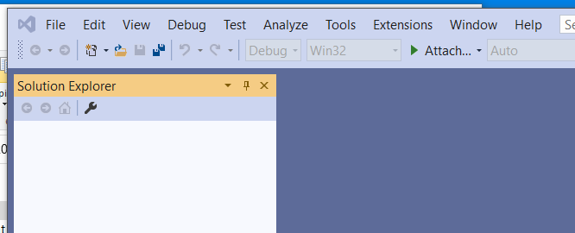
Ventana de Visual Studio 2019
En Windows:

Slide 249
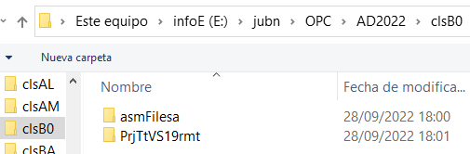
Apertura del proyecto MASM 1
Proyecto PrjTtVS19rmt, previamente preparado para ensamblador, seleccionar:
File > Open > Project / Solution
Seleccione la trayectoria de PrjTtVS19rmt de su computadora

Slide 250
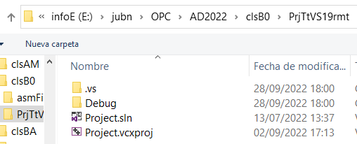
Apertura del proyecto MASM 2
Apareciendo
Seleccione Project.sln

Slide 251
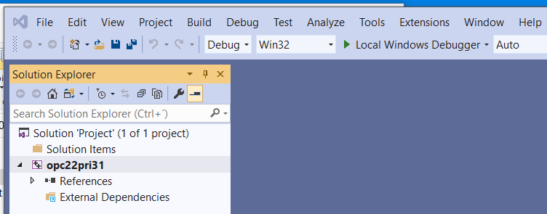
Apertura del proyecto MASM 3
Note: el nombre del fólder es PrjTtVS19rmt, el nombre del Solution Project es Project.sln , pero el ejecutable que se generara se llamara opc22pri31.exe

Slide 252
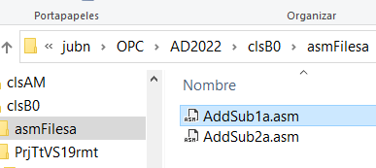
Característica del proyecto
El fólder PrjTtVS19rmt, no lleva archivo fuente “.asm”:
Hay que agregarlo al Proyecto de manera “virtual”, siendo que el archive “.asm” se encuentra en otro folder, p.e. asmFilesa

Slide 253
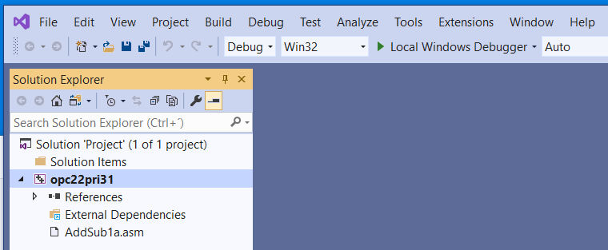
Agregado de un archivo “.asm”
Seleccione AddSub1.asm:
Arrastrelo, y deposítelo sobre opc22pri31 en VS, o
Haga copy, y paste sobre opc22pri31 en VS
Apareciendo dicho archive como sigue:

Slide 254
Ensamblado (Assembling)
Ensamblado es la actividad, llevada a cabo por el Ensamblador (ml.exe), de traducir el archivo de entrada (.asm, programa fuente en Lenguaje Ensamblador) en un programa en Lenguaje Máquina, puesto en el archivo de salida (.obj, programa objeto).
El archivo de listado (.lst) es opcional.
Source program
file.asm
Listing file
MASM
file.lst
file.obj
Object program

Slide 255
Ensamble del programa
Seleccione la línea de opc22pri31
Seleccione
Build > Build opc22pri31, o
Build > Rebuild opc22pri31
En la ventana de Output apareceran publicados lo errores en caso de existir.

Slide 256
Archivo opc22pri31.lst
Ubicado en el folder clsB0\PrjTtVS19rmt
Se puede abrir con Bloq de Notas o Notepad++
¿Que contiene? _____

Slide 257
Archivo .lst
Muestra la información que como el programa .asm fue ensamblado.
Contiene
código fuente
direcciones, offsets
código objeto (languaje máquina)
nombres de los segmentos
símbolos (variables, procedimientos, y constantes)

Slide 258
Ligado (Linking), lanzado por el ensamble
Ligado o vinculado , es la actividad, desarrollada por el Ligador (link.exe), de tomar el archivo objeto (.obj), revisando si el programa objeto contiene cualquier llamada a procedimientos o funciones de librería (del Sistema).
El ligador, agrega cualesquier procedimeinto o función de la librería, al programa ejecutable (.exe). El archivo ejecutable contiene el program a ser ejecutado por el Sistema Operativo.
Programa objeto
file.obj
Lista de procedures
library
Linker
file.exe
Programa ejecutable

Slide 259
Running
Running, or the act where the CPU executes the executable program, first, the operating system loader utility reads the executable ﬁle into memory and branches the CPU to the program’s starting address, and the program begins to execute.
Command to run the executable program:
file.exe

Slide 260
Ejecución del programa 1
Ubicarse en el folder clsB0\PrjTtVS19rmt\Debug
Doble click sobre Console.bat abriéndose la ventana, desde la cual prodra ejecutar el programa opc22pri31.exe

Slide 261
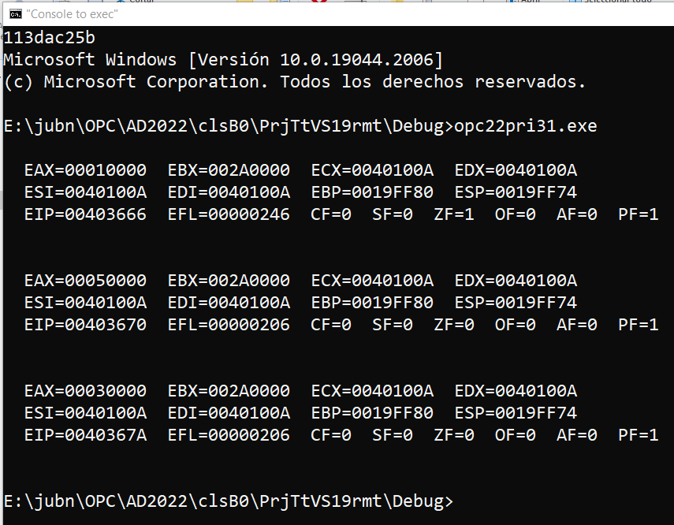
Ejecución del programa 2

Slide 262
Visualización y edición del “.asm”
Desde el Bloq de notas o Notepad++, o
Desde el mismo IDE del VS,
Tenga mucho cuidado, al modificarlo, de verificar que se guarde adecuadamente.

Slide 263
Para finalizar
Cerrar la ventana de Console.bat
Remover el archive AddSub1.asm del Proyecto con
seleccionar AddSub1.asm, con botó derecho del ratón, y seleccionar Exclude from proyect
Volver a ensamblar Build > Rebuild opc22pri31 para que el Proyecto vuelva al estado inicial.

Slide 264
Clase BA

Slide 265
Program structure
TITLE primer
;Descripcion del programa, fecha, versión
INCLUDE Irvine32.inc ;libreria de funciones; falta agregar más
.DATA
; directivas de almacenamiento y tipos de datos
.CODE
main PROC ; Inicia el procedimiento main
; instrucciones, mnemónicos
main ENDP ; Termina el procedimiento principal
END main ; Termina el area de Ensamble

Slide 266
Irvine32 Library Procedures
INCLUDE Irvine32.inc ; chapter 5
These procedures are for I/Os
DumpRegs
DumpMem
ReadInt
ReadHex
WriteInt
WriteHex
WriteString
Crlf
ReadString

Slide 267
DumpRegs
DumpRegs
It desplays all the general registers and the flags.
Sample call
.CODE
MOV ECX, 0
CALL DumpRegs
MOV EAX, 8Fh
CALL DumpRegs

Slide 268
DumpRegs example

Slide 269
DumpMem
DumpMem
It writes a range/block of memory to the console window in hexadecimal.
Pass, in ESI the starting address of the block, in ECX the number of units or elements, and in EBX the unit size (1 : byte, 2 : word, 4 : doubleword).
Sample call
.DATA
array DWORD 11, 12, 13
.CODE
MOV ESI, OFFSET array
MOV ECX, 3 ; ? ________
MOV EBX, 4 ; ? ________
CALL DumpMem

Slide 270
WriteInt
WriteInt
Writes a 32-bit signed integer to the console window in decimal format with a leading sign and no leading zeros.
Pass the integer into EAX.
Sample
.DATA
valInt SDWORD -317432
.CODE
MOV EAX, valInt
CALL WriteInt
CALL Crlf
MOV EAX, 235896
CALL WriteInt

Slide 271
WriteHex
WriteHex
Writes a 32-bit unsigned integer to the console window in 8-digit hexadecimal format.
Leading zeroes are inserted if necessary.
Pass the integer into EAX.
Sample
.DATA
valHex DWORD 6ABCh
.CODE
MOV EAX, valHex
CALL WriteHex
CALL Crlf
MOV EAX, 8EF9h
CALL WriteHex

Slide 272
WriteString
WriteString
It writes a null-terminated string to the console window.
Pass, in EDX register, the string’s offset.
Sample call
.DATA
line1 BYTE “Enter the data: “, 0
.CODE
MOV EDX, OFFSET line
CALL WriteString

Slide 273
Crlf (Carriage Return to Line Feed)
Crlf
It advances the cursor, inwindow console, to the beginning of the next line.
It writes down a string containing the ASCII characters 0Dh and 0Ah.
0Dh is the code of CR (Carriage Return, Enter) and 0Ah is the code of LF (Line Feed).
Check out the appendices 8-bit ASCII Code tables.
Sample call
.DATA
line1 BYTE “Enter the data: “, 0
.CODE
MOV EDX, OFFSET line
CALL WriteString
CALL Crlf

Slide 274
ReadInt
ReadInt
Reads a 32-bit signed integer from the keyboard and returns the value in EAX register.
Can be typed an optional leading plus or minus sign.
It sets the Overflow flag and display an error message if the value cannot be represented as a 32-bit signed integer (-2,147,483,648 to + 2,147,483,647)
Sample
.DATA
valInt SDWORD ?
.CODE
CALL ReadInt
MOV valInt, EAX

Slide 275
ReadHex
ReadHex
Reads a 32-bit hexadecimal integer from the keyboard and returns the value in EAX register.
No error checking is performed for invalid characteres.
Can use both uppercase letters and lowercase letters for the digits A through F.
Sample
.DATA
valHex DWORD ?
.CODE
CALL ReadHex
MOV valHex, EAX

Slide 276
ReadString
ReadString
It reads a string from the keyboard, stopping when the user types the ENTER key.
Pass the buffer’s offset in EDX register.
Set ECX to the maximum number of characters that the user can type, plus 1 to save space for the terminting null byte.
It returns, in EAX, the count of the number of characters typed by the user.
Sample
.DATA
bufferR BYTE 81 DUP(0) ; 80 characters plus 0 (terminator)
charCountR DWORD ?
.CODE
MOV EDX, OFFSET bufferR
MOV ECX, 81
CALL ReadString
MOV charCountR, EAX

Slide 277
8-bit ASCII Codes: 0-127

Slide 278
8-bit ASCII Codes: 128-255

Slide 279
Review these procedures
Chapter 5 (5.4.2, 5.4.3)
Clrscr
ReadChar, ReadDec, ReadKey
WriteBin, WriteBinB
WriteChar, WriteDec, WriteHexB

Slide 280
Clase BB

Slide 281
Operators in operands
Data-Related Operators in operands

Slide 282
Data-Related Operators in Operands
Data-Related Operators are a kind of Directives, that are not executable instructions, instead they are only assembled by the assemblers (.CODE segment).
OFFSET Operator
TYPE Operator
LENGTHOF Operator
SIZEOF Operator
and more …

Slide 283
OFFSET Operator
OFFSET returns the distance in bytes, of a label from the beginning of its enclosing DATA segment
Protected mode: 32, 64 bits
Real mode: 16 bits

Slide 284
OFFSET Examples
Let's assume that the DATA segment begins at 00000000h:
.DATA
BYTE 404000h DUP(?)
bVal BYTE ?
wVal WORD ?
dVal DWORD ?
dVal2 DWORD ?
.CODE
MOV ESI,OFFSET bVal ; ESI = 00404000
MOV ESI,OFFSET wVal ; ESI = 00404001
MOV ESI,OFFSET dVal ; ESI = 0040____
MOV ESI,OFFSET dVal2 ; ESI = 0040____

Slide 285
Relating to C/C++
The value returned by OFFSET is a pointer. Compare the following code written for both C++ and assembly language:
// C++ version:
char array[1000];
char * p = array;
; Assembly language:
.DATA
array BYTE 1000 DUP(?)
p DWORD ?
.CODE
MOV ESI,OFFSET array
MOV p, ESI

Slide 286
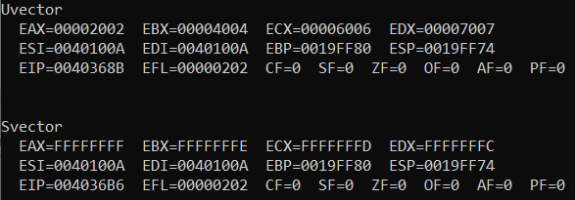
Assembly Program Practice
ejerBB02a.asm
The running

Slide 287
TYPE Operator
The TYPE operator returns the size, in bytes, of a single element of a data declaration.
.DATA
var1 BYTE ?
var2 WORD ?
var3 DWORD ?
var4 QWORD ?
.CODE
MOV EAX, TYPE var1 ; 1
MOV EAX, TYPE var2 ; 2
MOV EAX, TYPE var3 ; 4
MOV EAX, TYPE var4 ; 8

Slide 288
LENGTHOF Operator
The LENGTHOF operator counts the number of elements (magnitude) in a single data declaration.
.DATA LENGTHOF label
byte1 BYTE 10,20,30 ; 3
array1 WORD 30 DUP(?),0,0 ; 32
array2 WORD 5 DUP(3 DUP(?)) ; 15
array3 DWORD 1,2,3,4 ; 4
digitStr BYTE "12345678",0 ; 9
.CODE
MOV ECX, LENGTHOF array1 ; 32
MOV EBX, LENGTHOF digitStr ; 9
ADD EBX, TYPE digitStr ; 1
MOV EAX, TYPE array3 ; 4

Slide 289
SIZEOF Operator
The SIZEOF operator returns a value (Bytes) that is equivalent to multiplying LENGTHOF by TYPE.
.DATA SIZEOF label
byte1 BYTE 10,20,30 ; 3
array1 WORD 30 DUP(?),0,0 ; 64
array2 WORD 5 DUP(3 DUP(?)) ; 30
array3 DWORD 1,2,3,4 ; 16
digitStr BYTE "12345678",0 ; 9
.CODE
MOV EAX,TYPE array1 ; 2
MOV EBX,LENGTHOF array1 ; 32
MOV ECX,SIZEOF array1 ; 64

Slide 290
Spanning Multiple Lines (1 of 2)
In the following example, array1 identifies only the first WORD directive. Compare the values returned by LENGTHOF and SIZEOF here to those in the next slide:
.DATA
array1 WORD 10,20
WORD 30,40
WORD 50,60
.CODE
mov eax, LENGTHOF array1 ; 2
mov ebx, SIZEOF array1 ; 4

Slide 291
Spanning Multiple Lines (2 of 2)
A data Directive spans multiple lines if each line (except the last) ends with a comma. The LENGTHOF and SIZEOF operators include all lines belonging to the same Directive:
.DATA
array1 WORD 10,20,
30,40,
50,60
.CODE
MOV EAX,LENGTHOF array1 ; 6
MOV EBX,SIZEOF array1 ; 12

Slide 292
Symbols, Symbolic Constant
A symbol is an identifier.
ValorFinal, Fecha23
Symbolic constant (is not a label)
Is an identifier associated with a 32/64-bit integer expression (or constant)
Syntax identifier = expression (“=“ equal-sign directive)
ValorFinal = 452
MOV EAX, ValorFinal (really MOV EAX, 452)

Slide 293
Symbols, Symbolic Constant - 2
Symbols do not reserve storage.
Symbols are not labels.
Symbols only exist during the time while the Assembler is Assembling a program in Assembly Language.

Slide 294
Symbolic Constants
May be redifined
ValorFinal = 483
MOV EAX, ValorFinal ; really MOV EAX, 483
ValorFinal = 627
MOV EAX, ValorFinal ; really MOV EAX, 627
Why use Symbols? Clarifies the program
Better when you see ValorFinal instead of 483
EscKey = 27
MOV AL, EscKey ; really MOV EAX, 27

Slide 295
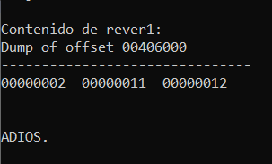
Assembly Program Practice
ejerBB03a.asm
The running

Slide 296
Clase BC

Slide 297
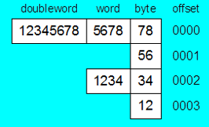
Memory storage of values
.DATA
Alfa DWORD 12345678h
; How is the DWORD stored in memory?
; Other ways to storage the same values
Beta WORD __...__
Delta BYTE __...__

Slide 298
Mapping data values
Mapping smaller data Registers inside longer data registers: e.g. AL, AH <>AX <> EAX, or, DL, DH <>DX <> EDX
What if now we start to do data mapping with memory storage locations?
Two ways for mapping:
Label Directive / Data Segment
“PTR” operator / Code Segment

Slide 299
LABEL Directive
assigns a label, with type and data value(s), the one to be mapped (e.g. zeta)
assigns an alternate label-name and type to an existing storage location, the mapping one
does not allocate any storage of its own. Symbol table?
.DATA
gamma LABEL DWORD ; no storage
epsilon LABEL WORD ; no storage
zeta BYTE 00h,10h,00h,20h ; storage
.CODE
mov EAX, gamma ; 20001000h
mov CX, epsilon ; 1000h
mov DL, zeta ; 00h

Slide 300
“type” PTR – Operand Operator
“type” PTR operator:
overrides the declared size (“type”) of an operand.
allows the selection of some part of a defined variable (label, variable).
It works in the section .CODE
Operand operator (“type” PTR) that works at assembly time (like directives TYPE, LENGTHOF, etc.).
Similar concept: HLL casting

Slide 301
“type” PTR - Operator Examples 1
.DATA
myDouble DWORD 12345678h
.CODE
MOV EAX, myDouble ; EAX =
MOV AX, myDouble ; error – why?
MOV AX, WORD PTR myDouble ; loads 5678h
MOV WORD PTR myDouble, 4A9Bh ; saves 4A9Bh
MOV AL, BYTE PTR myDouble ; AL =
MOV AL, BYTE PTR [myDouble+1] ; AL =
MOV AL, BYTE PTR [myDouble+2] ; AL =
MOV AL, BYTE PTR [myDouble+3] ; AL =
MOV AX, WORD PTR myDouble ; AX =
MOV AX, WORD PTR [myDouble+2] ; AX =

Slide 302
“type” PTR - Operator Examples 2
PTR can also be used to combine elements of a smaller data type and move them into a larger operand. The CPU will automatically consider the bytes in little-endian format.
.DATA
myBytes BYTE 12h,34h,56h,78h
.CODE
MOV AX, WORD PTR [myBytes] ; AX =
MOV AX, WORD PTR [myBytes+2] ; AX =
MOV EAX, DWORD PTR myBytes ; EAX =

Slide 303
“type” PTR - Operator Examples 3
.DATA
varB BYTE 65h,31h,02h,05h
varW WORD 6543h,1202h
varD DWORD 12345678h
.CODE
MOV AX, WORD PTR [varB+2] ; a.
MOV BL, BYTE PTR varD ; b.
MOV BL, BYTE PTR [varW+2] ; c.
MOV AX, WORD PTR [varD+2] ; d.
MOV EAX, DWORD PTR varW ; e.
AX=
BL=
BL=
AX=
EAX=

Slide 304
Clase BD

Slide 305
Multiplication and Division
Multiplication and Division Instructions
MUL – unsigned multiply
IMUL – signed multiply
DIV – unsigned division
IDIV – signed división

Slide 306
MUL Instruction (Unsigned Multiply) iiVa
The MUL (unsigned multiply) instruction multiplies an 8-, 16-, 32- or 64- bit operand by either AL, AX, EAX, or RAX.
The one-operand instruction formats are:
MUL reg/mem8 ;16-bit product
MUL reg/mem16 ;32-bit product
MUL reg/mem32 ;64-bit product
Implicit multiplicand: AL, AX or EAX.
Check CARRY flag after MUL for significant bits in the upper half of the product.
The product is twice the size of the multiplicand or the multiplier.
Multiplicand | Multiplier | Product
AL | reg/mem8 | AH:AL = AL * reg/mem8
AX | reg/mem16 | DX:AX = AX * reg/mem16
EAX | reg/mem32 | EDX:EAX = EAX * reg/mem32

Slide 307
MUL Examples 1
2000h * 100h, using 16-bit operands:
.DATA
val1 WORD 2000h
val2 WORD 100h
.CODE
MOV AX,val1
MUL val2 ; DX:AX = 00200000h, CF=1
The CARRY flag indicates whether or not the upper half of the product contains significant digits.
12345h * 1000h, using 32-bit operands:
MOV EAX,12345h
MOV EBX,1000h
MUL EBX ; EDX:EAX = 0000000012345000h, CF=0

Slide 308
MUL Examples 2
5h * 10h, using 8-bit operands:
.CODE
MOV AL,05h
MOV BL,10h
MUL BL ; AH:AL = 0050h, CF=0

Slide 309
Your turn . . . 1
What will be the hexadecimal values of DX, AX, and the Carry flag after the following instructions execute?
MOV AX,1234h
MOV BX,100h
MUL BX

Slide 310
Your turn . . . 2
What will be the hexadecimal values of EDX, EAX, and the Carry flag after the following instructions execute?
MOV EAX,00128765h
MOV ECX,10000h
MUL ECX

Slide 311
IMUL Instruction (Signed Multiply)
IMUL (signed integer multiply ) multiplies an 8-, 16-, 32- or 64- bit operand by either AL, AX, EAX, or RAX.
Preserves the sign of the product by sign-extending it into the upper half of the destination register
The one-operand instruction formats are:
IMUL reg/mem8 IMUL reg/mem32
IMUL reg/mem16 IMUL reg/mem64
CF and OF are set if the upper half of the product is not a sign extension of the lower half.
Multiplicand | Multiplier | Product
AL | reg/mem8 | AH:AL = AL * reg/mem8
AX | reg/mem16 | DX:AX = AX * reg/mem16
EAX | reg/mem32 | EDX:EAX = EAX * reg/mem32

Slide 312
IMUL Examples
Example: multiply 48 * 4, using 8-bit operands:
MOV AL,48 ; AL = 48 = 30h
MOV BL,4
IMUL BL ; AX(AH:AL) = 00C0h, OF=1
OF=1 because AH is not a sign extension of AL.
Example: multiply 48 * 4, using 16-bit operands:
MOV AX,48
MOV BX,4
IMUL BX ; DX:AX = 000000C0h, OF=0
OF=0 because DX is a sign extension of AX.

Slide 313
IMUL Instruction (Signed Multiply)
Two-operand 16-bit formats, 16-bit product:
IMUL reg16,reg/mem16
IMUL reg16,imm8
IMUL reg16,imm16
Two-operand 32-bit formats, 32-bit product:
IMUL reg32,reg/mem32
IMUL reg32,imm8
IMUL reg32,imm32
Two-operand 64-bit formats.
Two-operand IMUL formats truncate the product. When significant digits are lost OF and CF are set.
Multiplicand | Multiplier | Product
reg16 | reg/mem16 | reg16 = reg16 * reg/mem16
reg16 | imm8/imm16 | reg16 = reg16 * imm8/imm16
reg32 | reg/mem32 | reg32 = reg32 * reg/mem32
reg32 | imm8/imm32 | reg32 = reg32 * imm8/imm32

Slide 314
IMUL Instruction (Signed Multiply)
Three-operand 16-bit formats:
IMUL reg16,reg/mem16,imm8
IMUL reg16,reg/mem16,imm16
Three-operand 32-bit formats:
IMUL reg32,reg/mem32,imm8
IMUL reg32,reg/mem32,imm32
Three-operand 64-bit formats.
Three-operand IMUL formats truncate the product. When significant digits are lost OF and CF are set.
Multiplicand | Multiplier | Product
reg16 | reg/mem16 | reg16 = reg/mem16 * imm8
reg16 | imm8/imm16 | reg16 = reg/mem16 * imm16
reg32 | reg/mem32 | reg32 = reg/mem32 * imm8
reg32 | imm8/imm32 | reg32 = reg/mem32 * imm32

Slide 315
IMUL Examples
Example: multiply 4,823,424 * −423:
MOV EAX,4823424
MOV EBX,-423
IMUL EBX ; EDX:EAX = FFFFFFFF86635D80h, OF=0
OF=0, CF=0 because EDX is a sign extension of EAX.

Slide 316
Your turn . . . 3
What will be the hexadecimal values of DX, AX, and the OVERFLOW flag after the following instructions execute?
MOV AX,8760h
MOV BX,100h
IMUL BX

Slide 317
DIV Instruction (Unsigned Divide)
The DIV (unsigned divide) instruction performs 8-bit, 16-bit, 32-bit and 64-bit division on unsigned integers
A single operand is supplied (register or memory operand), which is assumed to be the divisor
Instruction formats:
DIV reg/mem8 ;16-bit dividend
DIV reg/mem16 ;32-bit dividend
DIV reg/mem32 ;64-bit dividend
DIV reg/mem64
Dividend | Divisor | Quotient | Reminder
AH:AL | reg/mem8 | AL | AH
DX:AX | reg/mem16 | AX | DX
EDX:EAX | reg/mem32 | EAX | EDX

Slide 318
DIV Examples
Divide 8003h by 100h, using 16-bit operands, 32-bit dividend
MOV DX,0 ; clear dividend, high
MOV AX,8003h ; dividend, low
MOV CX,100h ; divisor
DIV CX ; AX = 0080h, DX = 3
Same division, using 32-bit operands, 64-bit dividend:
MOV EDX,0 ; clear dividend, high
MOV EAX,8003h ; dividend, low
MOV ECX,100h ; divisor
DIV ECX ; EAX = 00000080h, EDX = 3

Slide 319
DIV conditions
All arithmetic status flag values are undefined (?) after executing DIV instructions.
What happens if the Quotient doesn’t fit the destination operand (register)?
A divide overflow condition results, causing a CPU interrupt and the current program halts.
What happens if the divisor is zero?
A division by zero condition results, causing a CPU interrupt and the current program halts.
To prevent division by zero, test de divisor before dividing.

Slide 320
Your turn . . . 4
What will be the hexadecimal values of DX and AX after the following instructions execute? Or, if divide overflow occurs, you can indicate that as your answer:
MOV DX,0087h
MOV AX,6000h
MOV BX,100h
DIV BX

Slide 321
Your turn . . . 5
What will be the hexadecimal values of DX and AX after the following instructions execute? Or, if divide overflow occurs, you can indicate that as your answer:
MOV DX,0087h
MOV AX,6002h
MOV BX,10h
DIV BX

Slide 322
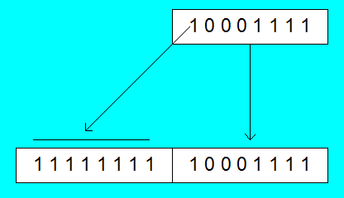
Signed Integer Division (IDIV)
Signed integers must be sign-extended before division takes place
fill high byte/word/doubleword with a copy of the low byte/word/doubleword's sign bit
For example, the high byte contains a copy of the sign bit from the low byte:

Slide 323
CBW, CWD, CDQ Instructions
The CBW, CWD, and CDQ instructions provide important sign-extension operations:
CBW (convert byte to word) extends AL into AH
CWD (convert word to dword) extends AX into DX
CDQ (convert dword to qword) extends EAX into EDX
CQO (convert qword to oword) extends RAX into RDX
Example:
.DATA
dwordVal SDWORD -101 ; FFFFFF9Bh
.CODE
MOV EAX,dwordVal
CDQ ; EDX:EAX = FFFFFFFFFFFFFF9Bh

Slide 324
IDIV Instruction
IDIV (signed divide) performs signed integer division
Same syntax and operands as DIV instruction
Example: 8-bit division of –48 by 5
MOV AL,-48 ; AL = D0h (-30h)
CBW ; extend AL into AH=FFh
MOV BL,5
IDIV BL ; AL = -9, AH = -3

Slide 325
IDIV Examples
Example: 16-bit division of –48 by 5
MOV AX,-48 ; AX = FFD0h
CWD ; extend AX into DX
MOV BX,5
IDIV BX ; AX = -9, DX = -3
Example: 32-bit division of –48 by 5
MOV EAX,-48 ; EAX = FFFFFFD0h
CDQ ; extend EAX into EDX
MOV EBX,5
IDIV EBX ; EAX = -9, EDX = -3

Slide 326
Your turn . . . 6
What will be the hexadecimal values of DX and AX after the following instructions execute? Or, if divide overflow occurs, you can indicate that as your answer:
MOV AX,0FDFFh ;AX= -513 = -0201h
CWD
MOV BX,100h ;BX= 256
IDIV BX

Slide 327
IDIV conditions
All arithmetic status flag values are undefined (?) after executing IDIV instructions.
What happens if the Quotient doesn’t fit the destination operand (register)?
A divide overflow condition results, causing a CPU interrupt and the current program halts.
What happens if the divisor is zero?
A division by zero condition results, causing a CPU interrupt and the current program halts.
To prevent division by zero, test de divisor before dividing.

Slide 328
Clase BE

Slide 329
Transfer of Control Instructions
Transfer of Control Unit (jumps) Instructions
Unconditional or Imperative
jump instruction: JMP
goto, in the beginning of the HLL
Conditional
conditional jump instructions: Jcond family

Slide 330
CPU Conceptual Map
CU
part of
executes next
executes
ALU
conditional jumps
arithmetic & bitwise operations
attached to
used by
provide
affect
status flags
branching logic

Slide 331
Jump instruction
JMP instruction
Causes an unconditional transfer of control (jump) to a destination (label:), inside .CODE.
This destination (label:) is translated like an offset.
Syntax: JMP label
Logic: EIP ← OFFSET label
Examples:
.CODE
lbl2:
instrucA
instrucB
JMP lbl2
.CODE
JMP lbl3
instrucR
instrucT
lbl3:

Slide 332
Conditional Jump instructions
Jcond instructions
The conditional transfer (Jcond) to a destination (label:), inside .CODE, jumps, only if the condition of a flag, or several flags are met.
Remember, only ALU instructrions (arithmetic, or logic) can modify several or all flags.

Slide 333
HLL Structured instructions. via
Algorithm ---- program
Structured thinking
Algorithm structures or Structured instructions
Selectives: If-then, if-then-else, switch-case
Repetitives: while, for, do-while, repeat
There are not such instructions in machine language.
The programmer must implement those algorithm structures.

Slide 334
HLL structures need jumps? via
IF-THEN
IF-THEN-ELSE
WHILE / FOR
DO-WHILE

Slide 335
Conditional Jump instructions
A conditional jump instruction (Jcond) branches to a label:, when a specific flag or several flag conditions are met.
The Jcond analyzes the CPU status flags affected by the last executed ALU instruction.
Some conditional jumps:
JC - jump to a label if the Carry flag is set
JZ - jump to a label if the Zero flag is set
JS - jump to a label if the Sign flag is set

Slide 336
Jconds usage
Example 1
Example2
instrucChgFlags
Jcond la1
. . .
. . .
la1:. . .
la2:
. . .
. . .
instrucChgFlags
Jcond la2
. . .

Slide 337
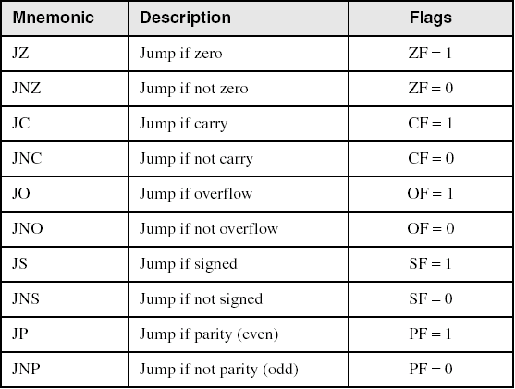
Jconds Based on one Flag (after instruction)

Slide 338
Jconds examples
Example 1
Example2
MOV EAX,1
SUB EAX,1
JZ la1
. . .
la1:. . .
la2:
. . .
MOV EAX,1
ADD EAX,1
JNC la2
. . .

Slide 339
Flags to Test for a Jcond?
How many flags have to be tested for a Jcond, when implementing a Boolean Expression of a HLL’s Algorithm Structure (if, while, …)?
For unsigned expressions?
Chiefly, CF and ZF
For signed expressions?
Mainly, SF and OF

Slide 340
Clase BF

Slide 341
Jconds
Hard to use them, because the predecessor instructions usually affect several flags at the same time, not necessaraly one flag.

Slide 342
CMP in Structured Instructions
CMP instruction is used to create conditional logic structures
When follow CMP with a conditional jump instruction, the result is the assembly language equivalent of an IF or a WHILE statement, or any other structured High Level Language instruction.

Slide 343
CMP Instruction
Syntax: CMP leftOp, rightOp
Compares the leftOp operand to the rightOp operand
Nondestructive implied subtraction of rightOp from leftOp (neither operand is changed)
Logic: leftOp - rightOp
The comparation affect all the flags.
The following operand combinations are permitted
CMP reg, reg
CMP reg, mem
CMP reg, imm
CMP mem, reg
CMP mem, imm

Slide 344
CMP + Jconds usage
Example 1 looks like an IF
Example2 looks like repetitive
cmp EAX,uno
Jcond la1
. . .
. . .
la1:. . .
la2:
. . .
. . .
cmp dos,EBX
Jcond la2
. . .

Slide 345
CMP of two Unsigned operands
Example 1: it works when leftOp == rightOp
MOV AL,5
CMP AL,5 ; ZF=1, CF=0
Example 2: it works when leftOp < rightOp
MOV AL,4
CMP AL,5 ; ZF=0, CF=1
Example 3: it works when leftOp > rightOp
MOV AL,6
CMP AL,5 ; ZF = 0, CF = 0

Slide 346
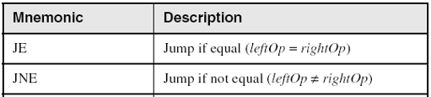
Jconds Based on Equality
For UNSIGNED or SIGNED use.

Slide 347
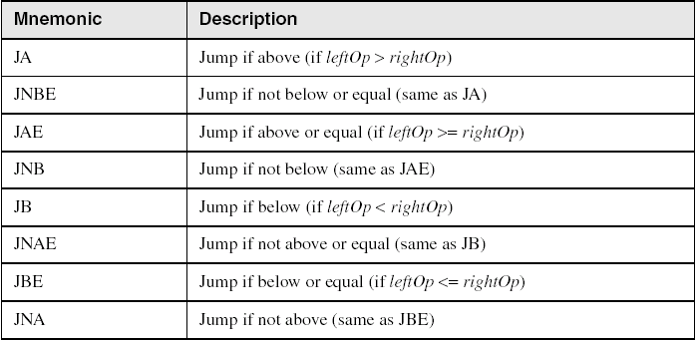
Jconds Based on Unsigned operands
Better use JA, JAE, JB and JBE Above, Below

Slide 348
Examples, Unsigned- 1
Task: Jump to a label Larger if unsigned EAX is greater than EBX
Solution: Use CMP, followed by JA
CMP EAX,EBX
JA Larger ; above
Jump to label L1 if unsigned EAX is less than or equal to Val1
CMP EAX,Val1
JBE L1 ; below or equal

Slide 349
CMP of two Signed operands
Example 4: it works when leftOp > rightOp
mov al,5
cmp al,-2 ; Sign flag == Overflow flag
Example 5: it works when leftOp < rightOp
mov al,-1
cmp al,5 ; Sign flag != Overflow flag
Example 6: it works when leftOp == rightOp
mov al,-1
cmp al,-1 ; ZF=1, CF=don´t care

Slide 350

Jconds Based on Signed operands
Better use JG, JGE, JL and JLE Greater, Lower

Slide 351
Examples, Signed- 2
Task: Jump to a label Greater if signed EAX is greater than EBX
Solution: Use CMP, followed by JG
CMP EAX,EBX
JG Greater
Jump to label L1 if signed EAX is less than or equal to Val1
CMP EAX,Val1
JLE L1

Slide 352
Clase BG

Slide 353
IF-then, IF-then-else, While, DO-while, user implementation, in Assembly

Slide 354
IF-then implementation
The IF Assembly implementation involves a conditional jump for the negative of the comparison (JnoCMP)
High Level L Assembly
IF(LfOp cmpOpr RhOp) CMP LfOp, RhOp
{ JnoCMP outIF
block. .; block. .
} outIF: ;next instruc

Slide 355
IF-then examples
Compare unsigned AX to BX, and copy the larger of the two into a variable named Large
High Level L Assembly
Large = BX; MOV Large,BX
IF(AX > BX) CMP AX,BX
{ JBE outIF ;Jump if AX<=BX
Large = AX; MOV Large,AX ; AX>BX
} outIF:
Compare signed AX to BX, and copy the smaller of the two into a variable named Small
High Level L Assembly
Small = AX; MOV Small,AX
IF(BX < AX) CMP BX,AX
{ JGE outIF ;Jump if BX>=AX
Small = BX; MOV Small,BX ;BX<AX
} outIF:

Slide 356
IF-then-else implementation
The IF Assembly implementation involves a conditional jump for the negative of the comparison (JnoCMP). A JMP is needed at the end of block1 to avoid enter into the ELSE area.
High Level L Assembly
IF(LfOp cmpOp RhOp) CMP LfOp,RhOp
{ JnoCMP inELSE
block1. .; block1. .
} JMP outIF
else inELSE:
{
black2. .; block2. .
} outIF: ;next instruc

Slide 357
WHILE implementation
The WHILE Assembly implementation involves a conditional jump for the negative of the comparison (JnoCMP). After the block it requieres to jump back (JMP) to do compare.
High Level L Assembly
WHILE(LfOp cmpOp RhOp) inWHILE: CMP LfOp,RhOp
{ JnoCMP outWHILE
block. .; block. .
} JMP inWhile
outWHILE: ;nextinstruc

Slide 358
WHILE example
The WHILE Assembly implementation involves a conditional jump for the negative of the comparison (JnoCMP). After the block it requires to jump back to do compare. Example signed.
High Level L Assembly
EAX=45; MOV EAX,45
EBX=1; MOV EBX,1
WHILE(EBX < 6) inWHILE: CMP EBX,6
{ JGE outWHILE
EAX=EAX-2; SUB EAX,2
EBX=EBX+1; INC EBX
} JMP inWhile
outWHILE: ;nextinstruc

Slide 359
DO-WHILE implementation
The DO-WHILE Assembly implementation involves a conditional jump for the same comparison (JsaCMP). After the block it requires to jump back to do compare.
High Level L Assembly
DO inDO:
block. .; block. .
WHILE(LfOp cmpOp RhOp) CMP LfOp,RhOp
JsaCMP inDO
;nextinstruc

Slide 360
DO-WHILE example
The DO-WHILE Assembly implementation involves a conditional jump for the positive of the comparison (JsaCMP). After the block it requires to jump back to do compare. Example signed.
High Level L Assembly
EAX=50; MOV EAX,50
EBX=0; MOV EBX,0
DO inDO:
EAX=EAX+1; INC EAX
EBX=EBX+1; INC EBX
WHILE(EBX < 4) CMP EBX,4
JL inDO
;nextinstruc

Slide 361
Clase BH

Slide 362
HLL Boolean Operators
Logical Operators, for Boolean operations:
Boolean values: true (1d= 0…01b) / false (0d= 0…0b)
NOT: !a (!true>false, !false>true)
AND: a && b
OR: a || b
Bitwise Operators, for bit-to-bit operations:
Integer-bit values: n bits (8, 16, 32, 64, … bits)
NOT: ~c (complement 1s)
AND: d & e
OR: d | e
XOR: d ^ e

Slide 363
Bitwise Boolean Instructions
Issue: there are not logical Boolean ASSEMBLY Instructions,
Only Bitwise (bit to bit computations): AND, OR, XOR, NOT, TEST

Slide 364
AND Instruction
AND, bitwise, bit to bit
Syntax: AND destination, source
The following operand combinations are permitted
AND reg, reg
AND reg, mem
AND reg, imm
AND mem, reg
AND mem, imm
Operands can be 8, 16, 32, or 64 bits, must be same size
Bit masking with the source operand.
Set INTERSECTION of bits

Slide 365


AND Instruction
Performs a Boolean AND operation between each pair of matching bits in two operands
Flags
Clears Overflow, Carry
Modifies Sign, Zero, and Parity
Syntax:
AND destination, source
(same operand types as MOV)
AND
Bit masking, source: 0 in source clears a bit, 1 leaves it unchanged.

Slide 366
OR Instruction
OR, bitwise, bit to bit
Syntax: OR destination, source
The following operand combinations are permitted
OR reg, reg
OR reg, mem
OR reg, imm
OR mem, reg
OR mem, imm
Operands can be 8, 16, 32, or 64 bits, must be same size
Useful when you want to set one or more bits without affecting the other bits
Set UNION of bits

Slide 367

OR Instruction
Performs a Boolean OR operation between each pair of matching bits in two operands
Flags
Clears Overflow, Carry
Modifies Sign, Zero, and Parity
Syntax:
OR destination, source
OR
1 in source set a bit, 0 leaves it unchanged.

Slide 368

XOR Instruction
Performs a Boolean eXclusive-OR bitwise operation between each pair of matching bits in two operands
XOR with 0 retains its value, with 1 reverses value
Flags
Clears Overflow, Carry
Modifies Sign, Zero, and Parity
Syntax:
XOR destination, source
XOR
XOR is a useful way to toggle (invert) the bits in an operand.

Slide 369

NOT Instruction
Performs a Boolean NOT bitwise operation on a single destination operand
The following operand combinations are permitted
NOT reg
NOT mem
Flags
No flags are affected
Syntax:
NOT destination
NOT
Results called one’s complement
Set COMPLEMENT of bits

Slide 370
Bit-Mapped Set Operations
Set Complement
MOV AL, SetB ; AL= SetB= 0000 0111b
NOT AL ; AL= 1111 1000b
Set Intersection
MOV AL, SetB ; AL= SetB= 0000 0111b
AND AL, SetS ; SetS= 0110 0011b AL= 0000 0011b
Set Union
MOV AL, SetB ; AL= SetB= 0000 0111b
OR EAX, SetS ; SetS= 0110 0011b AL= 0110 0111b

Slide 371
ASCII Code

Slide 372
Applications (1 of 4)
Task: Convert the character in AL to UPPER CASE.
Solution: Use the AND instruction to clear bit 5.
mov al, 'a' ; AL = 01100001b, ‘a’
and al, 11011111b ; AL = 01000001b, ‘A’

Slide 373
Applications (2 of 4)
Task: Convert a binary decimal byte into its equivalent ASCII Decimal Digit.
Solution: Use the OR instruction to set bits 4 and 5.
MOV AL,6 ; AL = 00000110b, 6
OR AL,00110000b ; AL = 00110110b, ‘6’
The ASCII digit '6' = 00110110b

Slide 374
Applications (3 of 4)
Task: Jump to a label if an integer is even.
Solution: AND the lowest bit with a 1. If the result is Zero, the number was even.
MOV AX, wordVal
AND AX, 1 ; low bit set?
JZ EvenValue ; jump if Zero flag set
Your turn: Write code that jumps to a label if an integer is negative.

Slide 375
Applications (4 of 4)
Task: Jump to a label if the value in AL is not zero.
Solution: OR the byte with itself, then use the JNZ (jump if not zero) instruction.
OR AL,AL
JNZ IsNotZero ; jump if not zero
ORing any number with itself does not change its value.

Slide 376
TEST Instruction
Performs a nondestructive AND bitwise operation between each pair of matching bits in two operands
No operands are modified.
Always clears the Overflow and Carry flags.
Modifies the Sign, Zero, and Parity flags.
Example: jump to a label if either bit 0 or bit 1 in AL is set.
TEST AL,00000011b
JNZ ValueFound
TEST AL,03h
JNZ ValueFound
Example: jump to a label if neither bit 0 nor bit 1 in AL is set.
TEST AL,00000011b
JZ ValueNotFound

Slide 377
Example
The value 0000 0011 in this example is called a bit mask.
TEST AL,00000011b
0 0 1 0 0 1 0 1 <- AL input value
0 0 0 0 0 0 1 1 <- test value
0 0 0 0 0 0 0 1 <- result: ZF = 0
TEST AL,00001001b
0 0 1 0 0 1 0 0 <- AL input value
0 0 0 0 1 0 0 1 <- test value
0 0 0 0 0 0 0 0 <- result: ZF = 1
The value 0000 1001 in this example is called a bit mask.

Slide 378
Clase BI

Slide 379
HLL’s COMPOUND EXPRESSIONS in CONDITIONAL STRUCTURES

Slide 380
Bitwise Boolean Instructions
To build up compound conditional expressions for IF-THEN, IF-THEN-ELSE, WHILE, DO-WHILE, REPEAT-UNTIL and FOR, logical Boolean instructions are required.
E.g.
(A > B) && (C <= 5)
&& is the Logical Boolean operator and, in a HLL

Slide 381
Compound Expression with AND - 1
When implementing the logical AND operator, consider that HLLs use short-circuit evaluation
In the following example, if the First expression is false, the Second expression is skipped:
if (al > bl) AND (bl > cl)
X = 1;

Slide 382
Compound Expression with AND - 2
if (al > bl) AND (bl > cl)
X = 1;
This is one possible implementation . . . no sign
cmp al,bl ; First expression...
JA L1 true
JMP next ;false :: a1<=b1
L1:
cmp bl,cl ; Second expression...
JA L2 ; true
JMP next false
L2: ; both are true
mov X,1 ; set X to 1
next:

Slide 383
Compound Expression with AND - 3
if (al > bl) AND (bl > cl)
X = 1;
But the following implementation uses 29% less code by reversing the first relational operator. We allow the program to "fall through" to the second expression:
cmp al,bl ; First expression...
JBE next ; quit if false
cmp bl,cl ; Second expression...
JBE next ; quit if false
mov X,1 ; both are true
next:

Slide 384
Compound Expression with AND - 4
Implement the following pseudocode in assembly language. All values are unsigned:
if( ebx <= ecx
&& ecx > edx )
{
eax = 5;
edx = 6;
}
cmp ebx,ecx
JA next
cmp ecx,edx
JBE next
mov eax,5
mov edx,6
next:
(There are multiple correct solutions to this problem.)

Slide 385
Compound Expression with OR - 1
When implementing the logical OR operator, consider that HLLs use short-circuit evaluation
In the following example, if the First expression is true, the Second expression is skipped:
if (al > bl) OR (bl > cl)
X = 1;

Slide 386
Compound Expression with OR - 2
if (al > bl) OR (bl > cl)
X = 1;
We can use "fall-through" logic to keep the code as short as possible:
cmp al,bl ; is AL > BL?
JA L1 ; yes
cmp bl,cl ; no: is BL > CL?
JBE next ; no: skip next statement
L1:
mov X,1 ; set X to 1
next:

Slide 387
Clase BJ

Slide 388
MACRO Procedure
MACRO (DIRECTIVE)
A MACRO procedure is a named block of Assembly Language instructions.
Every time that this named block is invoked , Assembler during preprocessing step, expands a copy of the block, of instructions, into the programe code.
The expanded code is passed to the assembly step, where it is checked for correctness.
Macro-Directives, in Section 10.2, Irvine.

Slide 389
Defining a Macro
A macro must be defined before it can be used.
Parameters are optional.
Each parameter follows the rules for identifiers. It is a string that is assigned a value when the macro is invoked.
Syntax:
macroname MACRO [parameter-1, parameter-2,...]
statement-list
ENDM

Slide 390
mNewLine Macro - an example
; Macro definition
mNewLine MACRO
CALL CrLf
ENDM
.DATA
.CODE
mNewLine
; Assembler program, after initial
; preprocessing Assembly step
; mNewLine is expanded out
.DATA
.CODE
CALL CrLf

Slide 391
mPutchar Macro - an example
; Macro definition with an argument
mPutchar MACRO char
push EAX
mov AL, char
call WriteChar
pop EAX
ENDM
.DATA
.CODE
mPutchar ‘A’
; Assembler program, after initial
; preprocessing Assembly step
; mPutchar ‘A’ is expanded out
.DATA
.CODE
push EAX
mov AL, ‘A’
call WriteChar
pop EAX

Slide 392
Invoking Macros
When you invoke a macro, each argument you pass matches a declared parameter.
Each parameter is replaced by its corresponding argument when the macro is expanded.
When a macro expands, it generates assembly language source code.
Arguments are treated as simple text by the preprocessor.

Slide 393
mWriteStr Macro - an example
; Macro definition with an argument
mWriteStr MACRO buffer
PUSH EDX
MOV EDX, OFFSET buffer
CALL WriteString
POP EDX
ENDM
.DATA
str1 BYTE "Welcome!", 0
.CODE
mWriteStr str1
; Assembler program, after initial
; preprocessing Assembly step
; mWriteStr str1 is expanded out
.DATA
str1 BYTE "Welcome!", 0
.CODE
PUSH EDX
MOV EDX, OFFSET str1
CALL WriteString
POP EDX

Slide 394
mDumpMem Macro - an example
The mDumpMem macro streamlines calls to the link library's DumpMem procedure.
mDumpMem MACRO address, itemsCount, itemSize
push ebx
push ecx
push esi
mov esi,address
mov ecx,itemsCount
mov ebx,itemSize
call DumpMem
pop esi
pop ecx
pop ebx
ENDM

Slide 395
Clase BK

Slide 396
CONDITIONAL CONTROL FLOW MACRO DIRECTIVES
SELECTIVES
.IF condition, .ELSE, .ELSEIF condition, .ENDIF
REPETITIVES
.WHILE condition, .ENDW
.REPEAT, .UNTIL condition
.BREAK, .CONTINUE, used with .WHILE and .REPEAT
Macro-Directives, in Section 6.7, Irvine.

Slide 397
Conditional Control Flow Directives
Directive | Description
.BREAK | Generates code to terminate a .WHILE or .REPEAT block
.CONTINUE | Generates code to jump to the top of a .WHILE or .REPEAT block
.ELSE | Begins block of statements to execute when the .IF condition is false
.ELSEIF condition | Generates code that tests condition and executes statements that follow, until an .ENDIF directive or another .ELSEIF directive is found
.ENDIF | Terminates a block of statements following an .IF, .ELSE, or .ELSEIF directive
.ENDW | Terminates a block of statements following a .WHILE directive
.IF condition | Generates code that executes the block of statements if condition is true.
.REPEAT | Generates code that repeats execution of the block of statements until condition becomes true
.UNTIL condition | Generates code that repeats the block of statements between .REPEAT and .UNTIL until condition becomes true
.WHILE condition | Generates code that executes the block of statements between .WHILE and .ENDW as long as condition is true

Slide 398
.IF family macro-directives
.IF, .ELSE, .ELSEIF, and .ENDIF can be used to evaluate runtime expressions and create block-structured IF statements.
Assembly examples:
.IF eax > ebx
mov edx,1
.ELSE
mov edx,2
.ENDIF
.IF eax > ebx && eax > ecx
mov edx,1
.ELSE
mov edx,2
.ENDIF
MASM generates (macro-expands) "hidden" code for you, consisting of code labels, CMP and conditional jump instructions, and replacing arguments.

Slide 399

Relational and Logical Operators

Slide 400
AND and OR: Compound Expressions
When using any directive, the || is the logical OR
.IF expression1 || expression2
Statements . . .
.ENDIF
When using any directive, the && symbol is the logical AND
.IF expression1 && expression2
Statements . . .
.ENDIF

Slide 401
Expression examples
eax > 10000h
val1 <= 100
val2 == eax
val3 != ebx
(eax > 0) && (eax > 10000h)
(val1 <= 100) || (val2 <= 100)
(val2 != ebx) && !CARRY?
(dl < 0) || (dl > 79)

Slide 402
Signed and Unsigned Comparisons - 1
.DATA
val1 DWORD 5
result DWORD ?
.CODE
mov EAX,6
.IF EAX > val1
mov result,1
.ENDIF
Expanded code:
mov EAX,6
cmp EAX,val1
JBE @C0001
mov result,1
@C0001:
MASM automatically generates an unsigned jump (JBE) because val1 is unsigned.

Slide 403
Signed and Unsigned Comparisons - 2
.DATA
val1 SDWORD 5
result SDWORD ?
.CODE
mov EAX,6
.IF EAX > val1
mov result,1
.ENDIF
Expanded code:
mov EAX,6
cmp EAX,val1
JLE @C0001
mov result,1
@C0001:
MASM automatically generates a signed jump (JLE) because val1 is signed.

Slide 404
Signed and Unsigned Comparisons - 3
.DATA
result DWORD ?
.CODE
mov EBX,5
mov EAX,6
.IF EAX > EBX
mov result,1
.ENDIF
Expanded code:
mov EBX,5
mov EAX,6
cmp EAX,EBX
JBE @C0001
mov result,1
@C0001:
MASM automatically generates an unsigned jump (JBE) when both operands are registers . . .

Slide 405
Signed and Unsigned Comparisons - 4
.DATA
result SDWORD ?
.CODE
mov EBX,5
mov EAX,6
.IF SDWORD PTR EAX > EBX
mov result,1
.ENDIF
Expanded code:
mov EBX,5
mov EAX,6
cmp EAX,EBX
JLE @C0001
mov result,1
@C0001:
. . . unless you prefix one of the register operands with the type PTR operator. Then a signed jump is generated.

Slide 406
Example 1
SetCursorPosition PROC
; Sets the cursor position.
; Receives: DL = X-coordinate, DH = Y-coordinate.
; Checks the ranges of DL and DH.
; Returns: nothing
; ------------------------------------------------
. DATA
BadXCoordMsg BYTE " X-Coordinate out of range! " , 0Dh, 0Ah, 0
BadYCoordMsg BYTE " Y-Coordinate out of range! " , 0Dh, 0Ah, 0
. CODE
.IF ( dl < 0 ) | | ( dl > 79 )
mov edx, OFFSET BadXCoordMsg
call WriteString
jmp quit
.ENDIF
.IF ( dh < 0 ) | | ( dh > 24)
mov edx, OFFSET BadYCoordMsg
call WriteString
jmp quit
.ENDIF
call Gotoxy
quit:
ret
SetCursorPosition ENDP
. CODE
; .IF ( dl < 0 ) | | ( dl > 79 )
cmp dl, 000h
jb @C0002
cmp dl, 04Fh
jbe @C0001
@C0002 :
mov edx, OFFSET BadXCoordMsg
call WriteString
jmp quit
; . ENDIF
@C0001:
; .IF ( dh < 0 ) | | ( dh > 24)
cmp dh, 000h
jb @C0005
cmp dh, 018h
jbe @C0004
@C0005:
mov edx, OFFSET BadYCoordMsg
call WriteString
jmp quit
; .ENDIF
@C0004:
call Gotoxy
quit:
ret

Slide 407
Example 2
; Determine registration based on two criteria:
; Average Grade
; Credits the person wants to take
.DATA
TRUE = 1
FALSE = 0
gradeAverage WORD 275 ; test value
credits WORD 12 ; test value
OkToRegister BYTE ?
.CODE
mov OkToRegister, FALSE
.IF gradeAverage > 350
movOkToRegister, TRUE
.ELSEIF (gradeAverage > 250 ) && ( credits <= 16)
mov OkToRegister, TRUE
.ELSEIF ( credits <= 12 )
mov OkToRegister, TRUE
.ENDIF
mov byte ptr OkToRegister, FALSE
;.IF gradeAverage > 350
cmp word ptr gradeAverage, 350
jbe @C0006
mov byte ptr OkToRegister, TRUE
jmp @C0008
@C0006:
;.ELSEIF (gradeAverage > 250 ) && ( credits <= 16)
cmp word ptr gradeAverage, 250
jbe @C0009
cmp word ptr credits, 16
ja @C0009
mov byte ptr OkToRegister, TRUE
jmp @C0008
@C0009 :
;.ELSEIF ( credits <= 12 )
cmp word ptr credits, 12
ja @C0008
mov byte ptr OkToRegister, TRUE
@C0008:
;.ENDIF

Slide 408
.WHILE family directives
Tests the loop condition before executing the loop body The .ENDW directive marks the end of the loop.
.WHILE condition
statements
.ENDW
Example:
; Display integers 1 – 10:
mov EAX,0
.WHILE EAX < 10
inc EAX
call WriteDec
call Crlf
.ENDW

Slide 409
.REPEAT family directives
Executes the loop body before testing the loop condition associated with the .UNTIL directive.
.REPEAT
statements
.UNTIL condition
Example:
; Display integers 1 – 10:
mov EAX,0
.REPEAT
inc EAX
call WriteDec
call Crlf
.UNTIL EAX == 10

Slide 410
Example 3: .WHILE nesting an .IF
;HLL
while( op1 < op2 )
{
op1++;
if( op1 == op3 )
X = 2 ;
else
X = 3 ;
}
;ASM
. DATA
X DWORD 0
op1 DWORD 2 ; test data
op2 DWORD 4 ; test data
op3 DWORD 5 ; test data
. CODE
mov eax, op1
.WHILE eax < op2
inc eax
mov op1, eax
.IF eax == op3
mov X, 2
.ELSE
mov X, 3
.ENDIF
.ENDW

Slide 411
Clase BL

Slide 412

STACK
STACK data structure
A STACK of values (data)
values are only added to the top (PUSH operation)
values are only removed from the top (POP operation)
LIFO (Last-in, First-out) data structure

Slide 413
Process memory space and resources
0xFFFFFFFF
OS resources
(open files, network connect.,
Sound channels, …)
CPU
General Registers
SS >
Runtime STACK
(storage call returns, etc.)
SP
ESP
Memory address space
heap
(dynamic allocated mem)
CS >
Code section
(text segment)
PC
EIP
DS >
static data section
(data segment)
0x00000000

Slide 414

Runtime STACK
STACK inside every Process
Managed by the CPU, using a stack pointer register
ESP (Extended Stack Pointer)
ESP always points to the last value added

Slide 415
PUSH Instruction
PUSH syntax, one operand
PUSH reg/mem16 ; for 2-Byte, 16-bit operand
PUSH reg/mem32 ; for 4-Byte, 32-bit operand
PUSH reg/mem64 ; for 8-Byte, 64-bit operand
PUSH imm32 ; for 4-Byte, 32-bit operand
PUSH imm64 ; for 8-Byte, 64-bit operand

Slide 416

PUSH operation 1
A PUSH operation decrements the stack pointer by nByOp (2 [16 bits], 4 [32 bits] or 8 Bytes [64 bits]), and copies a value into the location pointed to by the stack pointer ESP.
ESP ← ESP – nByOp ; nByOp=4 Bytes, a 32-bit operand
STACK [ESP] ← reg/var/value

Slide 417

PUSH operation 2
Same stack after pushing two more integers:
The stack grows downward. The area below ESP is always available (unless the stack has overflowed).

Slide 418
POP Instruction
POP syntax, one operand
POP reg/mem16 ; for 2-Byte, 16-bit operand
POP reg/mem32 ; for 4-Byte, 32-bit operand
POP reg/mem64 ; for 8-Byte, 64-bit operand

Slide 419

POP Operation
Copies value at STACK[ESP] into a register or variable.
Reg/Var ← STACK[ESP]
Adds n to ESP, where n is either 2, 4 or 8.
value of n depends on the attribute of the operand receiving the data
ESP ← ESP + n

Slide 420
Using PUSH and POP
Save and restore registers when they contain important values. PUSH and POP instructions occur in the opposite order.
.DATA
dwordVal DWORD 675
.CODE
PUSH ESI ; push registers
PUSH ECX
PUSH EBX
MOV ESI,OFFSET dwordVal ; display some memory
MOV ECX,LENGTHOF dwordVal
MOV EBX,TYPE dwordVal
CALL DumpMem
POP EBX ; restore registers
POP ECX ; aware of LIFO
POP ESI

Slide 421
Related Instructions
PUSHFD and POPFD
push and pop the EFLAGS register (32-bit)
PUSHAD pushes the 32-bit general-purpose registers on the stack
order: EAX, ECX, EDX, EBX, ESP, EBP, ESI, EDI
POPAD pops the same registers off the stack in reverse order
PUSHA and POPA, do the same for 16-bit registers
order: AX, CX, DX, BX, SP, BP, SI, DI

Slide 422
PUSHAD
The value pushed for the ESP register is its value before prior to pushing the first register.
Temporary = ESP;
Push(EAX);
Push(ECX);
Push(EDX);
Push(EBX);
Push(Temporary);
Push(EBP);
Push(ESI);
Push(EDI);

Slide 423
POPAD
The ESP register is incremented after each register is loaded.
EDI = Pop(); ESP=ESP+4
ESI = Pop(); ESP=ESP+4
EBP = Pop(); ESP=ESP+4
ESP = ESP + 4; //skip next 4 bytes of stack
EBX = Pop(); ESP=ESP+4
EDX = Pop(); ESP=ESP+4
ECX = Pop(); ESP=ESP+4
EAX = Pop(); ESP=ESP+4

Slide 424
Stack applications
Temporary save area for registers, once the registers end a set of operations, their original values can be restored.
The stack provides temporary storage for local variables.
The Call for a procedure, saves an address that uses up the Return of the procedure called.
HLL: The formal parameters and the automatic variables

Slide 425
Clase BM

Slide 426
Addressing Modes
Addressing Mode.
refers to the way, in which, the CPU accesses the effective values from the operand(s) of an instruction
Two general Addressing Modes:
Direct Addressing (seen up to now)
Indirect Addressing

Slide 427
Direct Addressing Mode
With DIRECT addressing mode, in Operands
The operand has the location to place an effective value, or has the content to get an effective value,
Examples
mov EAX, alfa
mov beta, EBX
mov alfa, 354
Direct Addressing Operands
Register Direct O.: EAX, EBX (location or content)
Memory Direct O.: alfa, beta (location or content)
Immediate Direct O: 354 (content)

Slide 428
Indirect Addressing Mode -1
With INDIRECT addressing mode, in operands
The operand has the memory address (offset) of the location to place a value, or has the memory address (offset) of the content to get a value
It means, the operand has a pointer (or a reference)
Example using pseudo-code - 1
mov ESI, OFFSET beta
mov EAX, ind{ESI}

Slide 429
Indirect Addressing Mode -2
Example using pseudo-code - 2
add ESI, 4
mov EAX, ind{ESI}

Slide 430
Indirect Addressing Modes -3
Two approaches
Indirect Operands
[reg]
reg contains an address (offset, pointer, or reference)
Indexed Operands
Coming soon!

Slide 431
Indirect Operands - 1
reg: could be any general-purpose register
Rmn, . . ., EAX, EBX, ECX, EDX ( 64, 32, 16, and 8 bits )
Rxy, . . ., ESI, EDI, EBP, ESP (64, 32 and 16 bits)
ESI and EDI prefered registers
RSI, ESI: Source Index
RDI, EDI: Destination Index
For each approach?
How come, you get the effective address? ____
How long (bits) must be the effective address? ____
What TYPE must be the location or the content? ____

Slide 432
Indirect Operands - 2
An indirect operand holds the address of a variable (pointer, offset, or reference), usually an ARRAY or STRING.
It can be dereferenced (just like a pointer).
In Protected Mode, any indirect operand can be any of the 32-bit or 64-bit general-purpose registers, surrounded by brackets.
Also, a memory place (DWORD / QWORD) can hold an address value.
General Protection Fault: in Protected Mode, if the effective address, points to an area outside your program’s data segment, the CPU executes a General Protection Fault (GP).

Slide 433
Indirect Operands - 3a
An indirect operand holds the address of a variable, usually an array or string. It can be dereferenced (just like a pointer).
.DATA
val1 BYTE 10h,20h,30h
.CODE
MOV ESI,OFFSET val1
MOV AL,[ESI] ; ESI=0000 0000h; AL = 10h
; Size of the location?___
; Size of the content?___
INC ESI
MOV AL,[ESI] ; ESI=0000 ____h; AL = 20h
INC ESI
MOV AL,[ESI] ; ESI=0000 ____h; AL = 30h

Slide 434
Indirect Operands - 3b
Use PTR to clarify the size attribute of a memory operand.
.DATA
myCount WORD 0
.CODE
MOV ESI,OFFSET myCount
INC [ESI] ; error: ambiguous
INC WORD PTR [ESI] ; ok
Should PTR be used here?
ADD [ESI],20
yes, because [ESI] could point to a byte, word, or doubleword

Slide 435
Pointers - 3c
You can declare a pointer variable that contains the offset of another variable (it must be 32-bit or 64-bit long).
.DATA
BYTE 16 DUP(?)
arrayW WORD 1000h,2000h,3000h
ptrW DWORD arrayW
.CODE
MOV ESI, ptrW
MOV AX,[ESI] ; AX = 1000h
Alternate format:
ptrW DWORD OFFSET arrayW

Slide 436
Array Sum Example - 3d
Indirect operands are ideal for traversing an array. Note that the register in brackets must be incremented by a value that matches the array type.
.DATA
arrayW WORD 1000h,2000h,3000h
.CODE
MOV ESI,OFFSET arrayW
MOV AX,[ESI]
ADD ESI,2 ;or better: ADD ESI,TYPE arrayW
ADD AX,[ESI]
ADD ESI,2
ADD AX,[ESI] ; AX = sum of the array

Slide 437
Direct and Indirect operands
Direct operands in two-operand instructions (f.i. CMP)
CMP reg, reg
CMP reg, mem
CMP reg, imm
CMP mem, reg
CMP mem, imm
Indirect operands in two-operand instructions (f.i. CMP)
CMP reg, [reg] like direct operand CMP reg, ___
CMP [reg], reg like direct operand CMP ___, reg
CMP [reg], imm like direct operand CMP ___, imm

Slide 438
Clase C0

Slide 439
Indirect Addressing Operands
With Indirect operands
[reg]
reg contains an address (offset)
With Indexed operands (also Indexed Addressing)
To get the effective address need to operate:
a constant, address and/or imm; and
a register

Slide 440
Indexed Operands - 5
Types of indexed operands
Basic Indexed Operand (I.O.),
Adding Displacements in I. O.,
Scale Factors in I. O.

Slide 441
Basic Indexed Operand – 5a
An indexed operand is conformed with the addition of a constant plus the content of a register, to generate an effective address. The format of the operand:
constant [reg] or [constant + reg]
constant must represent an address/offset
reg contains a displacement value
This addition is an indexed value with respect to an address.

Slide 442
Basic Indexed Operand – 5b
.DATA
; Starting address 500h
arrayW WORD 1000h,2000h,3000h
; index: 0, 1, 2
.CODE
; Basic Indexed or INDEXED
MOV ESI,0 ; index=0, displacement=0
MOV AX, arrayW[ESI] ; AX = 1000h
MOV AX, [arrayW + ESI] ; Alternative
ADD ESI,2 ; index=1, displacement=2
ADD AX, [arrayW + ESI] ; AX = 2000h
ADD AX, arrayW[ESI] ; Alternative

Slide 443
Adding Displacements I. O. – 5c
Format of the operand: [reg + constant]
reg: must hold an address
constant: meaning fixed displacement

Slide 444
Adding Displacements I. O. – 5d
.DATA
; Starting address 500h
arrayW WORD 1000h,2000h,3000h
.CODE
; ADDING DISPLACEMENTS
MOV ESI, OFFSET arrayW ; ESI holds an offset
MOV AX, [ESI + 2] ; AX = 2000h
MOV AX, [ESI + 4] ; AX = 3000h

Slide 445
Scale Factors in I. O. – 5e
Format of the operand: offset [reg * constant]
offset: fixed address
reg: holds an HLL index
constant: type of element (byte, word, dword, …)
The reg works like an index of an HLL array element.
The scale factor is the size (TYPE) of the array component.
Displacement= reg * constant

Slide 446
Index Scaling – 5f
You can scale an indirect or indexed operand to the offset of an array element. This is done by multiplying the index by the array's TYPE.
.DATA
; index 0, 1, 2, 3, 4, 5
arrayB BYTE 10, 11, 12, 13, 14, 15
arrayW WORD 10, 11, 12, 13, 14, 15
arrayD DWORD 10, 11, 12, 13, 14, 15
.CODE
MOV ESI,4 ; index 4
MOV AL, arrayB[ESI * TYPE arrayB] ; 14
MOV BX, arrayW[ESI * TYPE arrayW] ; 0014
MOV EDX, arrayD[ESI * TYPE arrayD] ; 00000014

Slide 447
Clase CA

Slide 448
Creating Procedures
Large problems can be divided into smaller tasks to make them more MANAGEABLE, MODULAR, and UNDERSTANDABLE
Declared using PROC and ENDP directives
A named block of statements
Must be assigned a name (valid identifier)
A procedure is the ASM equivalent of a Java Method, C or C++ Procedure or Function.
Following is an assembly language procedure named sample:
nomPro PROC
.
.
RET ;return instruction
nomPro ENDP

Slide 449
Documenting Procedures
Suggested documentation for each procedure:
A description of all tasks accomplished by the procedure.
Receives: A list of input parameters; state their usage and requirements.
Returns: A description of values returned by the procedure.
Requires: Optional list of requirements called preconditions that must be satisfied before the procedure is called.
If a procedure is called without its preconditions satisfied, it will probably not produce the expected output.

Slide 450
Example: Sum3 Procedure
main PROC
. . .
CALL Sum3
. . .
EXIT
main ENDP
;---------------------------------------------------------
Sum3 PROC ; Sum3(EBX, ECX, EDX)
; Calculates and returns the sum of three 32-bit integers.
; Receives: EBX, ECX, EDX, the three integers. May be
; signed or unsigned. Like Irvine
; Returns: EBX = sum, and the status flags (Carry,
; Overflow, etc.) are changed. Like Irvine
; Requires: nothing
;---------------------------------------------------------
ADD EBX,ECX
ADD EBX,EDX
RET
Sum3 ENDP
END main

Slide 451
CALL-RET Example 1
main PROC
;EIP=00000020h
00000020 CALL Sum3 ;EIP=00000025h
;EIP=00000040h
00000025 MOV EAX,EBX
. . .
main ENDP
Sum3 PROC
;EIP=00000040h
00000040 ADD EBX,ECX
. . .
000000B0 RET ;EIP=00000025h
Sum3 ENDP
END main
0000025 is the offset of the instruction immediately following the CALL instruction
00000040 is the offset of the first instruction inside Sum3 and also its offset

Slide 452
Global Values with Registers
REGISTERS. All CPU Registers are global to every procedure in the .CODE segment.
Using CPU Registers inside a procedure, to pass values, is not the best practice; but, at least, the Registers allow some extent of flexibility, passing values at CALLing and RETurning time.

Slide 453
CALL and RET Instructions
The CALL instruction calls a procedure
Pushes the offset of next instruction, after CALL, on the stack: PUSH EIP
Copies the address of the called procedure into EIP (Program Counter): MOV EIP, OFFSET nomProc
The RET instruction returns from a procedure
pops top of stack, having the offset of the next-instruction offset, into EIP (Program Counter): POP EIP

Slide 454

CALL & RET Example 2
The CALL instruction pushes 00000025 onto the stack, and loads 00000040 into EIP
(stack shown before RET executes)
The RET instruction pops 00000025 from the stack into EIP

Slide 455

Nested Procedure Calls
By the time Sub3 is called, the stack contains all three return addresses:

Slide 456
Global Scope of Data Labels
All Data Labels (variables) defined in the .DATA segment are global to every procedure defined in the .CODE segment, of the same file.
Using global variables (Data Labels) inside a procedure, to pass values, is a bad practice.
A better conceptual approach, is to hold a Local Area for each procedure, having own local variables, and passing arguments using stack and CPU-Registers at CALLing and RETurning time.

Slide 457
Procedure Arguments / Parameters
A good procedure might be usable in many different programs
but carefully when general-purpose registers and even worst when offset variable are used
Arguments / Parameters help to make procedures flexible because parameter values can change at runtime

Slide 458
Stack application – passing values
The CPU, pushes an offset, with CALL or INVOKE to a PROCEDURE.
The CPU, pops an offset, with RETurn from a PROCEDURE.
When calling a PROCEDURE, you can pass arguments PUSHing them on the stack.
Inside a PROCEDURE, you can recover arguments POPing them from the stack.

Slide 459
.DATA vision for Procedures
.DATA
;Local for PROC “main”
egm SDWORD 2002h
resul DWORD ?
- - -
;Local for PROC “nomPro”
finp SDWORD ?
dirRet DWORD ?
- - -
; >>
.CODE
main PROC
.
;resul=call nomPro(egm)
push egm
CALL nomPro
pop resul
.
EXIT
main ENDP
nomPro PROC
;nomPro(finp)
pop dirRet
pop finp
add finp, 15h
push finp
push dirRet
RET ;return finp
nomPro ENDP
END main

Slide 460
Global Data Labels in Procedures
The ArraySum procedure calculates the sum of an array. It makes two references to specific variable names:
ArraySum PROC
MOV ESI,0 ; array index
MOV EAX,0 ; set the sum to zero
MOV ECX,0 ; set to zero, counter
.WHILE ECX < LENGTHOF myArray
ADD EAX, myArray[ESI] ; add each integer to sum
ADD ESI,TYPE myArray ; point to next integer
inc ECX
.ENDW ; repeat for array size
MOV theSum, EAX ; store the sum
RET
ArraySum ENDP
What if you wanted to invoke to calculate the sum two or three with different arrays?

Slide 461
Global Data with Registers
This version of ArraySum returns the sum of any doubleword array whose address is in ESI. The sum is returned in EAX:
ArraySum PROC
; Receives: ESI points to an array of doublewords,
; EBX = TYPE doubleword
; ECX = number of array elements.
; Returns: EAX = sum
;-----------------------------------------------------
MOV EAX,0 ; set the sum to zero
.WHILE ECX > 0
ADD EAX,[ESI] ; add each integer to sum
ADD ESI,EBX ; point to next integer
dec ECX
.ENDW ; repeat for array size
RET
ArraySum ENDP

Slide 462
Clase CC

Slide 463
x86 Floating-Point
Floating-Point Binary Representation
Floating-Point Unit
Chapter 12

Slide 464
Floating-Point Decimal (Real) Number
A FP Decimal Number contains three components:
a sign (+, -)
negative in -38.7512 x 10⁵
a significand (or mantissa)
38.7512 in -38.7512 x 10⁵
an exponent
5 in -38.7512 x 10⁵

Slide 465
IEEE Floating-Point Binary Reals
Format Types (IEEE Standard 754-1985 for Binary FP Arithmetic)
Single Precision (short real)
32 bits: 1 bit for the sign, 8 bits for the exponent, and 23 bits for the fractional part of the significand (mantissa).
Approximate normalized range: 2⁻¹²⁶ to 2¹²⁷ ( 1.17549E-38 a 1.70141E+38 )
Double Precision (long real)
64 bits: 1 bit for the sign, 11 bits for the exponent, and 52 bits for the fractional part of the significand.
Approximate normalized range: 2⁻¹⁰²² to 2¹⁰²³ ( 2.2251E-308 a 8.9885E+307 )
Double Extended Precision (extended real)
80 bits: 1 bit for the sign, 16 bits for the exponent, and 63 bits for the fractional part of the significand.
Approximate normalized range: 2⁻¹⁶³⁸² to 2¹⁶³⁸³

Slide 466

Single-Precision (SP) Format
Approximate normalized range: 2⁻¹²⁶ to 2¹²⁷. Also called a short real.
MSB on the left, for SIGN (+, -), out of the 32 bits.
FRACTION is the significand, after normalize it.
8-bit EXPONENT, range 0 – 255 (unsigned integer).
Individual Bytes are stored, in memory, in little endian order; LSB at the starting address.

Slide 467
Components of a Single-Precision Real
(f1) Sign
1 = negative, 0 = positive
(f2) Fraction, first
Binary digits to the left & right of decimal point
weighted positional notation:
11.1011₂ = (1 x 2¹) + (1 x 2⁰) + (1 x 2^{–1}) + (0 x 2^{–2}) + (1 x 2^{–3}) + (1 x 2^{–4})
123.154₁₀ = (1 x 10²) + (2 x 10¹) + (3 x 10⁰) + (1 x 10^{–1}) + (5 x 10^{–2}) + (4 x 10^{–3})

Slide 468


Binary F-P vs Decimal Fractions

Slide 469

Converting Fractions to Binary Reals
Express as a sum of fractions having denominators that are powers of 2
Examples

Slide 470

Normalizing Binary F-P Numbers
(f2) Fraction, second
Significand / Mantissa is normalized when a single 1 appears to the left of the binary point
Unnormalized: shift binary point until exponent is zero
Examples
Fraction
.1101
.01
.010001

Slide 471

The Exponent
Actual exponent single-precision range: -126 - +127
(f3) Exponent represented as Unsigned Integer (0-255)
Integer bias (127 for single precision)
Add 127 to actual exponent to produce the biased exponent
The biased range: 1 - 254
The biased exponent never reaches 0 or 255.

Slide 472

Examples (Single Precision)
Order: sign bit, exponent bits, and fractional part
What is missing in Fraction? ze, on ______

Slide 473
Converting Single-Precision to Decimal
If the MSB is 1, the number is negative; otherwise, it is positive.
The next 8 bits represent the exponent. Subtract binary 01111111 (decimal 127), producing the unbiased exponent. Convert the unbiased exponent to decimal.
The next 23 bits represent the significand. Notate a “1.”, followed by the significand bits. Trailing zeros can be ignored. Create a floating-point binary number, using the significand, the sign determined in step 1, and the exponent calculated in step 2.
Unnormalize the binary number produced in step 3. (Shift the binary point the number of places equal to the value of the exponent. Shift right if the exponent is positive, or left if the exponent is negative.)
From left to right, use weighted positional notation to form the decimal sum of the powers of 2 represented by the floating-point binary number.

Slide 474
Example - 1
Convert 0 10000010 10110000000000000000000 to Decimal
The number is positive.
The unbiased exponent is binary 00000011, or decimal 3 (10000010 – 01111111= 00000011 ).
Combining the sign, exponent, and significand, the binary number is +1.1011 x 2³.
The unnormalized binary number is +1101.1₂.
The decimal value is +13 1/2, or +13.5₁₀.

Slide 475
Example - 2
Convert 0 10000011 00101100000000000000000 to Decimal
The number is positive.
The unbiased exponent is binary 00000100, or decimal 4 (10000011 – 01111111= 00000100 ).
Combining the sign, exponent, and significand, the binary number is +1.001011 x 2⁴.
The unnormalized binary number is +10010.11₂.
The decimal value is +17 1/2+1/4, or +17.75₁₀.

Slide 476
Fractions
What is the main goal of the normalization? _
Avoid leading _______, to store information that increase the precisión.

Slide 477
FPU binary representation
Do the real numbers can always fit in these binary representations? __

Slide 478
Real-Number Encodings
Normalized finite numbers
all the nonzero finite values that can be encoded in a normalized real number between zero and infinity
Positive and Negative Zero
Positive and Negative Infinity
NaN (Not a Number)
bit pattern that is not a valid FP value
Two types: Q and S
Quiet
Signaling

Slide 479

Real-Number Encodings
Specific encodings (single precision):

Slide 480
Clase CD

Slide 481
x86 Floating-Point
Floating-Point Binary Representation
Floating-Point Unit
Chapter 12

Slide 482
Floating-Point Unit, FPU
FPU Data Register Stack, core of the FPU
Eight individually addressable 80-bit FPU Data Registers named R0 through R7
Three-bit field named TOP in the FPU status word identifies then FPU Data Register Number that is currently the top of stack.

Slide 483
FPU Stack: Push and Pop
push / LOAD operation
LOAD operand ; from memory
TOP - - ; Register rotation, Ri -> Ri-1
ST(0) <- operand
pop / STORE operation
STORE operand ; inside memory
operand <- ST(0)
TOP + + ; Register rotation, Ri -> Ri+1

Slide 484

X86 Floating-Point Unit
FPU Stack, initial value, TOP = 100₂ , ST(0) is R4
FPU Stack after loading (pushing) 1.0 and 2.0
TOP--, ST(0) <- 1.0; TOP--, ST(0) <- 2.0
TOP = ___? TOP = ___?

Slide 485
Issues
FPU stack works in a circular fashion
Situations
If TOP equals 111₂ (R7) before a STORE (pop), TOP++ reaches 000₂ (R0).
LOADing (pushing) a value into a full stack (8 registers taken), can overwrite a data register, launching an exception.

Slide 486

FPU Special-Purpose Registers
• Opcode register: stores opcode of last non-control instruction executed
• Control register: controls precision and rounding method for calculations
• Status register: top-of-stack pointer, condition codes, exception warnings
• Tag register: indicates content type of each register in the register stack (size)
• Last instruction pointer register: pointer to last non-control executed instruction
• Last data (operand) pointer register: points to data operand used by last executed instruction

Slide 487
FPU Data Register Stack
Stack does it great evaluating expressions in postfix format
Infix expression
( 5 * 6 ) + 4
Postfix expression
5 6 * 4 +

Slide 488
Floating-Point Exceptions
Five types of exception conditions
Invalid operation
Divide by zero
Denormalized operand
Numeric overflow
Inexact precision
Each has a corresponding mask bit
if set when an exception occurs, the exception is handled automatically by FPU
if clear when an exception occurs, a software exception handler is invoked

Slide 489
FPU Instruction Set - 1
Instruction mnemonics begin with letter F
Second letter identifies data type of memory operand
B = BCD
I = binary integer
no letter: floating point, real numbers
Examples
FB BL D load Binary Coded Decimal
F I S T P store integer and pop stack
F M U L multiply floating-point operands

Slide 490
First FPU Instruction
FINIT
The FINIT instruction initializes the FPU.
Sets the initial states of the FPU.
Control instruction
It is recommend calling FINIT at the beginning of your programs, so you know the starting state of the FPU

Slide 491
FPU Instruction Set - 2
Operands
zero, one, or two
no immediate operands (integers)
no general-purpose registers (EAX, EBX, ...)
integers must be loaded (pushed) from memory onto the stack and converted to floating-point before being used in FPU calculations
if a FPU instruction has two operands, one must be a FPU register

Slide 492

FP Intrinsic Data Types
.DATA
One REAL4 21.3
Two REAL8 781.65
Four REAL10 2.03E-57

Slide 493
Floating-Point I/O
Irvine32 library procedures
ReadFloat
Reads FP value from keyboard, pushes it on the FPU stack TOP--, ST(0)<- keyboard
WriteFloat
Writes value from ST(0) to the console window in exponential format
ShowFPUStack
displays the whole content of FPU stack

Slide 494
Floating-Point Instruction Set
Basic categories of instructions.
Data transfer
Basic arithmetic
Comparison
Transcendental
Load constants (specialized predefined constants only)
And, many more . . . in Appendix B

Slide 495
Data Transfer Instructions
Very First Ones
FLD
FST
FSTP

Slide 496
Load a Floating-Point Value
FLD
LOADs Floating point operand from memory into the top of the FPU stack, ST(0)
TOP--; ST(0) <- memory location, a push.
FLD m32fp FLD m64fp FLD m80fp FLD ST(i)

Slide 497

FLD
FLD Example

Slide 498

Addressing Operand Types
FPU Addressing operand types are similar to the Integer operand ones

Slide 499
Store Floating-Point Value
FST
copies floating point operand from the top of the FPU stack and store it into memory
memory location / ST(i) <- ST(0)
FSTP
pops the stack after copying
memory location / ST(i) <- ST(0), TOP++; a pop
FST/FSTP m32fp FST/FSTP m64fp FST/FSTP m80fp FST/FSTP ST(i)

Slide 500

Arithmetic Instructions
Similar operand types as FLD and FST

Slide 501
Floating-Point Add
FADD
adds source to destination
No-operand version, pops the FPU stack
Examples
fadd mySingle ; ST(0) += mySingle
fadd REAL8 PTR[esi] ; ST(0) += REAL8 PTR[esi]
FADD FADD m32fp FADD m64fp FADD ST(0), ST(i) FADD ST(i), ST(0)

Slide 502


Floating-Point Add
FADD Examples:

Slide 503
Floating-Point Subtract
FSUB
subtracts source from destination.
No-operand version, pops the FPU stack after subtracting
Example
fsub mySingle ; ST(0) -= mySingle
fsub array[edi*8] ; ST(0) -= array[edi*8]
FSUB FSUB m32fp FSUB m64fp FSUB ST(0), ST(i) FSUB ST(i), ST(0)

Slide 504
Clase CE

Slide 505
Loading Constants
The following instructions load specialized constants on the stack. With no operands.
FLD1: pushes 1.0 onto the register stack.
FLDZ (load zero): pushes 0.0 on the FPU stack.
FLDL2T: pushes log₂10 onto the register stack.
FLDL2E: pushes log₂e onto the register stack.
FLDPI: pushes PI onto the register stack.
FLDLG2: pushes log₁₀2 onto the register stack.
FLDLN2: pushes log_{e}2 onto the register stack.

Slide 506
Conversions: Integer <> Floating-Point
FILD,
Load Integer. Instruction converts a 16-, 32-, or 64-bit signed integer source operand to double-precision floating point and loads it into ST(0).
FIST,
Store Integer. Instruction converts the value in ST(0) to signed integer and stores the result in the destination operand.
FILD/FIST m16int FILD/FIST m32int FILD/FIST m64int

Slide 507
Arithmetic Instructions
Similar operand types as FLD and FST

Slide 508
SIGN modifier instruction
FCHS, change sign,
reverses the sign of the floating-point value in ST(0).
FABS, absolute sign,
clears the sign of the number in ST(0) to create its absolute value.
With no operands.

Slide 509
Floating-Point Multiply / Division
FMUL
Multiplies source by destination, stores product in destination
FDIV
Divides destination by source, then pops the stack
Examples
fmul mySingle ; ST(0) *= mySingle
fdiv mySingle ; ST(0) /= mySingle
FMUL/FDIV FMUL/FDIV m32fp FMUL/FDIV m64fp FMUL/FDIV ST(0), ST(i) FMUL/FDIV ST(i), ST(0)

Slide 510
Floating-Point Division
Examples
.DATA
dblOne REAL8 1234.56
dblTwo REAL8 10.0
dblQuot REAL8 ?
.CODE
fld dblOne ; load into ST(0), (push dblOne) ST(0)=1234.56
fdiv dblTwo ; divide ST(0) by dblTwo, ST(0)=ST(0)/dblTwo=1234.56/10.0
fstp dblQuot ; store ST(0) to dblQuot, (pop dblQuot) dblQuot=123.456

Slide 511
FPU Code Example - 1
; Evaluating an Expression: valD = -valA + (valB * valC).
.DATA
valA REAL8 1.5
valB REAL8 2.5
valC REAL8 3.0
valD REAL8 ? ; expected +6.0
.CODE
fld valA ; ST(0) = valA
fchs ; change sign of ST(0)
fld valB ; load valB into ST(0)
fmul valC ; ST(0) *= valC
fadd ; ST(0) += ST(1)
fstp valD ; store ST(0) to valD

Slide 512
FPU Code Example - 2
; Sum of an Array
ARRAY_SIZE = 20
.DATA
sngArray REAL8 ARRAY_SIZE DUP(?)
.CODE
mov esi,0 ; array index
fldz ; push 0.0 on stack
mov ecx, ARRAY_SIZE
.WHILE … ARRAY_SIZE ; compare incomplete
fld sngArray[esi] ; load mem into ST(0)
fadd ; add ST(0), ST(1), pop
add esi, TYPE REAL8 ; move to next element
.ENDW
call WriteFloat ; display the sum in ST(0)

Slide 513
FPU Code Example - 3
; Sum of Square Roots
.DATA
valA REAL8 25.0
valB REAL8 36.0
.CODE
fld valA ; push valA
fsqrt ; ST(0) = sqrt(valA)
fld valB ; push valB
fsqrt ; ST(0) = sqrt(valB)
fadd ; add ST(0), ST(1)

Slide 514
Clase CG

Slide 515
SHIFT and ROTATE Instructions
SHIFTs
SHL Instruction
SHR Instruction
and more …
ROTATEs
RCL and RCR Instructions
and more …
All these instructions affect the Overflow and Carry Flags

Slide 516


Logical Right Shift SHR instruction
The SHR (SHift Right) instruction performs a LOGICAL RIGHT SHIFT on the destination operand. The highest bit position is filled with a zero.

Slide 517
SHR Instruction
Syntax and Operand types for SHR:
SHR destination, shiftscount
SHR reg,imm8
SHR mem,imm8
SHR reg,CL
SHR mem,CL
(Same for all shift and rotate instructions)
Shifting right n bits divides the operand by 2^{n}
MOV DL,80
SHR DL,1 ; DL = 40 [= 80 / 2¹] CF=__
SHR DL,2 ; DL = 10 [= 40 / 2²] CF=__

Slide 518
SHL Instruction
The SHL (SHift Left) instruction performs a LOGICAL LEFT SHIFT on the destination operand, filling the lowest bit with 0.
Syntax and Operand types for SHL:
SHL destination, shiftscount
SHL reg,imm8
SHL mem,imm8
SHL reg,CL
SHL mem,CL
(Same for all shift and rotate instructions)

Slide 519

Fast Multiplication
Shifting left 1 bit multiplies a number by 2
MOV DL,5
SHL DL,1
; CF= ___
Shifting left n bits multiplies the operand by 2^{n}
For example, 5 * 2¹ = 10
For example, 5 * 2² = 20
MOV DL,5
SHL DL,2 ; DL = 20, 00010100b, or 14h
; CF= ___

Slide 520
Your turn . . . 1
Indicate the hexadecimal value of AL after each shift:
MOV AL,5Ch
SHR AL,1 a.27h
SHL AL,3 b.5h

Slide 521

RCL Instruction
RCL (Rotate Carry Left) shifts each bit to the left
Copies the Carry flag to the Least significant bit
Copies the Most significant bit to the Carry flag
CLC ; CF = 0
MOV BL,88h ; CF= 0, BL= 10001000b
RCL BL,1 ; CF= 1, BL= 00010000b
RCL BL,1 ; CF=0, BL= 00100001b

Slide 522

RCR Instruction
RCR (Rotate Carry Right) shifts each bit to the right
Copies the Carry flag to the Most significant bit
Copies the Least significant bit to the Carry flag
STC ; CF = 1
MOV AH,10h ; CF= 1, AH= 00010000b
RCR AH,1 ; CF= 0, AH= 10001000b

Slide 523
Your turn . . . 3
Indicate the hexadecimal value of AL after each rotation:
STC
MOV AL,6Bh
RCR AL,1 a. CF=1, AL=B5h
RCL AL,3 b. CF=1, AL=A7h

Slide 524
Shift and Rotate Applications
Shifting an extended-precision integer or Multiple Doublewords
Binary Multiplication
Converting to Binary Bits

Slide 525
Shifting Multiple Doublewords
Programs may need to shift an extended-precision integer that has been devided into an array of bytes, words or doublewords (little endian order).
Programs sometimes need to shift all bits within an array, as one might when moving a bitmapped graphic image from one screen location to another.
How this extended-precision integer is storaged in memory?:
.DATA
;exprintgr DWORD3 234567899ABCDEF112345678h ;3 DWORDs long

Slide 526
Shifting Multiple Doublewords
The following shifts an array of 3 doublewords, 1 bit to the right (source code MultiShfProc1.asm), dividing by 2:
.DATA
ArraySize = 3
;exprintgr DWORD3 234567899ABCDEF112345678h
array DWORD 12345678h, 9ABCDEF1h, 23456789h
.CODE
MOV ESI,0
SHR array[ESI + 8],1 ; high dword
RCR array[ESI + 4],1 ; middle dword, include Carry
RCR array[ESI],1 ; low dword, include Carry

Slide 527

Binary Multiplication - 1
Mutiply 123 * 36
EAX= 123
EAX * 36
= EAX * (32 + 4)
= (EAX * 32)+(EAX * 4)
= (EAX * 2⁵)+(EAX * 2²)

Slide 528
Binary Multiplication - 2
We already know that SHL performs unsigned multiplication efficiently when the multiplier is a power of 2.
You can factor any binary number into powers of 2.
For example, to multiply EAX * 36, factor 36 into 32 + 4 and use the distributive property of multiplication to carry out the operation:
MOV EAX,123
MOV EBX,EAX
SHL EAX,5 ; mult by 2⁵
SHL EBX,2 ; mult by 2²
ADD EAX,EBX

Slide 529
Binary Multiplication - 3
Multiply AX by 26, using shifting and addition instructions. Factoring: 26 = 16 + 8 + 2 = 2⁴ + 2³ + 2¹.
MOV AX,2 ; test value
MOV DX,AX
SHL DX,4 ; AX * 16
PUSH EDX ; save for later
MOV DX,AX
SHL DX,3 ; AX * 8
SHL AX,1 ; AX * 2
ADD AX,DX ; AX * 10
POP EDX ; recall AX * 16
ADD AX,DX ; AX * 26

Slide 530
Converting to Binary Bits
Algorithm: Shift MSB into the Carry flag; If CF = 1, append a "1" character to a string; otherwise, append a "0" character. Repeat in a loop, 32 times (see WriteBin.asm).
.DATA
buffer BYTE 32 dup('x'),"..",0
.CODE
main PROC
mov ESI, OFFSET buffer
.WHILE (ECX < 32 )
mov BYTE PTR [ESI], '0'
shl EAX, 1
.IF ( CARRY? )
mov BYTE PTR [ESI], '1'
.ENDIF
inc ESI
inc ECX
.ENDW

