Slide 1



Simulation of Quantum Annealing to solve QUBO problems.
Diego Pesce
Department of Physics
Università degli Studi di Milano, Milano-Bicocca and Pavia
11 Sept 2024

Slide 2
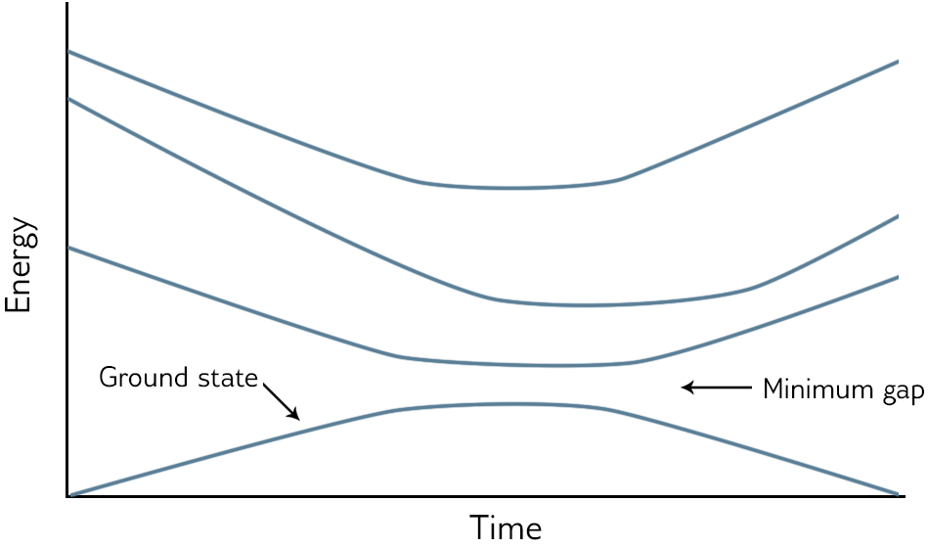
Quantum Annealing
Find global minima to QUBO problems.
Mathematical foundation: Adiabatic Theorem.
Concept: follow the ground state through time.

Slide 3

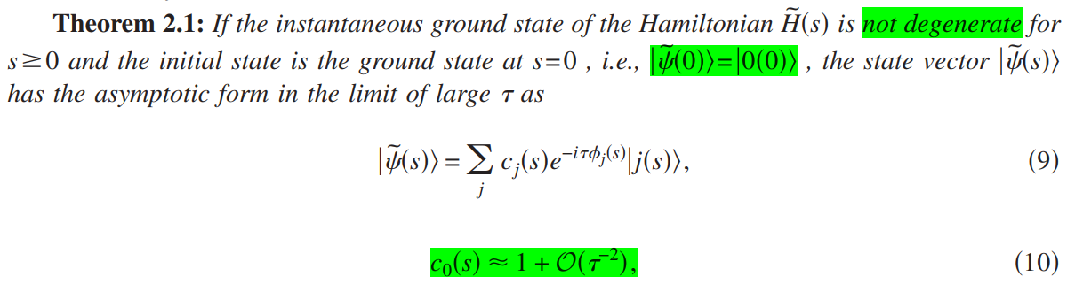
Adiabatic theorem
Morita (2008) Journal of Mathematical Physics 49, 125210 (2008) doi: 10.1063/1.2995837

Slide 4
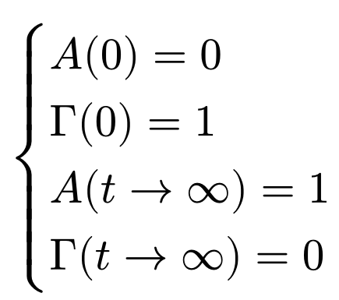
Quantum Ising Spin-glass model
Ground state for H_{I} → hard to find.
Ground state for H_{tf} → easy to obtain.
⇒ Start from H_{tf} ground state and move to the H_{I} one.

Slide 5
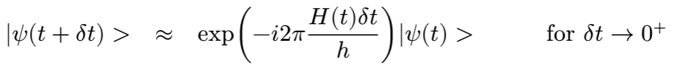

Trotterization
Time evolution operator.
Factorization of a exponential of summed non-commuting operators.
Unfeasible
Easy to calculate:

Slide 6

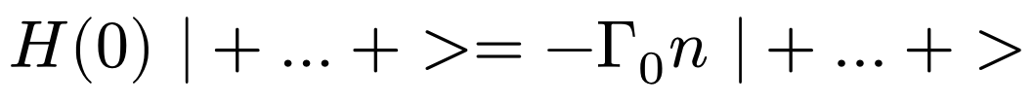
Ground state of T.F. component
Let’s work in this basis:
For our problem this means that the initial ground state is

Slide 7

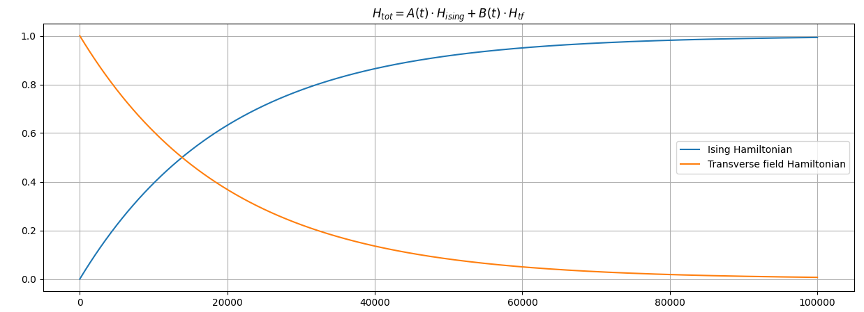
Numerical Setup
5 Qubits
Random weights
Time dependence

Slide 8
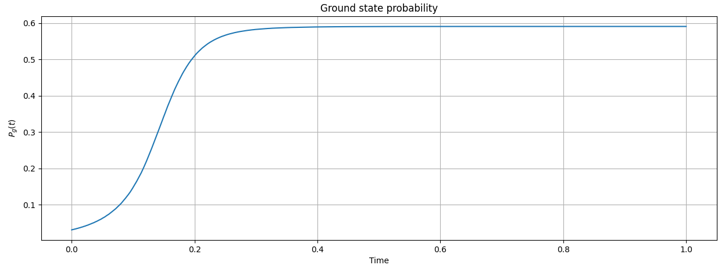
Numerical Results
Ground state emerged (60%).
Local minimum still present.
Too fast initial convergence.
The most of the time nothing changes.

Slide 9
Future Improvements
Slower time dependence.
Exponentials converge too fast.
Higher amount of time steps
Smoother and more accurate time evolution.

Slide 10
Thank you for your attention.
Diego Pesce,
Department of Physics,
Università degli studi di Milano, Milano-Bicocca and Pavia.

