Slide 1
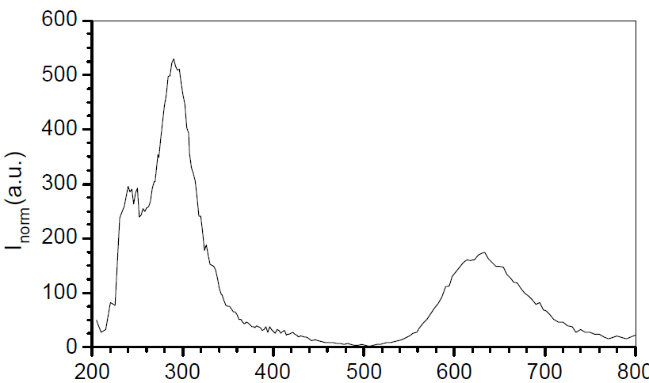
Spectra
(He/CF4: 60/40)

Slide 2
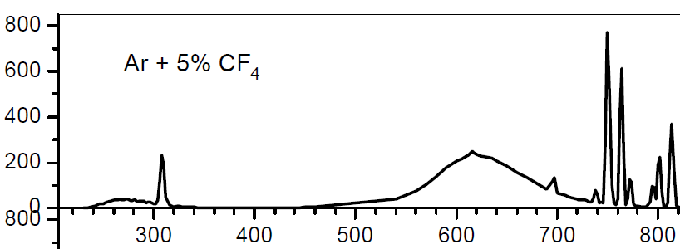

Slide 3


Slide 4
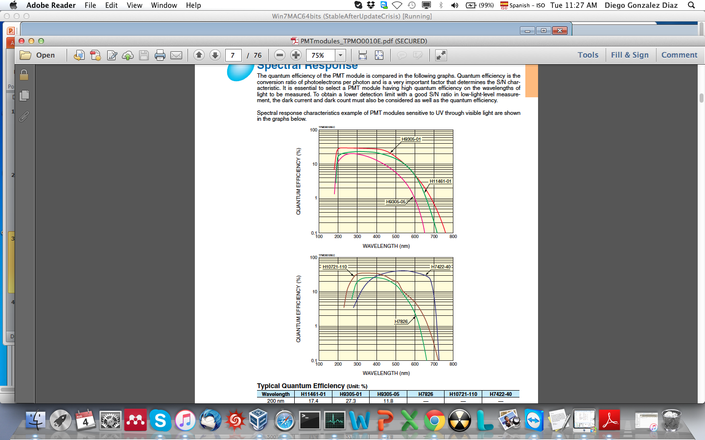
PMT modules (Hamamatsu)

Slide 6
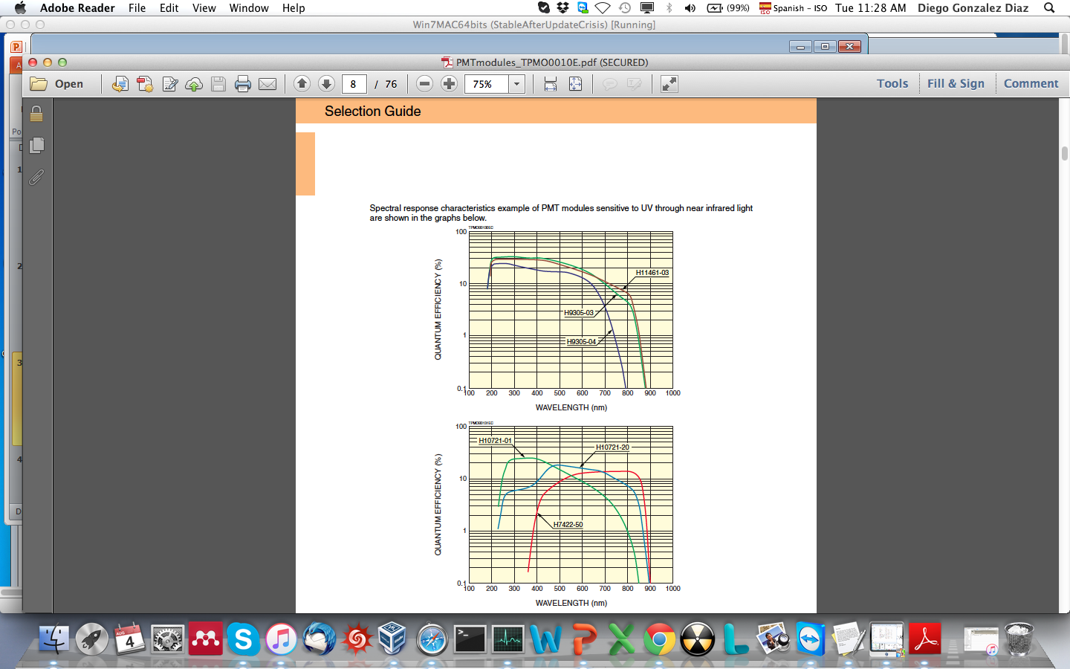

Slide 8
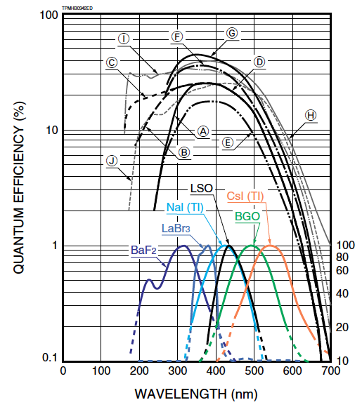
PMT tubes (Hamamatsu)

Slide 9
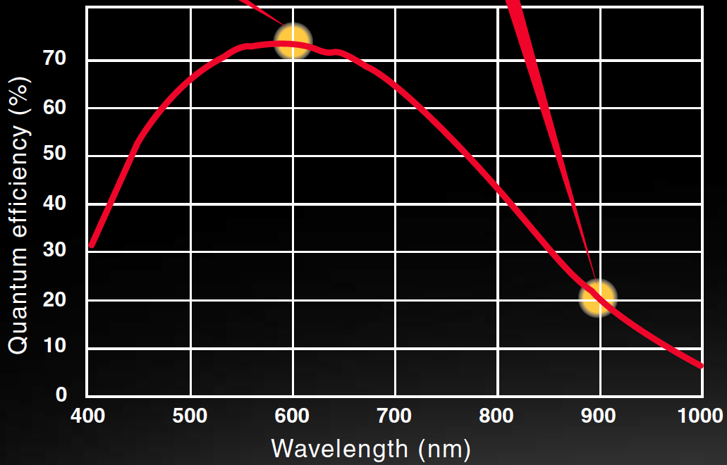
CCD camera

