Slide 1
Algoritmos y Estructuras de Datos 2020
Turno de Práctica - Jueves de 10 a 12:30

Slide 2
Recurrencias

Slide 3
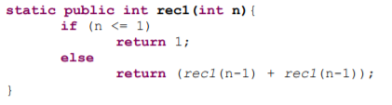
Ejercicio 10 - rec1
c₁ n <= 1
T(n) =
2T(n-1) + c₂ n >= 2

Slide 4
Ejercicio 10 - rec1
c₁ n <= 1
T(n) =
2T(n-1) + c₂ n >= 2
Paso 1: 2T(n-1) + c₂
Paso 2: 2 [ 2T(n - 1 -1) + c₂ ] + c₂ = 2²T(n - 2) + 2*c₂ + c₂ = 2²T(n - 2) + 3*c₂
Paso 3: 2² [ 2T(n - 2 -1)+ c₂ ] + 3*c₂ = 2³T(n - 3) + 4*c₂ + 3*c₂ = 2³T(n - 3) + 7*c₂
Paso i (general): 2^{i}T(n-i) +(2^{i} -1)* c₂
Se reemplaza i en el paso general
2^{n - 1}T(n-(n - 1)) +(2^{n - 1} -1)* c₂ = 2^{n - 1}T(1)+(2^{n - 1} -1)* c₂= 2^{n - 1}*c₁+(2^{n - 1} -1)* c₂
T (n) = (c₁ + c₂) * 2^{n - 1} - c₂
Caso base: n -i = 1
i = n - 1

Slide 5
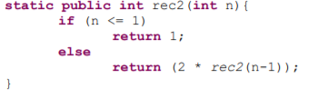
Ejercicio 10 - rec2
c₁ n <= 1
T(n) =
T(n-1) + c₂ n >= 2

Slide 6
Ejercicio 10 - rec2
c₁ n <= 1
T(n) =
T(n-1) + c₂ n >= 2
Paso 1: T(n-1) + c₂
Paso 2: [ T(n - 1 -1) + c₂ ] + c₂ = T(n - 2) + c₂ + c₂ = T(n - 2) + 2*c₂
Paso 3: [ T(n - 2 -1)+ c₂ ] + 2*c₂ = T(n - 3) + c₂ + 2*c₂ = T(n - 3) + 3*c₂
Paso i (general): T(n-i) + i* c₂
Se reemplaza i en el paso general
T(n-(n - 1)) +(n -1)* c₂ =T(1)+(n - 1)* c₂= c₁+(n - 1)* c₂
T (n) = c₂ n + c₁ - c₂
Caso base: n -i = 1
i = n - 1

Slide 7
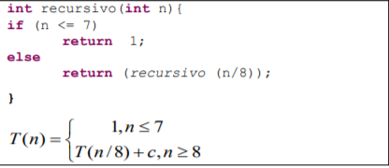
Ejercicio 12
1 n <= 7
T(n) =
T(n / 8) + c n >= 8

Slide 8
Ejercicio 12
1 n <= 7
T(n) =
T(n / 8) + c n >= 8
Paso 1: T(n/8) + c
Paso 2: [ T(n/8/8) + c ] + c = T(n /8²) + c + c = T(n / 8²) + 2*c
Paso 3: [ T(n /8/8/8)+ c] + 2*c = T(n /8³) + c + 2*c= T(n /8³) + 3*c
Paso i (general): T(n/8^{i}) + i* c
Se reemplaza i en el paso general
T(n/8^{log8(n)} ) +(log₈(n))* c =T(1)+(log₈(n))* c= 1+(log₈(n))* c
T (n) = c log₈(n) + 1
Caso base: n /8^{i}= 1
i = log₈(n)

Slide 9
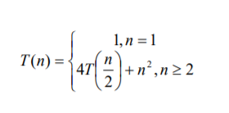
Ejercicio 13
Paso 1: 4T(n/2) + n²
Paso 2: 4[4 T(n/2/2) + (n/2)² ] + n² = 4²T(n /2²) + 4(n/2)² + n²= 4²T(n / 2²) + 2*n²
Paso 3: 4²[ 4T(n /2/2/2)+ (n/2/2)²] + 2*n² = 4³T(n /2³) + 4² (n/2²)²+ 2*n²=4³ T(n /2³) + 3*n²
Paso i (general): 4^{i}T(n/2^{i}) + i* n²
Se reemplaza i en el paso general
4^{log2(n)}T(n/2^{log2(n)} ) +(log₂(n))*n² =4^{log2(n)}T(1)+(log₂(n))* n² = (2^{log2(n)})²*1+(log₂(n))* n²
T (n) = n² +(log₂(n))* n²
Caso base: n /2^{i}= 1
i = log₂(n)

Slide 10
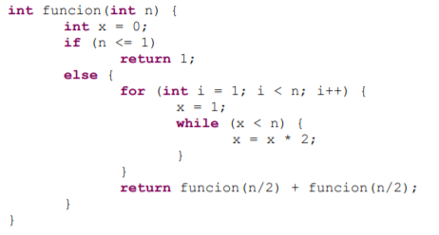
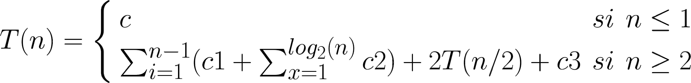
Ejercicio 14
Notes:
T(n)= \left\{ \begin{array}{lcc}
c & si & n \leq 1 \\
\sum_{i=1}^{n-1} (c1 + \sum_{x=1}^{log_{2}(n)}c2) + 2T(n/2)+c3 & si & n \geq 2
\end{array}
\right.

