Slide 1
pomerol
DATA PRODUCT CONSULTING · PROOF OF VALUE
ACME Inc.
Sales & Margin
Data Product
A business-ready analytics product that converts disconnected operational files into trusted margin, revenue and governance decisions.
TRUST
ACTION
SCALE
Source-to-insight lineage
Sales, margin and customer insight
POC-to-production roadmap
Diego Brito
Pomerol · June 2026
ACME Sales & Margin Data Product POC
Pomerol · value-first data consulting · June 2026
01

Slide 2
EXECUTIVE FRAMING
This POC is not a pipeline demo — it is a data product decision.
Pomerol’s value-first approach turns raw data into action: acquire, store, analyze, predict, govern and monitor.
11
$0
0
SOURCE FILES
ORDER REVENUE
AUTOMATED CHECKS
CSV, XML and Excel data existed, but without orchestration, lineage or governance.
The main order revenue column was zero for all orders; sales had to be reconstructed from line items.
Critical source issues were silently affecting every downstream business question.
Consulting position
The outcome is not “we loaded data”. The outcome is ACME now has a governed product for revenue, margin, pricing, budget and risk decisions.
ACME Sales & Margin Data Product POC
Pomerol · value-first data consulting · June 2026
02

Slide 3
PRODUCT ARCHITECTURE
A governed data product built on a Fabric Lakehouse foundation.
The architecture keeps engineering scalable while packaging the output as a business-facing product.
Acquire
Preserve
Govern
Model
Activate
11 files
Bronze
Silver
Gold
Power BI
CSV · XML · Excel
Immutable audit layer
Typed, enriched, controlled
Star/constellation schema
Direct Lake semantic model
Business adoption
Data reliability
Production path
Executive and operational views from a single trusted model.
DQ issues are measured, cataloged and visible instead of hidden.
The POC already identifies what must be hardened before go-live.
ACME Sales & Margin Data Product POC
Pomerol · value-first data consulting · June 2026
03

Slide 4
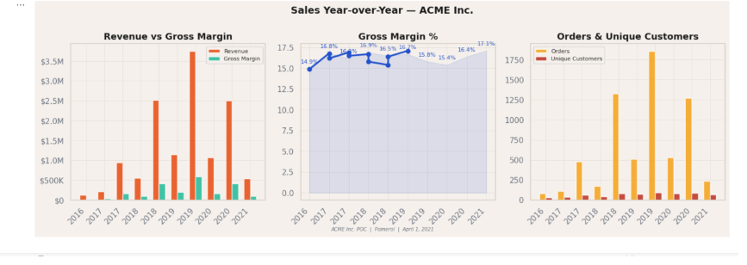
IMMEDIATE VALUE
The model creates executive visibility from day one.
Revenue, gross margin and customer activity become trackable from one governed source.
Sales year-over-year — revenue, margin and order/customer activity
Why this matters
Revenue and margin become comparable across periods.
Customer and order activity can be tracked without spreadsheet reconciliation.
The executive team gets a single version of truth for commercial performance.
Notebook NB_05 visualization
Product message
ACME can now manage revenue and margin as governed KPIs — not as fragile outputs of disconnected files.
ACME Sales & Margin Data Product POC
Pomerol · value-first data consulting · June 2026
04

Slide 5
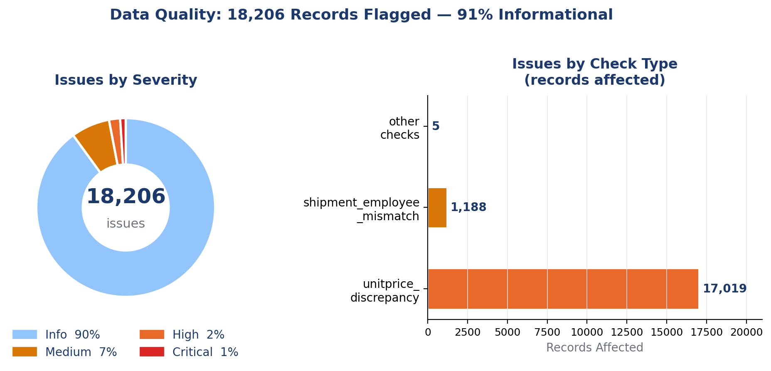
GOVERNANCE VALUE
The product exposed risks before they became executive reports.
Good consulting prevents bad decisions — especially when the data looks usable but is not trustworthy.
Data Quality Summary — issues by severity and check type
6,571
$0 orders
~20%
missing shippers
Revenue recomputed from line items.
Master data incomplete.
1
duplicate DivisionID
17,226
legacy shipment dates
Regional segmentation corrupted.
SLA cannot be trusted yet.
Source: NB_05
Governance principle: data quality is not a side note. It is part of the product experience and the production operating model.
ACME Sales & Margin Data Product POC
Pomerol · value-first data consulting · June 2026
05

Slide 6
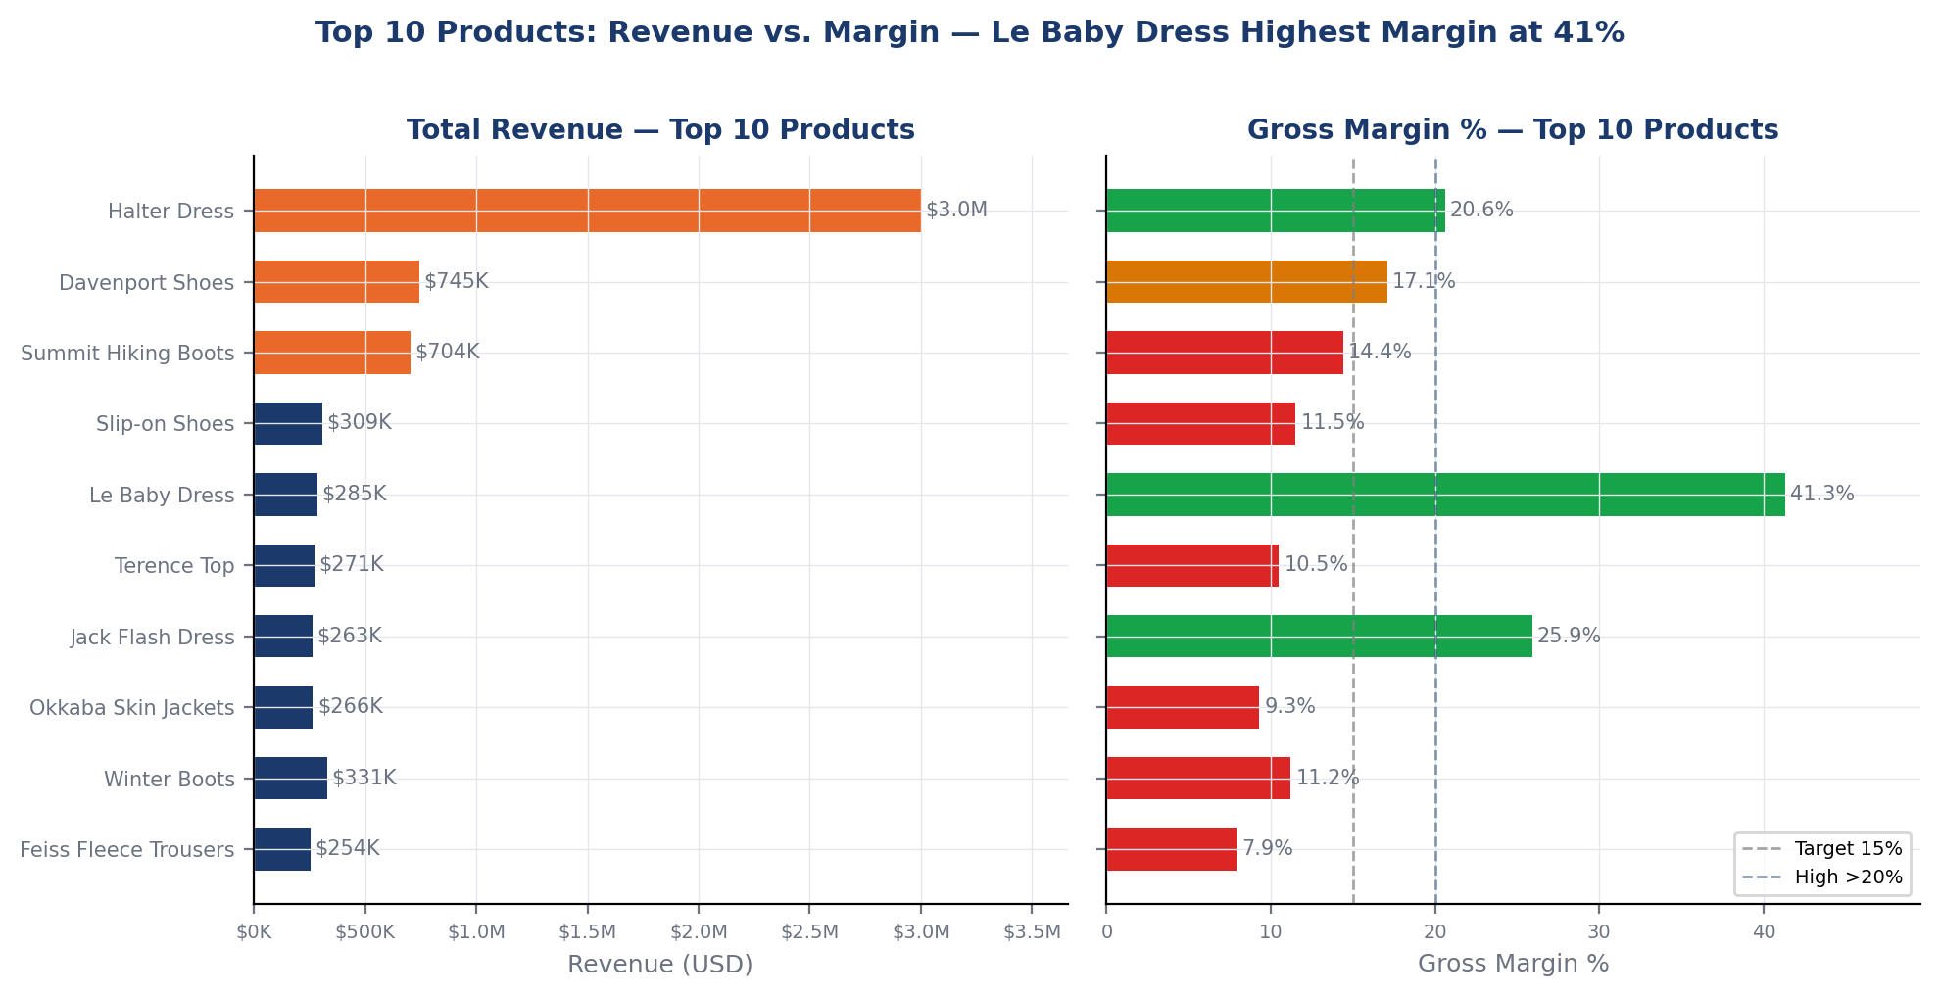
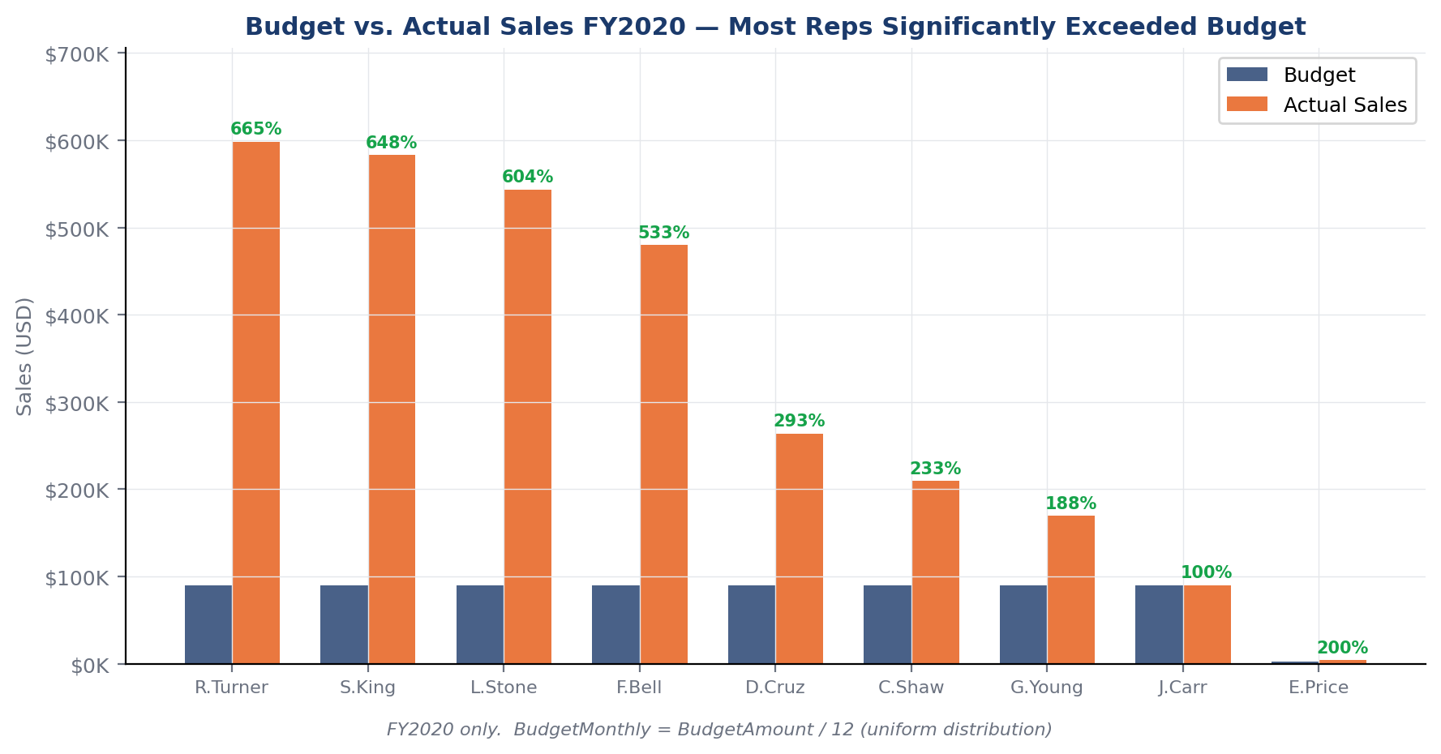
COMMERCIAL PERFORMANCE
The product separates revenue volume from margin quality.
ACME can now prioritize products and sales actions with financial context, not only order counts.
Top products by revenue and gross margin
Budget vs actual by sales rep
Product prioritization
Rep accountability
Sales actions
High revenue products are visible together with margin behavior — essential for category strategy.
Budget-to-actual visibility turns sales targets into measurable performance conversations.
This supports account planning, product focus and campaign activation with measurable outcomes.
ACME Sales & Margin Data Product POC
Pomerol · value-first data consulting · June 2026
06

Slide 7
GOLD LAYER
The constellation schema connects business questions without crossing-line complexity.
Two core fact tables share conformed dimensions; budget and DQ tables extend the product operating model.
FACT TABLE
Date
Customer
Product
Employee
Shipper
Budget
DQ Issues
fact_sales_items
line grain · revenue, qty, margin
fact_orders
order grain · freight, delivery, order value
fact_budget
employee × year · target vs actual
gold_dq_issues
governance grain · check, severity, source
Shared dimensions
Financial logic
Governance logic
dim_date · dim_customer · dim_product · dim_employee · dim_shipper
SalesAmount · GrossMargin · TotalOrderValue
Unknown members · quarantine · DQ issue table
ACME Sales & Margin Data Product POC
Pomerol · value-first data consulting · June 2026
07

Slide 8
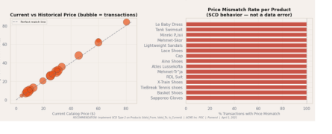
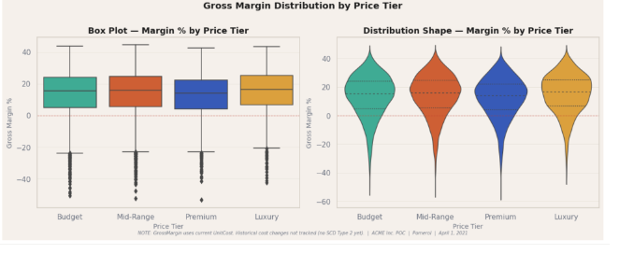
PRICING INTELLIGENCE
Historical price is a product requirement, not a technical preference.
The analysis shows catalog price has changed across the portfolio; margin accuracy depends on price history.
Current vs historical price — SCD pattern evidence
Gross margin distribution by price tier
Recommendation
Implement SCD Type 2 on Products — Valid_From, Valid_To and Is_Current — before relying on historical margin as a production KPI.
ACME Sales & Margin Data Product POC
Pomerol · value-first data consulting · June 2026
08

Slide 9
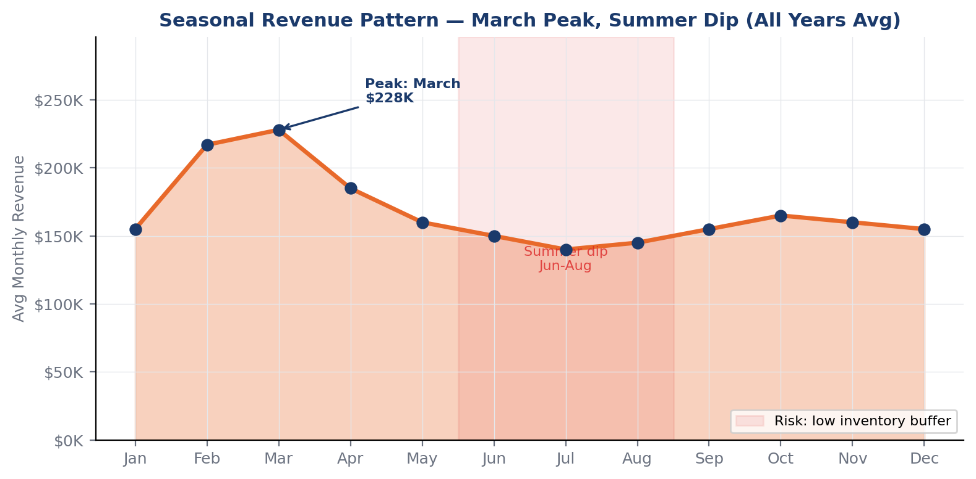
DEMAND PLANNING
Seasonality becomes visible — and operationally actionable.
The product identifies monthly demand patterns that can inform inventory, promotions and working-capital planning.
Seasonal sales pattern — monthly revenue heatmap and average revenue
Business opportunity
Prepare stock before visible demand peaks.
Coordinate pricing and campaign timing with seasonality.
Measure impact directly through the same semantic model.
Inventory planning
Campaign timing
ACME Sales & Margin Data Product POC
Pomerol · value-first data consulting · June 2026
09

Slide 10
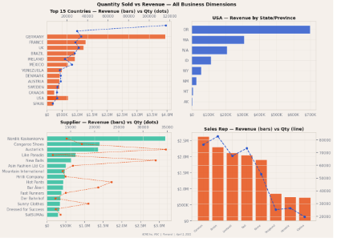
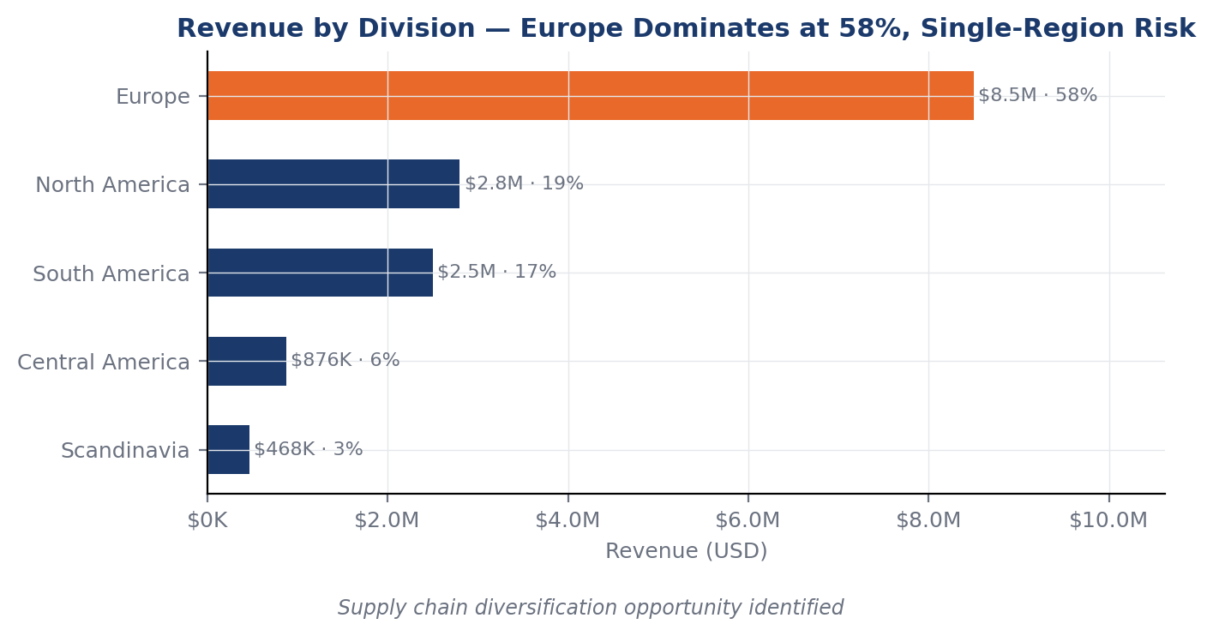
ADOPTION COVERAGE
The product answers executive, commercial and operational questions from the same model.
Coverage is not a list of charts — it is a repeatable decision capability.
Qty sold vs revenue — all business dimensions
Revenue by division — regional concentration
Executive
YTD/LY, revenue, margin, customer activity
Commercial
Product ranking, customer concentration, budget vs actual
Operations
Supplier, geography, seasonality and SLA feasibility
ACME Sales & Margin Data Product POC
Pomerol · value-first data consulting · June 2026
10

Slide 11
GO-LIVE ROADMAP
Two horizons: fix decision blockers, then scale the product.
This is how the POC becomes a production-grade ACME data product.
Before go-live
Next sprint
1
Fix DivisionID = 2
5
SCD Type 2 on Products
Remove dependency on engineering workaround for geography.
Enable historical margin and pricing intelligence.
2
Register ShipperIDs 4 and 5
6
Incremental loads
Complete the master data required for reliable order reporting.
MERGE/UPSERT patterns for production volume.
3
Resolve shipment date anomaly
7
Quarantine alerts
Current SLA reporting is blocked by legacy dates.
Operationalize data quality monitoring.
4
Clarify Freight treatment
8
Adoption layer
Finance must define whether freight belongs in gross revenue or pass-through cost.
Document KPI definitions and report ownership.
ACME Sales & Margin Data Product POC
Pomerol · value-first data consulting · June 2026
11

Slide 12
Executive decision
Approve the production hardening sprint.
The POC proved that ACME’s disconnected files can become a governed, business-facing Sales & Margin Data Product.
Value proven
Risk surfaced
Path defined
Revenue, margin, customer, product and YTD analysis are available from a trusted model.
Data quality blockers are documented before they contaminate executive reporting.
The roadmap is clear: master data fixes, shipment resolution, SCD Type 2 and incremental loads.
Recommended next move: 2-week production hardening sprint focused on data quality closure, pricing history and operationalization.
Diego Brito · Pomerol · June 2026
ACME Sales & Margin Data Product POC
Pomerol · value-first data consulting · June 2026
12

