Slide 1


Slide 2
Purpose and MVP
Target: Casual moviegoers
Entities: Users, reviews, and movies
Build a web application that allows users to:
Search movies
Learn more about movies
Read and write reviews

Slide 3
User Flow and Wireframes

Slide 4
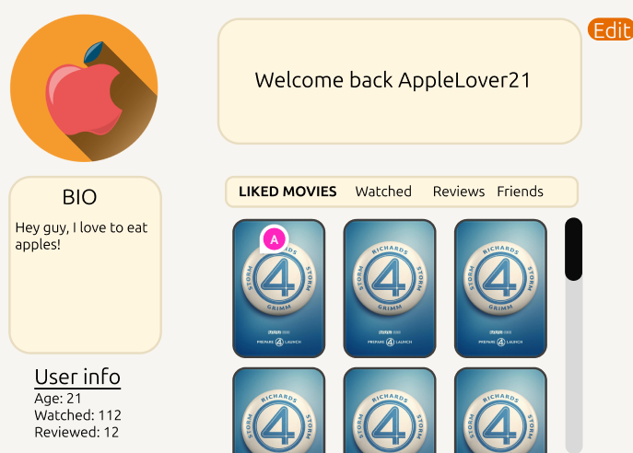
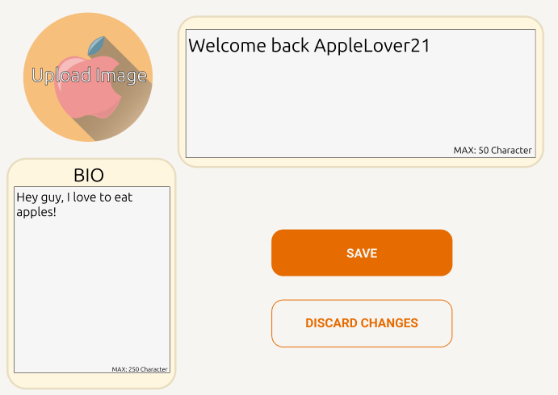
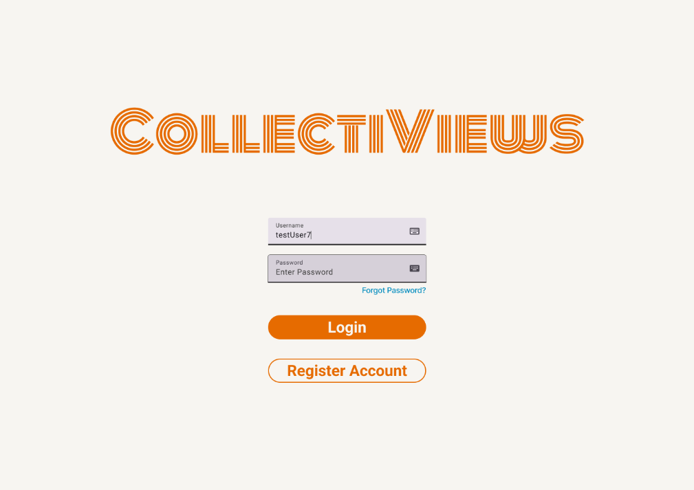
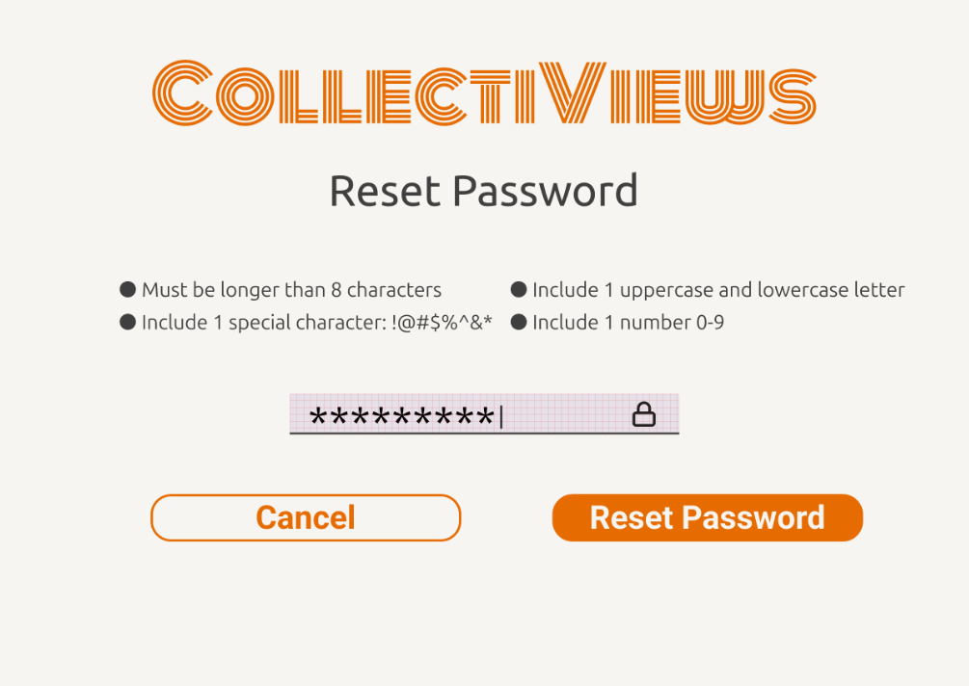
Update profile
Login

Slide 5
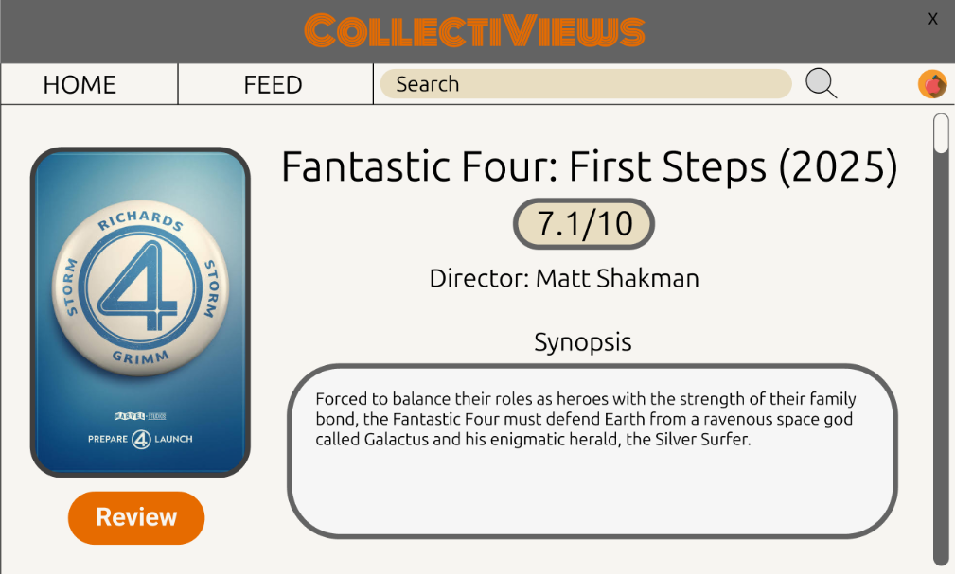
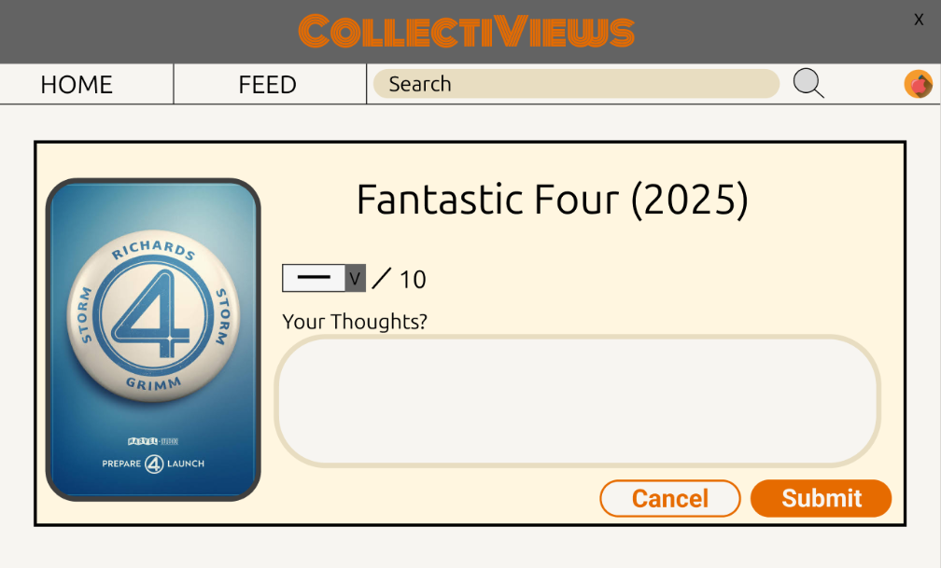
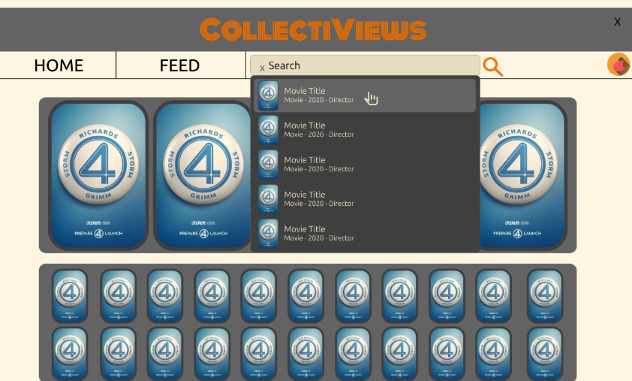
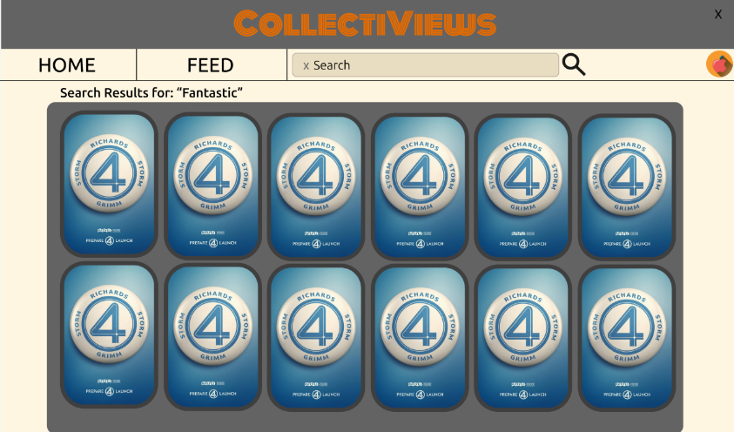
Review
Search

Slide 6
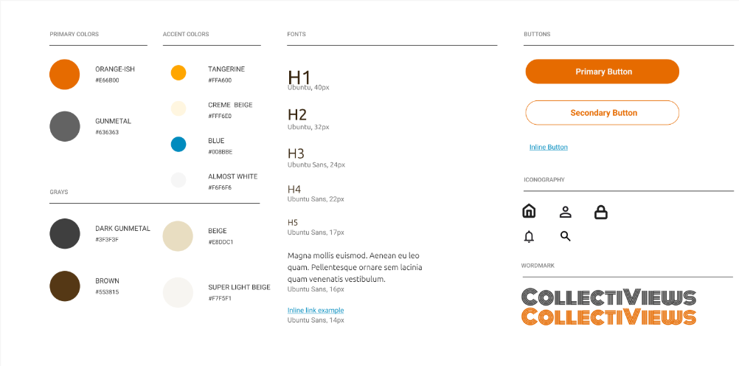
Brand Guide

Slide 7
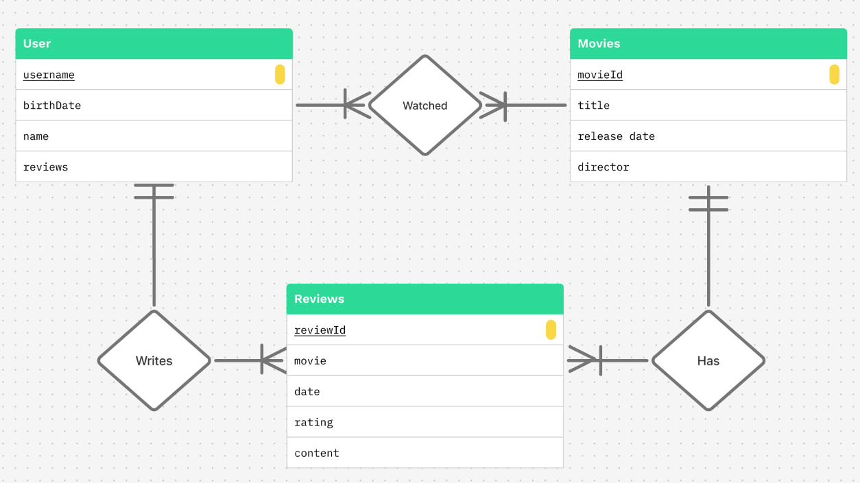
Conceptual Model

Slide 8
API Definitions
Implemented:
User: Get, Put, Post, Delete
Movie: Get, Put, Post, Delete
Movie List: Get, Put, Post, Delete
Review: Get, Put, Post, Delete
Refer to: https://github.com/WSU-kduncan/cs4900-api-fan4/blob/main/homework/homework-2/api-routes.md

Slide 9
CollectiViews DEMO!!!

