Slide 1

Pruebas En Proyecto spring
Angel Escaño
Diego Sicre

Slide 2

Cual es Nuestro Proyecto?

Slide 3

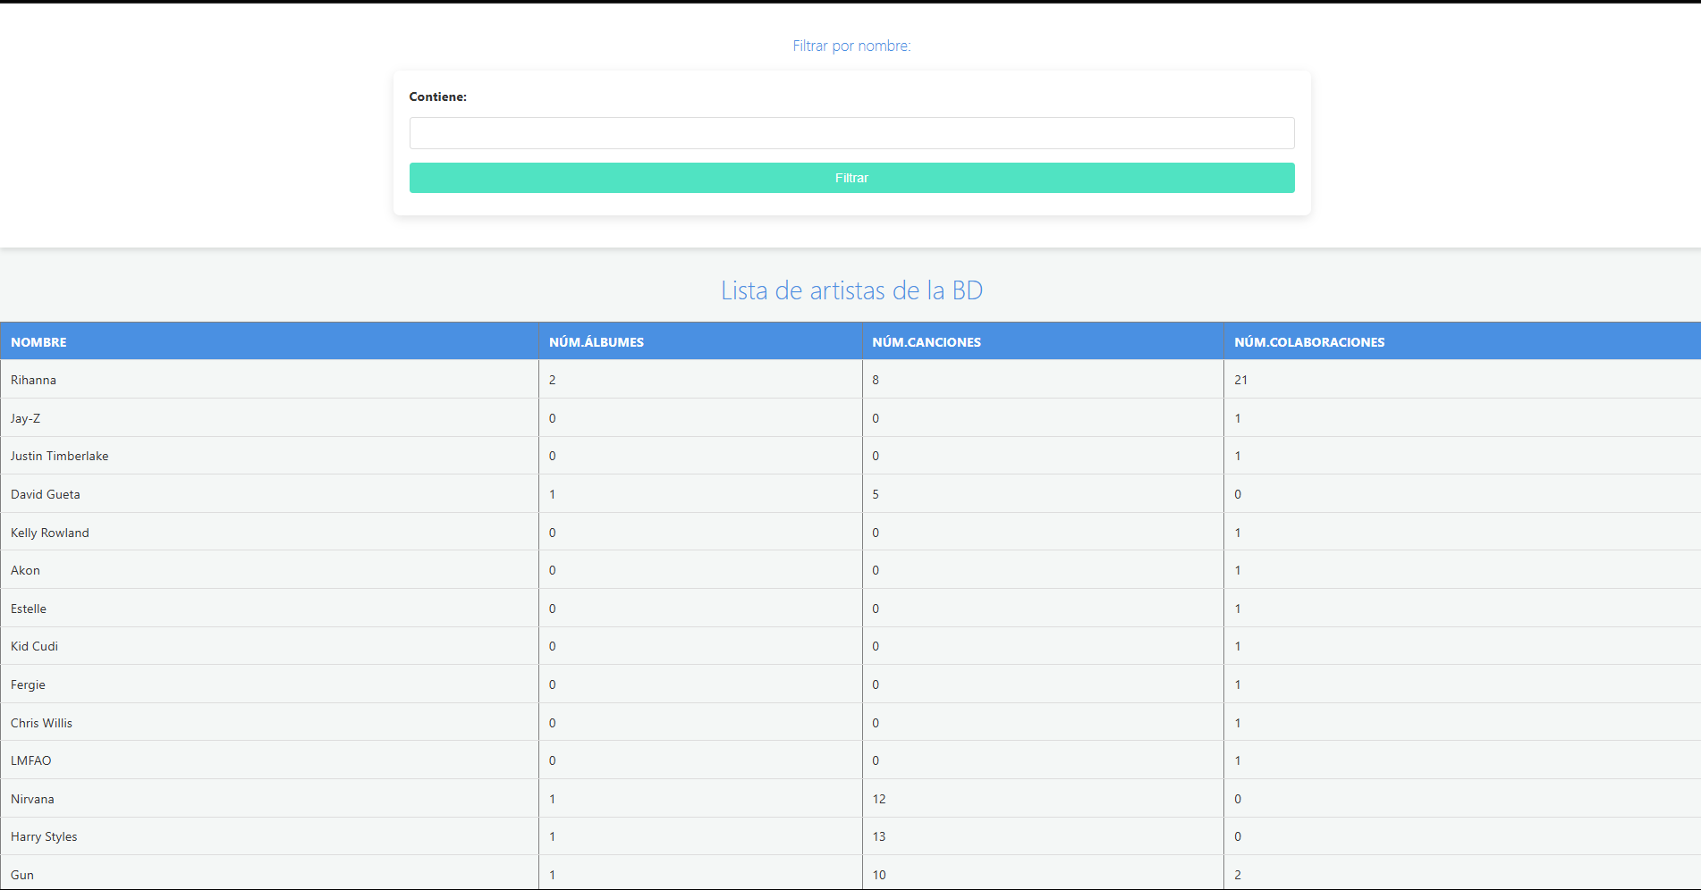
Gestion de canciones en springboot

Slide 4
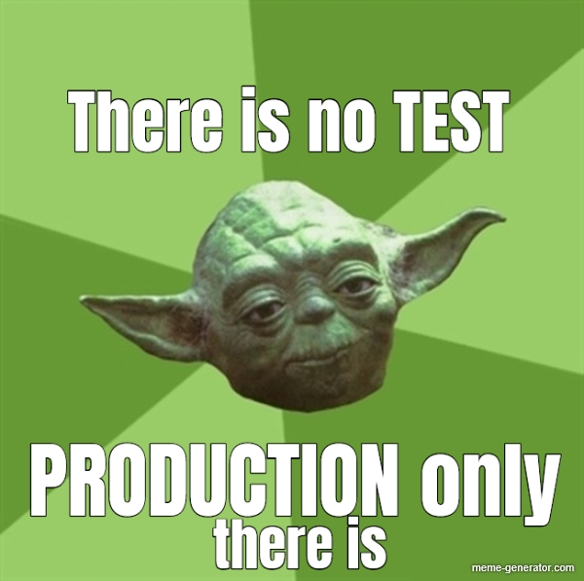
QUE TIPO DE PRUEBAS HEMOS REALIZADO?

Slide 5

PRUEBAS DE CARGA!!

Slide 6
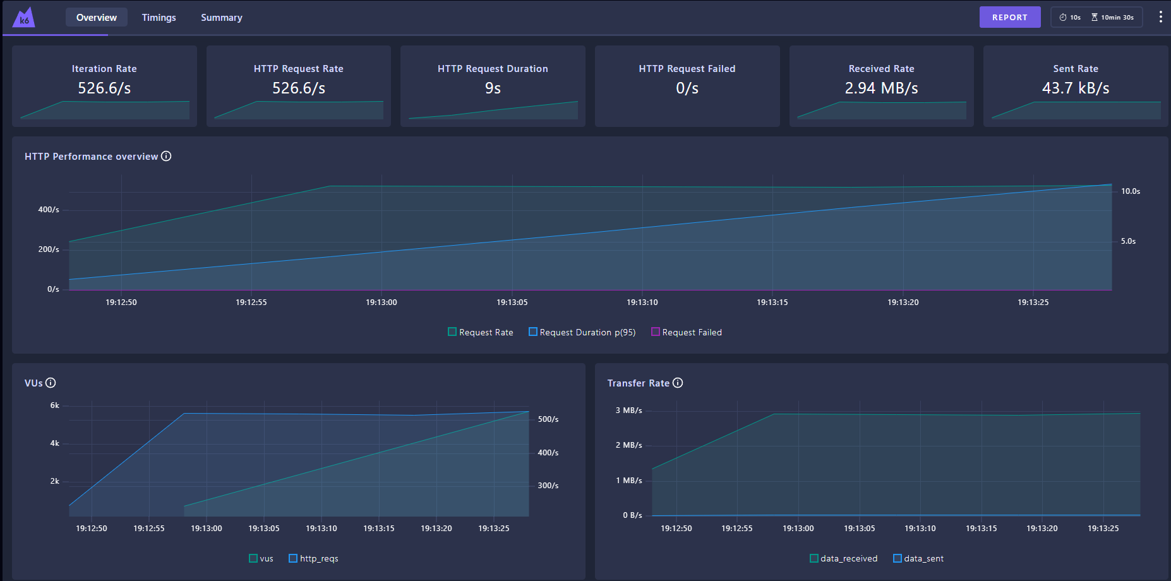
Breakpoint test
import http from 'k6/http'; export const options = { stages: [ { duration: '10m', target: 100000 }, ], thresholds: { http_req_failed: [{ threshold: 'rate<=0.01', abortOnFail: true }], }, }; export default function () { http.get('http://localhost:8080/'); }

Slide 7
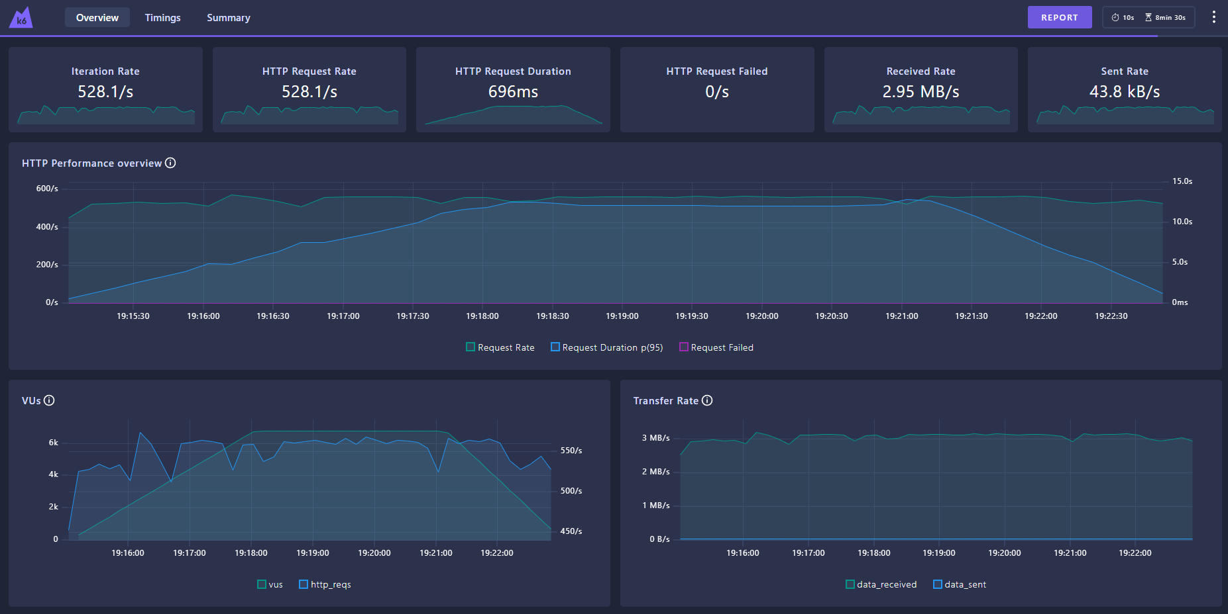
Stress test
import http from 'k6/http'; export const options = { stages: [ { duration: '3m', target: 6777 }, { duration: '3m', target: 6777 }, { duration: '2m', target: 0 }, ], thresholds: { http_req_failed: [{ threshold: 'rate<=0.01', abortOnFail: true }], http_req_duration: ['avg<1000'], }, }; export default function () { http.get('http://localhost:8080/'); }

Slide 8
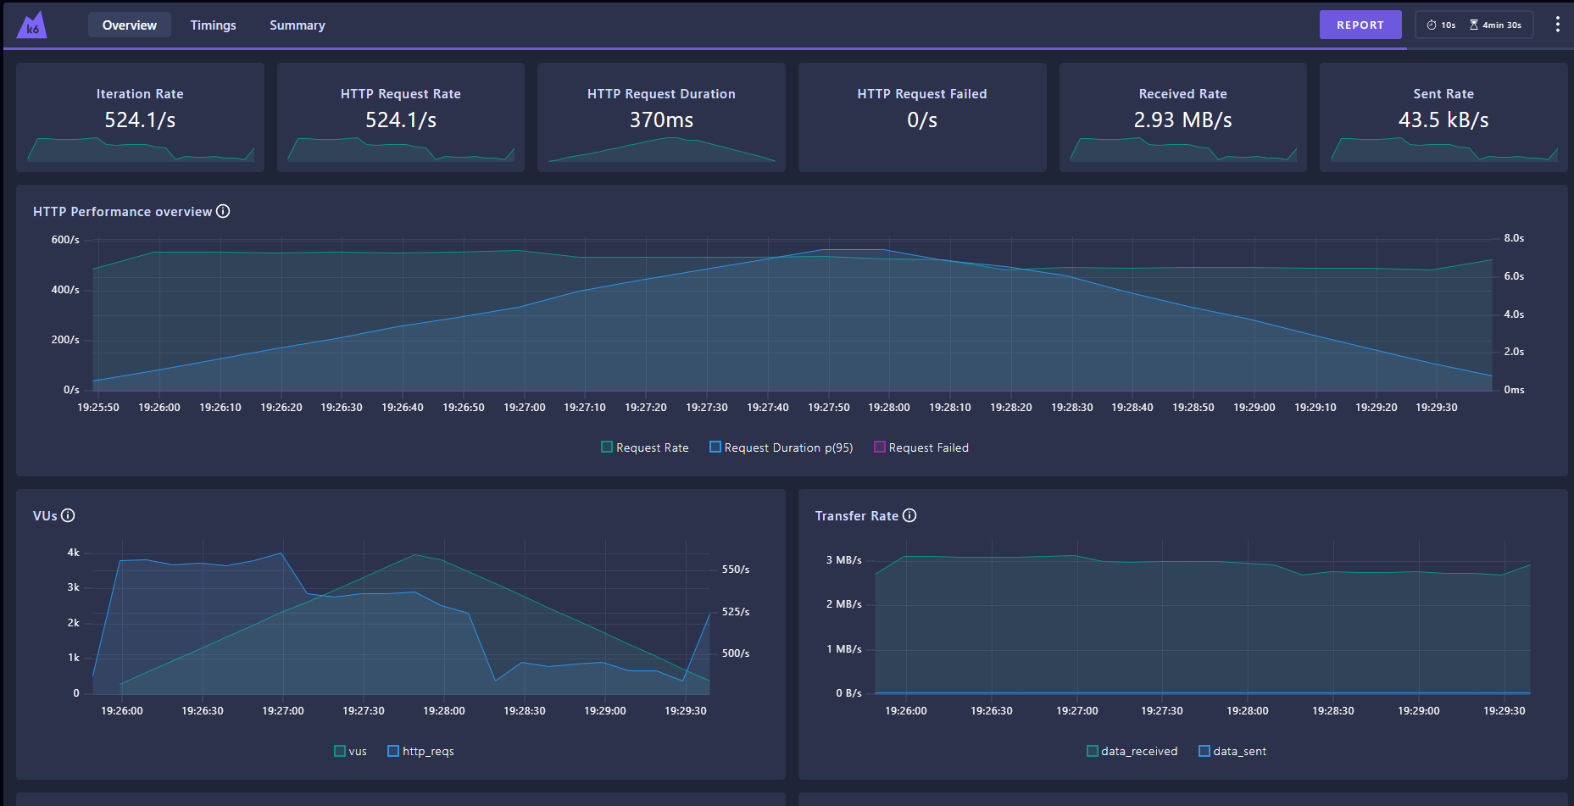
SPIKE TEST
import http from 'k6/http'; export const options = { stages: [ { duration: '2m', target: 4000 }, { duration: '2m', target: 0 }, ], thresholds: { http_req_failed: [{ threshold: 'rate<=0.005', abortOnFail: true }], }, }; export default function () { http.get('http://localhost:8080/'); }

Slide 9
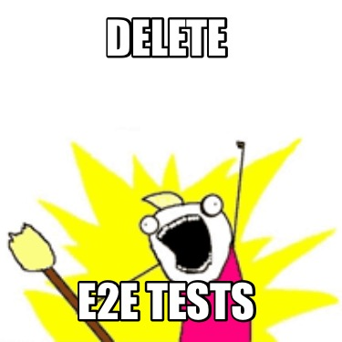
Y Pruebas end to end con playwright!!

Slide 10
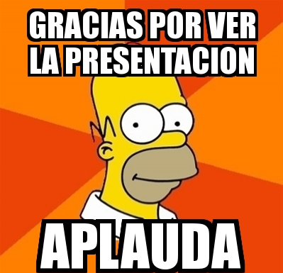
GRACIAS POR VER

