Slide 1
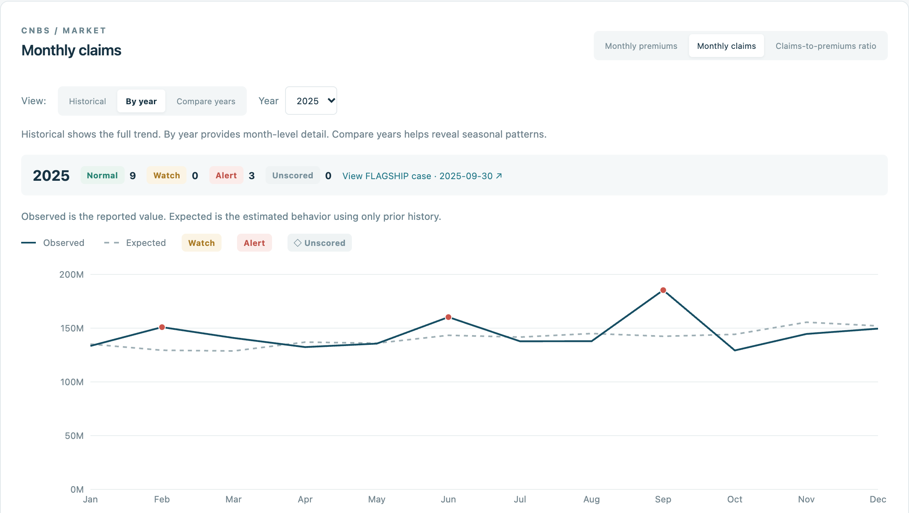
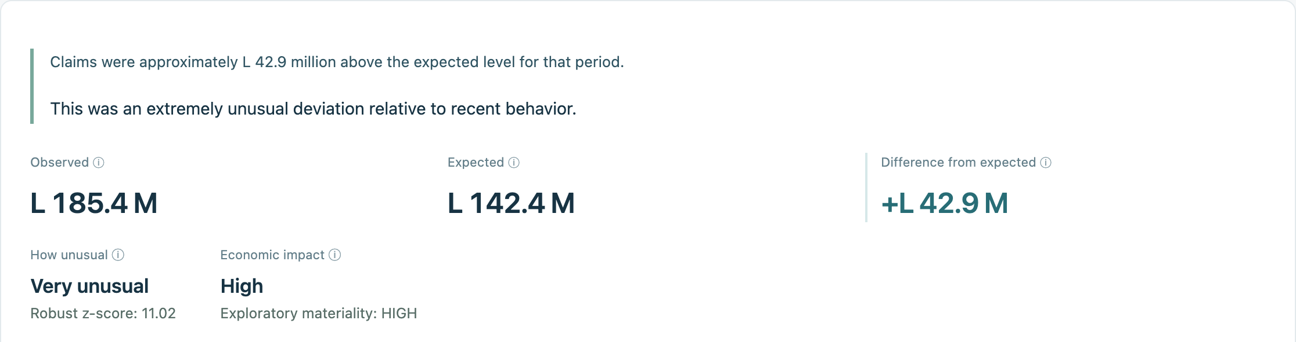
AMD DEVELOPER HACKATHON: ACT III
ACTUARIAL
SIGNAL RADAR
REAL PRODUCT / CNBS HONDURAS
Evolus Business Agents on AMD
We detect first.
AI investigates second.
Humans decide.
Diego Turcios
ACTUARIAL SIGNAL RADAR
CNBS Honduras · Saved analytical outputs · Real application captures
01
Notes:
Most dashboards show what happened. Actuarial Signal Radar asks whether it was unusually different from what we would have expected. It turns official insurance data into a signal an analyst can investigate. The separation is deliberate: we detect first, AI investigates second, and humans decide.
Sources / presenter reference (not for narration):
https://actuarial-signal-radar.diegoturciostc.workers.dev
https://github.com/DiegoTc/o-Actuarial-Signal-Radar

Slide 2
01 / THE PROBLEM
Dashboards tell us what happened.
We ask whether it was unusual.
TRADITIONAL
“What happened?”
A better next question
What was expected?
How different was reality?
Was that difference unusual?
What should we investigate?
MARCH 2025 · CLAIMS-TO-PREMIUMS RATIO
63.91% vs 53.05% · +10.86 pp · z 8.61
Raw NORMAL → adjusted ALERT
ACTUARIAL SIGNAL RADAR
CNBS Honduras · Saved analytical outputs · Real application captures
02
Notes:
Our source is official CNBS Honduras data for motor insurance in national currency. These are monetary monthly accounting aggregates, not accident or claim counts. March 2025 illustrates the value of asking a better question: the raw ratio was normal, but its deviation from trend and seasonality generated an alert. This is not a validated actuarial loss ratio.
Sources / presenter reference (not for narration):
https://github.com/DiegoTc/o-Actuarial-Signal-Radar/blob/main/reports/case-studies/market_ratio_2025_03.md
https://actuarial-signal-radar.diegoturciostc.workers.dev/?metric=claims&view=year&year=2025

Slide 3
02 / EXPLAINABLE DETECTION
Detection happens before AI
We learn what normally happens. Then we measure whether reality was unusually different.
01
02
03
04
05
Prior history
Trend +
seasonality
Expected
Difference
Robust Z
→
→
→
→
Previously available
monthly observations
Direction + recurring
monthly patterns
A reference for
this reporting month
Observed − Expected
(the residual)
How unusual is
that difference?
NORMAL
WATCH
ALERT
Primary: 12-month robust z-score on residuals · Complementary: standard Z, EWMA, two-sided CUSUM
NOV 2020
Large spike, but UNSCORED: insufficient residual history. No marker ≠ NORMAL.
CNBS Honduras · Saved analytical outputs · Real application captures
03
ACTUARIAL SIGNAL RADAR
Conservative two-month availability assumption · Strict point-in-time NOT VALIDATED
Notes:
Using only prior available history, we estimate trend and month-of-year seasonality. Observed minus expected gives a residual. A twelve-month robust z-score checks whether that residual is unusual; other statistics add context. November 2020 remained unscored despite its large spike, because residual history was insufficient. Availability uses a conservative calendar lag, not confirmed release dates.
Sources / presenter reference (not for narration):
https://github.com/DiegoTc/o-Actuarial-Signal-Radar/blob/main/docs/expected-behavior-methodology.md
https://github.com/DiegoTc/o-Actuarial-Signal-Radar/blob/main/reports/dashboard/phase52-validation.md
https://github.com/DiegoTc/o-Actuarial-Signal-Radar/blob/main/docs/historical-replay-methodology.md

Slide 4
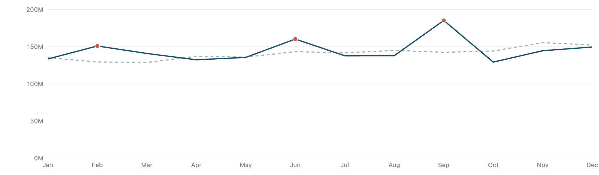
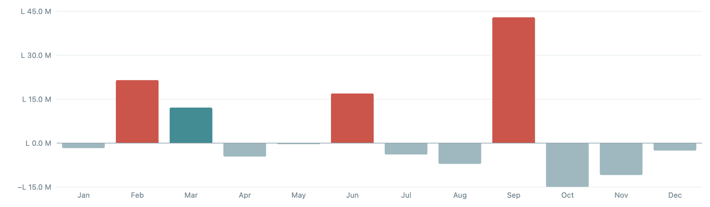
03 / FLAGSHIP · HONDURAN MOTOR INSURANCE
September 2025 triggered the signal
L185.4M
L142.4M
+L42.9M
OBSERVED MONETARY CLAIMS
EXPECTED
ABOVE EXPECTED
OBSERVED VS EXPECTED · 2025
DIFFERENCE FROM EXPECTED · LEMPIRAS
ALERT
+30.15%
Robust Z 11.02 · HIGH exploratory materiality
Reported: 2025-09-30 → Available for analysis (simulated): 2025-12-01
ACTUARIAL SIGNAL RADAR
CNBS Honduras · Saved analytical outputs · Real application captures
04
Notes:
In September 2025, reported vehicle claims were about 185.4 million Lempiras. The historical reference was 142.4 million: nearly 43 million, or thirty percent, above expected. The residual robust z-score was 11.02. This is money, not accident counts. Under our lag assumption, the signal becomes available December first. It warrants investigation; it does not establish a cause.
Sources / presenter reference (not for narration):
https://actuarial-signal-radar.diegoturciostc.workers.dev/cases/market_claims_2025_09
https://github.com/DiegoTc/o-Actuarial-Signal-Radar/blob/main/reports/case-studies/market_claims_2025_09.md

Slide 5
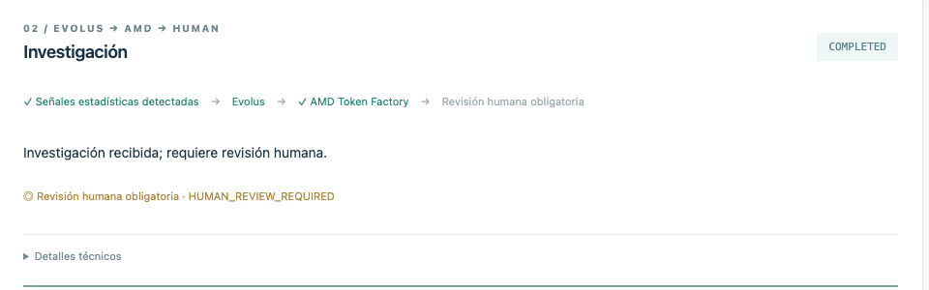
04 / THE ROLE OF AI
Detection and investigation are different jobs
STATISTICS
AI
HUMAN
Is something unusual?
→
What should we investigate?
→
What does it mean?
What should we do?
The AI never creates
or overrides the alert.
Summarize validated evidence
Propose testable hypotheses
Identify missing information
COMPLETED · REAL AMD EXECUTION
Recommend the next checks
Recorded real public run · Spanish output · Human review preserved
HUMAN_REVIEW_REQUIRED
ACTUARIAL SIGNAL RADAR
CNBS Honduras · Saved analytical outputs · Real application captures
05
Notes:
Detection and investigation are different jobs. Evolus and the AMD-hosted model organize what changed, possible explanations, missing evidence, and useful next checks. Hypotheses remain unestablished. The screenshot is a recorded real public execution in Spanish, not a fresh inference. A human must review every accepted result; AI cannot override the signal.
Sources / presenter reference (not for narration):
https://github.com/DiegoTc/o-Actuarial-Signal-Radar/blob/main/docs/investigation-methodology.md
https://github.com/DiegoTc/o-Actuarial-Signal-Radar/blob/main/docs/cloudflare-deployment.md#production-results-and-remaining-blocker

Slide 6
05 / EVOLUS BUSINESS AGENTS ON AMD
A business-agent workflow, not just a chatbot
01 / HANDOFF
EVOLUS
02 / INFERENCE
Validated signal
Actuarial Signal Investigation
AMD
Token Factory
Immutable values
Existing ALERT
Quality + sensitivity context
→
Workflow orchestration
Knowledge Library context
Structured-response validation
Mandatory human review
→
DeepSeek-V4-Flash
OpenAI-compatible
Chat Completions API
6 indexed documents · checksums verified
Structured investigation → HUMAN_REVIEW_REQUIRED
ACTUARIAL SIGNAL RADAR
CNBS Honduras · Saved analytical outputs · Real application captures
06
Notes:
Evolus is central to this partner-track submission. Its workflow receives the validated package, retrieves six indexed domain documents with checksum checks, orchestrates AMD Token Factory inference, and validates the response. DeepSeek-V4-Flash completed our tested investigations more reliably than the evaluated Qwen path, not a general benchmark. We did not validate self-hosted ROCm or vLLM. Native semantic search was not independently validated.
Sources / presenter reference (not for narration):
https://github.com/DiegoTc/o-Actuarial-Signal-Radar/blob/main/evolus/README.md
https://github.com/DiegoTc/o-Actuarial-Signal-Radar/blob/main/amd/README.md

Slide 7
06 / A DELIBERATE METHODOLOGICAL CHOICE
Broad market coverage.
Limited temporal granularity.
HONDURAS
2018–2026
≈100 months
Available motor-insurance market
Historical source snapshot
Per primary time series
An interpretable statistical baseline
Complex detectors could overfit a small temporal sample.
AUDITABLE
REPRODUCIBLE
TRANSPARENT
NEXT, IF RICHER DATA BECOMES AVAILABLE
Claim-level frequency + severity + richer variables → benchmark ML against this baseline.
CNBS Honduras · Saved analytical outputs · Real application captures
07
ACTUARIAL SIGNAL RADAR
Monthly aggregates · Possible source revisions · Exploratory materiality
Notes:
Broad coverage does not mean millions of training examples. This source provides roughly a hundred monthly points per main series. We chose transparent statistics so the same data and configuration produce the same signal. With individual claims, frequency, severity, vehicle characteristics, or repair costs, more complex models could be benchmarked against this baseline. They would not automatically be better.
Sources / presenter reference (not for narration):
https://github.com/DiegoTc/o-Actuarial-Signal-Radar/blob/main/README.md
https://github.com/DiegoTc/o-Actuarial-Signal-Radar/blob/main/docs/expected-behavior-methodology.md

Slide 8
07 / LIVE PRODUCT · HONEST VALIDATION
From public data to a production investigation
CNBS
→
Statistics
→
Cloudflare
→
Railway
→
Evolus
→
AMD
→
Human
VERIFIED IN RECORDED RUNS
✓ Public dashboard
✓ Railway production API
✓ Evolus workflow
✓ AMD Token Factory
✓ DeepSeek-V4-Flash
✓ Mandatory human review
PARTIAL / VERIFIED FOR CLAIMS CASE
Claims completed in ~154 seconds. Ratio retry: “Missing model execution envelope”. Safeguards were not weakened.
We detect first. AI investigates second. Humans decide.
LIVE DEMO
actuarial-signal-radar.diegoturciostc.workers.dev
GITHUB
github.com/DiegoTc/o-Actuarial-Signal-Radar
ACTUARIAL SIGNAL RADAR
CNBS Honduras · Saved analytical outputs · Real application captures
08
Notes:
The product is public on Cloudflare, backed by Railway, Evolus, and AMD Token Factory. The latest public claims investigation completed in about 154 seconds. The ratio retry exposed an execution-envelope failure; we did not weaken validation. This remains a lagged retrospective backtest, not strict point-in-time performance. Public aggregates, possible revisions, exploratory materiality, and transient runtime state remain limitations. Explore the live demo and source code.
Sources / presenter reference (not for narration):
https://actuarial-signal-radar.diegoturciostc.workers.dev
https://github.com/DiegoTc/o-Actuarial-Signal-Radar
https://github.com/DiegoTc/o-Actuarial-Signal-Radar/blob/main/docs/cloudflare-deployment.md

