Slide 1
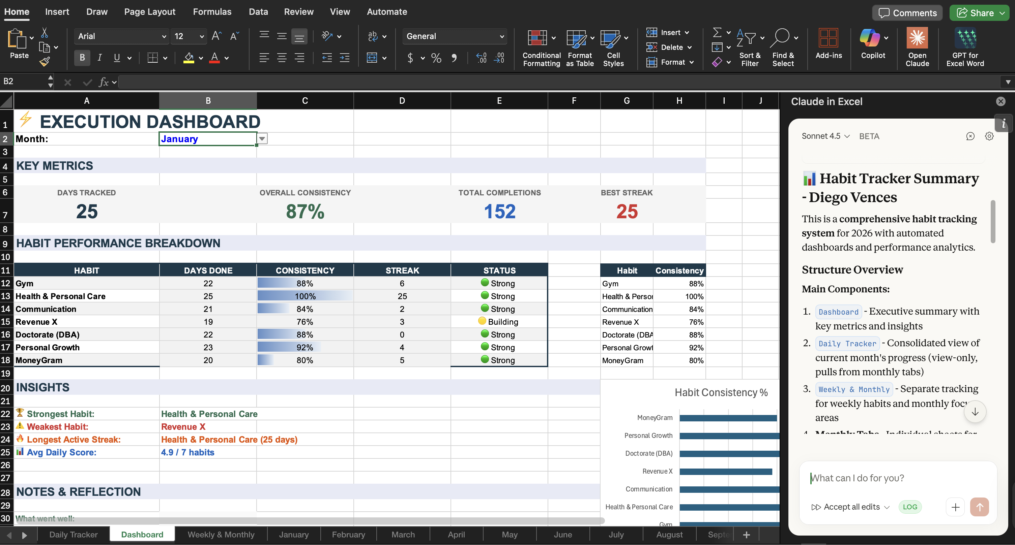
EXCEL
FROM CHECKBOXES → TO PATTERNS
"I used to track habits in rows.
Now I see what's actually working."
→ 87% consistency visible at a glance
→ Claude summarizes structure automatically
@DiegoVences
>>>

Slide 2
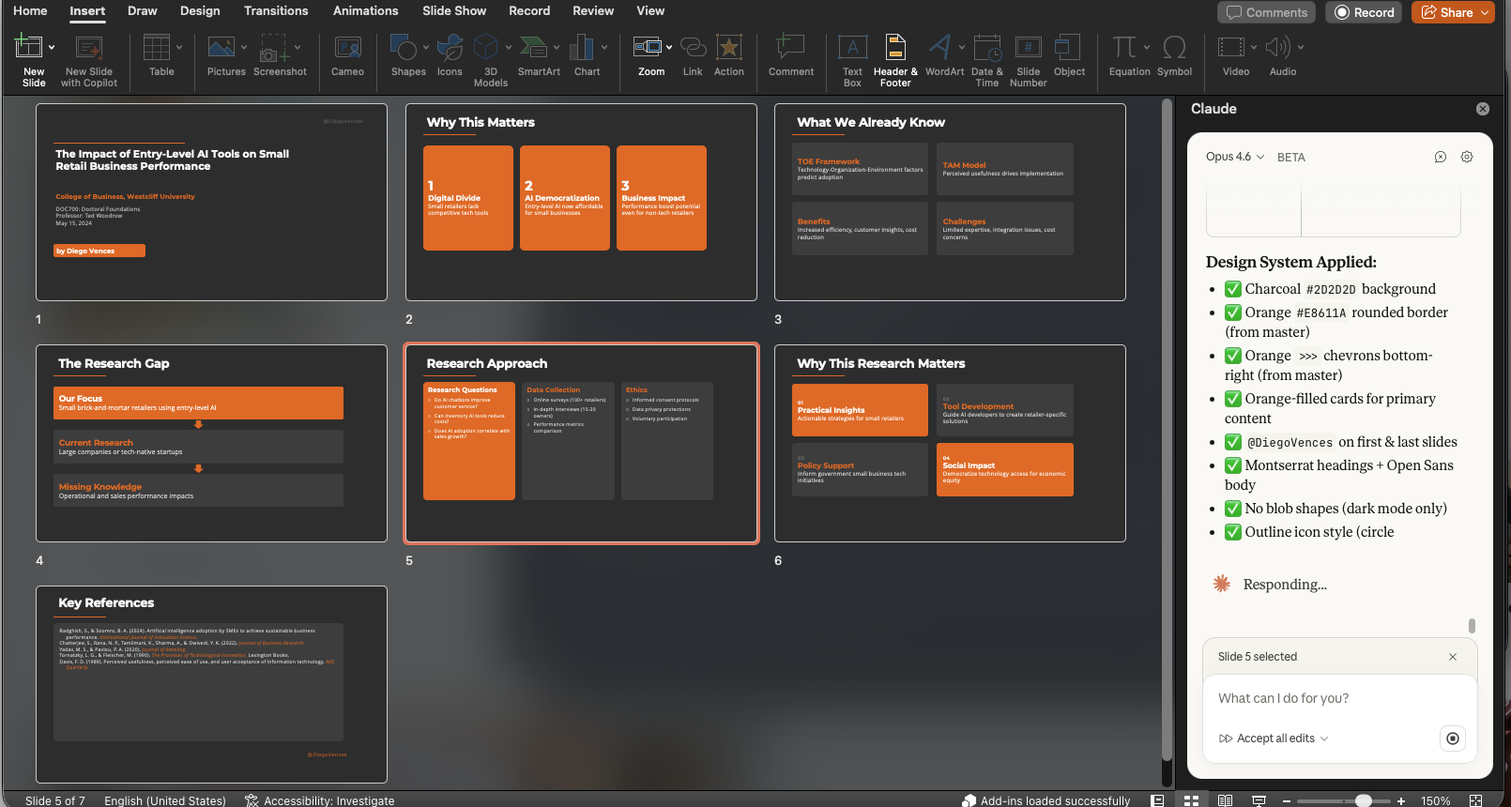
POWERPOINT
FROM MANUAL FORMATTING → TO BRAND LOCK
"Same colors. Every deck.
Without thinking about it."
→ Design system checklist in sidebar
→ Orange + dark mode applied automatically
@DiegoVences
>>>

Slide 3
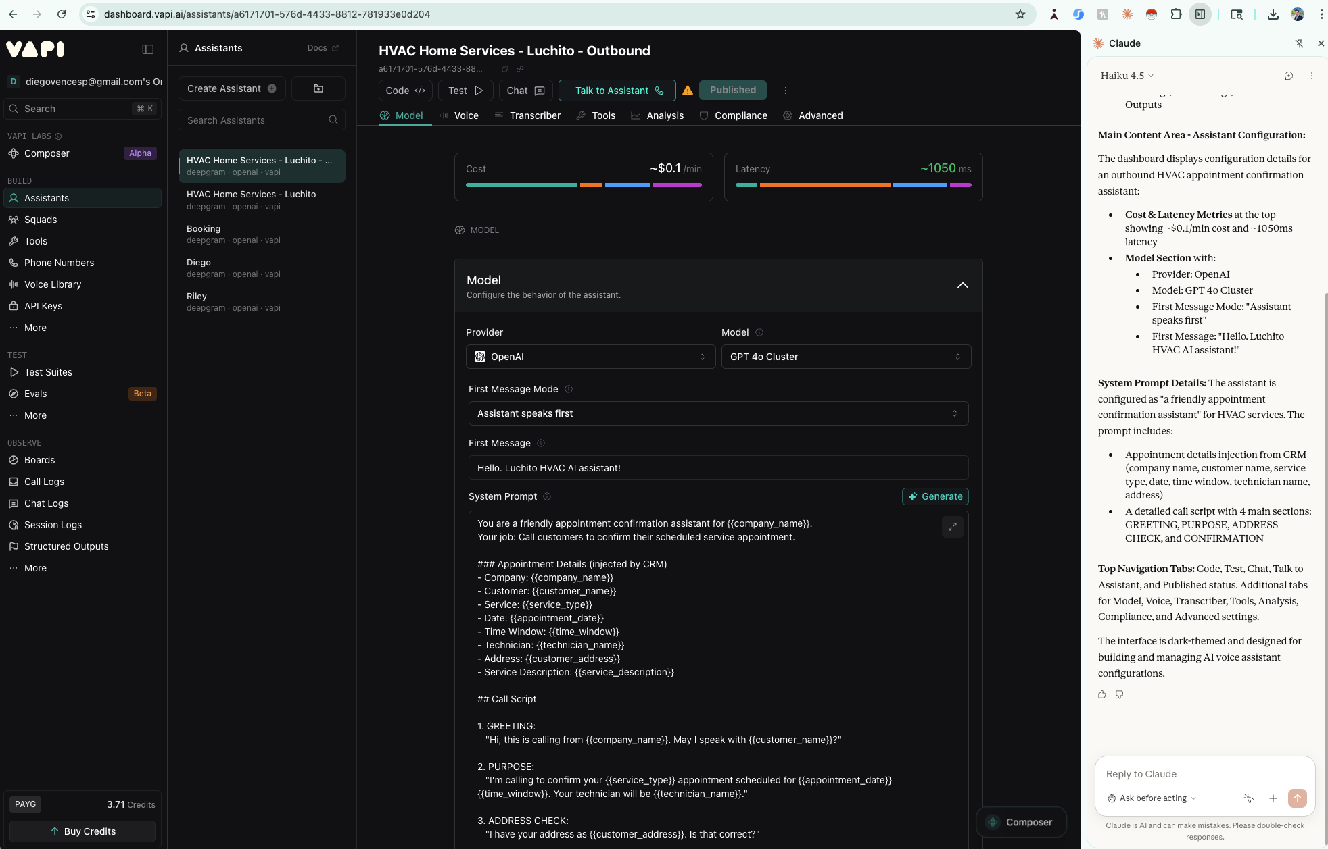
CHROME
FROM STUCK → TO SOLVED
"1 hour debugging.
5 minutes with Claude."
→ Walked me through the Vapi AI fix
→ Claude understands what's on screen
Same work. Less friction.
@DiegoVences

