Slide 1
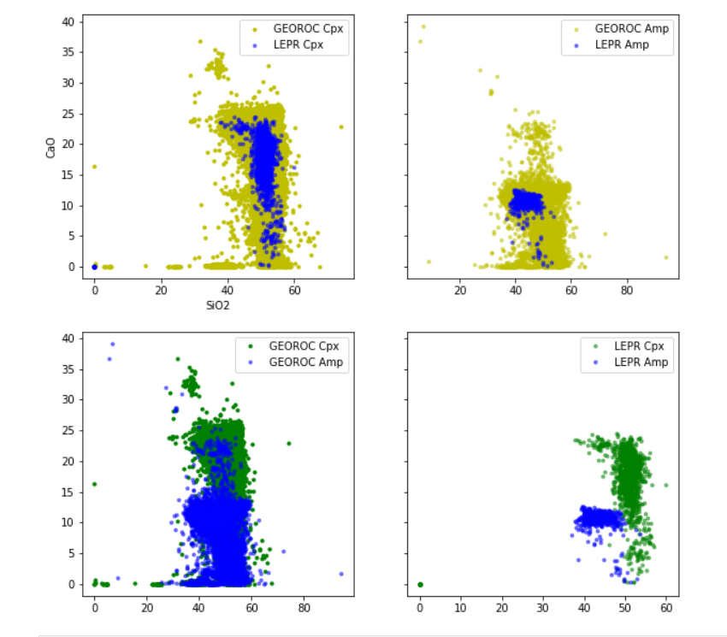
First, compile Cpxs and Amps from LEPR
Do same from GEOROC.
LEPR Cpxs and Amps can be told apart based on CaO and SiO2 alone.
GEOROC cpx have a much bigger SiO2 range compared to LEPR Cpxs
Georoc cpxs also clearly also pigeonites and opxs
GEOROC amps and cpxs almost entirely overlap.
No filters applied here

Slide 2
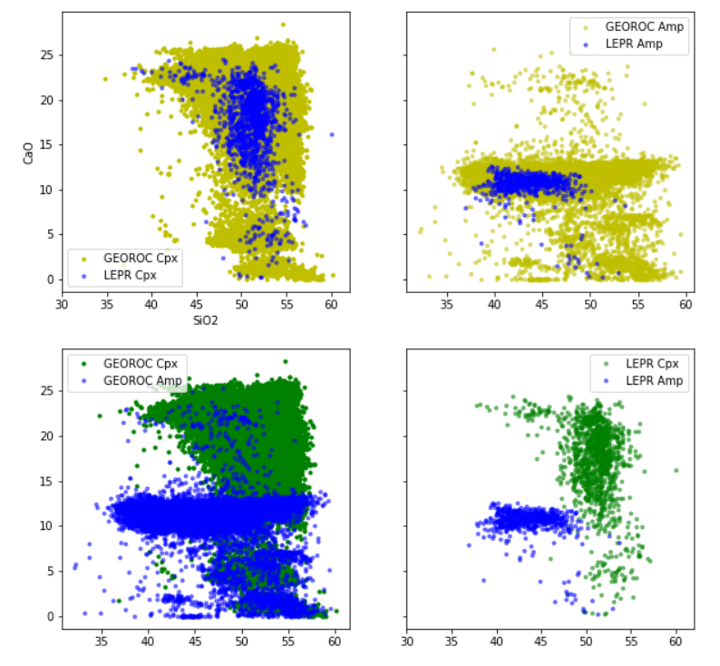
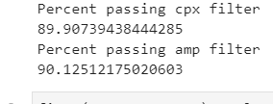
Now apply Cpx filter, 3.95 to 4.05
Amp 15 to 16 sums
Gets rid of some crap
GEOROC Cpx still has much higher SiO2
GEOROC amps have much higher SiO2, wider range of
CaO contents
GEOROC Cpx and Amp still overlap almost entirely in SiO2-CaO space, unlike LEPR.

Slide 3
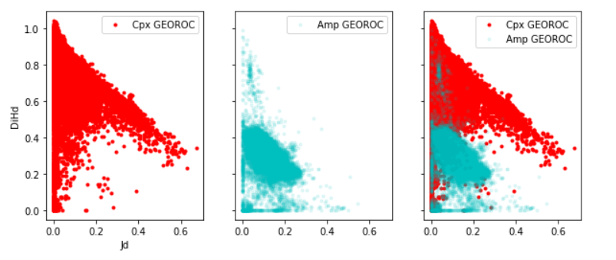
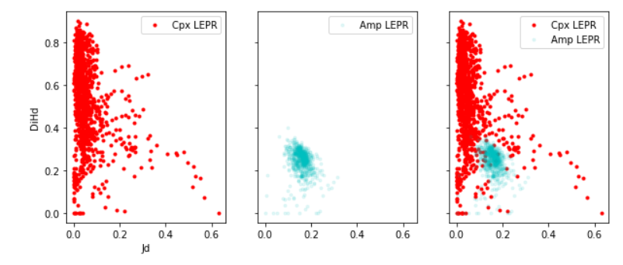
Can calculate Cpx components for all – Say “well could it be Cpx”

Slide 4
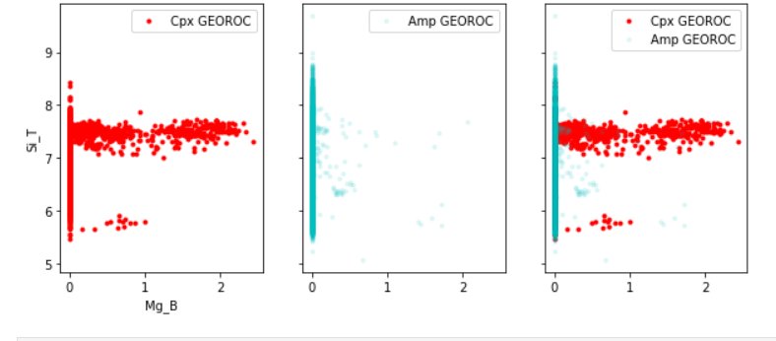
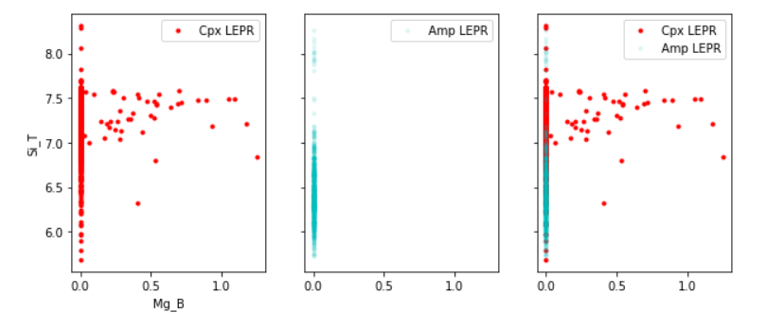
Maybe helps a bit,
As lots more Cpxhave Mg_B>0
And in LEPR, no amps do….

Slide 5
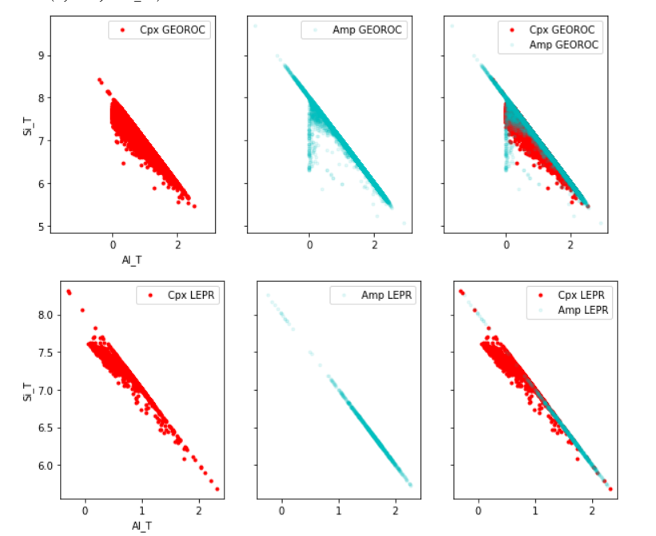
In general Cpxs below line
Lots of overlap

Slide 6
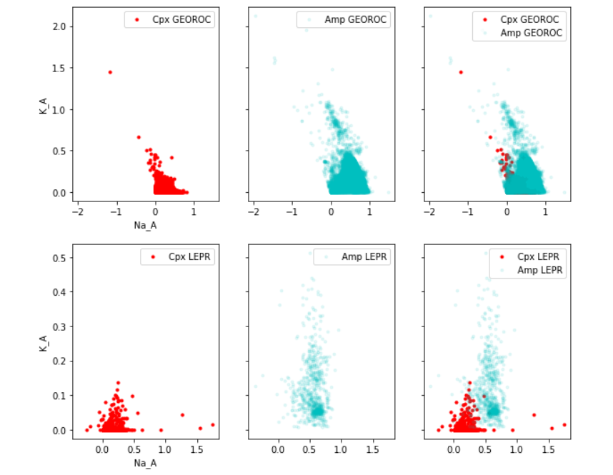

Slide 7
