Slide 1
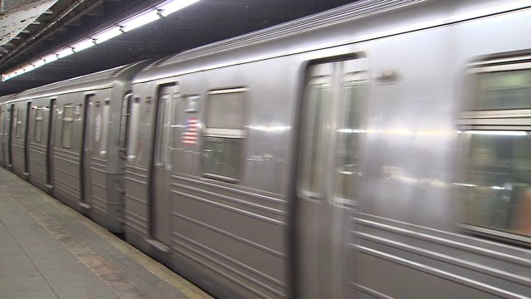
How Will the L Train Closure Impact Commercial Activity?
Maria Ortiz, Manushi Majumdar, Diego Garzon, and Dan Quasney

Slide 2

Background
The Canarsie tunnel connecting the L Train Bedford Ave and 1st Ave stations was damaged by Hurricane Sandy in 2012
200,000 people per day commute using the tunnel
Increased rider volume in recent years requires capacity expansion
5% growth in 2014 alone
MTA plans to combine Sandy repairs and capacity expansion into one project
Highly unfavorable reaction from business community and commuters
Notes:
Our project was inspired by the public reaction to a leaked news story about an impending shutdown of L train service between Brooklyn and Manhattan.
In 2012, during Hurricane Sandy, the Canarsie tunnel that connects Brooklyn and Manhattan was filled with over 7 million gallons of saltwater (imagine 10 olympic-sized swimming pools), and service was suspended for 11 days.
Ridership has grown over 5% in the past years, adding further stress to the precarious state of the L train infrastructure. During daily commutes at peak hours, currently trains are filled beyond capacity.
As such, the MTA needs to add more trains to the line, however, the current state of the tunnel would not allow safe operation.
The MTA has not yet issued formal plans for the shutdown, and the reaction of the business community has been particularly vocal, even forming an advocacy group named the L Train Coalition. (anything in italics is to omit)

Slide 3
Question
Can we quantify the economic impact on businesses around Bedford Avenue Station caused by the closure of the Canarsie tunnel?
The Stakeholders
Merchants associations: Brooklyn Chamber of Commerce
City Agencies: MTA, Small Business Services
Citizenry: Community Boards 1 and 4 in Brooklyn, Permanent Citizens Advisory Committee to the MTA
Notes:
Given this reaction, our main question was how to quantify the impact of the shutdown specifically

Slide 4
Data and Methodology
Method split into four steps:
Estimate the size of the economy in dollars using household expenditures
Estimate foot traffic to the area around Bedford Ave. using MTA turnstile data
Determine the relationship between foot traffic and economy size
Calculate new size of economy of area around Bedford Ave.
Notes:
Method is split into two parts: estimating the size in dollars of the local economy using relevant household expenditure categories and estimating foot traffic to that same area using turnstile exit data provided by the MTA

Slide 5
Data and Methodology
Estimate the size in dollars of the local economy using relevant household expenditures
Estimate Williamsburg economy in relevant expenditure categories - $911M
Healthcare, Apparel, Dining, Entertainment, and Misc.
Estimate economy size within the Bedford radius
Calculate proportion of commercial area within a quarter-mile buffer around Bedford as part of total Williamsburg - 6.5%, or $59M
Data used: American Community Survey (ACS), NYCEDC Economic Snapshot May 2014, DCP MapPluto
Notes:
Method is split into two parts: estimating the size in dollars of the local economy using relevant household expenditure categories and estimating foot traffic to that same area using turnstile exit data provided by the MTA

Slide 6
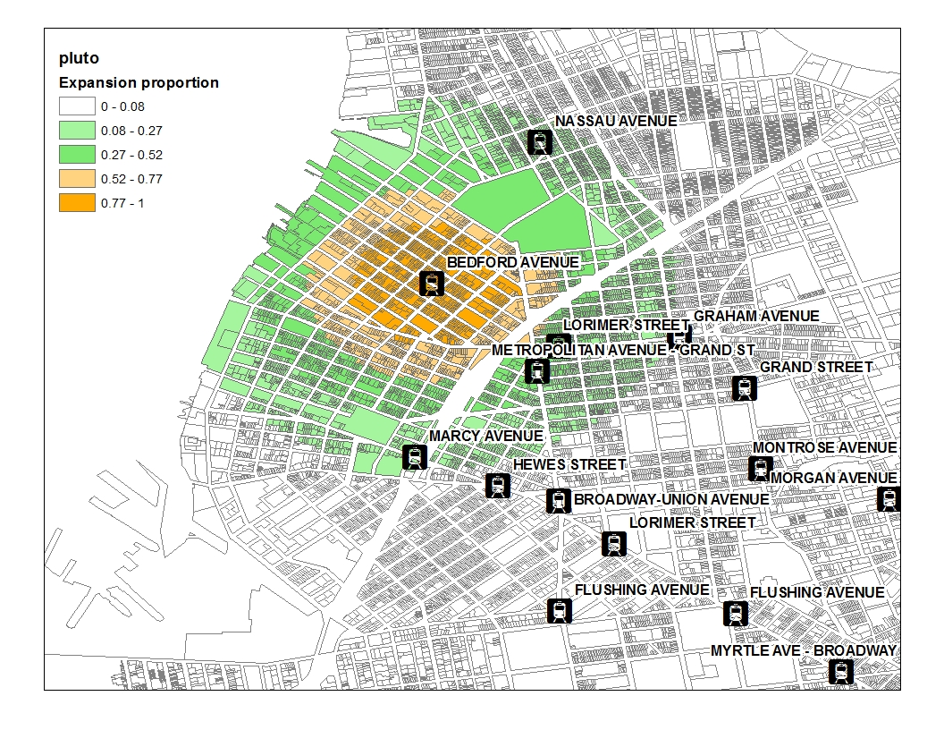
Data and Methodology
2. Estimate foot traffic to the area around Bedford Ave. using turnstile exit data provided by the MTA
Calculate average daily turnstile exits for the five nearest stations within our study area.
Estimate the percent contribution each station has to foot traffic around Bedford Ave. depending on distance
Data used: MTA turnstile from 1/31/2015 to 3/4/2016, distances from Google Earth

Slide 7
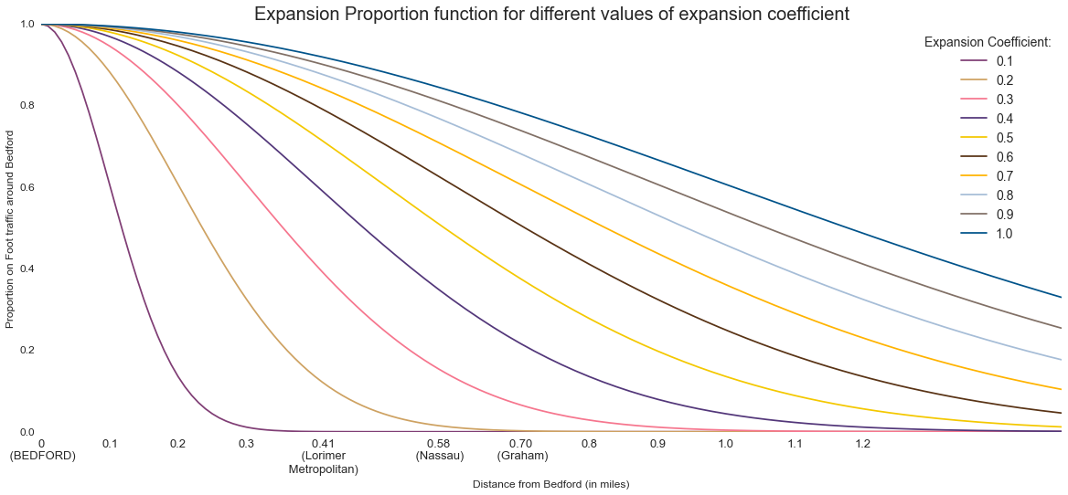
Data and Methodology
Notes:
NOTE: CURRENT MODEL DOES NOT MEASURE FINANCIAL IMPACT; further research and development necessary
Assumes many of the goods sold in small businesses in Williamsburg have highly elastic demand and are non-essential, meaning that people would not go out of their way to buy them if it was inconvenient

Slide 8
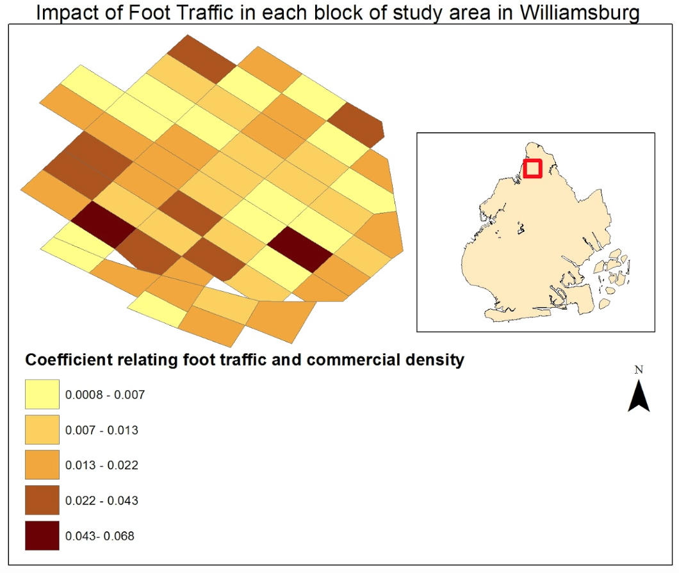
Data and Methodology
3. Determine the relationship between foot traffic and economy size
Estimate the relationship between foot traffic and commercial area in each census block.
Estimate the reduction in commercial density caused by reduction of foot traffic
After the shutdown, Bedford Ave will lose all of its traffic from Manhattan (42%)
Data used: NYC PLUTO 2015, LEHD
Notes:
Don’t say Williamsburg or economy each block is treated differently, because as we see the map, the relationship b/w ft & ca is not homogenous across the census blocks. LEHD J2J gives the 42%

Slide 9
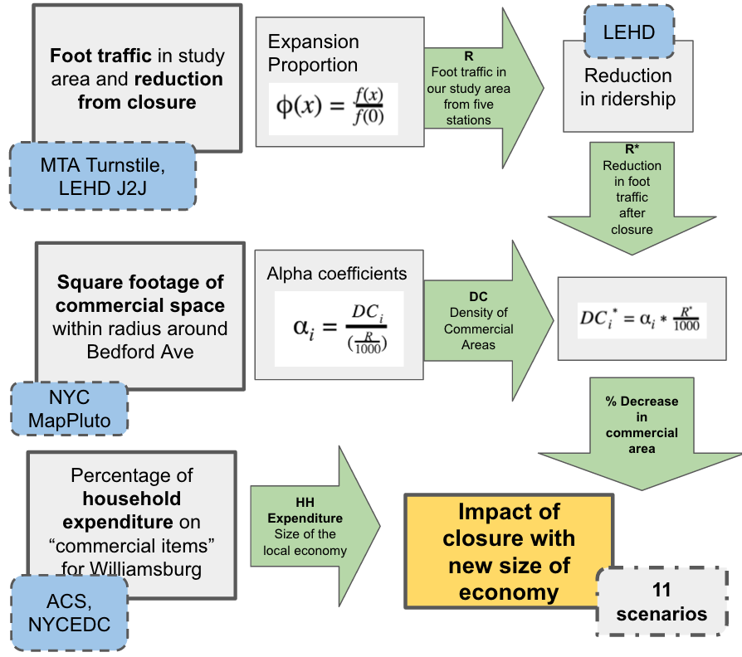
Methodology Overview
Notes:
11 scenarios - 0% supported by public transport
Quarter mile radius around Bedford Av

Slide 10
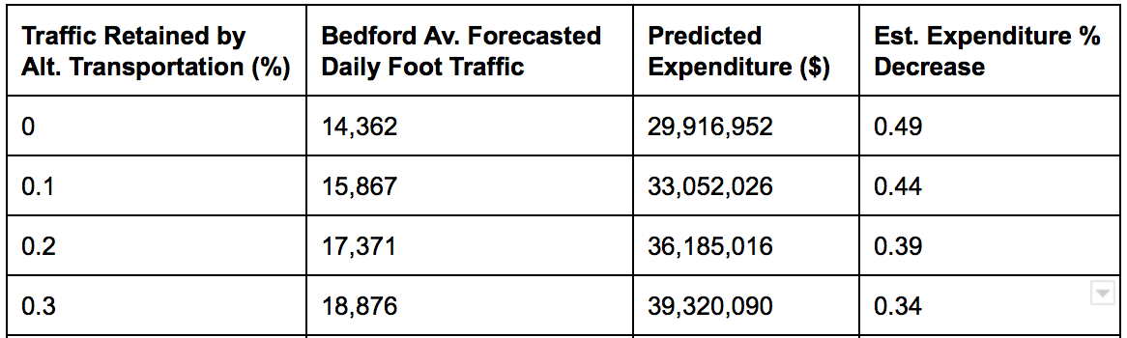
Results
4. Calculate new size of economy of area around Bedford Ave. using the reduced commercial area and foot traffic
All scenarios use an expansion coefficient of 0.3
Each 10% of riders accommodated reduces the economic impact by 5%

Slide 11
Results
We cannot predict which businesses might close or why
Local business environment is highly diverse, and firms fail for many reasons
No financial disclosures publicly available for private businesses
The model calculates a net economic impact
Some businesses may thrive if consumers previously preferred to buy outside of Williamsburg, but are now unable
Notes:
The model estimates the decrease in local economic activity as a function of foot traffic in the area

Slide 12
Conclusion
Outcome:
Model that uses open data to present possible outcomes of economic impact based on the proportion of people able to visit the area after a station shutdown
Can be applied to any part of the city serviced by the MTA subway network
Limitations:
Assumes causation between commercial area, foot traffic, and economy size
Vulnerable business types not measured
Future work:
Evaluate and adjust assumptions after shutdown project is finished
Modify the methodology to incorporate length of shutdown
Replicate model in Excel to increase accessibility and ease of use
GitHub Repository: github.com/DQOfficial/usi_L_train
Notes:
By adding average number of customers, demographic variables and having a more detailed look at impact by business type, the model could further incorporate context specific changes.

