Slide 1

Milestone 1
Michael Kelly | Keith Johnson | Eric Wells
Faculty Sponsor: Dr. William H. Allen

Slide 2
Milestone 1
 | % Complete | Michael K. | Keith J. | Eric W.
Requirements Document | 100% | 33% | 33% | 34%
Design Document | 100% | 33% | 33% | 34%
Test Plan | 100% | 33% | 33% | 34%

Slide 3
Requirements Document
Goal: SNES games in browser
Stakeholders: Ourselves and Dr. Allen
Users
Developers
Game Enthusiasts
Casual Gamer

Slide 4
Requirements Document
Functional
Load ROMs from Server or Client
Save / Load game save data
Input
Usability
Simple Interface
Configuration options

Slide 5
Requirements Document
Performance
Smooth visuals and input
Look and Feel
Java Applet
Customizable size
Legal
Does not distribute ROMs

Slide 6
What we know about the SNES
255 CPU Opcodes (+1 Reserved)
24-bit Memory Addressing, 16-bit Registers
Separate Sound CPU (8-bit SPC-700) w/ DSP
PPU generates graphics from VRAM
Memory layouts: LoROM and HiROM
Cartridge layout / header info
> 30 megabytes of documentation (> 700 files)

Slide 7
Design Document – System Overview

Slide 8
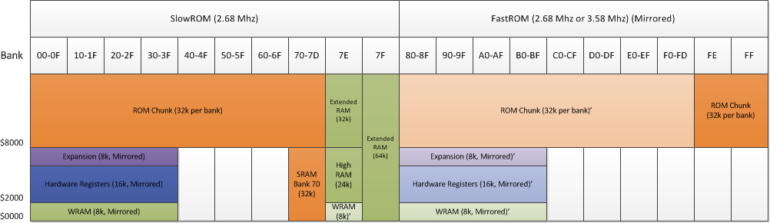
Design Document – Memory Map

Slide 9
Test Plan
Play testing using ROMs
Unit testing using Junit
Automated, easy to track
Allows refactoring with no fear
EMMA for Code Coverage
Scenario tests for each requirement
FindBugs to analyze source code

Slide 10
Milestone 2
 | Michael K. | Keith J. | Eric W.
Partial CPU Emulation | 33% | 33% | 34%
Basic Applet Frontend | 33% | 33% | 34%
Read ROM from Client | 33% | 33% | 34%
Memory implementation | 33% | 33% | 34%

Slide 11
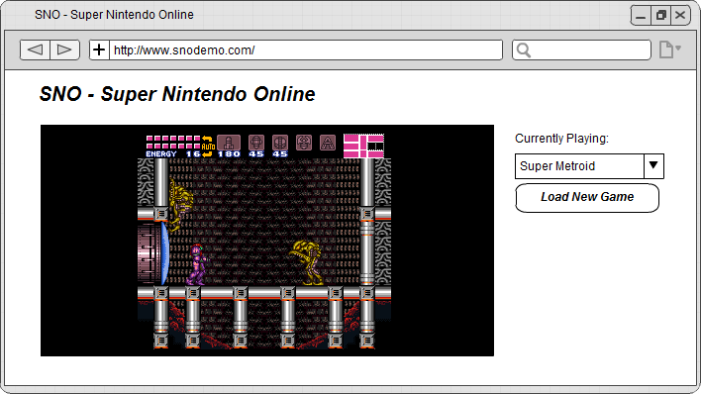
Questions?

