Slide 1

Milestone 3
Michael Kelly | Keith Johnson | Eric Wells
Faculty Sponsor: Dr. William H. Allen

Slide 2
Milestone 3
 | % Complete | Michael K. | Keith J. | Eric W.
Improved CPU Emulation | 100% | 33% | 34% | 33%
Basic Video Functionality | 100% | 33% | 34% | 33%
GUI Configuration Options | 100% | 33% | 34% | 33%

Slide 3
Improved CPU Emulation
Code Coverage
Unit Tests

Slide 4
Basic Video
Draws background layers
Reads graphics and palette data
TODO
Sprite Objects
Background offsets, priority
Scanlines, timing

Slide 5
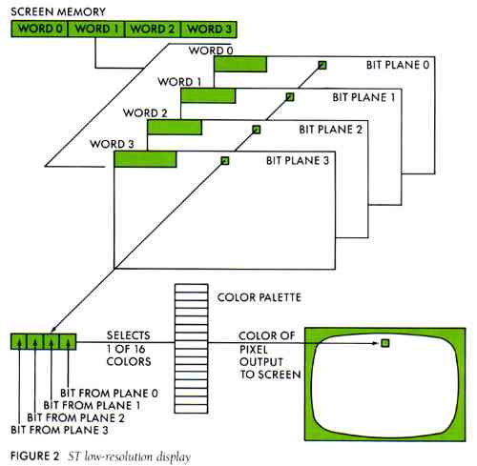
SNES Graphics Format
Image: FujiBoink! Behind the Bit Planes
http://www.atarimagazines.com/startv1n2/Fujiboink.html

Slide 6
Settings GUI
Options displayed in categories
Changes set flags in system
TODO
Controller Key mapping
More Options

Slide 7
Demo

Slide 8
Winter Break Goals
Audio CPU Basic Implementation
HiROM Implementation
Refactoring / Documentation
Better Video

Slide 9
Questions?

