Slide 1

Milestone 5
Michael Kelly | Keith Johnson | Eric Wells
Faculty Sponsor: Dr. William H. Allen

Slide 2
Milestone 5
 | % Complete | Michael K. | Keith J. | Eric W.
Improved Video | 100% | 33% | 33% | 34%
Compatibility | 100% | 33% | 33% | 34%
Performance | 100% | 33% | 33% | 34%
User Experience Improvements | 100% | 33% | 33% | 34%
Showcase Poster | 100% | 33% | 33% | 34%

Slide 3
Milestone 5
Rewrote graphics engine “twice”
Load a save file from the server
Frameskipping
Improved interrupt support (IRQ)
Customize controls
Settings dialogs that work

Slide 4

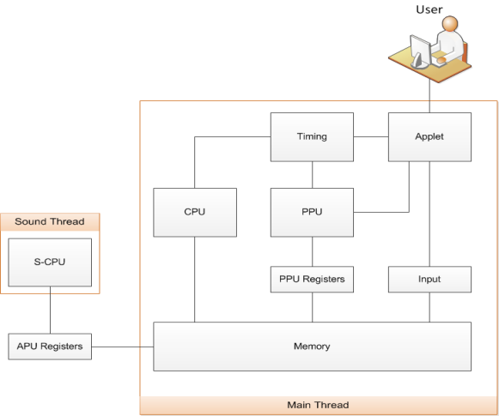
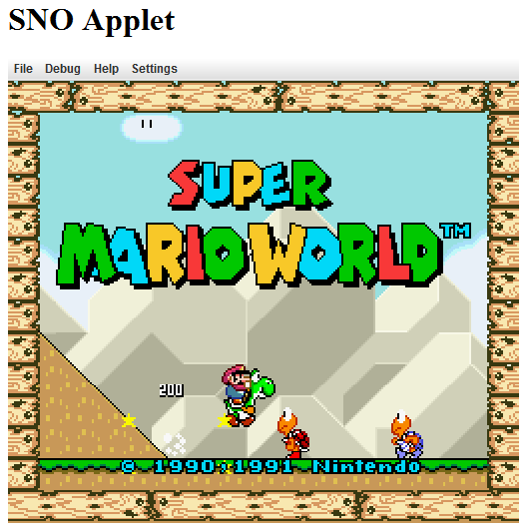
What is SNO?
SNO is a Super Nintendo Emulator that can be embedded into a web page. SNO allows website creators to embed a virtual Super Nintendo that lets users play Super Nintendo games right on their website!
Requirements
Embeddable Java applet
Executes SNES code in Java environment
Emulates Super Nintendo functions
Process Main CPU and Audio CPU code simultaneously
Render graphics to applet
Controller input via keyboard
Loads snapshot of game state – drop the player into any point in the game!
Load game and snapshot from server
Testing
Unit testing using JUnit
Unit tests for all 255 CPU instructions
Memory write / read tests
Graphics tests
Comparison with output of other SNES emulators
Acceptance testing to ensure games are playable
Challenges
Process hardware code using software
Code is downloaded and executed live in software
Read over 1100 pages of documentation about SNES
Performance
4 Tiled backgrounds of up to 64x64 tiles per background
Up to 128 sprites on-screen at once
Blend colors using color math & masking
Accurately reproduce precise timing
System Diagram
Screenshot
Team
Keith Johnson
Michael Kelly
Eric Wells
Sponsor: Dr. William Allen
Future Improvements
Improved compatibility
Audio output
Scripting integration via Javascript
Watch / fork on Github: https://github.com/Osmose/sno

Slide 5
Demo

Slide 6
Milestone 6
 | Michael K. | Keith J. | Eric W.
Performance | 33% | 34% | 33%
Polish | 33% | 34% | 33%
Demo Video | 33% | 34% | 33%
User Manual | 33% | 34% | 33%

Slide 7
Questions?

