Slide 1

Note: The data and information in this document is reflective of a hypothetical situation and client. This document is to be used for KPMG Virtual Internship purposes only.
Sprocket Central Pty Ltd
Data analytics approach
[Division Name] - [Engagement Manager], [Senior Consultant], [Junior Consultant]

Slide 2
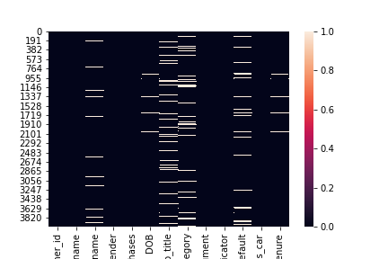
Note: The data and information in this document is reflective of a hypothetical situation and client. This document is to be used for KPMG Virtual Internship purposes only.
Agenda
Introduction
Data Exploration
Model Development
Interpretation

Slide 3
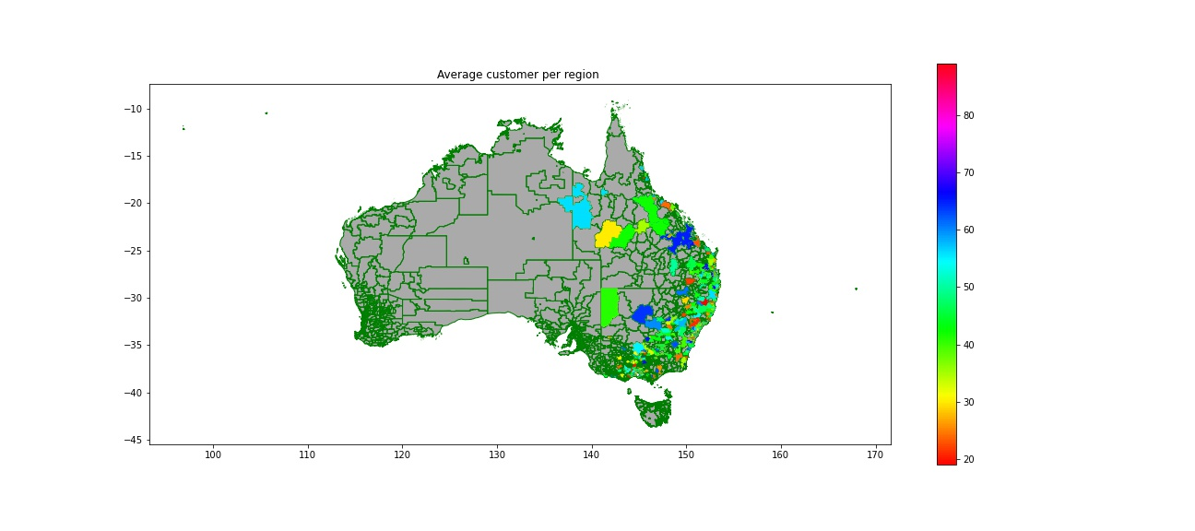
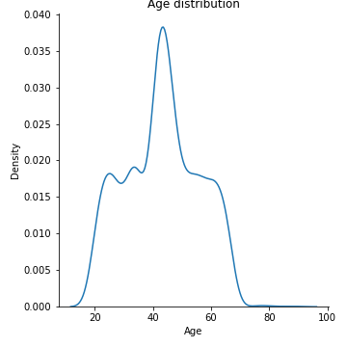
Note: The data and information in this document is reflective of a hypothetical situation and client. This document is to be used for KPMG Virtual Internship purposes only.
Introduction
3 Datasets : Demographic – Address - Transactions
About Demographic: Most of client have between 40 and 50 years old
Place any supporting images, graphs, data or extra text here.

Slide 4
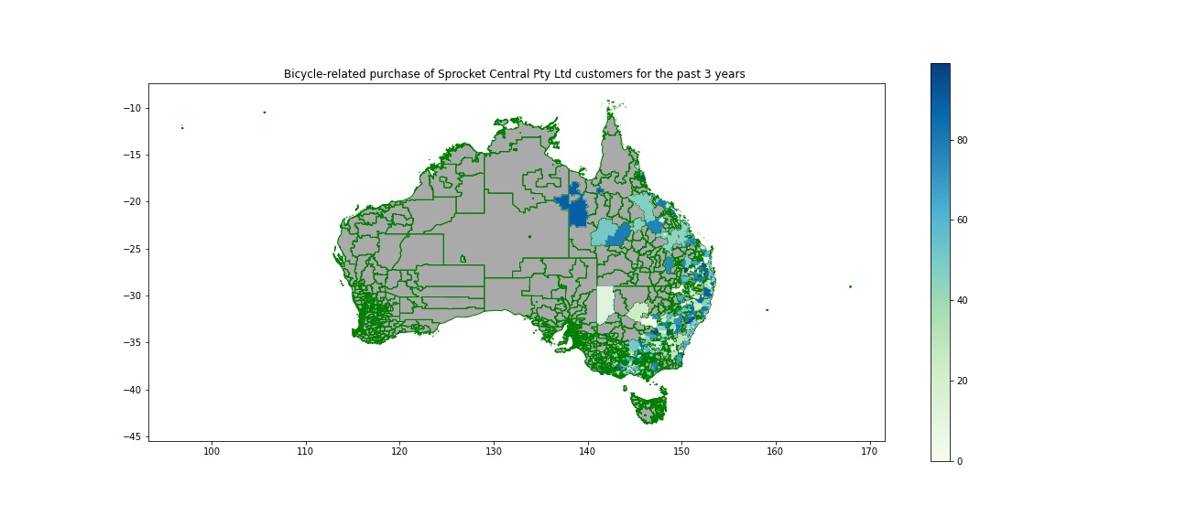
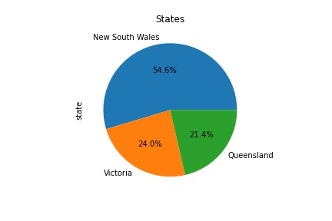
Note: The data and information in this document is reflective of a hypothetical situation and client. This document is to be used for KPMG Virtual Internship purposes only.
Data Exploration
Our Customer are located in East of Australie and her spent related to bike is higher more Victoria
15 out 20 highest bicycle related purchased are in Victoria
More than half customers in New South Wales
Place any supporting images, graphs, data or extra text here.

Slide 5
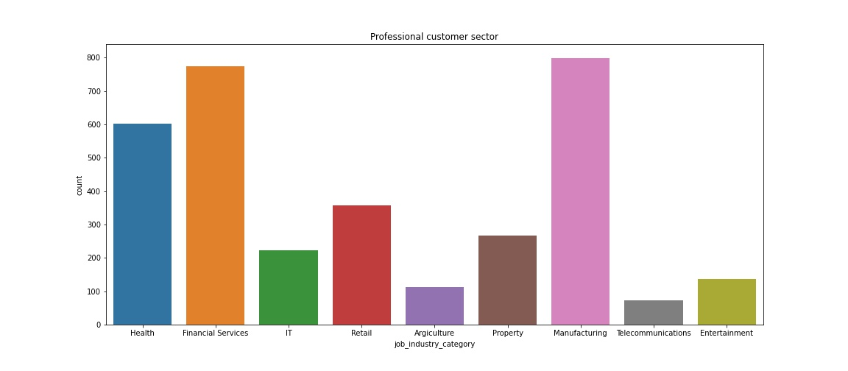
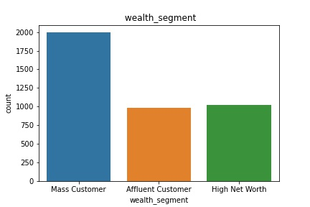
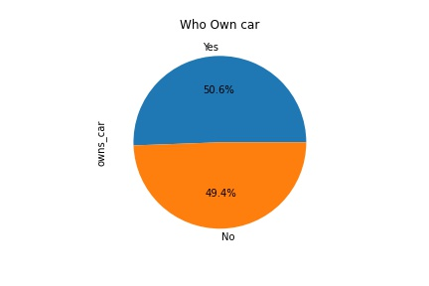
Note: The data and information in this document is reflective of a hypothetical situation and client. This document is to be used for KPMG Virtual Internship purposes only.
Data Exploration
Our client mainly work in Manufacturing, Financial service and Health
There are rather mass customer with no
High income
Place any supporting images, graphs, data or extra text here.

Slide 6
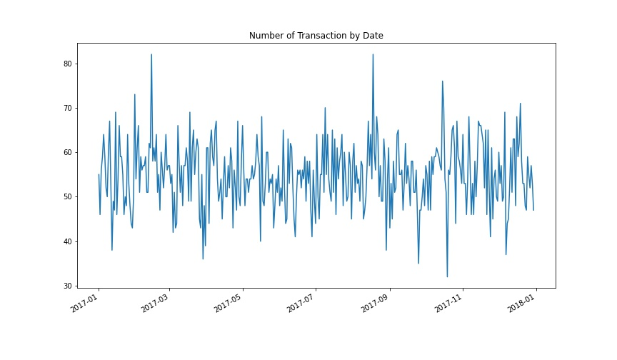
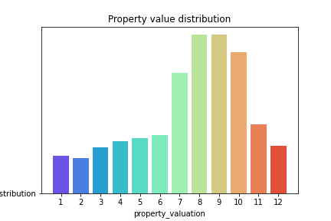
Note: The data and information in this document is reflective of a hypothetical situation and client. This document is to be used for KPMG Virtual Internship purposes only.
Model Development
Pic of Transactions in February and August
Modal class of property are 8 and 9
Place any supporting images, graphs, data or extra text here.

Slide 7
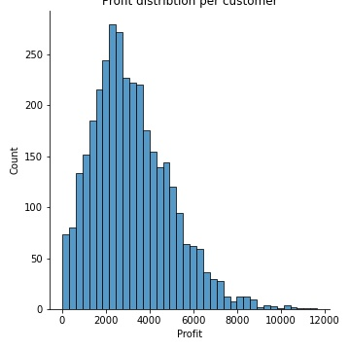
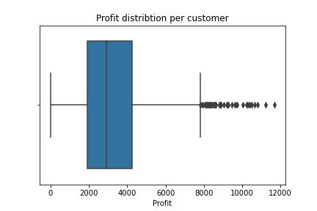
Note: The data and information in this document is reflective of a hypothetical situation and client. This document is to be used for KPMG Virtual Internship purposes only.
Model Development
Creation of Target Variable from Transaction dataset
Profit = list_price - standard_cost ,to get customer who provide best benefit
We will split this variable in three class to make this a classification problem
Place any supporting images, graphs, data or extra text here.

Slide 8
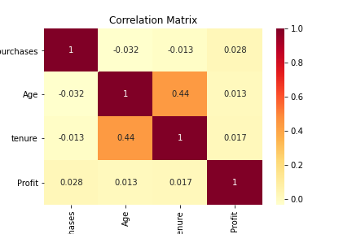
Note: The data and information in this document is reflective of a hypothetical situation and client. This document is to be used for KPMG Virtual Internship purposes only.
Model Development
delete useless columns - > process Age outliers
- Manually encode categorical variable yes or no in 1 and 0,
Splitting dependent Variable et target in X and y,
OneHot encode the other qualitative variables(gender, wealth_segment)
NA management (with Knn Inputer)
(OneHot encode the target variables y for the Neural network classification)
Splitting the dataset into train and test
Featurescaling of Xtrain and Xtest
Implementing Ann
Place any supporting images, graphs, data or extra text here.

Slide 9
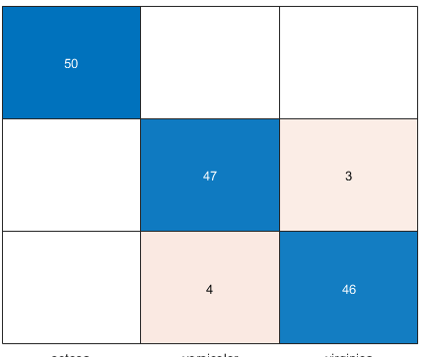
Note: The data and information in this document is reflective of a hypothetical situation and client. This document is to be used for KPMG Virtual Internship purposes only.
Interpretation
0 class will be the Lower Margin clients
1 class Intermediate Clients
2 Premium clients
We will evaluate the model with confusion matrix and the accuracy
Place any supporting images, graphs, data or extra text here.

Slide 10

Note: The data and information in this document is reflective of a hypothetical situation and client. This document is to be used for KPMG Virtual Internship purposes only.
Thank you

